Slide 1
Airflow 101: What and...Why?
24-10-2020

Slide 2
What is it?
Basically another scheduler......

Slide 3
.....and then some.
Monitoring Cron jobs
Transferring data from one place to another.
Automating your DevOps operations.
Periodically fetching data from websites and update the database for your awesome price comparison system.
Data processing for recommendation-based systems.
Machine Learning Pipelines.

Slide 4
Problems with current forms of chronological scheduling -
Errors
Monitoring
Deployment
Scalability
Auditing and backfilling

Slide 5
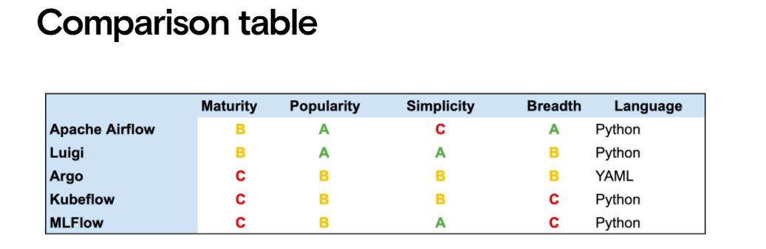
Luigi, Argo, Kubeflow, MLFlow
Of course there are alternatives
Image from datarevenue.com

Slide 6
Components
DAGs
Schedulers
  start_date
  Intervals : @quarterly, @weekly, @daily
  Backfilling!
Operators
  Bash, Postgres, Google Cloud, Python, Papermill etc
Connections
Variables

Slide 7
Demo
Installation -
  pip install airflow
  airflow initdb
  airflow webserver -p 8080
How to add new DAGs?

Slide 8
Where is it used in the wild?
Integration of data pipelines
These are not processes that can happen in a single setup
Separate jobs, chain them as necessary, schedule them for when they’re supposed to run, manage dependencies
Why?! - More automation only.

Slide 9
What I actually wanted to show
Sandman :(
Maybe next time :(

Slide 10
Are we there yet?
Prefect >= Airflow*
* - If you want more APIs, versioning etc.
I haven’t compared Prefect vs Airflow yet

Slide 11
Resources
https://github.com/kiwiz/gkeepapi
https://github.com/abhiramr/Talks_Resources

