Slide 1
AngularJS
Shivakumar
Vishwaraj

Slide 2
History of AngularJS
Created by Miško Hevery and Adam Abrons in 2009
an open source, client-side JavaScript framework that promotes a high-productivity web development experience.
HTML as your template language and lets you extend HTML's syntax to express your application components
Its data binding and dependency injection

Slide 3
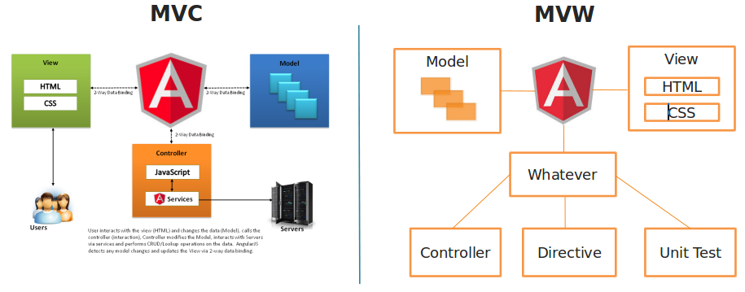
MVC Architecture

Slide 4
Hello world in AngularJS

Slide 5
Different Component of AngularJS
Module
Scope/RootScope
Form Validation
Expressions
Filters
Directives
Routing
Services
Factories

Slide 6
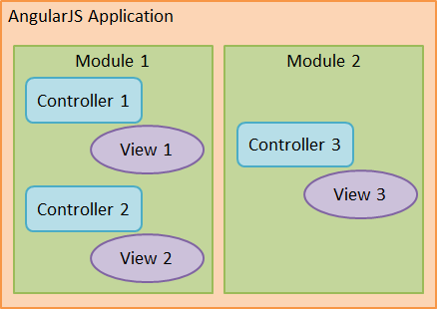
Module
main way to define an AngularJS app
It contains all the application code
One application may contains several module
Keeping our global namespace clean tests easier
Making it easy to share code between applications
Allowing our app to load different parts of the code in any order

Slide 7
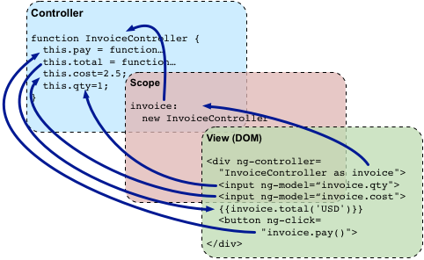
Scope / RootScope
Core fundamental of App
Execution context for expressions
We define the business functionality of the app, methods in ctrl and properties of views
Serves as a glue b/w ctrl and views
Scopes are the source of truth for the application state

Slide 8
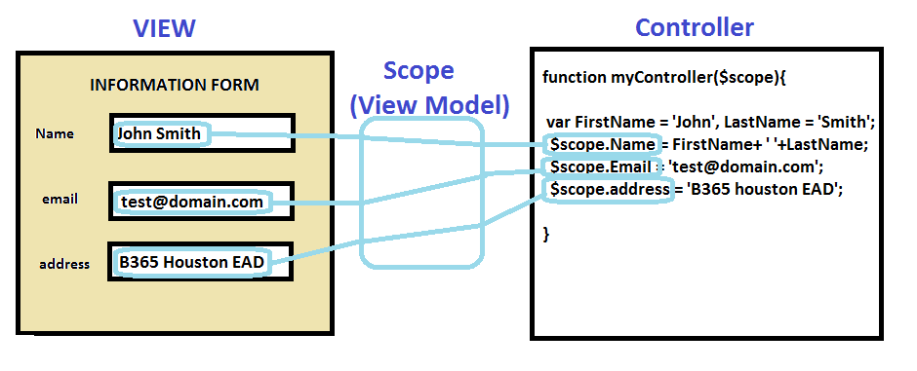
Controller
Controllers in AngularJS exist to augment the view of an AngularJS application
It is a function that adds additional functionality to the scope of the view
use it to set up an initial state and to add custom behavior to the scope object.

Slide 9
Implementing Module
The Angular module API allows us to declare a module using the angular.module() API method.
Takes two parameters
Name of module
Dependencies also know as injectable
Examples
angular.module('myApp') without any dependenices
angular.module('myApp‘, [‘GetTourServices’])

Slide 10
Directives
A directive is an extension of the HTML vocabulary that allows us to create new behaviors.
This technology lets the developers create reusable components that can be used within the whole application and even provide their own custom components.
The directive can be applied as an attribute, element, class, and even as a comment, using the camelCase syntax
AngularJS has built-in directives such as ngBind, ngModel etc

Slide 11
The ngApp directive
The ngApp directive is the first directive we need to understand because it defines the root of an AngularJS application
Applied to one of the elements, in general HTML or body, this directive is used to bootstrap the framework
However, it is recommended that you provide a module name, defining the entry point of the application in which other components such as controllers, services, filters, and directives can be bound,
There can be only one ngApp directive in the same HTML document that will be loaded and bootstrapped by the framework automatically.

Slide 12
The ngController directive
We can attach any controller to the view using the ngController directive.
After using this directive, the view and controller start to share the same scope and are ready to work together
<body ng-controller="parkingCtrl">
</body>

Slide 13
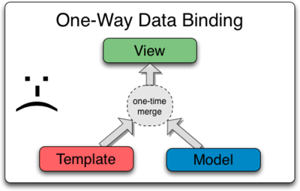
The ngBind directive
The ngBind directive is generally applied to a span element and replaces the content of the element with the results of the provided expression. It has the same meaning as that of the double curly markup, for example, {{expression}}.
Why to use ngBind instead {{}}
<body ng-controller="parkingCtrl">
<h3 ng-bind="appTitle"></h3>
</body>

Slide 14
The ngRepeat directive
The ngRepeat directive is really useful to iterate over arrays and objects
It can be used with any kind of element such as the rows of a table, the elements of a list, and even the options of select.
Special Expression : variable in array
<tbody>
<tr ng-repeat="car in cars">
<td><span ng-bind="car.plate"></span></td>
<td><span ng-bind="car.entrance"></span></td>
</tr>
</tbody>

Slide 15
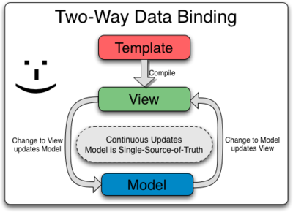
The ngModel directive
The ngModel directive attaches the element to a property in the scope, thus binding the view to the model.
In this case, the element can be input (all types), select, or textarea, as shown in the following code:
<input type="text" ng-model="car.plate" placeholder="What's the plate?“ />

Slide 16
The ngClick directive and other event directives
It allows you to bind any custom behavior to the click event of the element.
<button ng-click="park(car)">Park</button>
Other directives that have the same behavior but are triggered by other events are ngBlur, ngChange, ngCopy, ngCut, ngDblClick, ngFocus, ngKeyPress, ngKeyDown, ngKeyUp, ngMousedown, ngMouseenter, ngMouseleave, ngMousemove, ngMouseover, ngMouseup, and ngPaste.

Slide 17
Commonly used directives
The ngDisable directive
The ngClass directive
The ngOptions directive
The ngStyle directive
The ngShow and ngHide directives
The ngIf directive
The ngInclude directive

Slide 18
Expressions
The {{ }} notation for showing a variable
attached to a $scope is actually an expression: {{ expression }}.
We use an expression (or a function) that Angular will evaluate.
All expressions are executed in the context of the scope and have access to local $scope variables.
An expression doesn’t throw errors if it results in a TypeError or a ReferenceError.
They do not allow for any control flow functions (conditionals; e.g., if/else).
They can accept a filter and/or filter chains.

Slide 19
Filters
A filter provides a way to format the data we display to the user
We invoke filters in our HTML with the | (pipe) character inside the template binding characters {{ }}
For example :
{{ name | uppercase }}
{{ 123.456789 | number:2 }}
app.controller('DemoController', ['$scope', '$filter',
function($scope, $filter) {
$scope.name = $filter('lowercase')('Ari');
}]);

Slide 20
Form Validation
AngularJS supports form validation with a mix of the HTML5 form validation inputs as well as with its own validation directives.
Such as
Required
Minimum Length
Maximum Length
Matches a Pattern
Email
Number
URL

Slide 21
Control Variables in Forms
These properties enable us to react to the form in real time
Unmodified Form
This property is a boolean that tells us whether the user has modified the form. It is true if the user hasn’t touched the form, and false if they have. Ex: formName.inputFieldName.$pristine;
Modified Form
This property is a boolean that tells us if and only if the user has actually modified the form. It is set regardless of validations on the form: formName.inputFieldName.$dirty

Slide 22
Continues
Valid Form
This property is a boolean that tells us whether or not the form is valid. If the form is currently valid, then the following will be true: formName.inputFieldName.$valid
Errors
This object contains all of the validations on a particular form and a record of whether they are valid or invalid Ex formName.inputfieldName.$error

Slide 23
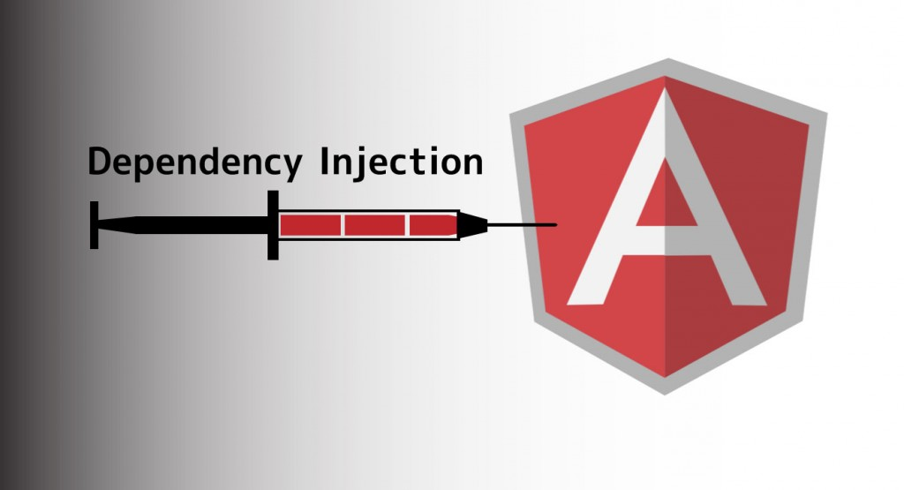

Slide 24
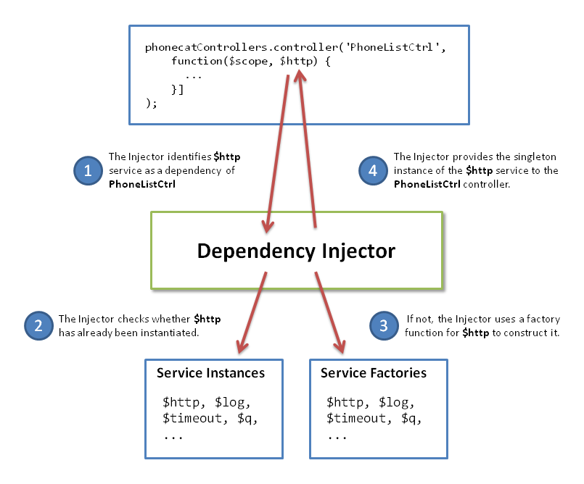
Example

Slide 25
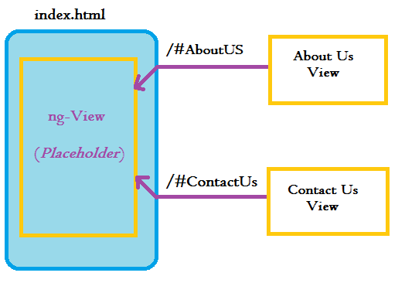
Routing

Slide 26


