Slide 1

Stability and Fixed points of dynamical systems
Daniel Arovas , Phys Dept., University of California, San Diego
Steven Strogatz : Nonlinear Dynamics and Chaos,

Slide 2

Stability and Fixed points of dynamical systems
$$\frac{du}{dt}=f(u)$$

Slide 3

Stability and Fixed points of dynamical systems
$$\frac{du}{dt}=f(u)$$

Slide 4
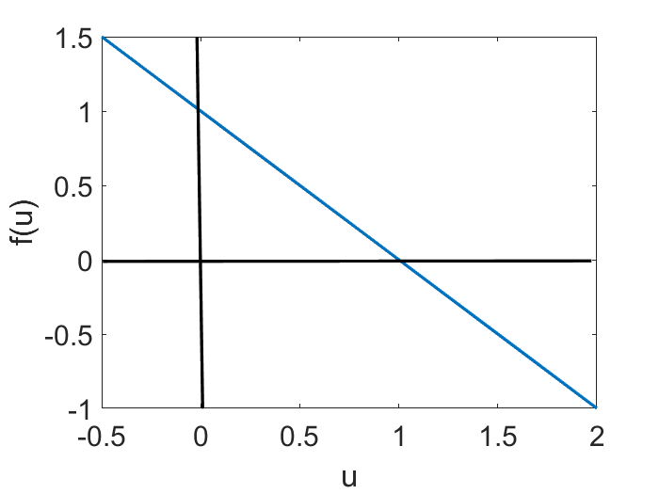

Stability and Fixed points of dynamical systems (vector flow)
$$\frac{du}{dt}=f(u)$$
$$a=b=1$$

Slide 5

Stability and Fixed points of dynamical systems (Model 1)
$$\frac{du}{dt}=f(u)$$
$$u$$

Slide 6
Numerical Solution with Euler Method

Slide 7
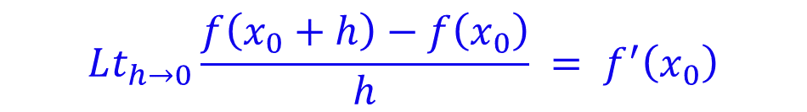
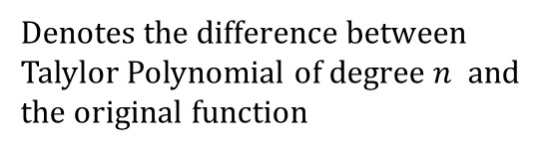
Basics: Numerical techniques (Derivative of a function)
$$f\left(x_{0}+h\right)=f\left(x_{0}\right)+h f^{′}\left(x_{0}\right)+\frac{h^{2}}{2!}f^{′′}\left(x_{0}\right)+…+\frac{h^{n}}{n!} f^{n}\left(x_{0}\right)+R_{n}(x)$$
For the first derivative
Denotes the difference between Talylor Polynomial of degree $n$ and the original function
$$f\left(x_{0}+h\right)=f\left(x_{0}\right)+h f^{′}\left(x_{0}\right)+R_{1}(x)$$
Samll
$$Lt_{h→0}\frac{f\left(x_{0}+h\right)−f\left(x_{0}\right)}{h} = f^{′}\left(x_{0}\right)$$

Slide 8
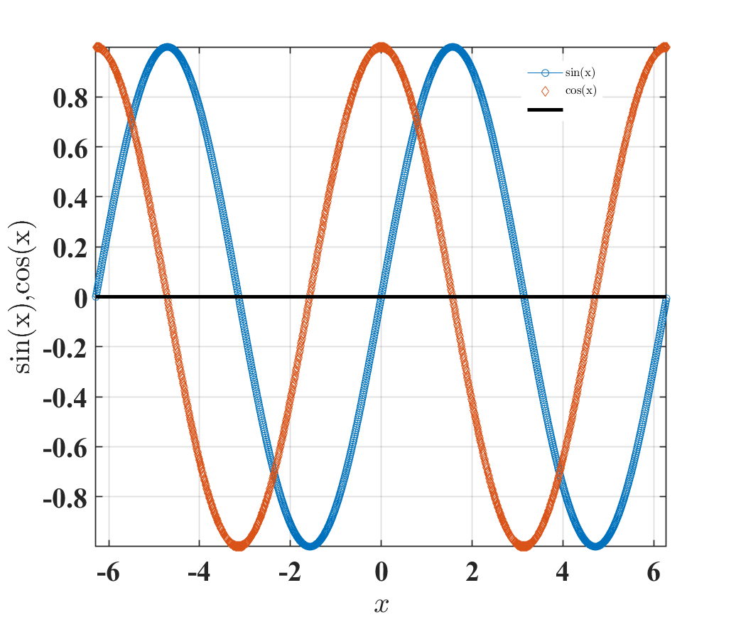

Numerical techniques
$$f\left(x_{0}+h\right)=f\left(x_{0}\right)+h f^{′}\left(x_{0}\right)+\frac{h^{2}}{2!}f^{′′}\left(x_{0}\right)+…+\frac{h^{n}}{n!} f^{n}\left(x_{0}\right)+R_{n}(x)$$
$$Lt_{h→0}\frac{f\left(x_{0}+h\right)−f\left(x_{0}\right)}{h} = f^{′}\left(x_{0}\right)$$
x=-2*pi:0.01:2*pi;
h=0.01;
f=sin(x);
g= (sin(x+h)-sin(x))./h;
plot(x,f,'-o');
hold on;
plot(x,g,'d');
legend 'sin(x)' 'cos(x)'
z=zeros(1,length(x));
hold on;
plot(x,z,'k','linewidth',3);

Slide 9
$$f\left(x_{0}+h\right)=f\left(x_{0}\right)+h f^{′}\left(x_{0}\right)+\frac{h^{2}}{2!}f^{′′}\left(x_{0}\right)+…+\frac{h^{n}}{n!} f^{n}\left(x_{0}\right)+R_{n}(x)$$
We can use central differences as well.
$$f\left(x_{}+h\right)=f\left(x_{}\right)+h f^{′}\left(x_{}\right)$$
$$f\left(x_{}−h\right)=f\left(x_{}\right)−h f^{′}\left(x_{}\right)$$
$$\frac{f\left(x_{}+h\right)−f\left(x_{}−h\right)}{2h}=f′(x)$$
Here we can obtain second order of accuracy as $h^{2}$ term will be cancelled.

Slide 10

Euler’s Method: Tangent Line Approximation
For our first order initial value problem
an alternative is to compute approximate values of the solution y = φ(t) at a selected set of t-values.
Ideally, the approximate solution values will be accompanied by error bounds that ensure the level of accuracy.
In this section, we examine the tangent line method, which is also called Euler’s Method.
$$y^{′}=f(t,y),y(t_{0})=y_{0},$$

Slide 11
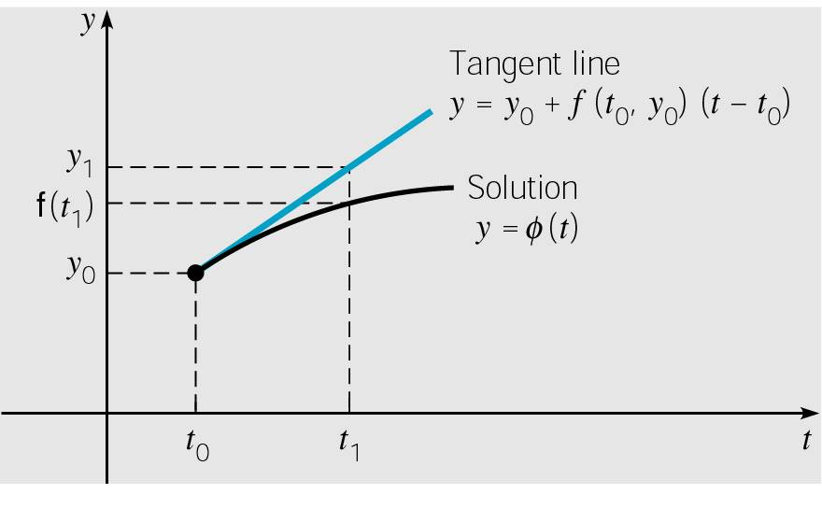



Euler’s Method: Tangent Line Approximation
For the initial value problem
approximating solution: y = φ(t) at initial point t₀.
The line tangent to solution at initial point is thus
Thus, if t₁ is close enough to t₀,
we can approximate φ(t₁) by
$$y^{′}=f(t,y),y(t_{0})=y_{0},$$
$$y=y_{0}+f\left(t_{0},y_{0}\right)\left(t−t_{0}\right)$$
$$y_{1}=y_{0}+f\left(t_{0},y_{0}\right)\left(t_{1}−t_{0}\right)$$
Notes:
The solution passes through initial point (t₀, y₀) with slope
f (t₀, y₀).

Slide 12


Euler’s Method: Tangent Line Approximation
For a point t₂ close to t₁, we approximate φ(t₂) using the line passing through (t₁, y₁) with slope f (t₁, y₁):
Thus we create a sequence y_{n} of approximations to φ(t_{n}):
where f_{n} = f (t_{n}, y_{n}).
For a uniform step size h = t_{n} – t_{n-1}, Euler’s formula becomes
$$y_{2}=y_{1}+f\left(t_{1},y_{1}\right)\left(t_{2}−t_{1}\right)$$
$$y_{1}=y_{0}+f_{0}⋅\left(t_{1}−t_{0}\right) \\ y_{2}=y_{1}+f_{1}⋅\left(t_{2}−t_{1}\right) \\ ⋮ \\ y_{n+1}=y_{n}+f_{n}⋅\left(t_{n+1}−t_{n}\right)$$
$$y_{n+1}=y_{n}+f_{n}h,n=0,1,2,…$$

Slide 13
Numerical errors
Discretization error:
Error resulting from the computation of quantities that have been calculated using an approximation to the true solution
We may neglect higher order terms for example
This error is sometimes called truncation error
Unavoidable problem in numerical integration work
Would occur even in the presence of infinite precision
Round-off error
Result of finite precision arithmetic

Slide 14
Euler’s Method: Model 1
x0=0.2;
y0=[x0];
%[t,y]=ode45(@(t,y) stability_ex1(t,y,a,b),[0,tspan], y0);%[ 2.5 0 1 0]);
init = [x0 y0]; % y0 = [v0, w0]
t = linspace(0,10,500)';
% Runge-Kutta 4th-Order Algorithm
y_euler = zeros(length(t), 2);
y_euler(1, :) = init;
h = t(2)-t(1);
for i = 2:length(t)
k1 =stability_ex1(t(i-1), y_euler(i-1, :),a,b);
y_euler(i, :) = y_euler(i-1, :)+h*k1;
End
function [yprime] = stability_ex1(t,y,a,b)
y_prime=zeros(1,1);
yprime(1) = a-b*y(1);
yprime=yprime';
end

Slide 15
Stability and Fixed points of dynamical systems (linear stability analysis)

Slide 16

Stability and Fixed points of dynamical systems (linear stability analysis)
$$\dot{u}=f(u)$$
Perturbing around the fixed points:
$$\dot{u}+\dot{ε}=f\left(u+ε\right){\left.​\right|}_{u=u^{∗}}=f\left(u^{∗}\right)+εf^{′}\left(u^{∗}\right)+\frac{ε^{2}}{2!}f^{′′}\left(u^{∗}\right)+O(ε^{3})$$

Slide 17
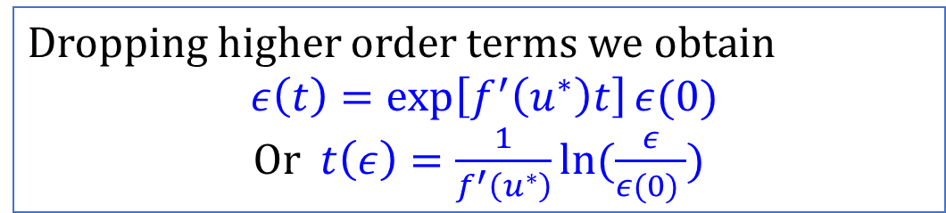

Stability and Fixed points of dynamical systems
$$\dot{u}=f(u)$$
Perturbing (small and linear) around the fixed points:
$$\dot{u}+\dot{ε}=f\left(u+ε\right){\left.​\right|}_{u=u^{∗}}=f\left(u^{∗}\right)+εf^{′}\left(u^{∗}\right)+\frac{ε^{2}}{2!}f^{′′}\left(u^{∗}\right)+O(ε^{3})$$
$$\dot{ε}=εf^{′}\left(u^{∗}\right)$$
The perturbation grows if $f^{′}\left(u^{∗}\right)>0$ and decreases if $f^{′}\left(u^{∗}\right)>0$
Dropping higher order terms we obtain
$ε\left(t\right)=\exp\left[f^{′}\left(u^{∗}\right)t\right]ε(0)$
Or $t\left(ε\right)=\frac{1}{f^{′}\left(u^{∗}\right)}ln⁡(\frac{ε}{ε(0) })$

Slide 18
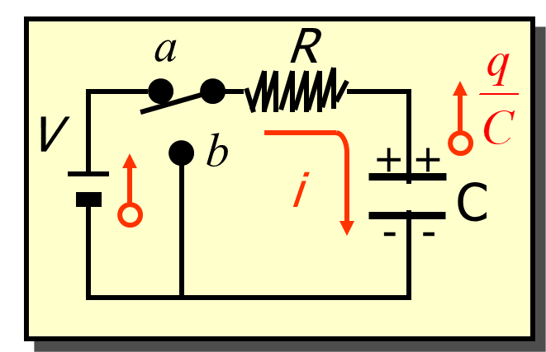

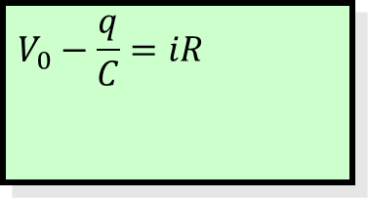
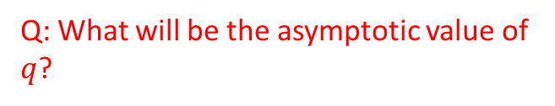

RC Circuit: Charging Capacitor (Model 2)
Interpreting a differential equation as a vector field Flows on the Line
$$V_{0}−\frac{q}{C}=iR$$
$$V_{0}$$
Q: What will be the asymptotic value of $q$?
$$R\frac{dq}{dt}=V_{0}−\frac{q}{C}$$

Slide 19
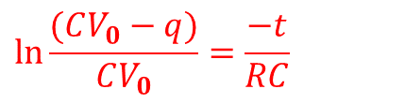
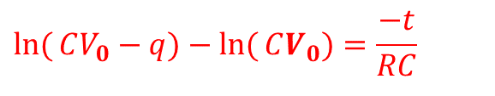
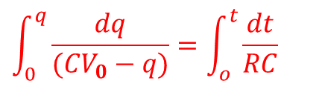
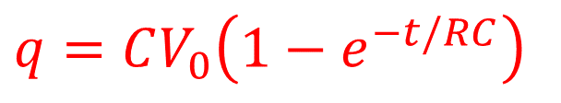
RC Circuit: Charging Capacitor
Interpreting a differential equation as a vector field Flows on the Line
$$V_{0}−\frac{q}{C}=iR$$
$$V_{0}$$
$$\int_{0}^{q}{\frac{dq}{(CV_{0}−q)}}=\int_{o}^{t}{\frac{dt}{RC}}$$
$$R\frac{dq}{dt}=V_{0}−\frac{q}{C}$$
$$\ln{(}CV_{0}−q)−\ln{(}CV_{0})=\frac{−t}{RC}$$
At time $t = 0: q = CV_{0}(1 − 1); q = 0$
$$\ln{\frac{(CV_{0}−q)}{CV_{0}}}=\frac{−t}{RC}$$
At time $t = : q = CV_{0}(1 − 0); qmax = CV_{0}$
$$q=CV_{0}\left(1−e^{−t/RC}\right)$$
The charge q rises from zero initially to its maximum value $qmax = CV_{0}$

Slide 20
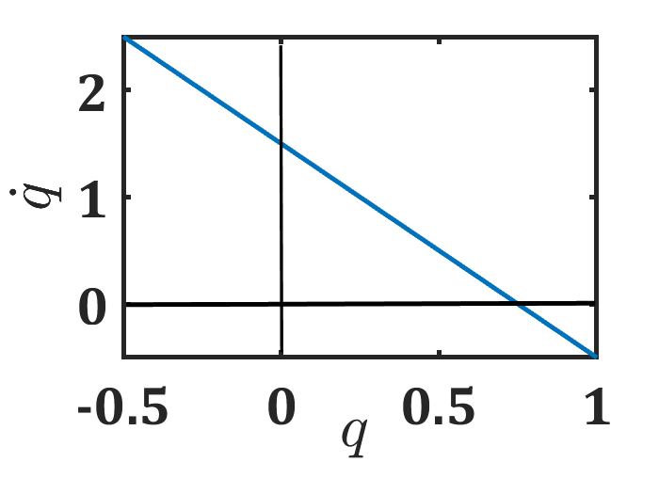

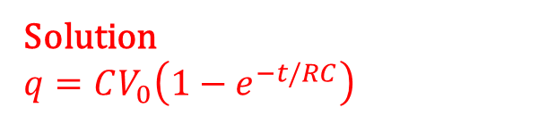





Interpreting a differential equation as a vector field Flows on the Line
$$f(q)$$
$$R\frac{dq}{dt}=V_{0}−\frac{q}{C}$$
$\dot{q}=f\left(q\right)=\frac{V}{R}−\frac{q}{CR}$
Solution
$$q=CV_{0}\left(1−e^{−t/RC}\right)$$
$$f\left(q\right)>0$$
$$q^{∗}$$
$$f\left(q\right)<0$$
$$V_0=1.5;C=0.5;R=1$$

Slide 21
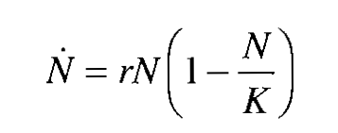

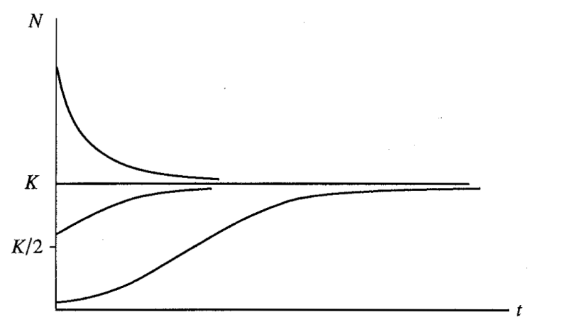
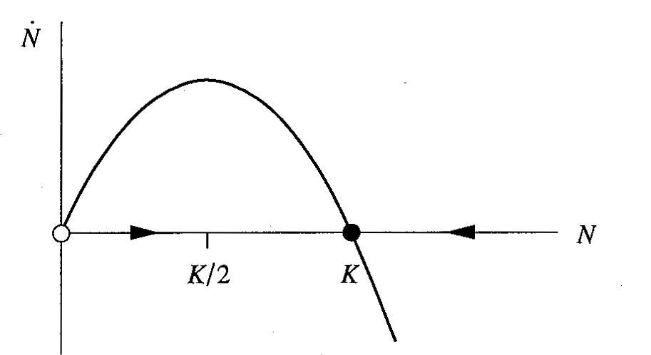
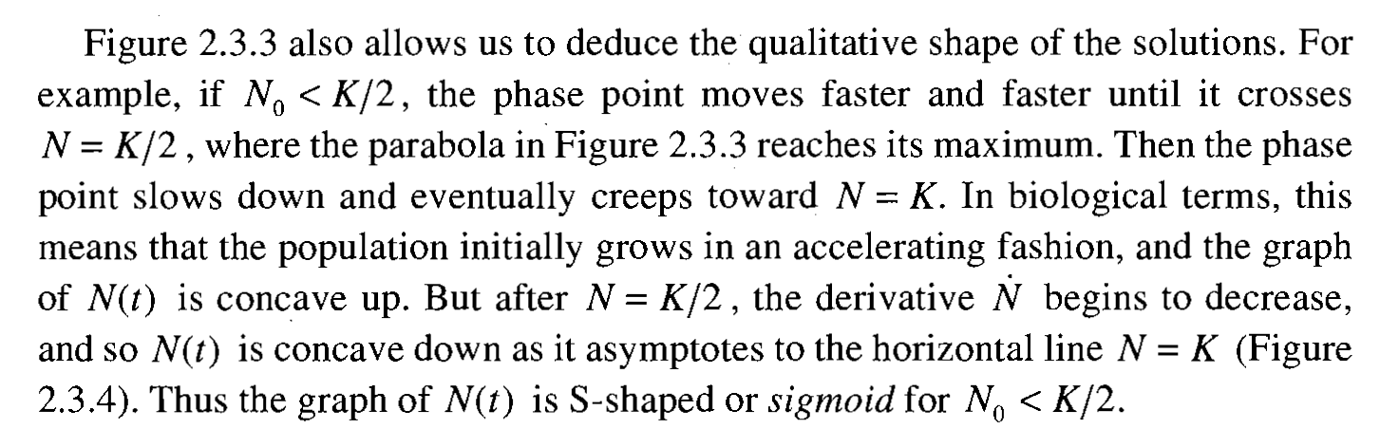
Logistic equation (Model 3)
Interpreting a differential equation as a vector field Flows on the Line
Analysis of Fixed points
Per Capita Growth Rate
Carrying Capacity

Slide 22
Bifurcation theory in 1d
Transcritical
Saddle-node
Pitchfork

Slide 24
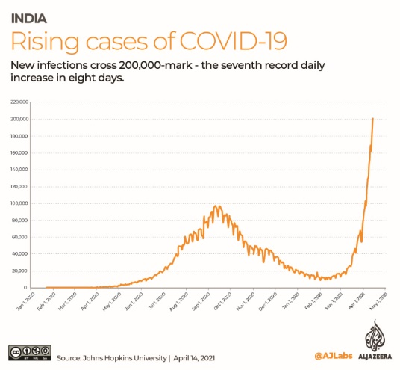

Infection spreading : Modelling

Slide 25
Epidemic Spreading : Modelling
SIS Dynamics
Large population
Single initial case
Rest of the population is fully susceptible

Slide 26
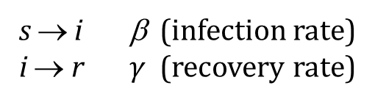



Epidemic Spreading : Modelling
SIS Dynamics
s → i β (infection rate)
i → r $γ$ (recovery rate)
Large population
Single initial case
Rest of the population is fully susceptible
Examples:
Chlamydia
Human papilloma virus
(Respiratory syncytial virus / influenza)
$$\frac{ds}{dt}=γi−βs i$$
$$\frac{di}{dt}=βs i−γi$$
$s+i=1$ (Constant)
Assumptions:
Homogeneous mixing
Constant recovering rate

Slide 27
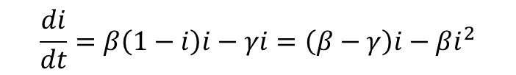




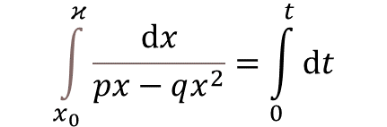
Epidemic Spreading : Modelling
SIS Dynamics
$$\frac{ds}{dt}=γi−βs i$$
$$\frac{di}{dt}=βs i−γi$$
$$\frac{di}{dt}=β\left(1−i\right)i−γi=\left(β−γ\right)i−βi^{2}$$
$s+i=1$ (Constant)
$$\int_{x_{0}}^{κ}{\frac{ⅆx}{px−qx^{2}}}=\int_{0}^{t}{ⅆt}$$
$$p=\left(β−γ\right);q=β$$

Slide 28
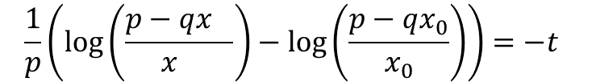
Epidemic Spreading : Modelling
SIS Dynamics
$$\frac{ds}{dt}=γi−βs i$$
$$\frac{di}{dt}=βs i−γi$$
$$\frac{di}{dt}=β\left(1−i\right)i−γi=\left(β−γ\right)i−βi^{2}$$
$s+i=1$ (Constant)
$$\int_{x_{0}}^{κ}{\frac{ⅆx}{px−qx^{2}}}=\int_{0}^{t}{ⅆt}$$
$$p=\left(β−γ\right);q=β$$
$$\frac{1}{p}\left(\log\left(\frac{p−qx_{}}{x_{}}\right)−\log\left(\frac{p−qx_{0}}{x_{0}}\right)\right)=−t$$

Slide 29


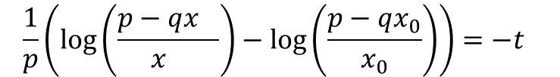
Epidemic Spreading : Modelling
SIS Dynamics
$$\frac{ds}{dt}=γi−βs i$$
$$\frac{1}{p}\left(\log\left(\frac{p−qx_{}}{x_{}}\right)−\log\left(\frac{p−qx_{0}}{x_{0}}\right)\right)=−t$$
$$\frac{di}{dt}=βs i−γi$$
$$p=\left(β−γ\right);q=β$$
$s+i=1$ (Constant)
$$\left(\frac{p−qx_{}}{x_{}}\right)=e^{−pt}(\frac{p−qx_{0}}{x_{0}})$$

Slide 30


Epidemic Spreading : Modelling
SIS Dynamics
$$\frac{ds}{dt}=γi−βs i$$
$$\frac{1}{p}\left(\log\left(\frac{p−qx_{}}{x_{}}\right)−\log\left(\frac{p−qx_{0}}{x_{0}}\right)\right)=−t$$
$$\frac{di}{dt}=βs i−γi$$
$$p=\left(β−γ\right);q=β$$
$s+i=1$ (Constant)
$$\left(\frac{p−qx_{}}{x_{}}\right)=e^{−pt}(\frac{p−qx_{0}}{x_{0}})$$
$$\frac{p}{x}=q+e^{−pt}(\frac{p−qx_{0}}{x_{0}})$$
$$x=\frac{p}{q+e^{−pt}(\frac{p−qx_{0}}{x_{0}}) }$$

Slide 31

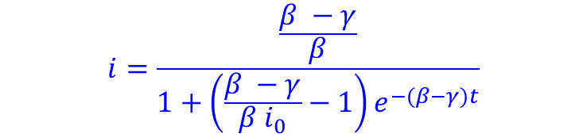
Epidemic Spreading : Modelling
SIS Dynamics
$$\frac{ds}{dt}=γi−βs i$$
$$\frac{di}{dt}=βs i−γi$$
$$p=\left(β−γ\right);q=β$$
$s+i=1$ (Constant)
$$i=\frac{\frac{β −γ}{β}}{1+\left(\frac{β −γ}{β i_{0}}−1\right)e^{−(β−γ)t}}$$
$i_{ee}=\frac{β −γ}{β}$ endemic equilibrium, $t→∞$

Slide 32
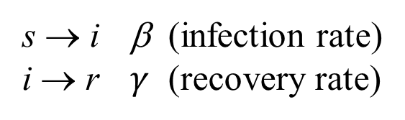


SIR Modelling
s=S/N: density of Susceptible individuals
i=I/N: density of Infective individuals
r=R/N: density of Removed (recovered/dead) individuals
SIR Dynamics
$$\left(\frac{ds}{dt}+\frac{di}{dt}+\frac{dr}{dt}=0\right)$$
s → i β (infection rate)
i → r $γ$ (recovery rate)
$$s+i+r=1$$
Assumptions:
Homogeneous mixing
Constant recovering rate

Slide 33



SIR Modelling
s=S/N: density of Susceptible individuals
i=I/N: density of Infective individuals
r=R/N: density of Removed (recovered/dead) individuals
SIR Dynamics
$$\left(\frac{ds}{dt}+\frac{di}{dt}+\frac{dr}{dt}=0\right)$$
s → i β (infection rate)
i → r $γ$ (recovery rate)
$$\frac{ds}{dt}=−βs i$$
$$s+i+r=1$$
$$\frac{di}{dt}=βs i−γi$$
$$\frac{dr}{dt}=γi$$

Slide 34



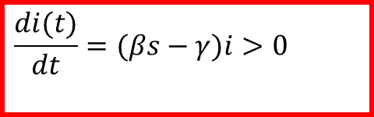
SIR Modelling
s=S/N: density of Susceptible individuals
i=I/N: density of Infective individuals
r=R/N: density of Removed (recovered/dead) individuals
SIR Dynamics
$$\left(\frac{ds}{dt}+\frac{di}{dt}+\frac{dr}{dt}=0\right)$$
s → i β (infection rate)
i → r $γ$ (recovery rate)
$$\frac{ds}{dt}=−βs i$$
$$s+i+r=1$$
$$\frac{di}{dt}=βs i−γi$$
$$\frac{di(t)}{dt}=(βs−γ)i>0$$
$$(s(0)≈1)$$
$$\frac{dr}{dt}=γi$$
$$R_{o}≡\frac{β}{γ}>1$$
$$βs(0)−γ>0$$

Slide 35
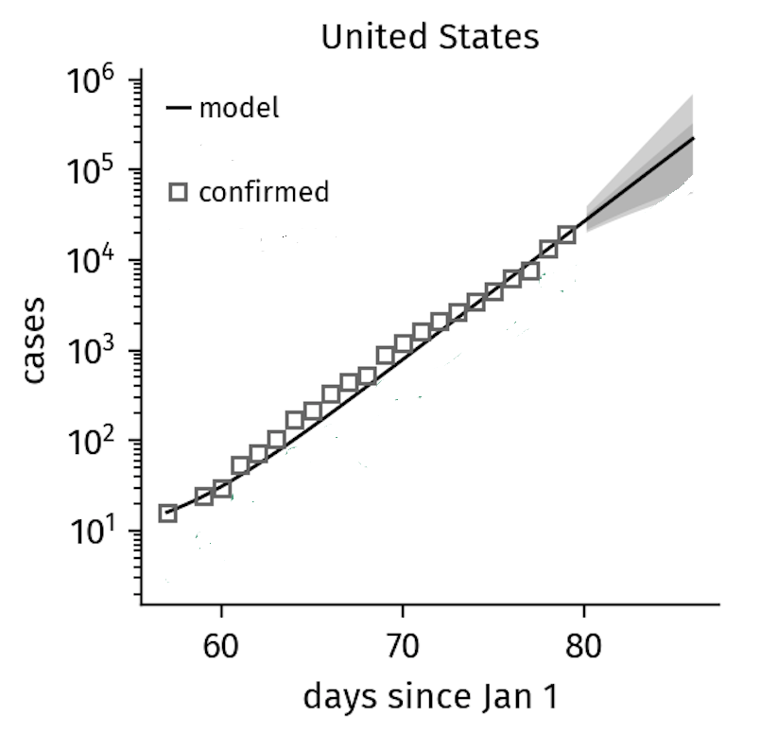
SIR Modelling
SIR Dynamics
$$\frac{ds}{dt}=−βs i$$
$$\frac{di}{dt}=βs i−γi$$
$$\frac{dr}{dt}=γi$$
http://rocs.hu-berlin.de/corona/docs/forecast/model/
Science 368, 742–746 (2020), Maier et al

Slide 36
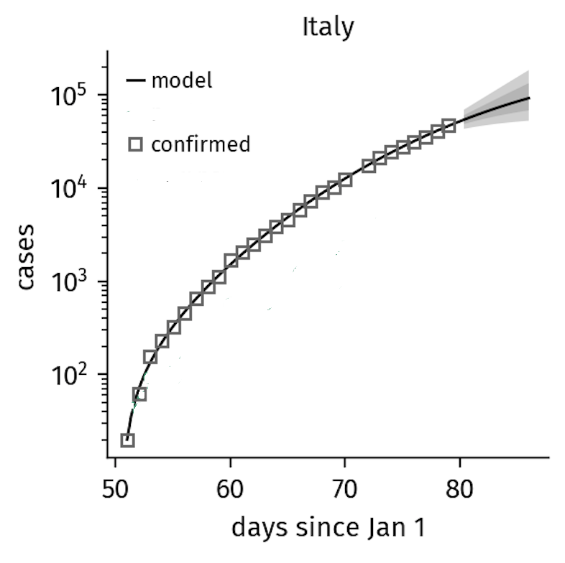


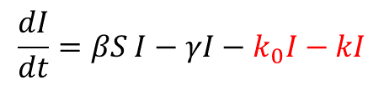

SIR Modelling
SIR-X Dynamics
$$\frac{dS}{dt}=−βSI−k_{0}S$$
$$\frac{dI}{dt}=βS I−γI−k_{0}I−kI$$
$$\frac{dR}{dt}=γI+k_{0}S$$
$$\frac{dX}{dt}=\left(k+k_{0}\right)I$$
Quarantined Individual
http://rocs.hu-berlin.de/corona/docs/forecast/model/
Science 368, 742–746 (2020), Maier et al

