Slide 3


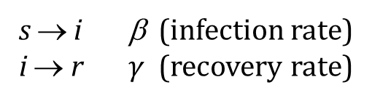



Epidemic Spreading : Modelling
SIS Dynamics
s → i β (infection rate)
i → r $γ$ (recovery rate)
Large population
Single initial case
Rest of the population is fully susceptible
Examples:
Chlamydia
Human papilloma virus
(Respiratory syncytial virus / influenza)
$$\frac{ds}{dt}=γi−βs i$$
$$\frac{di}{dt}=βs i−γi$$
$s+i=1$ (Constant)
Assumptions:
Homogeneous mixing
Constant recovering rate

Slide 4








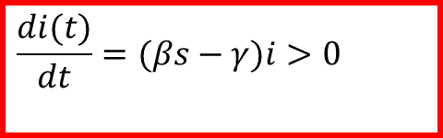
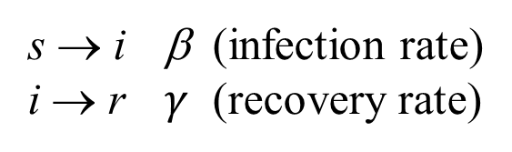
SIR Modelling
s=S/N: density of Susceptible individuals
i=I/N: density of Infective individuals
r=R/N: density of Removed (recovered/dead) individuals
SIR Dynamics
$$\left(\frac{ds}{dt}+\frac{di}{dt}+\frac{dr}{dt}=0\right)$$
s → i β (infection rate)
i → r $γ$ (recovery rate)
$$\frac{ds}{dt}=−βs i$$
$$s+i+r=1$$
$$\frac{di}{dt}=βs i−γi$$
$$\frac{di(t)}{dt}=(βs−γ)i>0$$
$$(s(0)≈1)$$
$$\frac{dr}{dt}=γi$$
$$R_{o}≡\frac{β}{γ}>1$$
$$βs(0)−γ>0$$

Slide 5
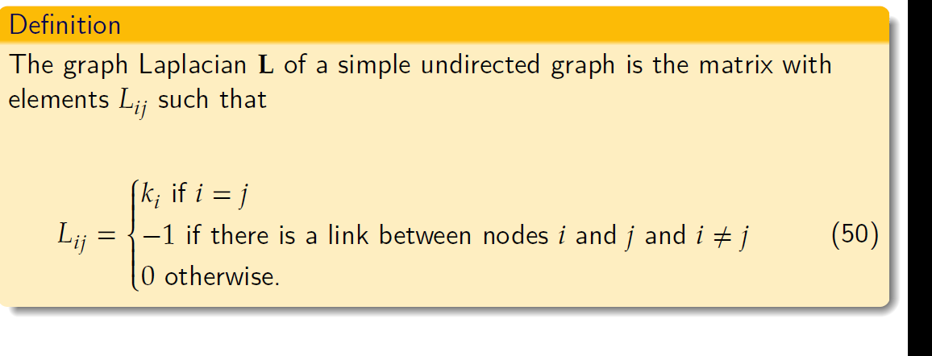
Graph Laplacian

Slide 6
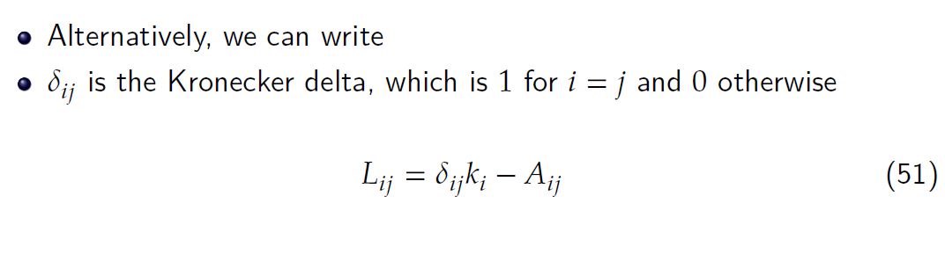
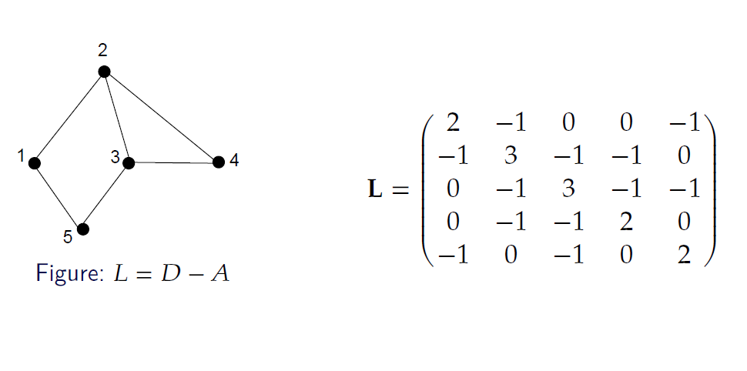
Graph Laplacian

Slide 7
Graph Laplacian

Slide 8
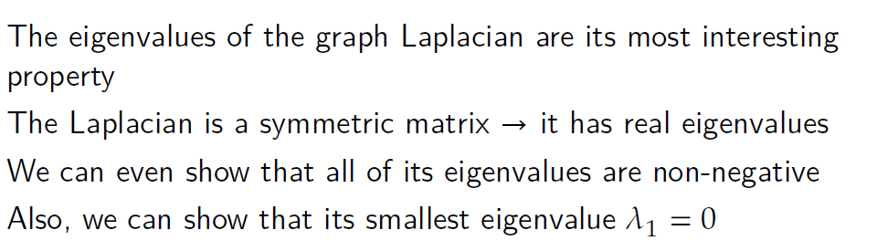
Graph Laplacian

Slide 9
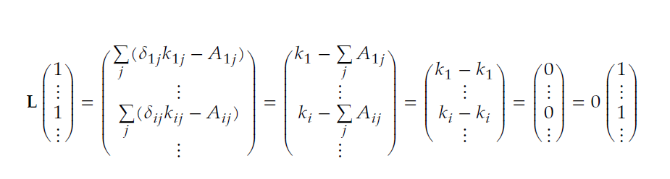
Graph Laplacian

Slide 10
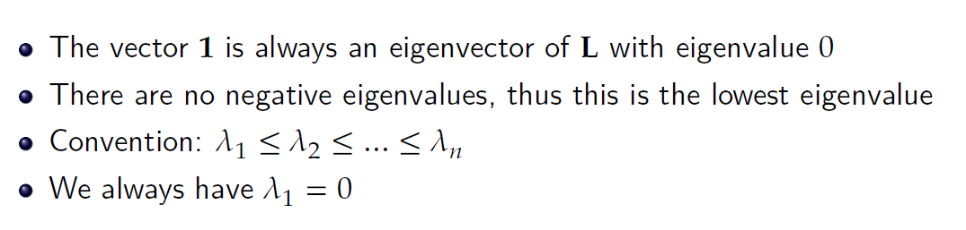
Graph Laplacian

Slide 11
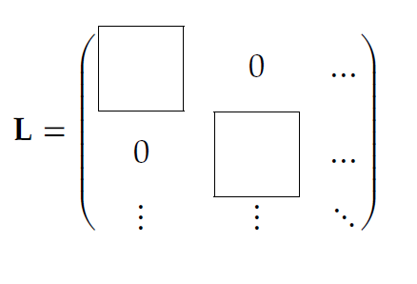
Connected Components and the algebraic connectivity
Suppose we have a network with $c$different components
The components have sizes $n_{1}, n_{2}, … , n_{c}$

Slide 12
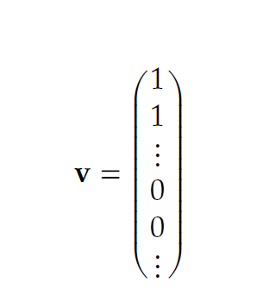
Connected Components and the algebraic connectivity
Suppose we have a network with $c$different components
The components have sizes $n_{1}, n_{2}, … , n_{c}$

Slide 13
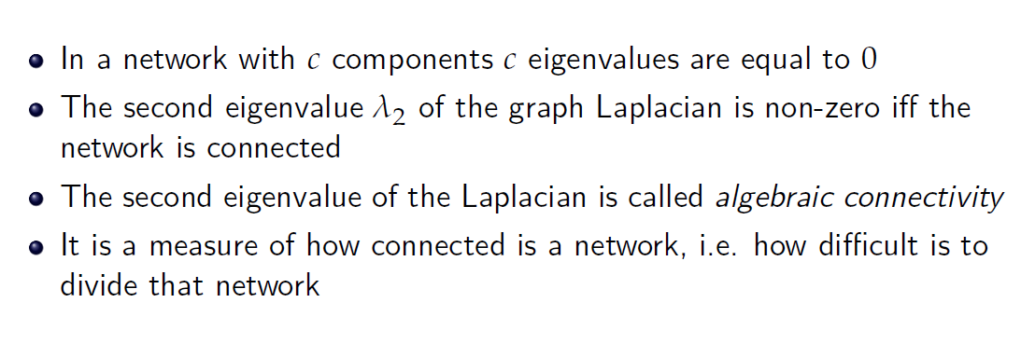
Connected Components and the algebraic connectivity

Slide 14
Dynamics on Networks

Slide 15
Dynamics on Networks: General Model
Denis Helic

Slide 16
Dynamics on Networks: Diffusion Dynamics
Denis Helic

Slide 17
Dynamics on Networks: Diffusion Dynamics
Denis Helic

Slide 18
Dynamics on Networks: Diffusion Dynamics
Denis Helic

Slide 19
Dynamics on Networks: Diffusion Dynamics
Denis Helic

Slide 20
Dynamics on Networks: Diffusion Dynamics
Denis Helic

Slide 21
Dynamics on Networks: Diffusion Dynamics
Denis Helic

Slide 22
Dynamics on Networks: Diffusion Dynamics
Denis Helic

Slide 23
Dynamics on Networks: Diffusion Dynamics
Denis Helic

Slide 24
Dynamics on Networks: Diffusion Dynamics
Denis Helic

Slide 25
Dynamics on Networks: SI model

Slide 26
Dynamics on Networks: SI model
Infected dynamics
Denis Helic

Slide 27
Dynamics on Networks: SI model
Infected dynamics
Denis Helic

Slide 28
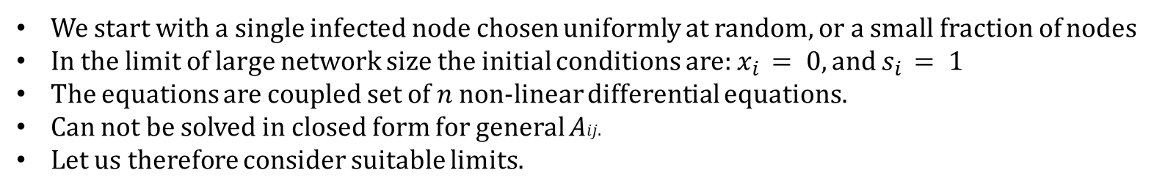
Dynamics on Networks: SI model
We start with a single infected node chosen uniformly at random, or a small fraction of nodes
In the limit of large network size the initial conditions are: $x_{i} = 0, and$ $s_{i} = 1$
The equations are coupled set of 𝑛 non-linear differential equations.
Can not be solved in closed form for general 𝐴𝑖𝑗.
Let us therefore consider suitable limits.
For large $n$ and assuming initial conditions as above $x_{i}$ will be small.
We can ignore terms of quadratic order in small quantities.
Denis Helic

Slide 29
Dynamics on Networks: SI model
Denis Helic

Slide 30


Dynamics on Networks: SI model
$$r=1$$
$$r=1$$
$$r=1$$
Denis Helic

Slide 31

Dynamics on Networks: SI model
$$r=1$$
$$r=1$$
$$r=1$$
Denis Helic

Slide 32
Dynamics on Networks: SI model
Denis Helic

