Slide 1

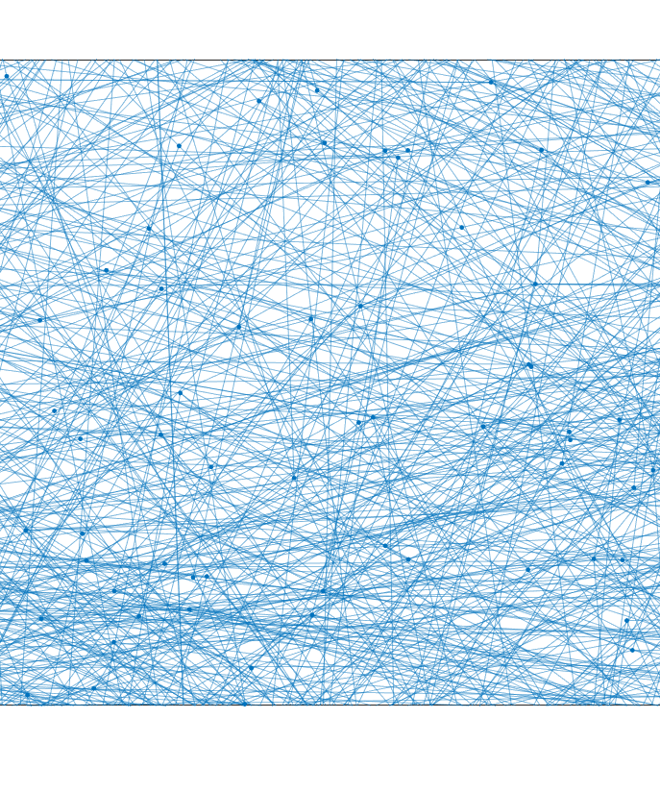
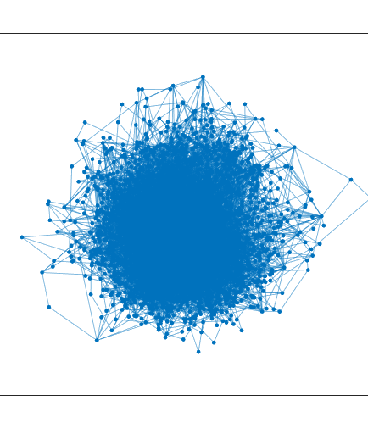
Degree Distribution

Slide 5
RMP-Barabasi

Slide 6
Many of the things that scientists measure have a typical size or “scale”—a typical value around which individual measurements are centred.

Slide 7
Many of the things that scientists measure have a typical size or “scale”—a typical value around which individual measurements are centred.
Histogram of people’s heights
Heights in centimetres of American males. Data from the National Health Examination Survey, 1959–1962 (US Department of Health and Human Services).
https://aaronclauset.github.io/powerlaws/data.htm

Slide 8
Histogram : Linear binning
Key Steps in Linear Binning
Define the Range: Determine the minimum and maximum values of the dataset.
Divide into Bins: Split the range into equal-sized intervals or bins.
Assign Data Points: Place each data point into the corresponding bin based on its value.
Aggregate: Optionally, compute aggregate statistics (e.g., count, sum, or average) for each bin

Slide 9
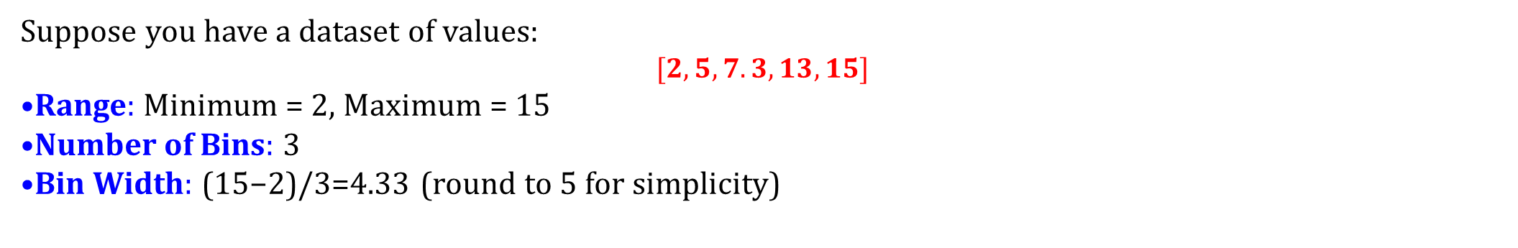
Histogram : Linear binning
Key Steps in Linear Binning
Define the Range: Determine the minimum and maximum values of the dataset.
Divide into Bins: Split the range into equal-sized intervals or bins.
Assign Data Points: Place each data point into the corresponding bin based on its value.
Aggregate: Optionally, compute aggregate statistics (e.g., count, sum, or average) for each bin
Suppose you have a dataset of values: $$[2, 5, 7.3, 13, 15]$$
Range: Minimum = 2, Maximum = 15
Number of Bins: 3
Bin Width: (15−2)/3=4.33 (round to 5 for simplicity)

Slide 10

Histogram : Linear binning
Key Steps in Linear Binning
Define the Range: Determine the minimum and maximum values of the dataset.
Divide into Bins: Split the range into equal-sized intervals or bins.
Assign Data Points: Place each data point into the corresponding bin based on its value.
Aggregate: Optionally, compute aggregate statistics (e.g., count, sum, or average) for each bin
Suppose you have a dataset of values: $$[2, 5, 7.3, 13, 15]$$
Range: Minimum = 2, Maximum = 15
Number of Bins: 3
Bin Width: (15−2)/3=4.33 (round to 5 for simplicity)
Data points in bins:
Bin 1: [2, 5]
Bin 2: [7.3]
Bin 3: [13, 15]

Slide 11
Histogram : Linear binning
Applications
Histograms: To visualize the distribution of data.
Data Compression: Reducing the number of data points by grouping them into bins.
Signal Processing: Discretizing continuous signals.
Numerical Methods: Approximating functions or integrals.

Slide 12
Many of the things that scientists measure have a typical size or “scale”—a typical value around which individual measurements are centred.
Again the histogram of speeds is strongly peaked, in this case around 75mph.
Right: histogram of speeds in miles per hour of cars on UK
motorways. Data from Transport Statistics 2003 (UK Department for Transport).

Slide 13


But not all things we measure are peaked around a typical value. Some vary over an enormous dynamic range, sometimes many orders of magnitude!!!!!
frequency table of words in a text.
Zipf's law (/zɪf/; German pronunciation: [tsɪpf]) is an empirical law stating that when a list of measured values is sorted in decreasing order, the value of the n-th entry is often approximately inversely proportional to n.
George Kingsley Zipf (Statistics, linguistics)

Slide 14
But not all things we measure are peaked around a typical value. Some vary over an enormous dynamic range, sometimes many orders of magnitude!!!!!

Slide 15
But not all things we measure are peaked around a typical value. Some vary over an enormous dynamic range, sometimes many orders of magnitude!!!!!
Histogram of the populations of all US cities with population of 10000 or more.
The largest city in the US is New York City, with over 8.5 million residents. Los Angeles and Chicago follow, each with more than 2.5 million residents, and southern US cities Houston and Phoenix round out the top five with populations of almost 2.3 million and 1.6 million, respectively.

Slide 16
But not all things we measure are peaked around a typical value. Some vary over an enormous dynamic range, sometimes many orders of magnitude!!!!!
Histogram of the populations of all US cities with population of 10000 or more.
Monowi, Nebraska
During the 2000 census, the village had a total population of two; only one married couple, Rudy and Elsie Eiler, lived there. Rudy died in 2004, leaving his wife as the only resident in the village. In this capacity, she acts as mayor, and granted herself a liquor license. She is required to produce a municipal road plan every year in order to secure state funding for the village's four street lights.

Slide 17
But not all things we measure are peaked around a typical value. Some vary over an enormous dynamic range, sometimes many orders of magnitude!!!!!
Note: the ratio of largest to smallest population is at least $∼{10}^{5}$.
The histogram is highly right-skewed, meaning that while the bulk of the distribution occurs for fairly small sizes most US cities have small populations—there is a small number of cities with population much higher than the typical value, producing the long tail to the right of the histogram.

Slide 18
This right-skewed form is qualitatively quite different from the histograms of people’s heights, but is not itself very surprising. Given that we know there is a large dynamic range from the smallest to the largest city sizes, we can immediately deduce that there can only be a small number of very large cities
The histogram of city sizes again, but this time replotted with logarithmic horizontal and vertical axes. Now a remarkable pattern emerges: the histogram, when plotted in this fashion, follows quite closely a straight line.

Slide 19
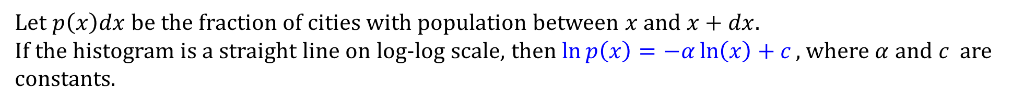
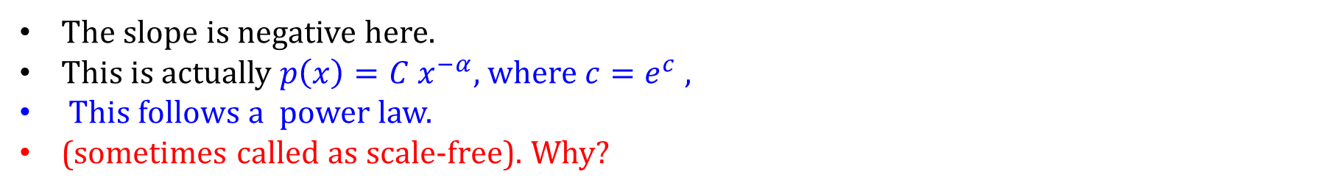
This observation seems first to have been made by Auerbach, although it is often attributed to Zipf. What does it mean?
Let $p\left(x\right)dx$ be the fraction of cities with population between $x$ and $x+dx.$
If the histogram is a straight line on log-log scale, then $\ln{p\left(x\right)=−α\ln\left(x\right)+c},$ where $α$ and $c$ are constants.
The slope is negative here.
This is actually $p\left(x\right)=C x^{−α}$, where $c=e^{c}$ ,
This follows a power law.
(sometimes called as scale-free). Why?

Slide 20
This observation seems first to have been made by Auerbach, although it is often attributed to Zipf. What does it mean?
Let $p\left(x\right)dx$ be the fraction of cities with population between $x$ and $x+dx.$
If the histogram is a straight line on log-log scale, then $\ln{p\left(x\right)=−α\ln\left(x\right)+c},$ where $α$ and $c$ are constants.
The slope is negative here.
This is actually $p\left(x\right)=C x^{−α}$, where $c=e^{c}$ ,
This follows a power law.
(sometimes called as scale-free). Why?

Slide 21
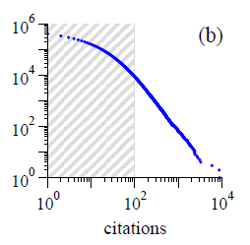
Cumulative distributions or “rank/frequency plots”
(a) Numbers of occurrences of unique words in the novel Moby Dick by Hermann Melville.
(b) Numbers of citations to scientific papers published in 1981, from time of publication until June 1997.
(f) Magnitude of earthquakes in California between January 1910 and May 1992. The Richter magnitude is defined as the logarithm, base 10, of the maximum amplitude of motion detected in the earthquake, and hence the horizontal scale in the plot, which is drawn as linear, is in effect a logarithmic scale of amplitude. The power law relationship in the earthquake distribution is thus a relationship between amplitude and frequency of occurrence. The data are from the National Geophysical Data Center, www.ngdc.noaa.gov.
https://aaronclauset.github.io/powerlaws/data.html
https://physics.bu.edu/~redner/projects/citation/isi.html

Slide 22
(g) Diameter of craters on the moon. Vertical axis is measured per square kilometre.
(h) Peak gamma-ray intensity of solar flares in counts per second, measured from Earth orbit between February 1980 and November 1989.
The observations were made between 1980 and 1989 by the instrument known as the Hard X-Ray Burst Spectrometer aboard the Solar Maximum Mission satellite launched in 1980. The spectrometer used a CsI scintillation detector to measure gamma-rays from solar flares and the horizontal axis in the figure is calibrated in terms of scintillation counts per second from this detector. The data are from the NASA Goddard Space Flight Center, umbra.nascom.nasa.gov/smm/hxrbs.html.
But these plots are cumulative!!

Slide 23
Power-law distributions occur in an extraordinarily diverse range of phenomena. In addition to city populations,
The sizes of earthquakes [3],
Moon craters [4],
Solar flares [5],
Computer files [6] and wars [7],
The frequency of use of words in any human language [2, 8],
The frequency of occurrence of personal names in most cultures [9], the numbers of papers scientists write [10], the number of citations received by papers [11],
The number of hits on web pages [12],
The sales of books, music recordings and almost every other branded commodity [13, 14],
The numbers of species in biological taxa [15],
People’s annual incomes [16] follows power law distributions.
[3] B. Gutenberg and R. F. Richter, Frequency of earthquakes in california. Bulletin of the Seismological Society of America 34, 185–188 (1944).
[4] G. Neukum and B. A. Ivanov, Crater size distributions and impact probabilities on Earth from lunar, terrestrial planet, and asteroid cratering data. In T. Gehrels (ed.), Hazards Due to Comets and Asteroids, pp. 359–416, University of Arizona Press, Tucson, AZ (1994).
[5] E. T. Lu and R. J. Hamilton, Avalanches of the distribution of solar flares. Astrophysical Journal 380, 89–92
(1991).
[6] M. E. Crovella and A. Bestavros, Self-similarity in World Wide Web traffic: Evidence and possible causes. In B. E. Gaither and D. A. Reed (eds.), Proceedings of the 1996 ACM SIGMETRICS Conference on Measurement and
Modeling of Computer Systems, pp. 148–159, Association of Computing Machinery, New York (1996).
[7] D. C. Roberts and D. L. Turcotte, Fractality and sel forganized criticality of wars. Fractals 6, 351–357 (1998).
[8] J. B. Estoup, Gammes Stenographiques. Institut Stenographique de France, Paris (1916).
[9] D. H. Zanette and S. C. Manrubia, Vertical transmission of culture and the distribution of family names. Physica A 295, 1–8 (2001).
[10] A. J. Lotka, The frequency distribution of scientific production. J. Wash. Acad. Sci. 16, 317–323 (1926).
[11] D. J. de S. Price, Networks of scientific papers. Science 149, 510–515 (1965).
[12] L. A. Adamic and B. A. Huberman, The nature of markets in the World Wide Web. Quarterly Journal of Electronic Commerce 1, 512 (2000).
[13] R. A. K. Cox, J. M. Felton, and K. C. Chung, The concentration of commercial success in popular music: an analysis of the distribution of gold records. Journal of Cultural Economics 19, 333–340 (1995).
[14] R. Kohli and R. Sah, Market shares: Some power law results and observations. Working paper 04.01, Harris School of Public Policy, University of Chicago (2003).
[15] J. C. Willis and G. U. Yule, Some statistics of evolution and geographical distribution in plants and animals, and their significance. Nature 109, 177–179 (1922).
[16] V. Pareto, Cours d’Economie Politique. Droz, Geneva (1896).

Slide 24
Histogram : Linear binning
Key Steps in Linear Binning
Define the Range: Determine the minimum and maximum values of the dataset.
Divide into Bins: Split the range into equal-sized intervals or bins.
Assign Data Points: Place each data point into the corresponding bin based on its value.
Aggregate: Optionally, compute aggregate statistics (e.g., count, sum, or average) for each bin

Slide 25
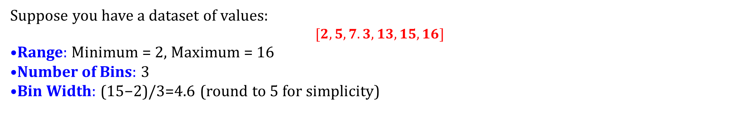
Histogram : Linear binning
Key Steps in Linear Binning
Define the Range: Determine the minimum and maximum values of the dataset.
Divide into Bins: Split the range into equal-sized intervals or bins.
Assign Data Points: Place each data point into the corresponding bin based on its value.
Aggregate: Optionally, compute aggregate statistics (e.g., count, sum, or average) for each bin
Suppose you have a dataset of values: $$[2, 5, 7.3, 13, 15, 16]$$
Range: Minimum = 2, Maximum = 16
Number of Bins: 3
Bin Width: (15−2)/3=4.6 (round to 5 for simplicity)

Slide 26

Histogram : Linear binning
Key Steps in Linear Binning
Define the Range: Determine the minimum and maximum values of the dataset.
Divide into Bins: Split the range into equal-sized intervals or bins.
Assign Data Points: Place each data point into the corresponding bin based on its value.
Aggregate: Optionally, compute aggregate statistics (e.g., count, sum, or average) for each bin
Suppose you have a dataset of values: $$[2, 5, 7.3, 13, 15, 16]$$
Range: Minimum = 2, Maximum = 16
Number of Bins: 3
Bin Width: (15−2)/3=4.6 (round to 5 for simplicity)
Data points in bins:
Bin 1: [2, 5]
Bin 2: [7.3]
Bin 3: [13, 15, 16]

Slide 27
Histogram : Linear binning
Applications
Histograms: To visualize the distribution of data.
Data Compression: Reducing the number of data points by grouping them into bins.
Signal Processing: Discretizing continuous signals.
Numerical Methods: Approximating functions or integrals.

Slide 28
Histogram : Log binning
Log binning is a technique used in data analysis, particularly for dealing with data that spans several orders of magnitude, such as distributions that follow power laws.
Instead of using linear bin widths, the bins are spaced logarithmically, allowing better representation of data in cases where the frequency of occurrence decreases exponentially with increasing values.

Slide 29
Histogram : Log binning
Key Features of Log Binning:
Logarithmic Bin Widths:
The width of the bins increases logarithmically, meaning the difference between bin boundaries grows as the values increase.
For example, bin edges might be spaced like 1,10, 100, 1000 rather than 1,2,3,4.
Preserves Detail Across Scales:
Small bins are used for low-value ranges, capturing fine details.
Larger bins are used for high-value ranges, ensuring sparsely populated regions are still well-represented.

Slide 30
Histogram : Log binning
Key Features of Log Binning:
Logarithmic Bin Widths:
The width of the bins increases logarithmically, meaning the difference between bin boundaries grows as the values increase.
For example, bin edges might be spaced like 1,10, 100, 1000 rather than 1,2,3,4.
Preserves Detail Across Scales:
Small bins are used for low-value ranges, capturing fine details.
Larger bins are used for high-value ranges, ensuring sparsely populated regions are still well-represented.
Reduces Noise:
In distributions with a long tail (e.g., power-law distributions), linear binning can lead to sparse or empty bins for large values. Log binning aggregates these values more effectively, reducing statistical noise.
Logarithmic Representation:
Data is often plotted on a log-log scale for visualization. The x-axis represents the bin range, and the y-axis shows the frequency or probability density.

Slide 32
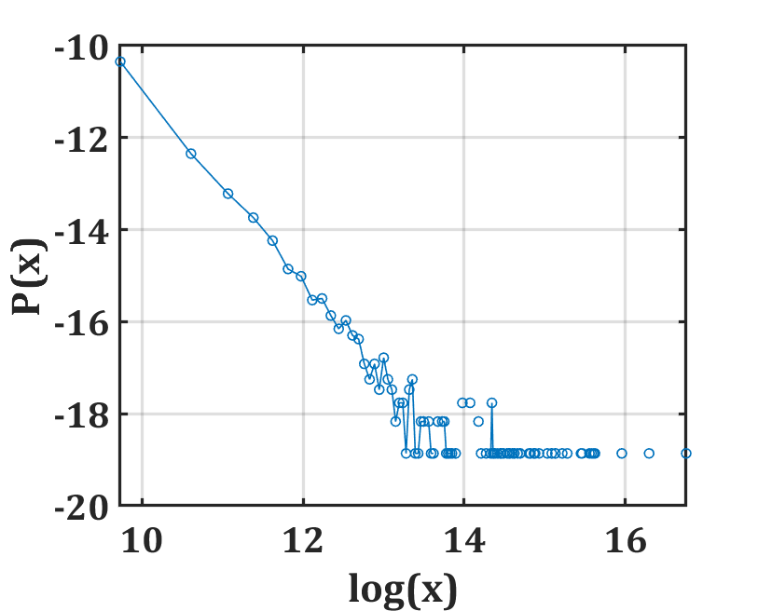
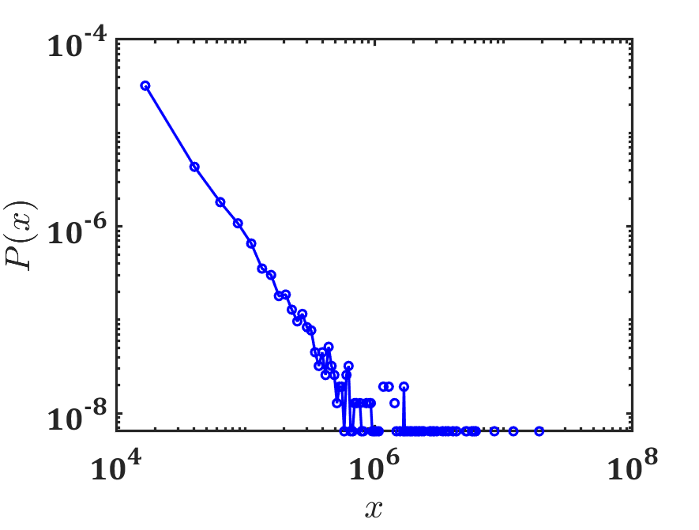
Histogram (US population)
Linear binning and log of the binned data
Linear binning and log-scale
log

Slide 33
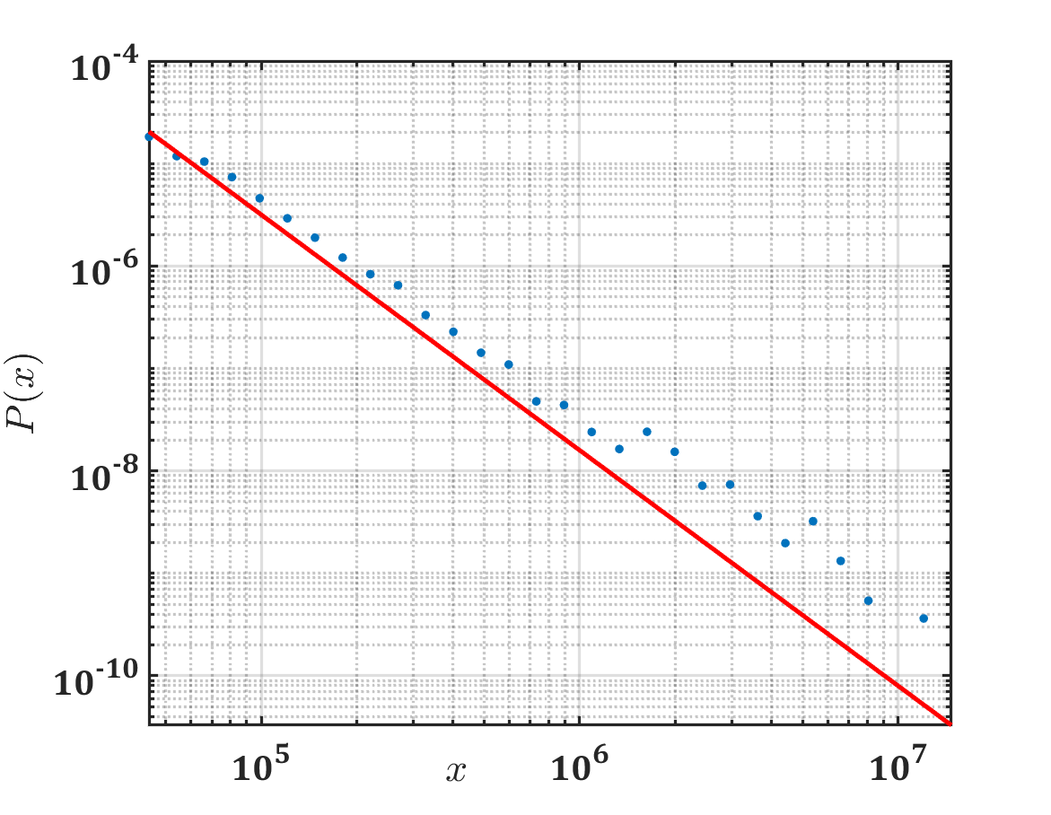
Histogram (US population)
Log binning and log scale
log

Slide 34
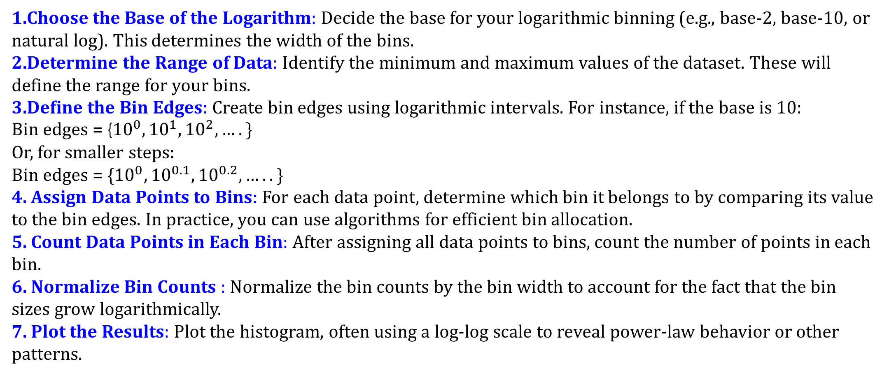
Histogram : Log binning
Choose the Base of the Logarithm: Decide the base for your logarithmic binning (e.g., base-2, base-10, or natural log). This determines the width of the bins.
Determine the Range of Data: Identify the minimum and maximum values of the dataset. These will define the range for your bins.
Define the Bin Edges: Create bin edges using logarithmic intervals. For instance, if the base is 10:
Bin edges = {${10}^{0}, {10}^{1}, {10}^{2}, ….\}$
Or, for smaller steps:
Bin edges = {${10}^{0}, {10}^{0.1}, {10}^{0.2},…..\}$
4. Assign Data Points to Bins: For each data point, determine which bin it belongs to by comparing its value to the bin edges. In practice, you can use algorithms for efficient bin allocation.
5. Count Data Points in Each Bin: After assigning all data points to bins, count the number of points in each bin.
6. Normalize Bin Counts : Normalize the bin counts by the bin width to account for the fact that the bin sizes grow logarithmically.
7. Plot the Results: Plot the histogram, often using a log-log scale to reveal power-law behavior or other patterns.

Slide 35
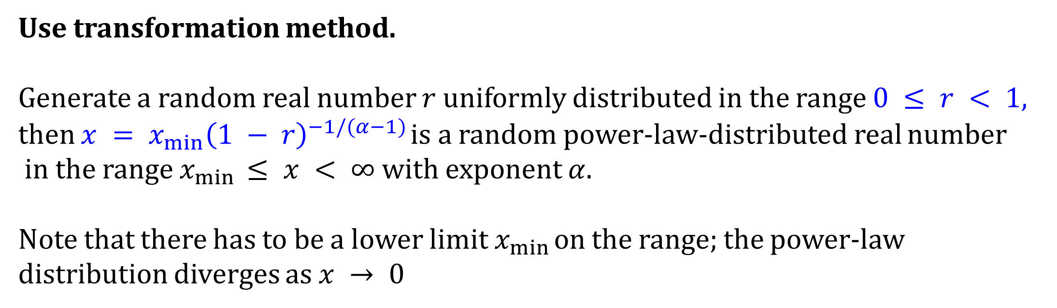
Histogram : Linear binning and Log binning
Task : Histogram of the set of random numbers which will have a power-law distribution with exponent α = 2.5.
Use transformation method.
Generate a random real number $r$ uniformly distributed in the range $0 ≤ r < 1$,
then $x = x_{min}{\left(1 − r\right)}^{−1/(α−1)}$is a random power-law-distributed real number
in the range $x_{min} ≤ x < ∞$with exponent $α$.
Note that there has to be a lower limit $x_{min}$ on the range; the power-law distribution diverges as $x → 0$

Slide 36
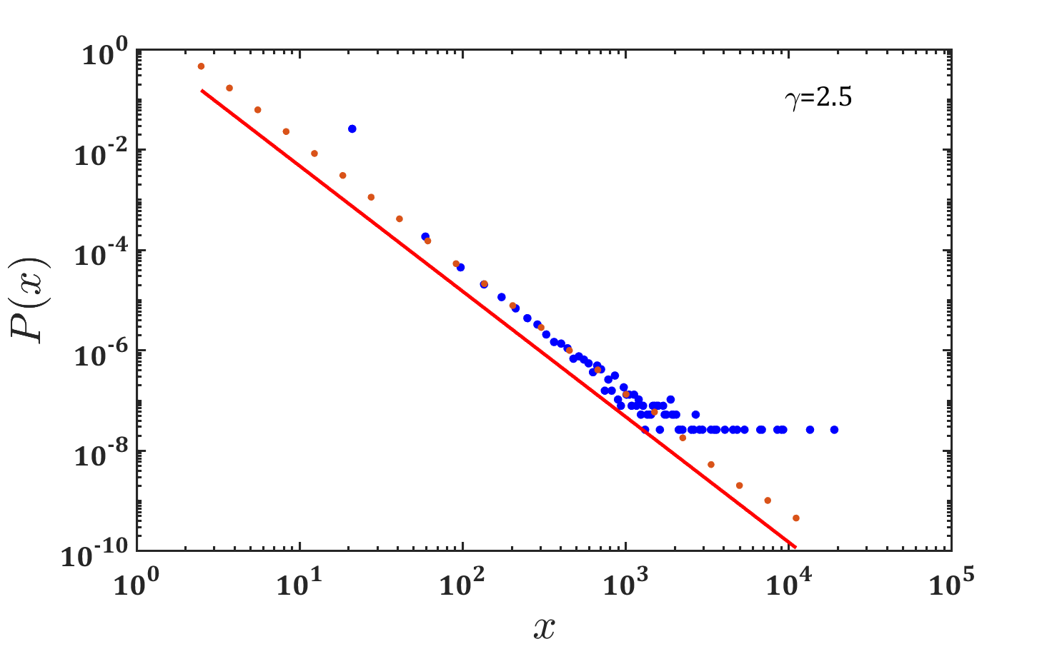
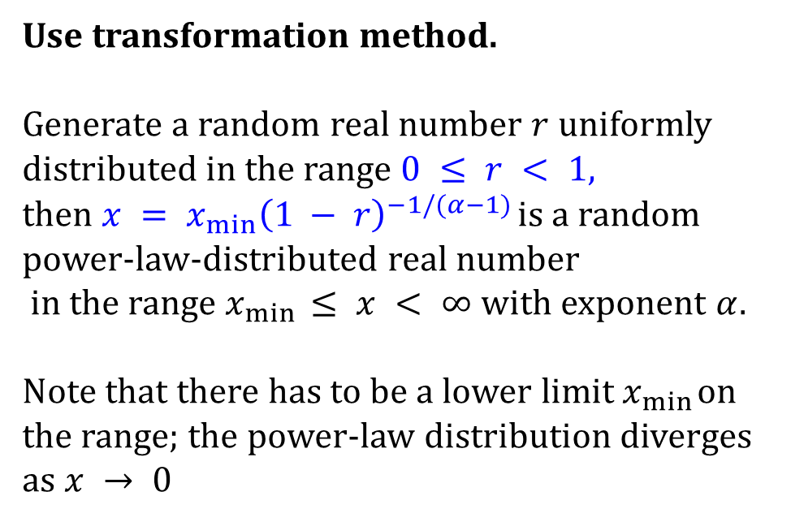
Histogram : Linear binning vs Log binning
(Synthetic data)
Task : Histogram of the set of random numbers which will have a power-law distribution with exponent α = 2.5.
Use transformation method.
Generate a random real number $r$ uniformly distributed in the range $0 ≤ r < 1$,
then $x = x_{min}{\left(1 − r\right)}^{−1/(α−1)}$is a random power-law-distributed real number
in the range $x_{min} ≤ x < ∞$with exponent $α$.
Note that there has to be a lower limit $x_{min}$ on the range; the power-law distribution diverges as $x → 0$

Slide 37
Histogram : Linear binning vs Log binning
(Synthetic data)
Task : Histogram of the set of random numbers which will have a power-law distribution with exponent α = 2.5.
To reveal the power-law form of the distribution it is better, as we have seen, to plot the histogram on logarithmic scales, and when we do this for the current data we see the characteristic straight-line form of the power-law distribution (blue dots).
However, the plot is in some respects not a very good one. In particular the right-hand end of the distribution is noisy because of sampling errors.
The power-law distribution dwindles in this region, meaning that each bin only has a few samples in it, if any. So the fractional fluctuations in the bin counts are large and this appears as a noisy curve on the plot.

Slide 38
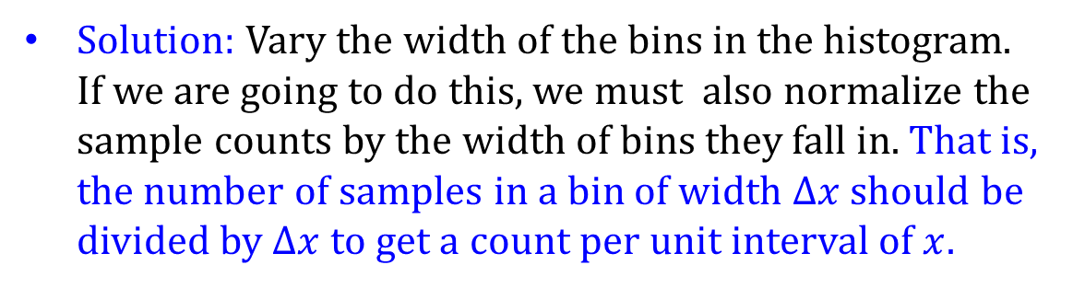
Histogram : Linear binning vs Log binning
Task : Histogram of the set of random numbers which will have a power-law distribution with exponent α = 2.5.
Solution: Vary the width of the bins in the histogram. If we are going to do this, we must also normalize the sample counts by the width of bins they fall in. That is, the number of samples in a bin of width $Δx$ should be divided by $Δx$ to get a count per unit interval of $x$.
Then the normalized sample count becomes independent of bin width on average and we are free to vary the bin widths as we like.
The most common choice is to create bins such that each is a fixed multiple wider than the one before it. This is known as logarithmic binning.

Slide 40
Note that this expression becomes infinite if $α≤ 2.$ Power laws with such low values of have no finite mean. The distributions of sizes of solar flares and wars in are examples of such power laws.

Slide 42
If $α>3$, then the, second moment is finite and well-defined, taking the value

Slide 43
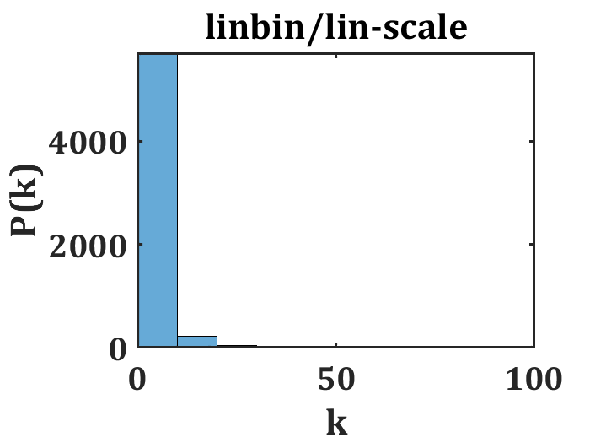
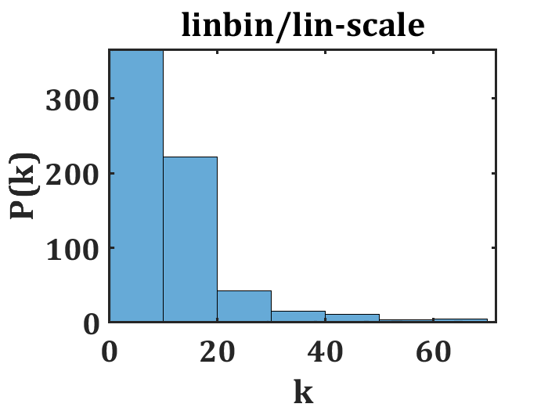
Degree Distribution
Zoomed

Slide 44
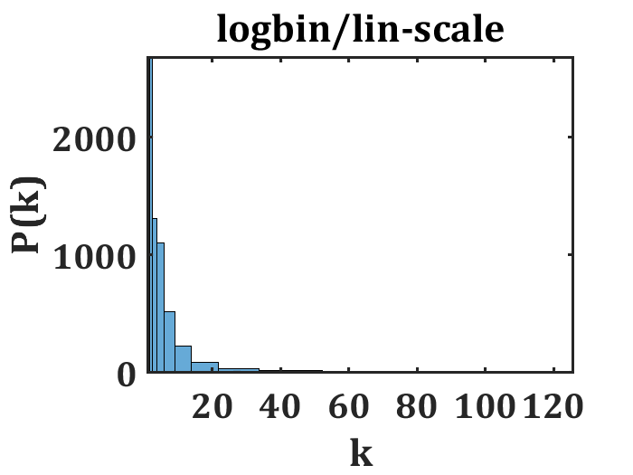
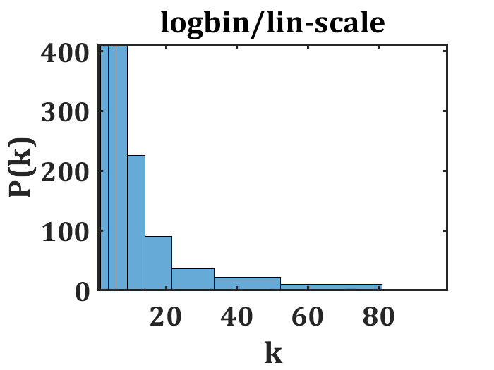
Degree Distribution
Zoomed
Zoomed

Slide 45
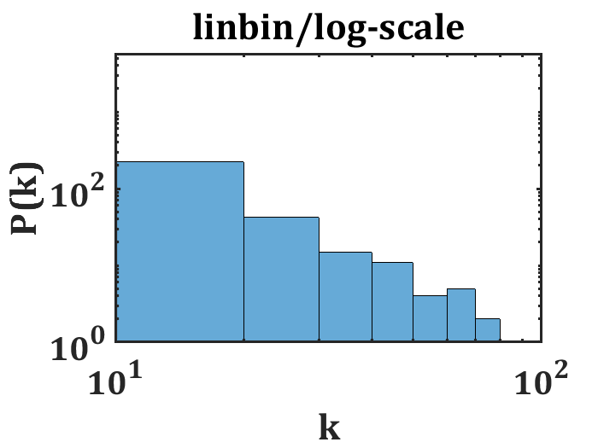
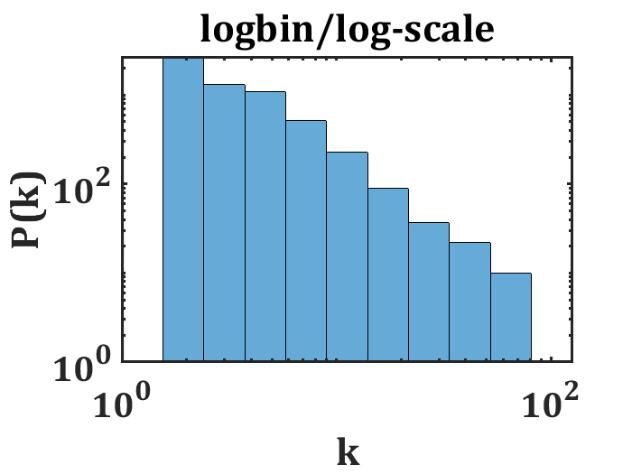
Degree Distribution
Log/lin-binning , log scale

Slide 46
Degree Distribution
Matlab Script
load A_7k.mat;
deg=sum(A);
edges = 0.0:10:106;
edges2 = 3.^(0:0.4:4.4);
% %edges=10.^[-1:1:3];
figure(1); histogram(deg,edges);
axis tight;%%% Linear
set(findall(gcf,'-property','FontSize'),'FontName','Cambria',...
'FontSize',24,'linewidth',2.0,'fontweight','b') ;
set(gca, "Xscale", "log")
set(gca, "YScale", "log")
xlabel('k');
ylabel('P(k)');
title('linbin/log-scale')
%%%%%%%%%%%%%%%%%%%%%%%%
figure(2); histogram(deg,edges2);
axis tight;
set(findall(gcf,'-property','FontSize'),'FontName','Cambria',...
'FontSize',24,'linewidth',2.0,'fontweight','b')
set(gca, "Xscale", "log");
set(gca, "YScale", "log");
xlabel('k');
ylabel('P(k)');
title('logbin/log-scale')

Slide 47
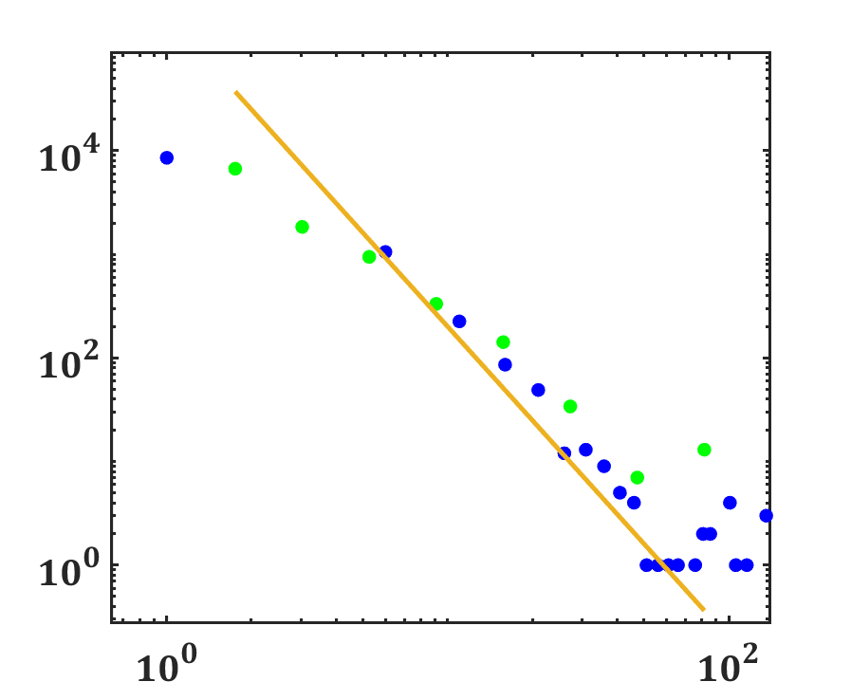
Degree Distribution (Plotting is tricky!!)
10k node

Slide 48
Degree Distribution (log/lin binning in log-log scale)
load('A_6k.mat');
% A=BA(9000,4);
%load A_7k.mat;
deg=sum(A);
ind=find(deg==1);
deg(ind)=2;
edges = 1.1:5:150;
edges2 = 3.^(0.01:0.5:4.7);
%%%%%%%%%%%%%%%%%%%%%%%%%%%%%%%%%%
[Lob, Lob2] =histcounts(deg, edges2);
ds = diff(edges2);
sl = (edges2(1:end-1)+edges2(2:end))*0.5;
nsl = Lob(1:end)./(sum(Lob)*ds);
loglog(sl,nsl,'g.','MarkerSize',30); hold on;
%%%%% Linear bin %%%%%%%%%%%%%%%%
[LiNb,LiNb1] = histcounts(deg,edges);
ds1 = diff(edges);
slin = (edges(1:end-1)+edges(2:end))*0.5;
loglog(slin,LiNb./(sum(LiNb)*ds1),'b.','MarkerSize',30);
6k node
hold on;
% loglog(Lob2(2:end-1),Lob2(2:end-1).^-3,'-','linewidth',3);
loglog(sl,8*sl.^-3,'-','linewidth',3);
set(gcf,'InvertHardCopy','off','Color','white');
set(gcf, 'PaperPositionMode', 'auto','position', [0, 0, 700, 700]);
set(legend,'color','none');
set(legend, 'Box', 'on');
xlabel('$k$','Interpreter','LaTeX','FontSize',30);
ylabel('$P(k)$','Interpreter','LaTeX','FontSize',30);
xlim([0.8 200]);
ylim([10^-6 10]);
set(findall(gcf,'-property','FontSize'),'FontName','Cambria',...
'FontSize',24,'linewidth',2.0,'fontweight','b')

Slide 49
Degree Distribution

