Slide 1
Regular Graph (Open Chain)
A
B
C
D
A
B
A
C
A
D
B
C
B
D
Length 3
C
D
Length 2
4-3=1
Length 1
4-2=2
4-1=3

Slide 2
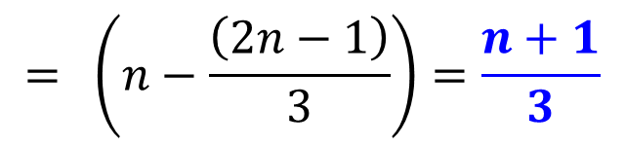
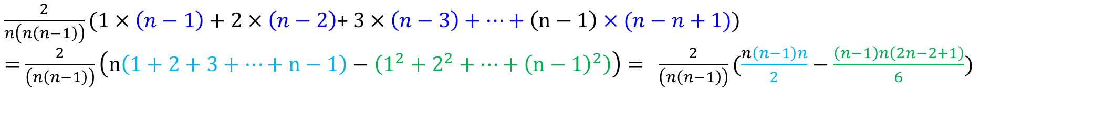

Regular Graph (Open Chain)
A
B
C
D
E
A
B
A
C
A
D
A
E
Length 4
B
C
B
D
B
E
5-4=1
Length 3
C
D
C
E
5-3=2
Length 2
D
E
5-2=3
Length 1
$$\frac{2}{\left(n\left(n−1\right)\right)}\sum_{j=1}^{n−1}{j(n−j)}=$$
5-1=4
$\frac{2}{n\left(n\left(n−1\right)\right)}(1×\left(n−1\right)+2×\left(n−2\right)$+ $3×\left(n−3\right)+…+\left(n−1\right)×(n−n+1))$
$=$ $\frac{2}{\left(n\left(n−1\right)\right)}\left(n\left(1+2+3+…+n−1\right)−\left(1^{2}+2^{2}+…+{\left(n−1\right)}^{2}\right)\right)= \frac{2}{\left(n\left(n−1\right)\right)}(\frac{n\left(n−1\right)n}{2}−\frac{\left(n−1\right)n\left(2n−2+1\right)}{6})$
$$= \left(n−\frac{\left(2n−1\right)}{3}\right)=\frac{n+1}{3}$$

Slide 3
Star Graph
Q: Find the average pathlength, clustering coefficients of start graph.
Change network size , derive mathematically and explain.

Slide 4

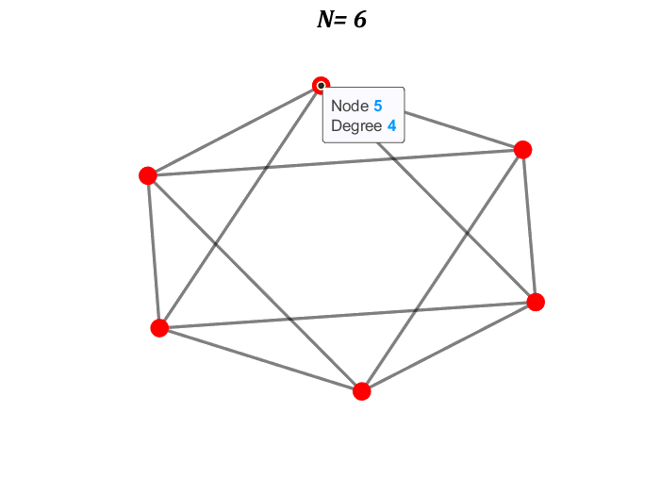
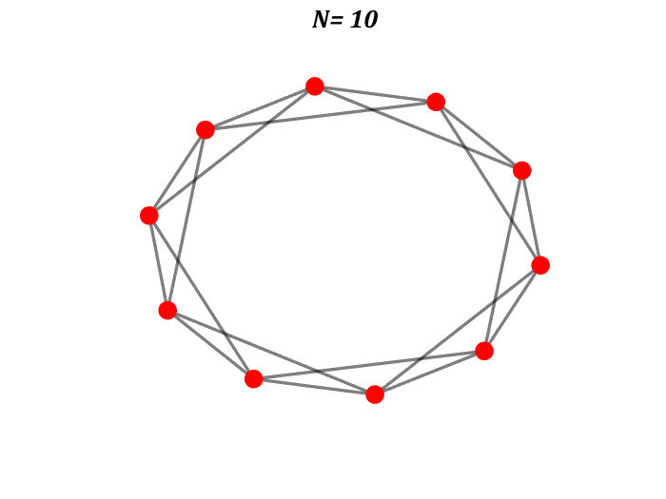
Regular Graph (Ring)
Q: What will be the average pathlength?

Slide 5
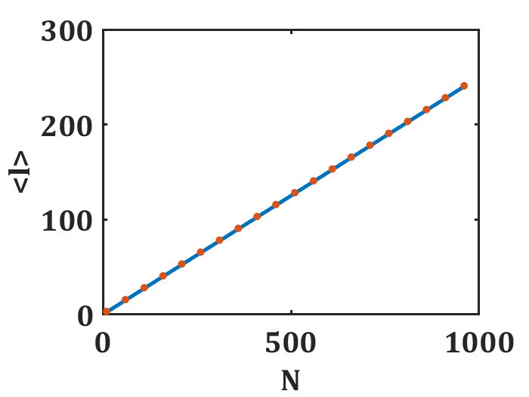
Regular Graph (Ring)
Q: What will be the average pathlength?

Slide 6
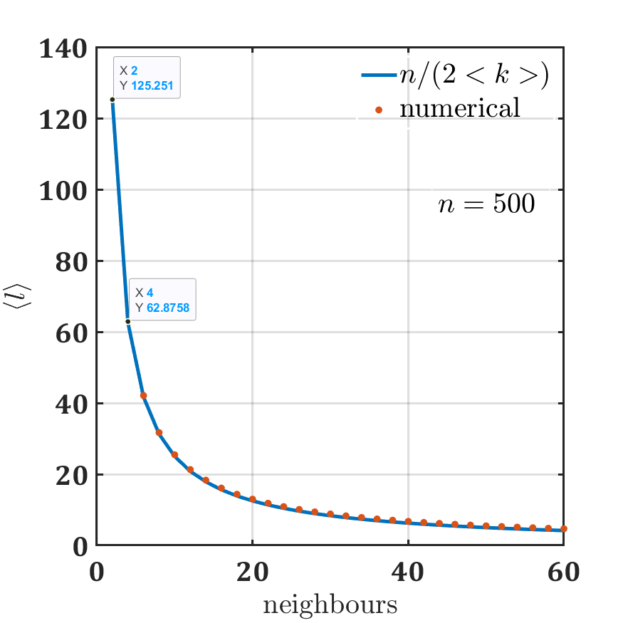
Regular Graph (Ring)
Q: What will be the average pathlength?

Slide 7
Regular Graph (Ring)
n=100;
ZZ=[];
for n=[6 10]
n
c=2;
%for c=1:3:20
A = smallw(n,c,0);
A=zeros(n,n)+A;
%A=A+A;
deg=sum(A);
avg_deg=mean(deg);
l=pathlength(A);
G=graph(A);
figure; plot(G);
deg = degree(G);
end

Slide 8
ONE DIMENSIONAL LATTICE: nodes on a ring
Network Science: Graph Theory 2012

Slide 9

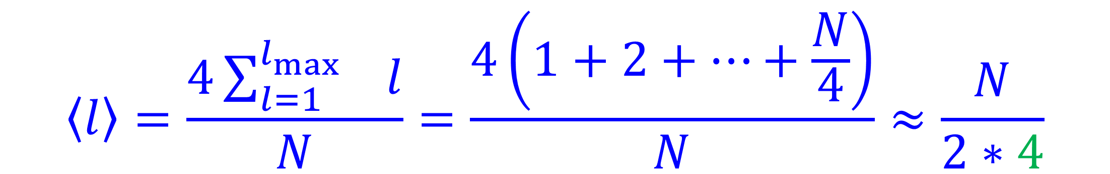

ONE DIMENSIONAL LATTICE: nodes on a ring
$1+\sum_{l=1}^{l_{\max{}}}{4} ≈N$
Thus, $l_{\max{}}≈\frac{N}{4}$
$$\left\langle l\right\rangle =\frac{4\sum_{l=1}^{l_{\max{}}}{l}}{N}=\frac{4\left(1+2+…+\frac{N}{4}\right)}{N}≈\frac{N}{2∗4}$$
The average path-length varies as
Constant degree, constant clustering coefficient.
$$\left\langle l\right\rangle ≈N;N≫1$$
Network Science: Graph Theory 2012

Slide 10
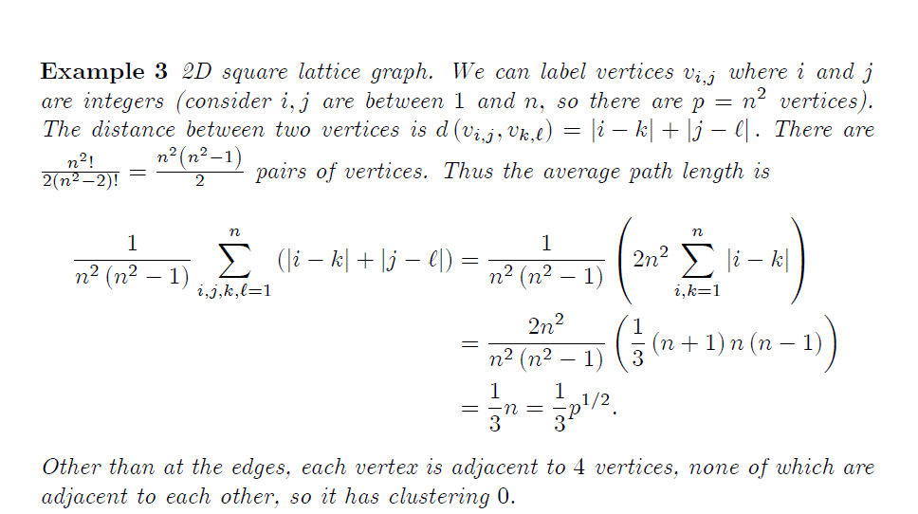
TWO DIMENSIONAL LATTICE
David Glickenstein

Slide 11
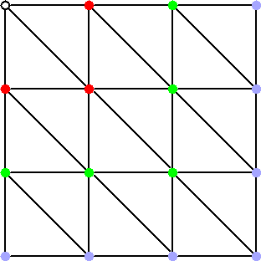
TWO DIMENSIONAL LATTICE
In general, the average distance varies as
where D is the dimensionality of the lattice. Constant degree (coordination number), constant clustering coefficient.
Network Science: Graph Theory 2012

Slide 12
Complete Graphs
Complete Graph
Connected
Each node is connected to all other nodes
Notes:
The Human Disease Network, whose nodes are diseases connected if they have common genetic origin.
K.-I. Goh, M. E. Cusick, D. Valle, B. Childs, M. Vidal, and A.-L. Barabasi.
The human disease network. PNAS, 104:8685–8690, 2007.

Slide 13
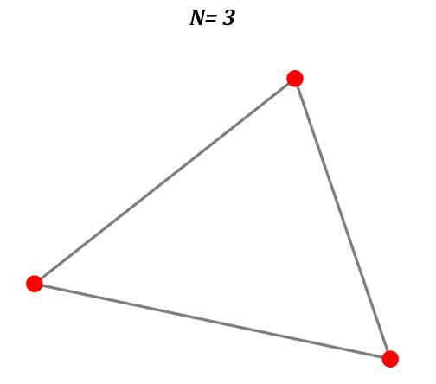
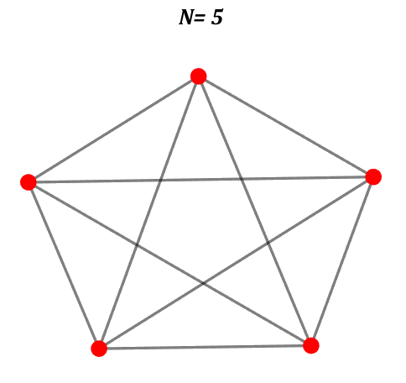
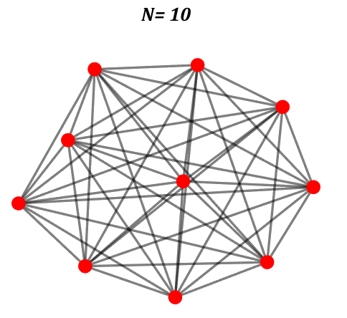
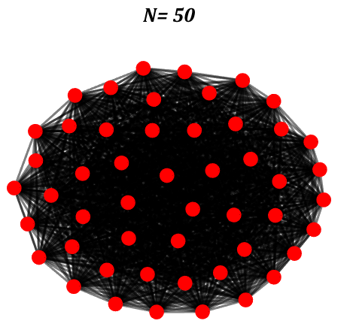
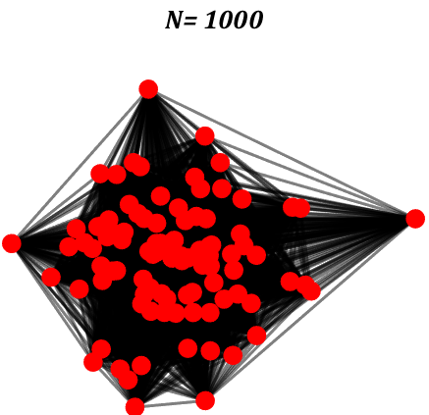
Complete Graphs
Complete Graph
Notes:
The Human Disease Network, whose nodes are diseases connected if they have common genetic origin.
K.-I. Goh, M. E. Cusick, D. Valle, B. Childs, M. Vidal, and A.-L. Barabasi.
The human disease network. PNAS, 104:8685–8690, 2007.

Slide 14
Complete Graphs plot
Complete Graph
for N= [3 5 10 50 1000]
A=ones(N,N);
A(1:N+1:N*N)=0;
G=graph(A);
figure; plot(G);
deg = degree(G);
%deg = degree(h2);
nSizes = 8+4*sqrt(deg-min(deg)+0.5);
% NC=cell2mat(data(j,7));
nColors = rand(N,1)*0+3;%NC(:,3);% deg;
%%
%p=plot(G,'MarkerSize',nSizes,'NodeCData',...
% nColors,'EdgeAlpha',0.5);
p=plot(G,'MarkerSize',nSizes,'EdgeAlpha',0.5);
p.NodeFontSize=0.3;
p.NodeFontWeight='b';
p.EdgeColor='k';
Notes:
The Human Disease Network, whose nodes are diseases connected if they have common genetic origin.
K.-I. Goh, M. E. Cusick, D. Valle, B. Childs, M. Vidal, and A.-L. Barabasi.
The human disease network. PNAS, 104:8685–8690, 2007.

Slide 15
Complete Graphs plot
Complete Graph
for N= [3 5 10 50 1000]
A=ones(N,N);
A(1:N+1:N*N)=0;
G=graph(A);
figure; plot(G);
deg = degree(G);
%deg = degree(h2);
nSizes = 8+4*sqrt(deg-min(deg)+0.5);
% NC=cell2mat(data(j,7));
nColors = rand(N,1)*0+3;%NC(:,3);% deg;
%%
%p=plot(G,'MarkerSize',nSizes,'NodeCData',...
% nColors,'EdgeAlpha',0.5);
p=plot(G,'MarkerSize',nSizes,'EdgeAlpha',0.5);
p.NodeFontSize=0.3;
p.NodeFontWeight='b';
p.EdgeColor='k';
p.LineWidth=2;
p.NodeColor='r';
A=[];
set(findall(gcf,'-property','FontSize'),'FontName','Cambria',...
'FontSize',24,'linewidth',2.0,'fontweight','b')
set(gcf,'InvertHardCopy','off','Color','white');
pp=mat2str(N);
[t]= title(sprintf('N= %s', pp));
% title(['Time= ',num2str(pp), 'Sec'])
% pp=[];
t.FontSize = 16;
t.FontAngle = 'italic';
axis off
end
Notes:
The Human Disease Network, whose nodes are diseases connected if they have common genetic origin.
K.-I. Goh, M. E. Cusick, D. Valle, B. Childs, M. Vidal, and A.-L. Barabasi.
The human disease network. PNAS, 104:8685–8690, 2007.

Slide 16
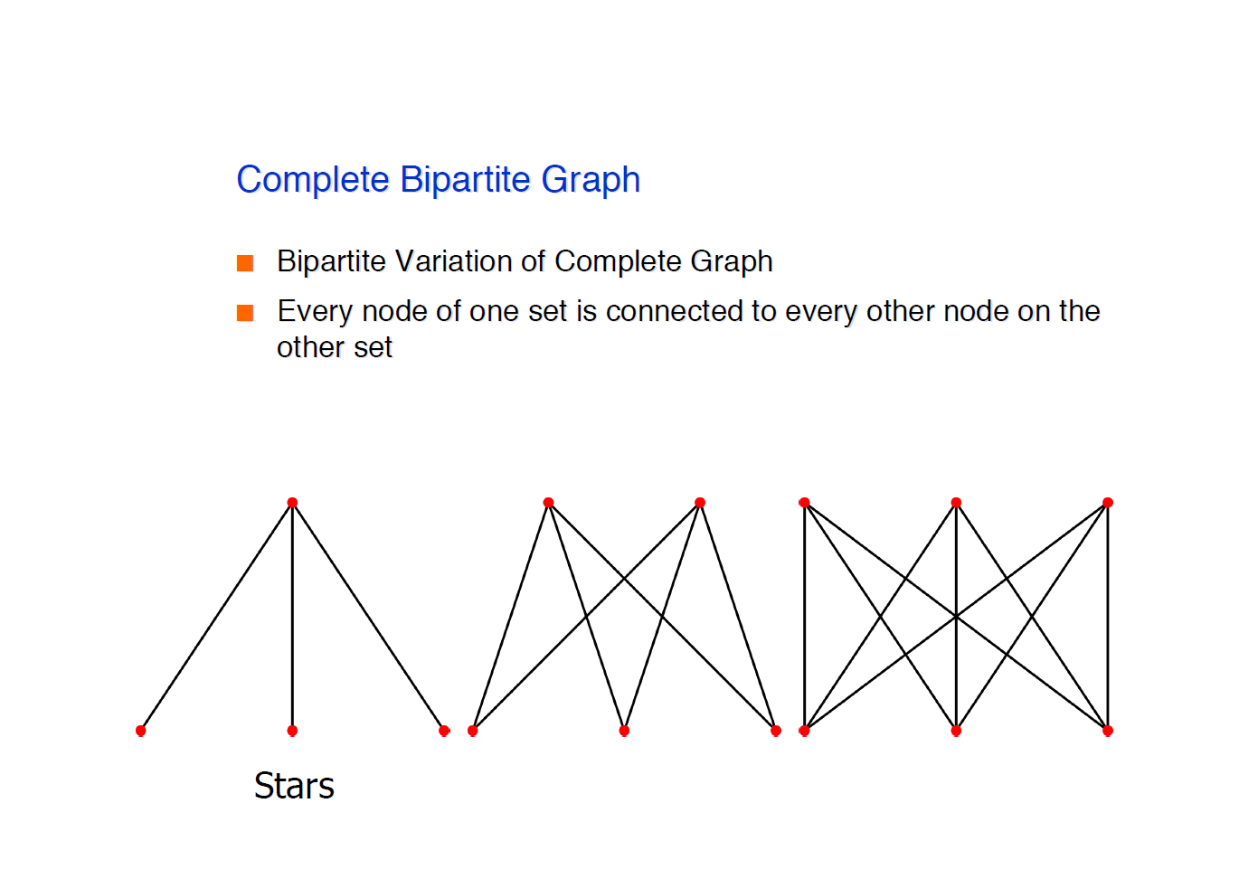
Complete bipartite Graphs
Complete bipartite Graph
Notes:
The Human Disease Network, whose nodes are diseases connected if they have common genetic origin.
K.-I. Goh, M. E. Cusick, D. Valle, B. Childs, M. Vidal, and A.-L. Barabasi.
The human disease network. PNAS, 104:8685–8690, 2007.

Slide 17
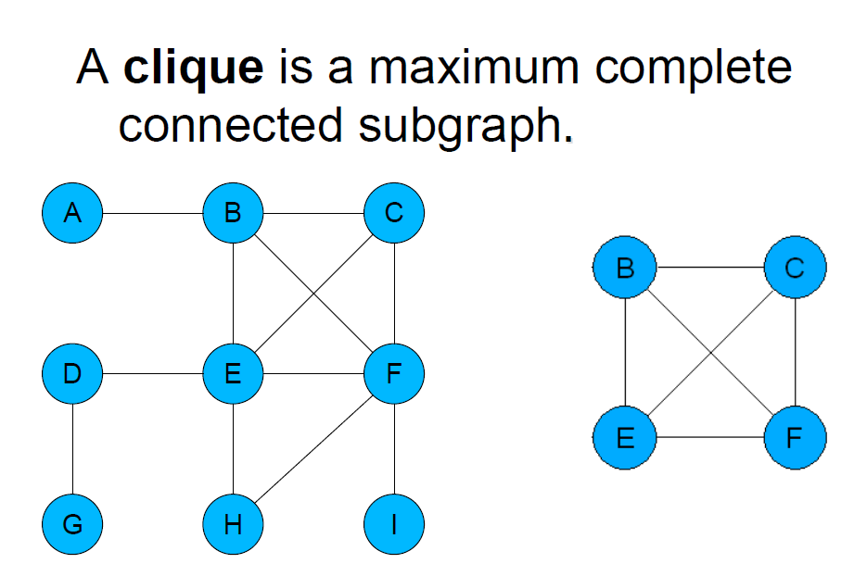
Cliques
Notes:
The Human Disease Network, whose nodes are diseases connected if they have common genetic origin.
K.-I. Goh, M. E. Cusick, D. Valle, B. Childs, M. Vidal, and A.-L. Barabasi.
The human disease network. PNAS, 104:8685–8690, 2007.

Slide 18
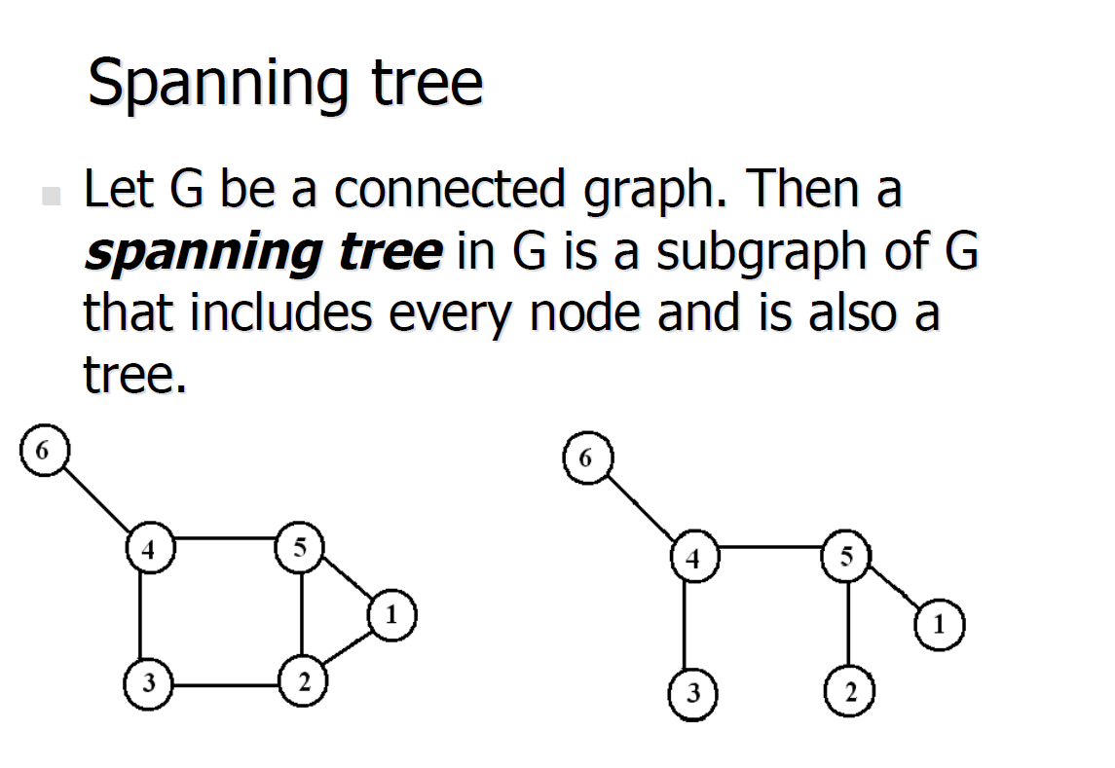
Spanning Tree
Notes:
The Human Disease Network, whose nodes are diseases connected if they have common genetic origin.
K.-I. Goh, M. E. Cusick, D. Valle, B. Childs, M. Vidal, and A.-L. Barabasi.
The human disease network. PNAS, 104:8685–8690, 2007.

