Slide 1

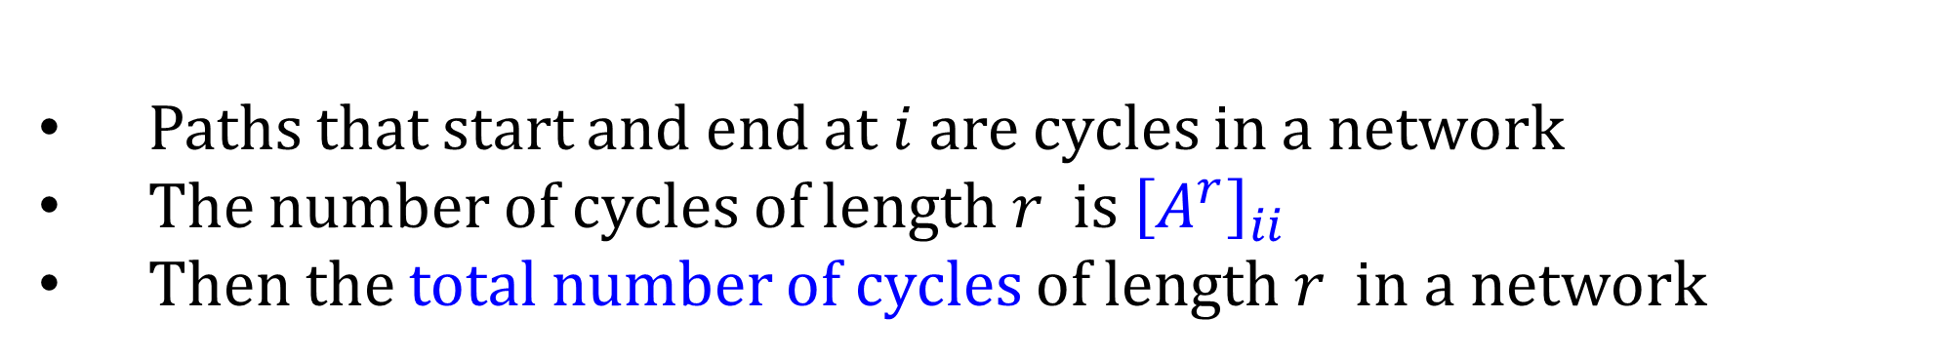
Cycles (Calculation of total number of cycles of length $r$)
Paths that start and end at $i$ are cycles in a network
The number of cycles of length $r$ is ${\left[A^{r}\right]}_{ii}$
Then the total number of cycles of length $r$ in a network

Slide 2


Cycles (Calculation of total number of cycles of length $r$)
Paths that start and end at $i$ are cycles in a network
The number of cycles of length $r$ is ${\left[A^{r}\right]}_{ii}$
Then the total number of cycles of length $r$ in a network
$$L_{r}=∑{\left[A^{r}\right]}_{ii}=Tr A^{r}$$
Tr is a trace of a matrix, the sum of elements of the main diagonal.

Slide 3
Trace can be in terms of the eigenvalues of the adjacency matrix
For undirected graphs the adjacency matrix is symmetric
The adjacency matrix has 𝑛 real eigenvalues
Denis Helic

Slide 4
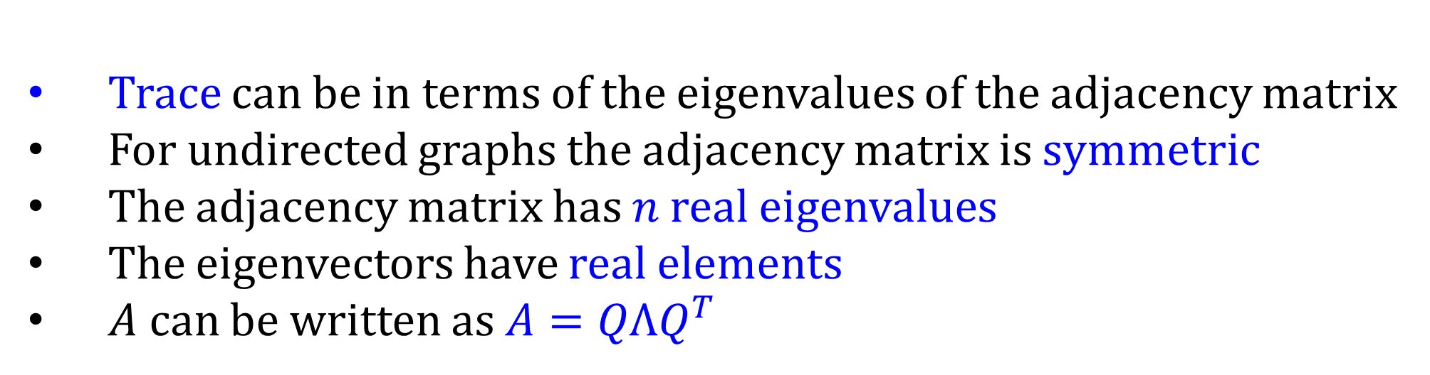
Trace can be in terms of the eigenvalues of the adjacency matrix
For undirected graphs the adjacency matrix is symmetric
The adjacency matrix has 𝑛 real eigenvalues
The eigenvectors have real elements
$A$ can be written as $A=QΛQ^{T}$
Denis Helic

Slide 5

Trace can be in terms of the eigenvalues of the adjacency matrix
For undirected graphs the adjacency matrix is symmetric
The adjacency matrix has 𝑛 real eigenvalues
The eigenvectors have real elements
$A$ can be written as $A=QΛQ^{T}$
Q is orthogonal matrix whose columns are the real, orthonormal
eigenvectors of $A$ . And $Λ$ is a diagonal matrix whose entries
are the eigenvalues of $A$
Denis Helic

Slide 6
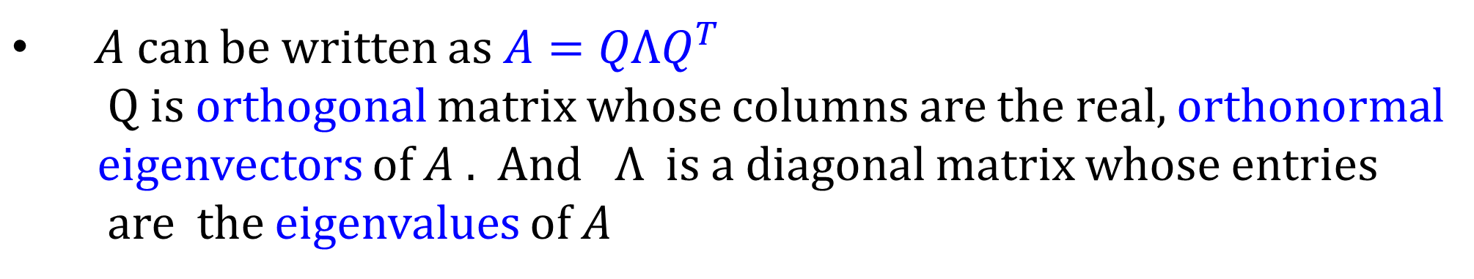

$A$ can be written as $A=QΛQ^{T}$
Q is orthogonal matrix whose columns are the real, orthonormal
eigenvectors of $A$ . And $Λ$ is a diagonal matrix whose entries
are the eigenvalues of $A$
$$A^{r}={\left(QΛQ^{T}\right)}^{r}=?$$
say r=2 : $A^{2}=QΛQ^{T}QΛQ^{T}=QΛ^{2}Q^{T}$
Denis Helic

Slide 7

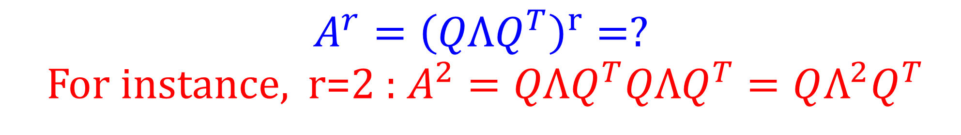
$A$ can be written as $A=QΛQ^{T}$
Q is orthogonal matrix whose columns are the real, orthonormal
eigenvectors of $A$ . And $Λ$ is a diagonal matrix whose entries
are the eigenvalues of $A$
$$A^{r}={\left(QΛQ^{T}\right)}^{r}=?$$
For instance, r=2 : $A^{2}=QΛQ^{T}QΛQ^{T}=QΛ^{2}Q^{T}$
$$A^{r}={QΛ^{r}Q^{T}}^{}$$
Denis Helic

Slide 8

Cycles (Calculation of total number of cycles of length $r$)
$$A^{r}={QΛ^{r}Q^{T}}^{}$$
The total number of cycles of length $r$ in a network
$L_{r}=∑{\left[A^{r}\right]}_{ii}=Tr\left(QΛ^{r}Q^{T}\right)=$ $Tr\left(QQ^{T}Λ^{r}\right)=\sum_{i}{λ_{i}^{r}}$
Denis Helic

Slide 9
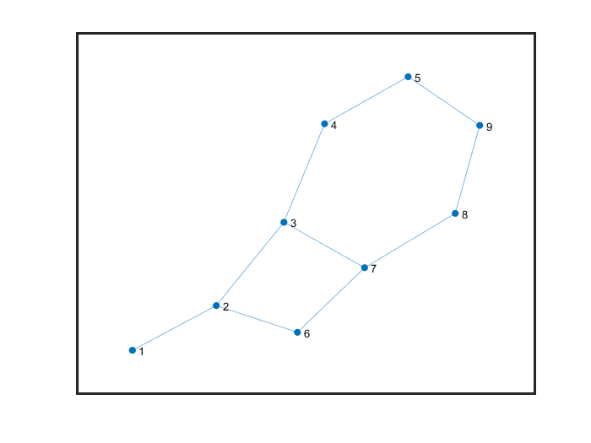
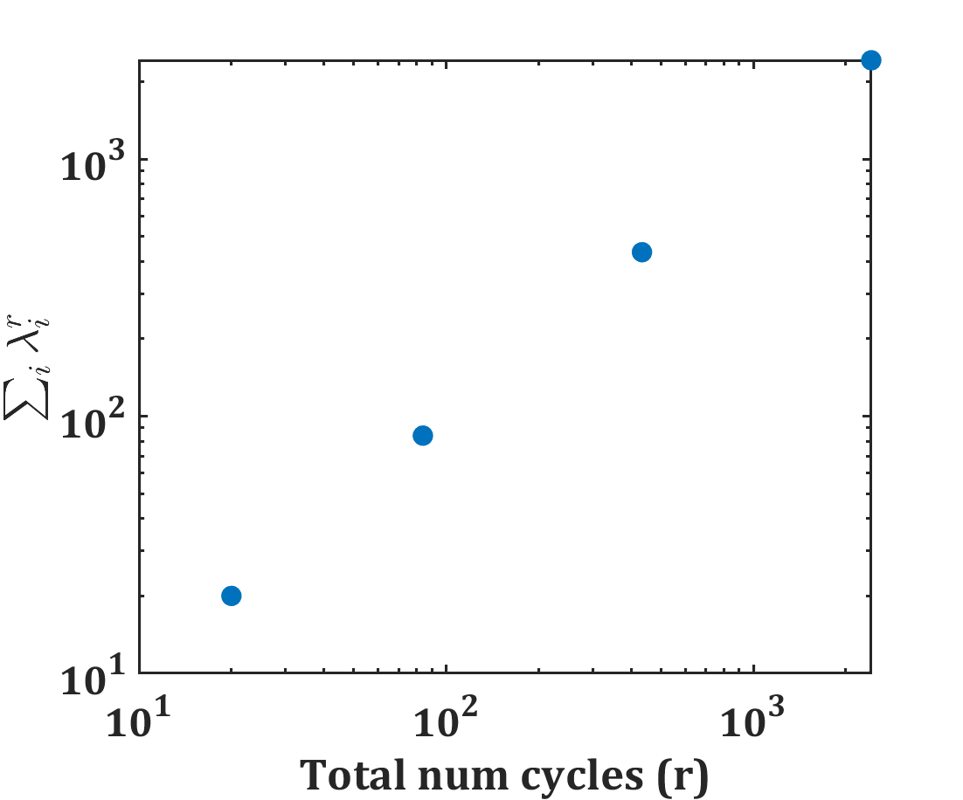
Cycles (Calculation of total number of cycles of length $r$)
$L_{r}=∑{\left[A^{r}\right]}_{ii}=Tr\left(QΛ^{r}Q^{T}\right)=$ $Tr\left(QQ^{T}Λ^{r}\right)=\sum_{i}{λ_{i}^{r}}$
Denis Helic

Slide 10
Advanced studies (First half)
Eigen value distribution of random graph
Largest eigenvalue of adjacency matrix

Slide 11


































Map of Eigenvalues for real 𝑛×𝑛 square matrices
P
Projection
$$\left[\begin{matrix}1 & 0 & 0 \\ 0 & −1 & 1 \\ 0 & −1 & −1\end{matrix}\right]$$
I
Identity
$$\left[\begin{matrix}1 & 0 & 0 \\ 0 & 1 & 0 \\ 0 & 0 & 0\end{matrix}\right]$$
$$\left[\begin{matrix}0 & 1 & 1 \\ 0 & 0 & 1 \\ 0 & 0 & 0\end{matrix}\right]$$
$$\left[\begin{matrix}z & 0 & 0 \\ 0 & z & 0 \\ 0 & 0 & z\end{matrix}\right]$$
O
Zero
$$\left[\begin{matrix}1 & 0 & 0 \\ 0 & 1 & 0 \\ 0 & 0 & 1\end{matrix}\right]$$
N
Nilpotent
zI
z times Identity
$$\left[\begin{matrix}0 & 0 & 0 \\ 0 & 0 & 0 \\ 0 & 0 & 0\end{matrix}\right]$$
Invertible
$$P=P^{2}=P^{T}$$
$$N^{k}=O$$
0
z
$$|A|≠0$$
0
1
0
1
0
0
$$∀λ=0$$
$$∀λ=1$$
$$∀λ=0 or 1$$
$$∀λ=0$$
$$∀λ=z$$
$$∀λ≠0$$
Markov
$$\left[\begin{matrix}0 & 0 & 1 \\ 1 & 0 & 0 \\ 0 & 1 & 0\end{matrix}\right]$$
$$\left[\begin{matrix}0 & 0.2 & 0.9 \\ 0.9 & 0 & 0.1 \\ 0.1 & 0.8 & 0\end{matrix}\right]$$
$$\left[\begin{matrix}0 & 0 & 0 \\ 0 & −1 & 1 \\ 0 & −1 & −1\end{matrix}\right]$$
$$\left[\begin{matrix}1 & 2 & 2 \\ 2 & 0 & 1 \\ 2 & 1 & 0\end{matrix}\right]$$
S₊
Positive definite
$$\left[\begin{matrix}0 & 1 & 0 \\ −1 & 0 & 1 \\ 0 & −1 & 0\end{matrix}\right]$$
Q
Orthogonal
S
Symmetric
$$\left[\begin{matrix}2 & 0 & 1 \\ 0 & 1 & 0 \\ 1 & 0 & 1\end{matrix}\right]$$
Anti-symmetric
$$S=S^{T}, x^{T}Sx>0 (∀x)$$
Singular
$$S=S^{T}$$
$$A={−A}^{T}$$
$$QQ^{T}=I$$
$$1^{T}A=1$$
$$\left|A\right|=0$$
0
0
1
1
0
$$∀λ∈ℝ$$
$$∀λ >0$$
$$∀λ∈iℝ$$
$$∀|λ|=1$$
$$∃λ=1,$$
$$other |λ|≤1$$
$$∃λ=0$$

Slide 12






$$\left[\begin{matrix}0 & 0 & 1 \\ 1 & 0 & 0 \\ 0 & 1 & 0\end{matrix}\right]$$
Ortho=[0 0 1; 1 0 0; 0 1 0];
l2=eig(A_ortho);
%% Large Orthogonal %%%
sigma=1;N=200;
AA=normrnd(0,sigma,N);
[Q R]=qr(AA);
EIg_ortho=(eig(Q));
plot(real(EIg_ortho), imag(EIg_ortho),'o');
figure; plot(abs(EIg_ortho));
Q
Orthogonal
$$QQ^{T}=I$$
1
$$∀|λ|=1$$
$$\left[\begin{matrix}1 & 2 & 2 \\ 2 & 0 & 1 \\ 2 & 1 & 0\end{matrix}\right]$$
S
Symmetric
$$S=S^{T}$$
$$∀λ∈ℝ$$
sigma=1;N=2000;
B_May=normrnd(0,sigma,N);
B_May = B_May/max(abs(eigs(B_May)));
Jac_M_May=triu(B_May);
% % Jac_M_May(1:length(B_May)+1:end)=0;
% % % %eigen_all_M=eig(Jac_M_L);
B_May_symm= Jac_M_May+Jac_M_May'; %%% Symmetric matrix
histogram((eigen_all_M),20);

Slide 13
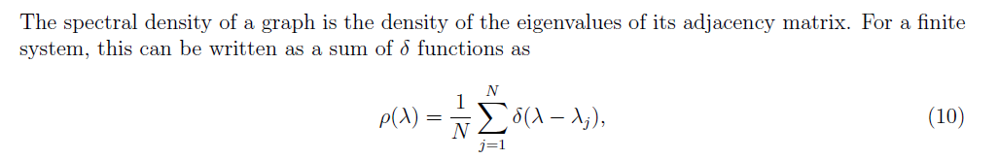

Spectral Density
Spectral properties of complex networks, Camellia Sarkar1 & Sarika Jalan;

Slide 14
Spectral Density
Spectral properties of complex networks, Camellia Sarkar1 & Sarika Jalan;

Slide 15
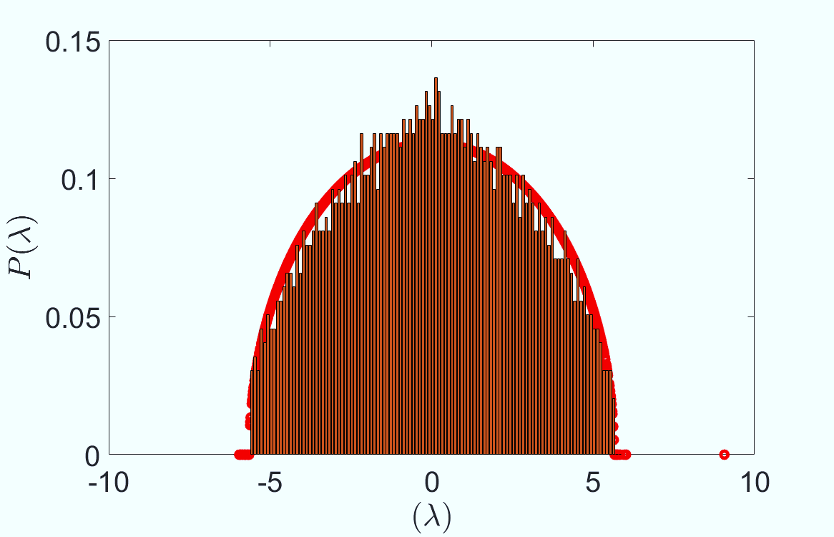
Spectral Density
N=3000, p=0.002, Binary, Symmetric
Spectral properties of complex networks, Camellia Sarkar1 & Sarika Jalan;

Slide 16
Spectral Density
Spectral properties of complex networks, Camellia Sarkar1 & Sarika Jalan;

Slide 17
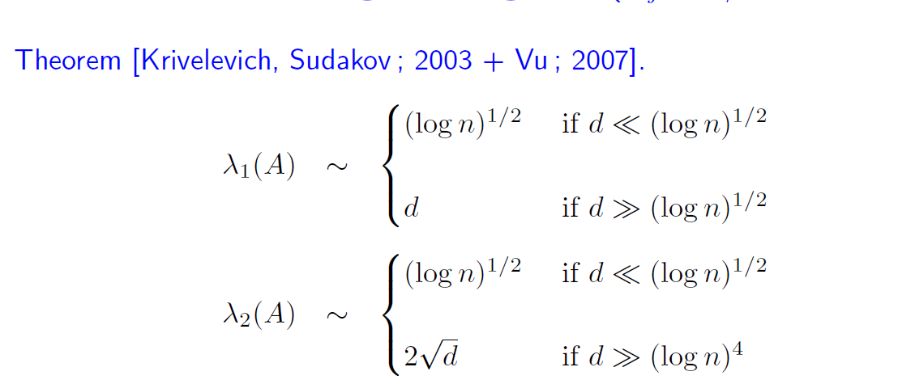


Spectral Density of a random graph
$$p=\frac{d}{n}$$
Mean(degree) ~d
Spectral properties of complex networks, Camellia Sarkar1 & Sarika Jalan;

Slide 18
Map of Eigenvalues for real 𝑛×𝑛 square matrices

Slide 19
Map of Eigenvalues for real 𝑛×𝑛 square matrices
40 years of Robert May, Stefano ALesina

Slide 20
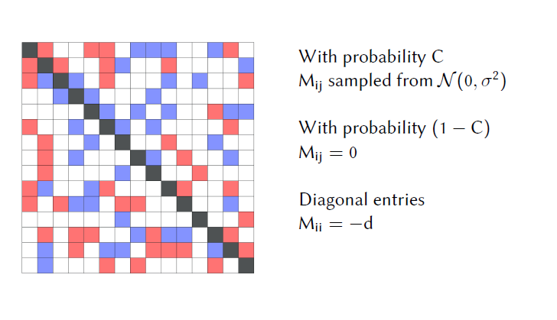
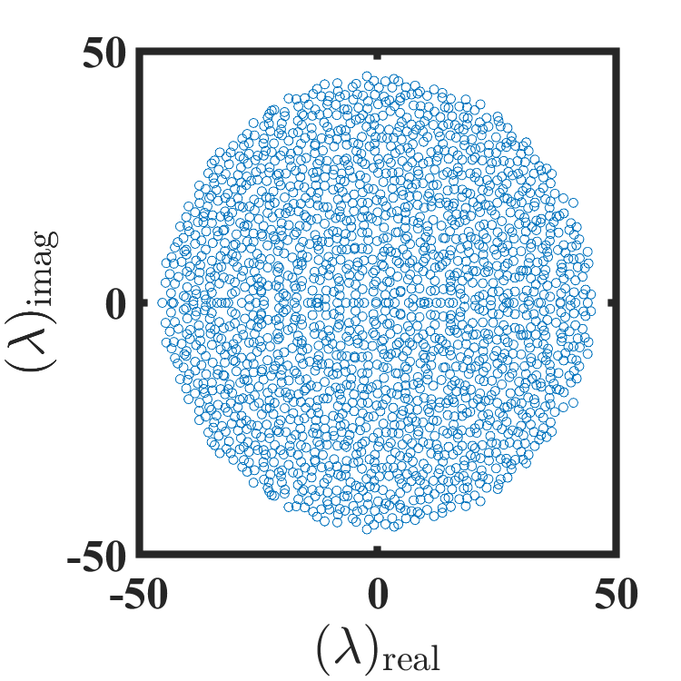

Slide 21
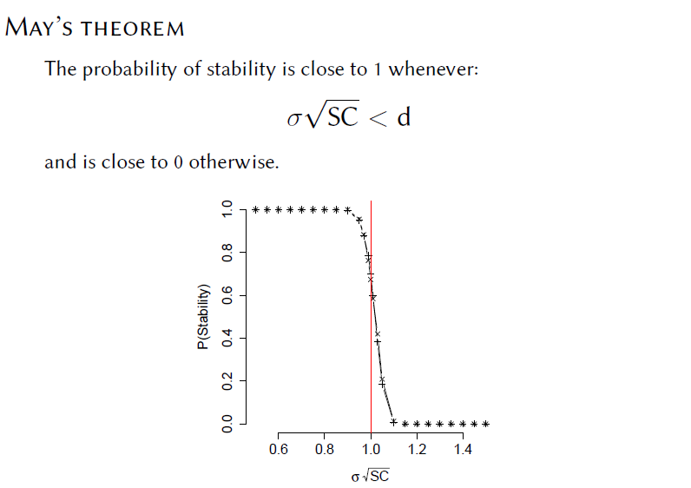
Random
Following the circular law
Allesina,Tang, Nature 2012

Slide 22
Spectral Density/Eigenvalue Distribution
What will happen (eigenvalue distribution) if the elements are randomly drawn from Gaussian distribution?
(Robert May-Nature, Stefano Alesina-Nature 2012)
What will happen (eigenvalue distribution) if the elements are correlated?
(Stefano Alesina-Nature 2012, Somplonsky-PRL)
What will happen if the underlying matrix is sparse: a diluted graph with known degree distribution?
(Note: If the degree distribution is Poisson/Binomial, it can capture the notion of May/Alesina work: Next slide.)
State of the art: Given:
Degree distribution, Underlying connectivity, BUT elements are not random rather coming from particular distributions.
What will be the eigen value distribution? How the distribution parameters control the largest eigen value?

Slide 23
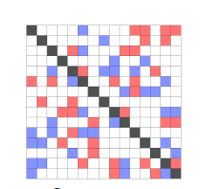
Predator-prey
Stability Condition
Mixture of competition and mutualism
Stability Condition
Allesina,Tang, Nature 2012

Slide 24
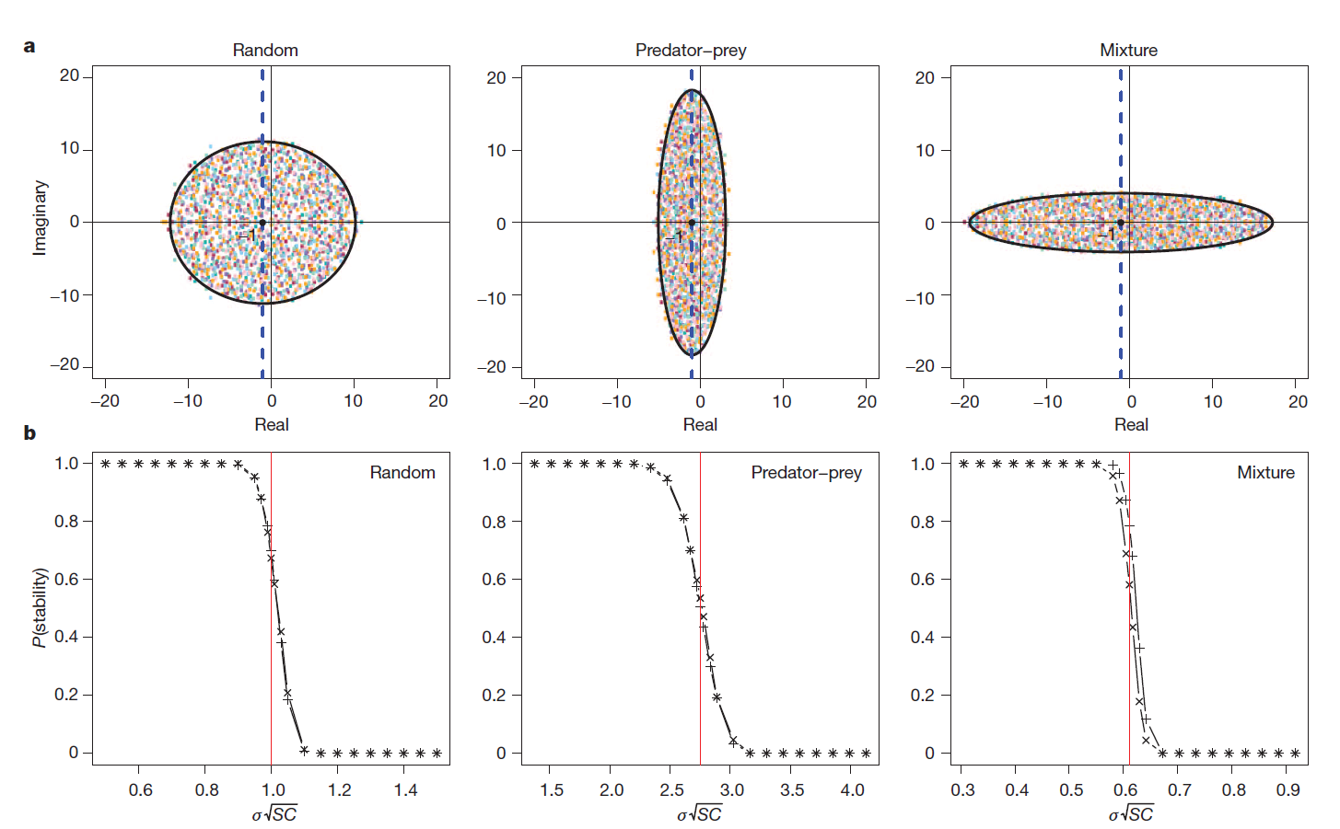
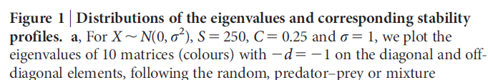
Allesina,Tang, Nature 2012

Slide 25
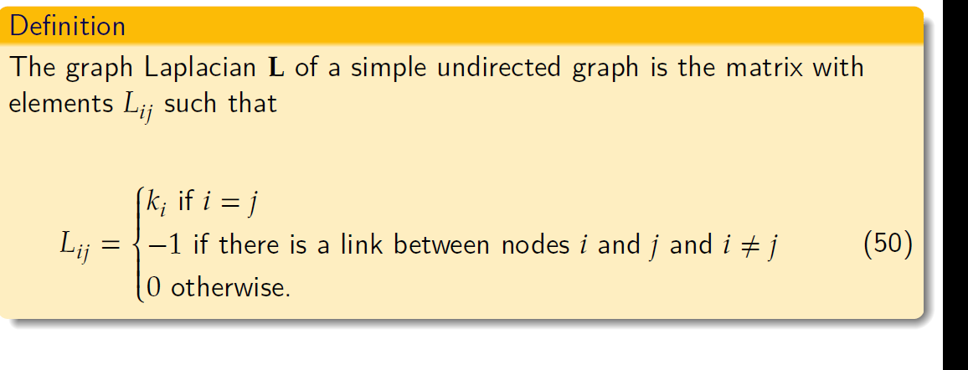
Graph Laplacian

Slide 26
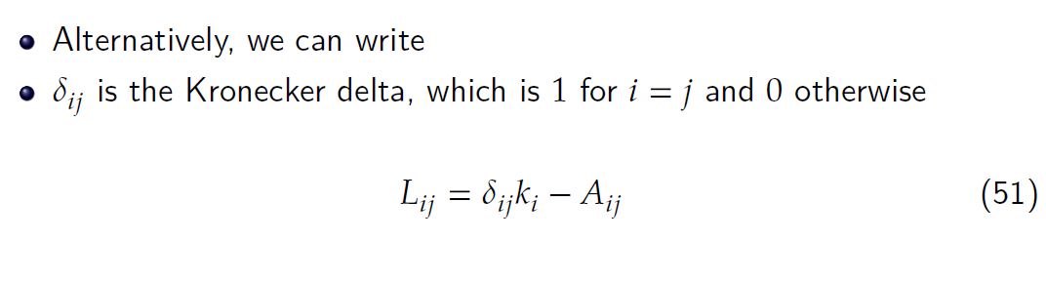
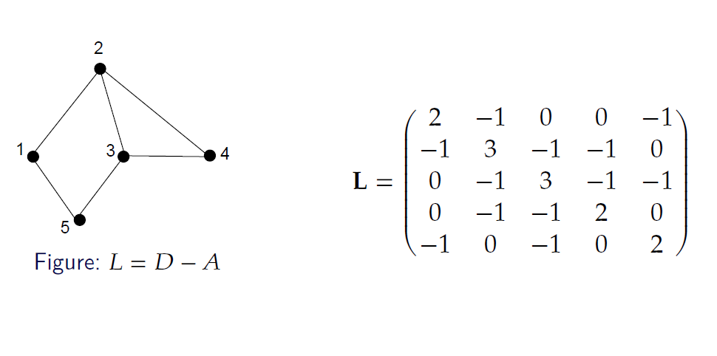
Graph Laplacian

Slide 27
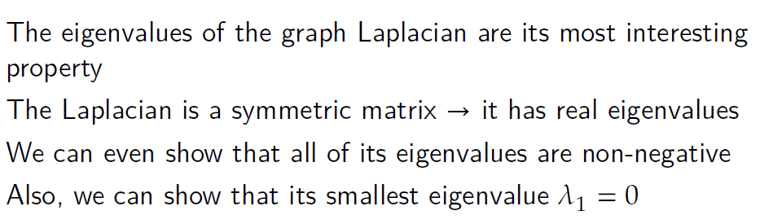
Graph Laplacian

Slide 28
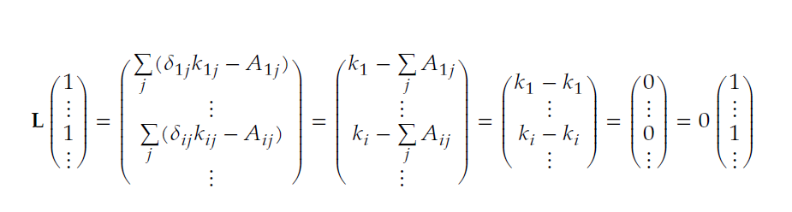
Graph Laplacian

Slide 29
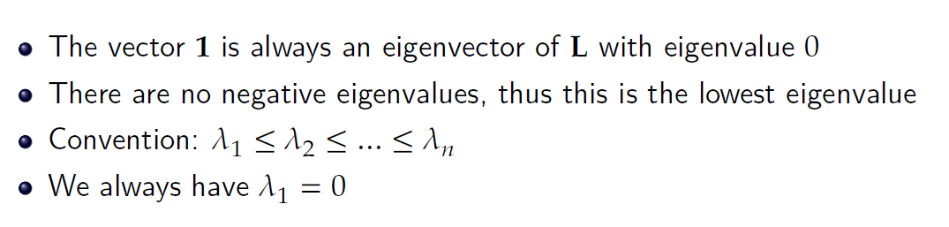
Graph Laplacian

Slide 30
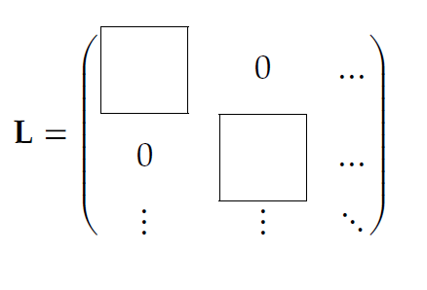
Connected Components and the algebraic connectivity
Suppose we have a network with $c$different components
The components have sizes $n_{1}, n_{2}, … , n_{c}$

Slide 31
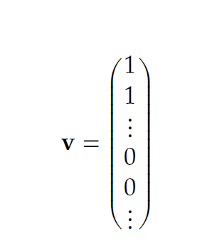
Connected Components and the algebraic connectivity
Suppose we have a network with $c$different components
The components have sizes $n_{1}, n_{2}, … , n_{c}$

Slide 32
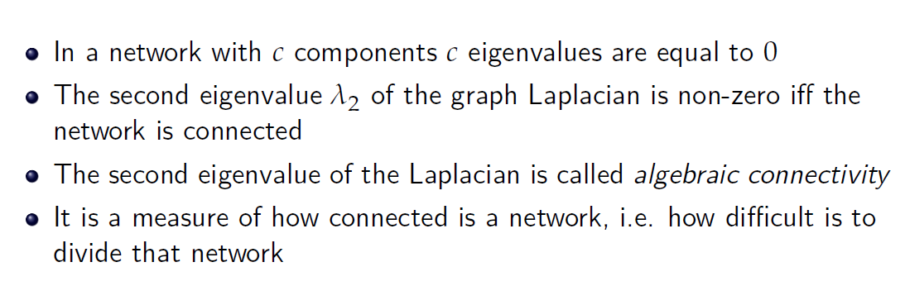
Connected Components and the algebraic connectivity

