Slide 1
Real-time Chat App Utilizing TCP Connection for Seamless Communication
Presented by:
Abhijeet Rishoo(2104002)
Baibhav Kumar Sahoo(2104013)
Jahnavi Paul(2104024)
Nikkon Sengupta(2104030)

Slide 2

INTRODUCTION
The Real-time Chat App allows instant communication between users over a TCP connection. This presentation explores the beneﬁts and challenges of implementing real-time chat and the signiﬁcance of TCP in ensuring seamless communication.

Slide 3

TCP CONNECTION
Transmission Control Protocol (TCP) provides reliable, ordered, and error-checked delivery of a stream of bytes. It ensures data integrity and is ideal for real- time chat applications that require stable connections for continuous communication.

Slide 4
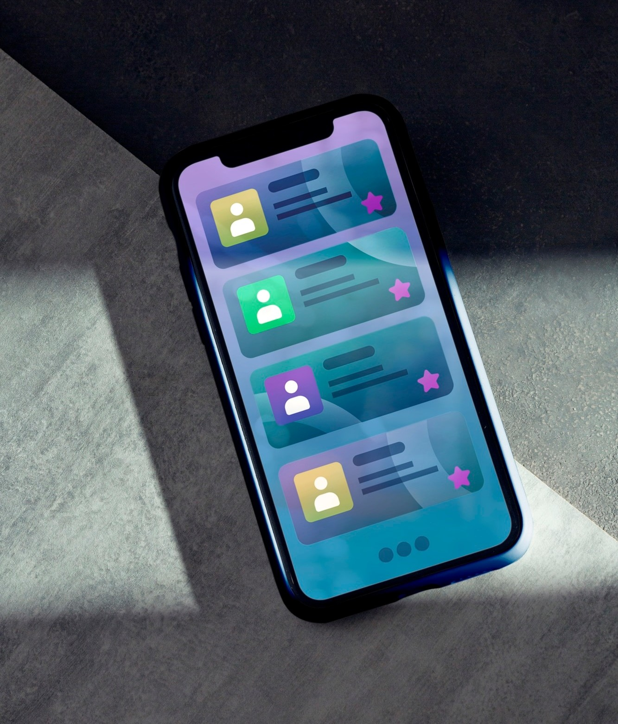
REAL-TIME CHAT APP
The Real-time Chat App enables users to exchange messages instantly, creating a dynamic communication environment. It fosters immediate interaction and enhances user engagement through seamless communication.

Slide 5

BENEFITS OF SEAMLESS COMMUNICATION
Seamless communication in real-time chat apps leads to enhanced collaboration, faster
decision-making, and improved user experience. It promotes efﬁciency and real-time problem-solving.

Slide 6

CHALLENGES OF REAL- TIME CHAT
Implementing real-time chat apps requires addressing challenges such as scalability, security, and latency.
Overcoming these challenges is crucial for ensuring reliable communication and data privacy.

Slide 7
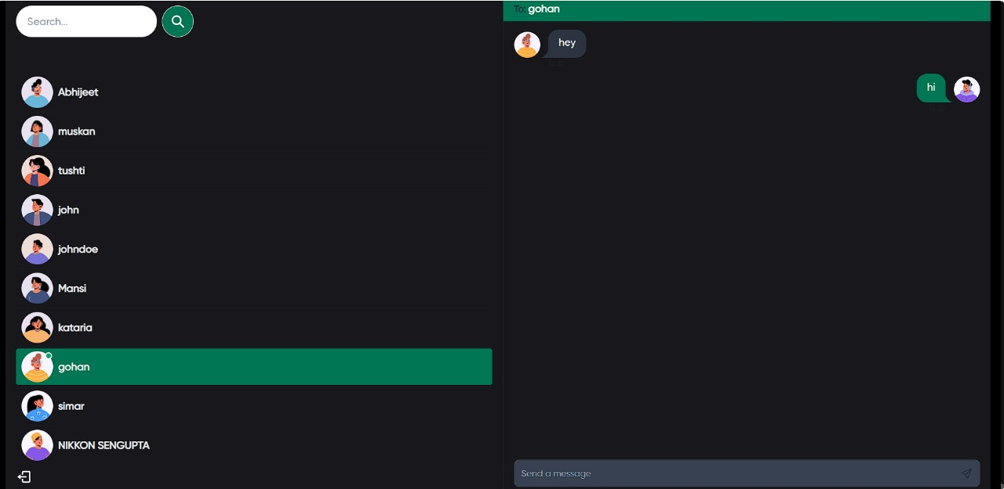
OUR APP INTERFACE

Slide 8

TCP for Reliability
TCP's reliability ensures that all data is delivered accurately and in the correct order. This is essential for real-time chat apps to maintain message integrity and provide a seamless user experience.

Slide 9
CONCLUSION
Real-time chat apps using TCP connections offer a platform for instantaneous communication. By leveraging the beneﬁts of TCP and addressing the associated challenges, these apps can provide seamless and secure communication for users.

Slide 10
Thank You

