Slide 1

Why do AI/ML professionals earn more?
Stack Overflow Developer Survey (2020-2024)
ABHIROOP KUMAR

Slide 2

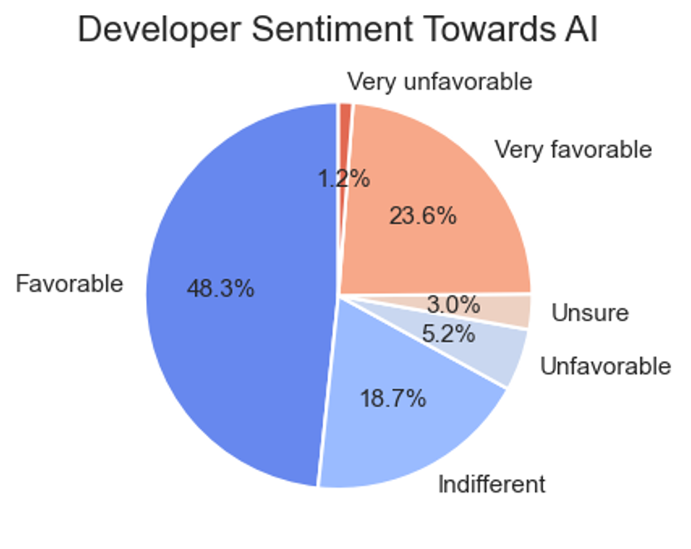
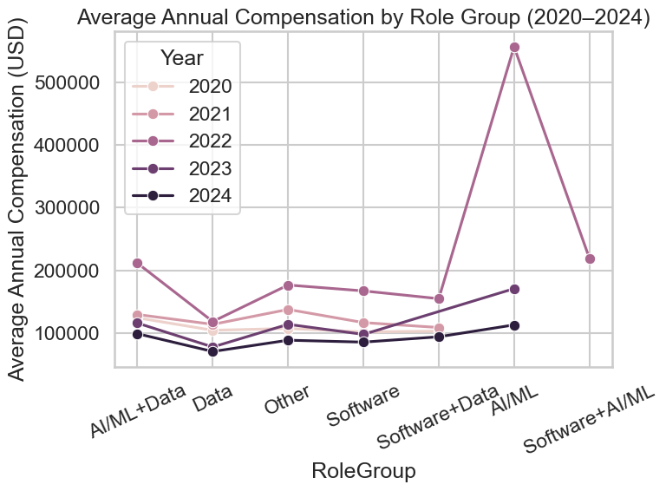
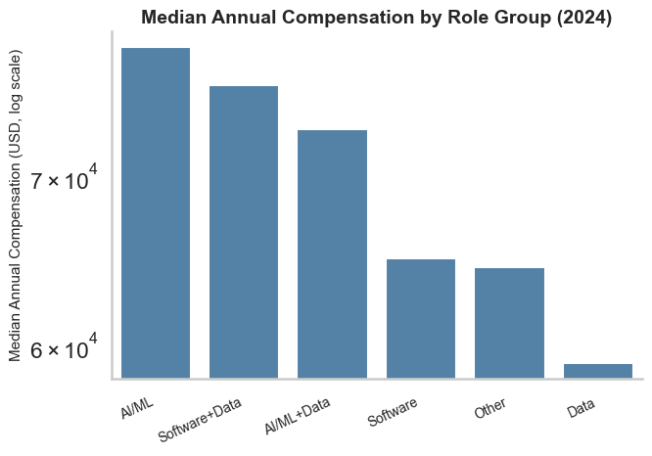
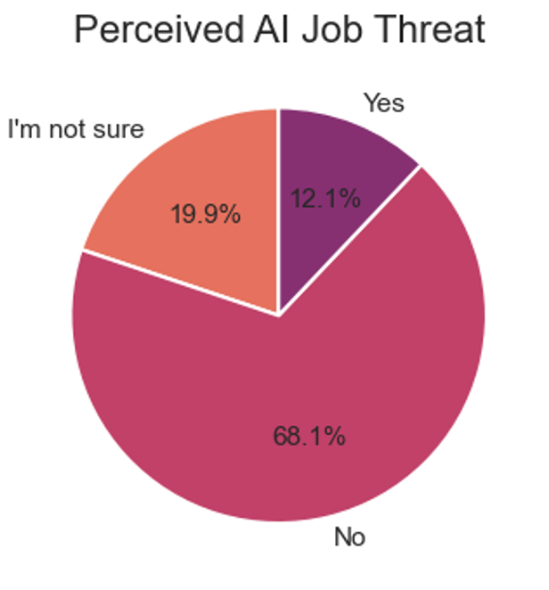
AI/ML Professionals on Average Earn the Most – But Why?
AI roles consistently lead in pay
Pay Rises with Experience & Scale
AI threat perception is minor
Positive AI sentiment alignment

Slide 3
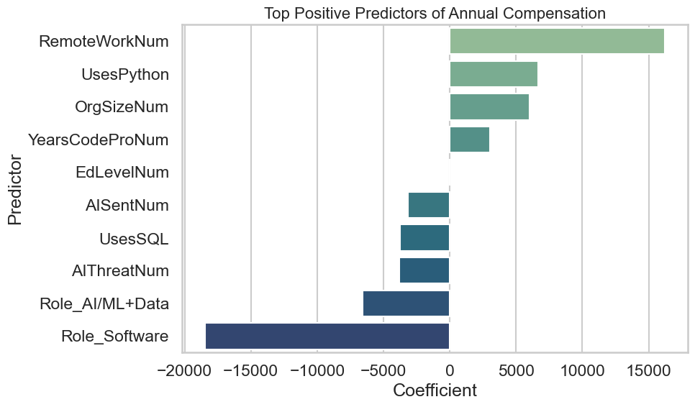
Data Deep Dive
Dataset & Variables
  Sample: ~65,000 respondents in 2024 dataset
  Dependent Variable: AnnualComp
  Predictors: YearsCodeProNum, OrgSizeNum, AISentNum, AIThreatNum, RoleGroup,...
Workflow
  Imported & cleaned data from 2020–2024
  Created “AnnualComp” normalized for USD
  Defined “RoleGroup” for Software, Data, AI/ML, and hybrid roles
  Encoded AI Sentiment and AI Threat variables
  Built an MLR model to identify key pay drivers
Significant Predictors
  Positive: RemoteWorkNum, UsesPython, OrgSizeNum, YearsCodeProNum
  Negative: AIThreatNum, AISentNum
Model Performance
Only around 25% of the variation in developer salaries could be explained by the model, with an average prediction difference of roughly ±$39K as compared to the actual salary.
Conclusion
Pay gaps stem from experience, company size, and AI engagement. Professionals who embrace AI and Python earn more, while those who fear it fall behind.

