Slide 1

Small Businesses Loan Default
Prediction
Mrunal Dalvi, Abhiroop Kumar, Emily Lagnese, Keerti Rawat

Slide 2

O
V
E
R
V
I
E
W
Problem Description
1
Problem Importance
2
Exploratory Analysis
3
Solution & Actionables
4

Slide 3

the Big pROBLEM.

Slide 4
Can we predict which loans will default?

Slide 5


7(a):
Purchasing/starting a business, getting working capital, purchasing real estate
Max loan size of $5 million
Average revenue less than $7.5 million
SBA Loan Programs
504:
Purchasing existing building, heavy machinery/equipment, expansion of building
Max loan size of $30 million
Average net profit under $6.5 million
Notes:
Explain dataset here

Slide 6
SBA 7(a) and 504 loans from 2020-Present
Data such as:
Borrower and lender information
Approval amounts
Business type and age
Number of jobs supported from loan
Dataset

Slide 7

Why You Should Care

Slide 8
59%
of small businesses applied for a loan in 2023
(Federal Reserve Banks, 2024)

Slide 9
Impact
Fostering Small Business Growth
Lending Strategy Improvement
Risk Mitigation

Slide 10

Let's Stare at Some Graphs!

Slide 11

Data Preprocessing
Dataset merging and column standardization
Created Loan Success response variable
Eliminated columns with >70% missing values
Replaced missing values
Excluded unwanted features
Moving to Graphs… ➡️➡️➡️
Notes:
Should we include?

Slide 12
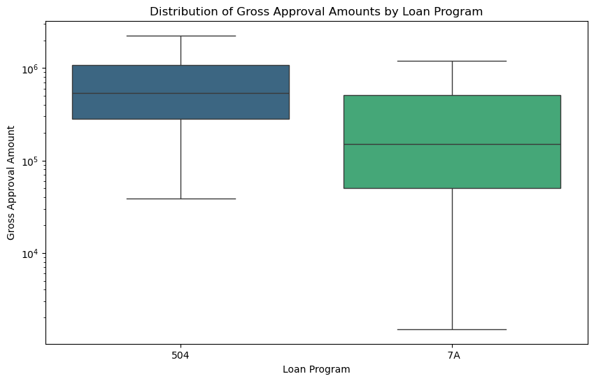

Slide 13
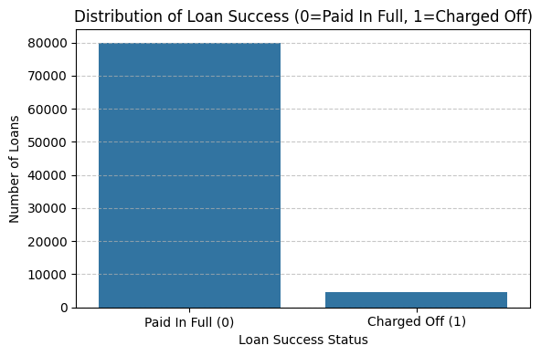

Slide 14
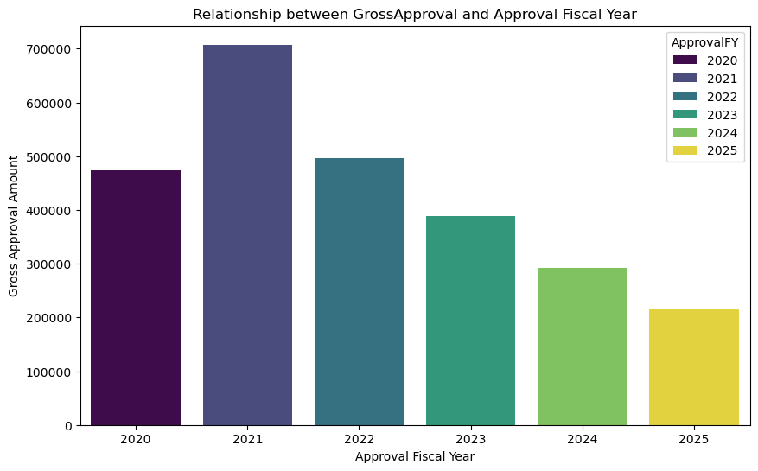

Slide 15
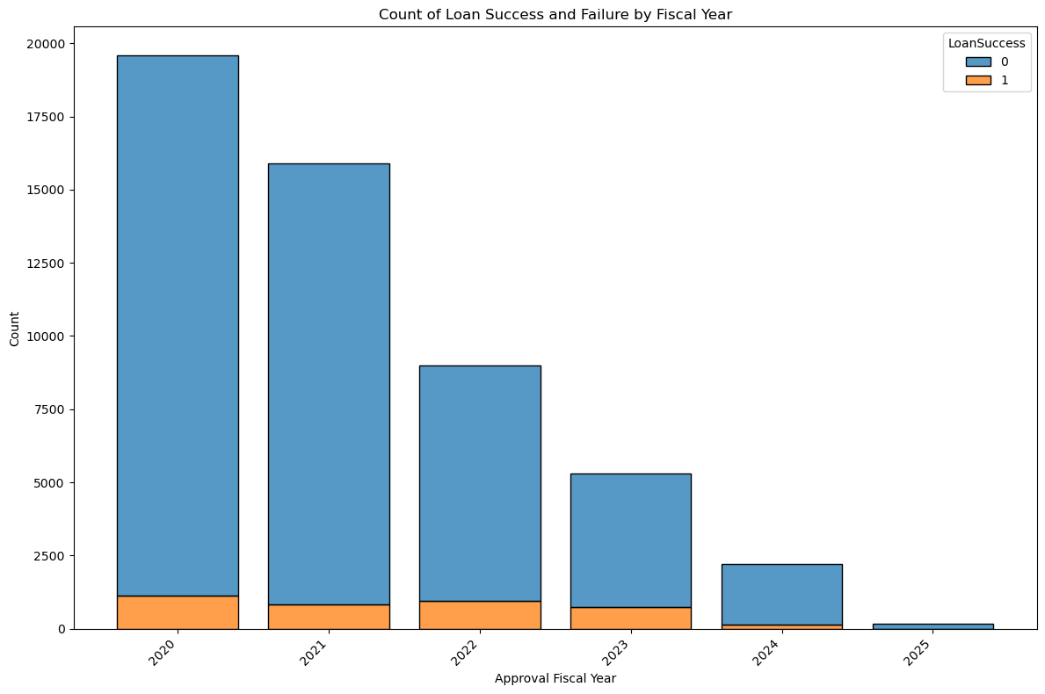

Slide 16
Making Stuff Up!
1. SBA Guarantee Ratio
SBAGuaranteedApproval / GrossApproval
2. Loan Term Burden Ratio
GrossApproval / TerminMonths
3. Jobs Impact Efficiency Ratio
GrossApproval / JobsSupported

Slide 17
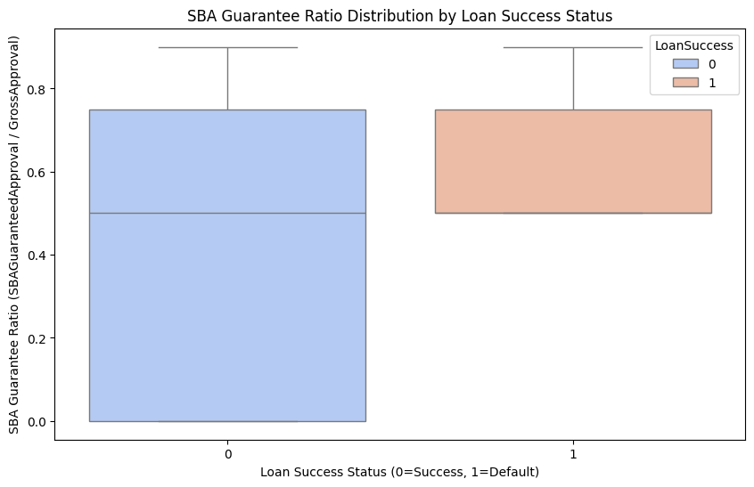

Slide 18
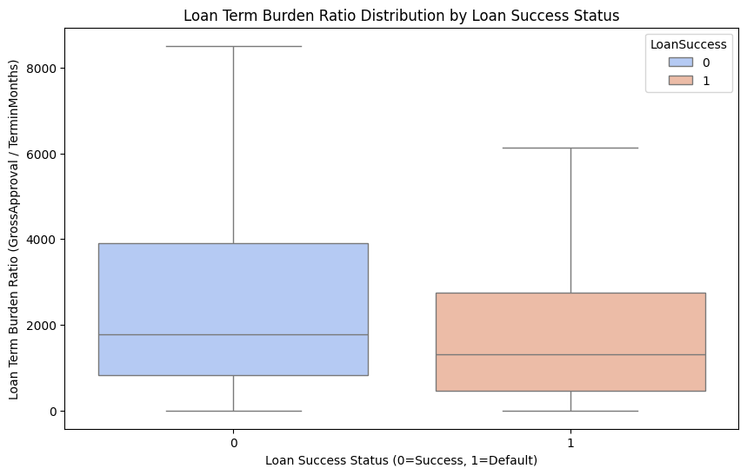

Slide 19
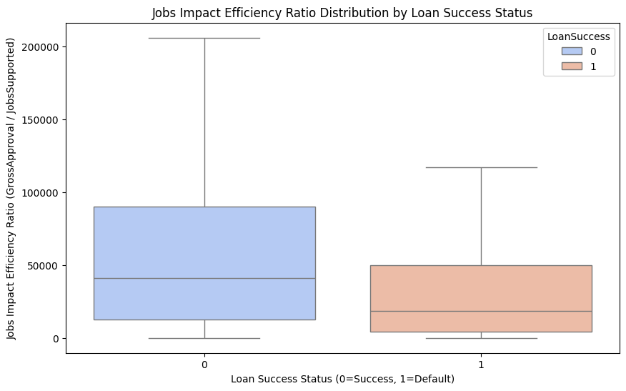

Slide 20
What is one hot encoding?
Convert categorical data into numerical format
Columns are expressed as binary values (0 & 1)
Stops models from ranking categories

Slide 21

Solution(s?)

Slide 22
Models
Logistic Regression
Random Forest
XGBoost

Slide 23
Imbalanced data biases model predictions
Improves minority class detection
Leads to more robust, reliable models
Tackling Class Imbalance

Slide 24
Key Metrics
(with weights) | Logistic Regression | Random Forest | XGBoost
Accuracy | 47.84% | 96.65% | 97.10%
Precision | 10.37% | 92.18% | 97.43%
Class weightage increases minority prediction capability of the models
[In this case, ‘Loan Default’]

Slide 25
Confusion Matrix
XGBoost | Predicted Negative | Predicted Positive
Actual Negative | 9602 (TN) | 74 (FP)
Actual Positive | 172 (FN) | 588 (TP)
without weights
True Negative (TN): Correctly predicted non-defaults
False Positive (FP): Incorrectly predicted defaults
False Negative (FN): Incorrectly predicted non-defaults
True Positive (TP): Correctly predicted defaults
➡️
XGBoost | Predicted Negative | Predicted Positive
Actual Negative | 9451 (TN) | 225 (FP)
Actual Positive | 78 (FN) | 682 (TP)
➡️
with weights

Slide 26

Our "plan."

Slide 27
The Story so far…
Can we predict which loans will default?
SBA 7(a) & 504 Loan Lending Portfolio Dataset
Data Standardization & Feature Exclusion
Exploratory Data Analysis + One-hot Encoding
Model Predictions ➡️ Key Metrics Visualization
What’s next?

Slide 28

Practical Implications

Slide 29
Enhanced Risk Assessment
Targeted Lending
Early Warning System
Policy Refinement

Slide 30
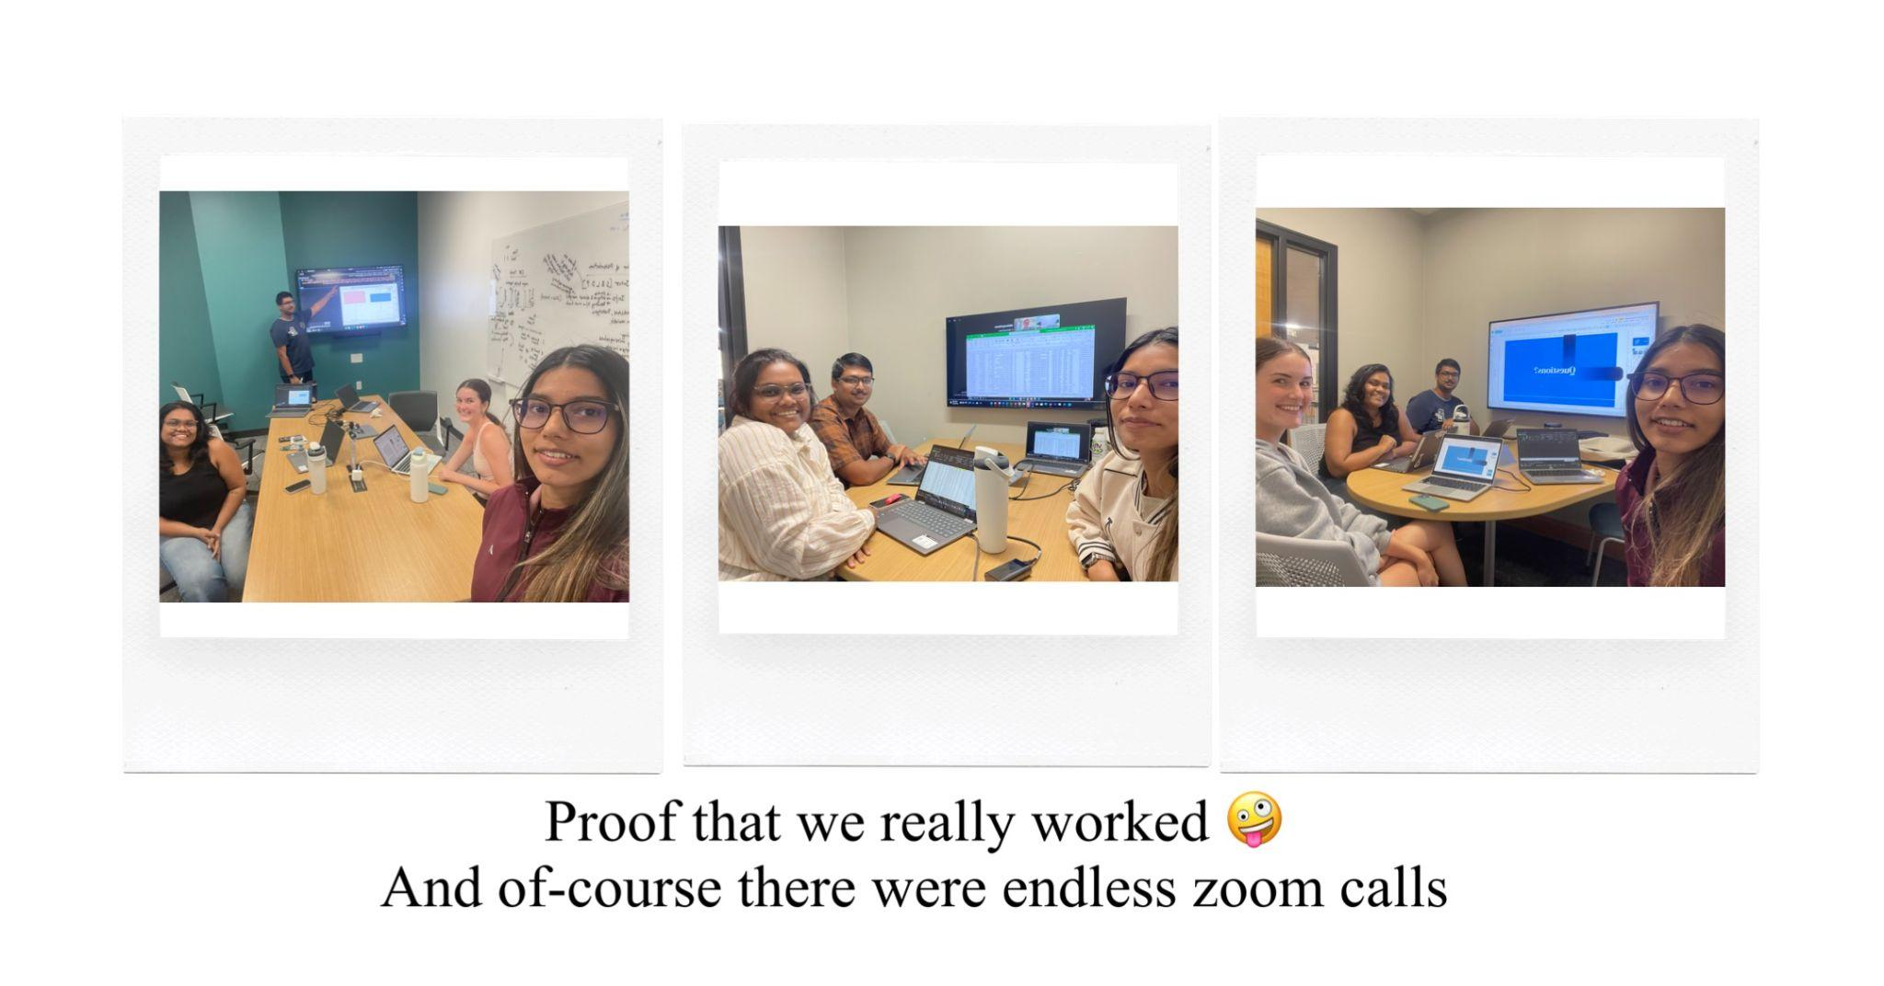

Slide 31
Questions?
PS: Please, no hard ones.

