Slide 1
Scaling in Anderson Model
EPQM
dd/mm/yy

Slide 2
Single Impurity Anderson Model
Conduction band
Impurity site
Hybridisation

Slide 3
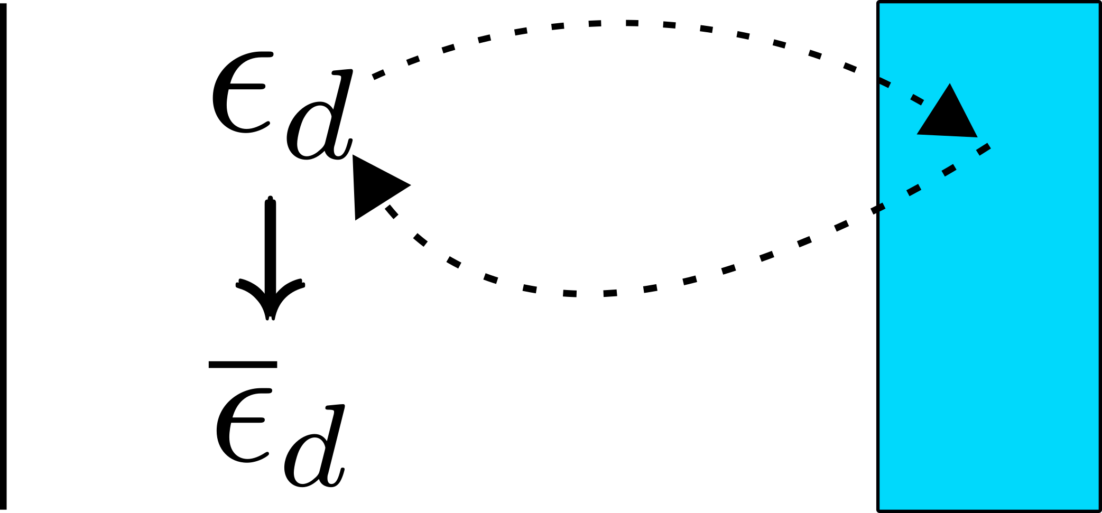
Scaling Procedure
Reduce bandwidth:
Virtual excitations to modify couplings

Slide 4
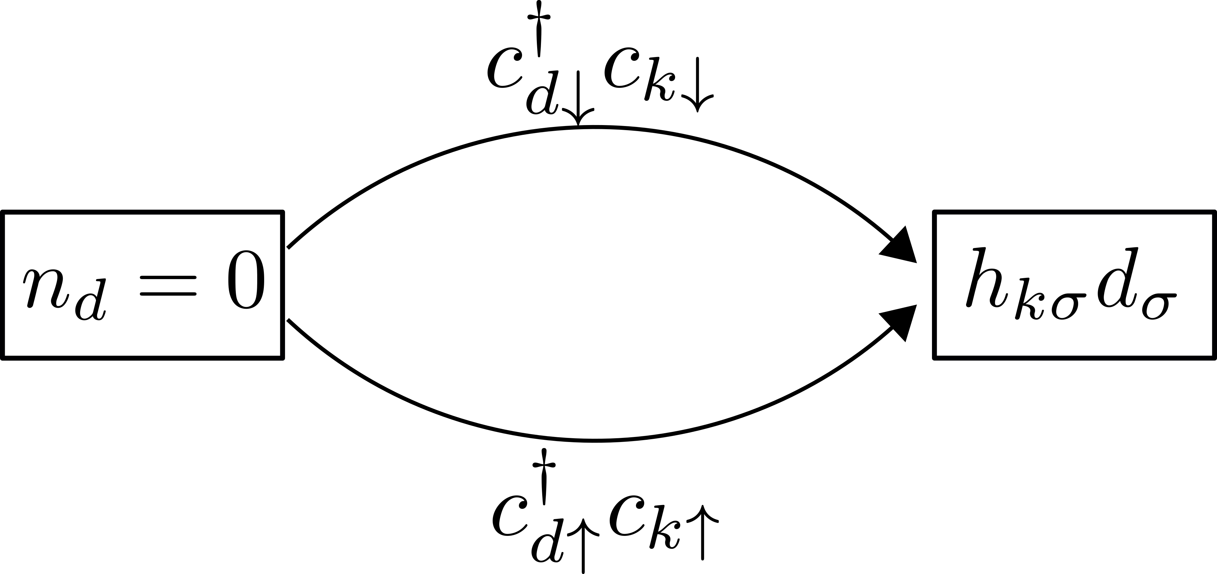
Scaling of

Slide 5
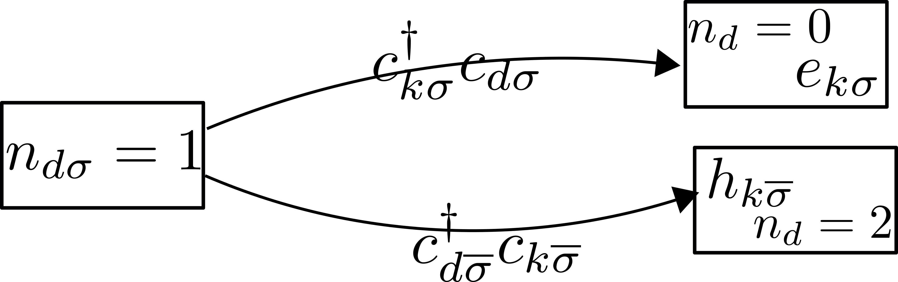
Scaling of

Slide 6
Scaling of
No scaling if both levels are either far inside or far outside
Assuming
depends on the
initial conditions
( starting values of
and )

Slide 7
Scaling of
Assumed was constant!
From higher order virtual scatterings
No renormalisation in
for

Slide 8
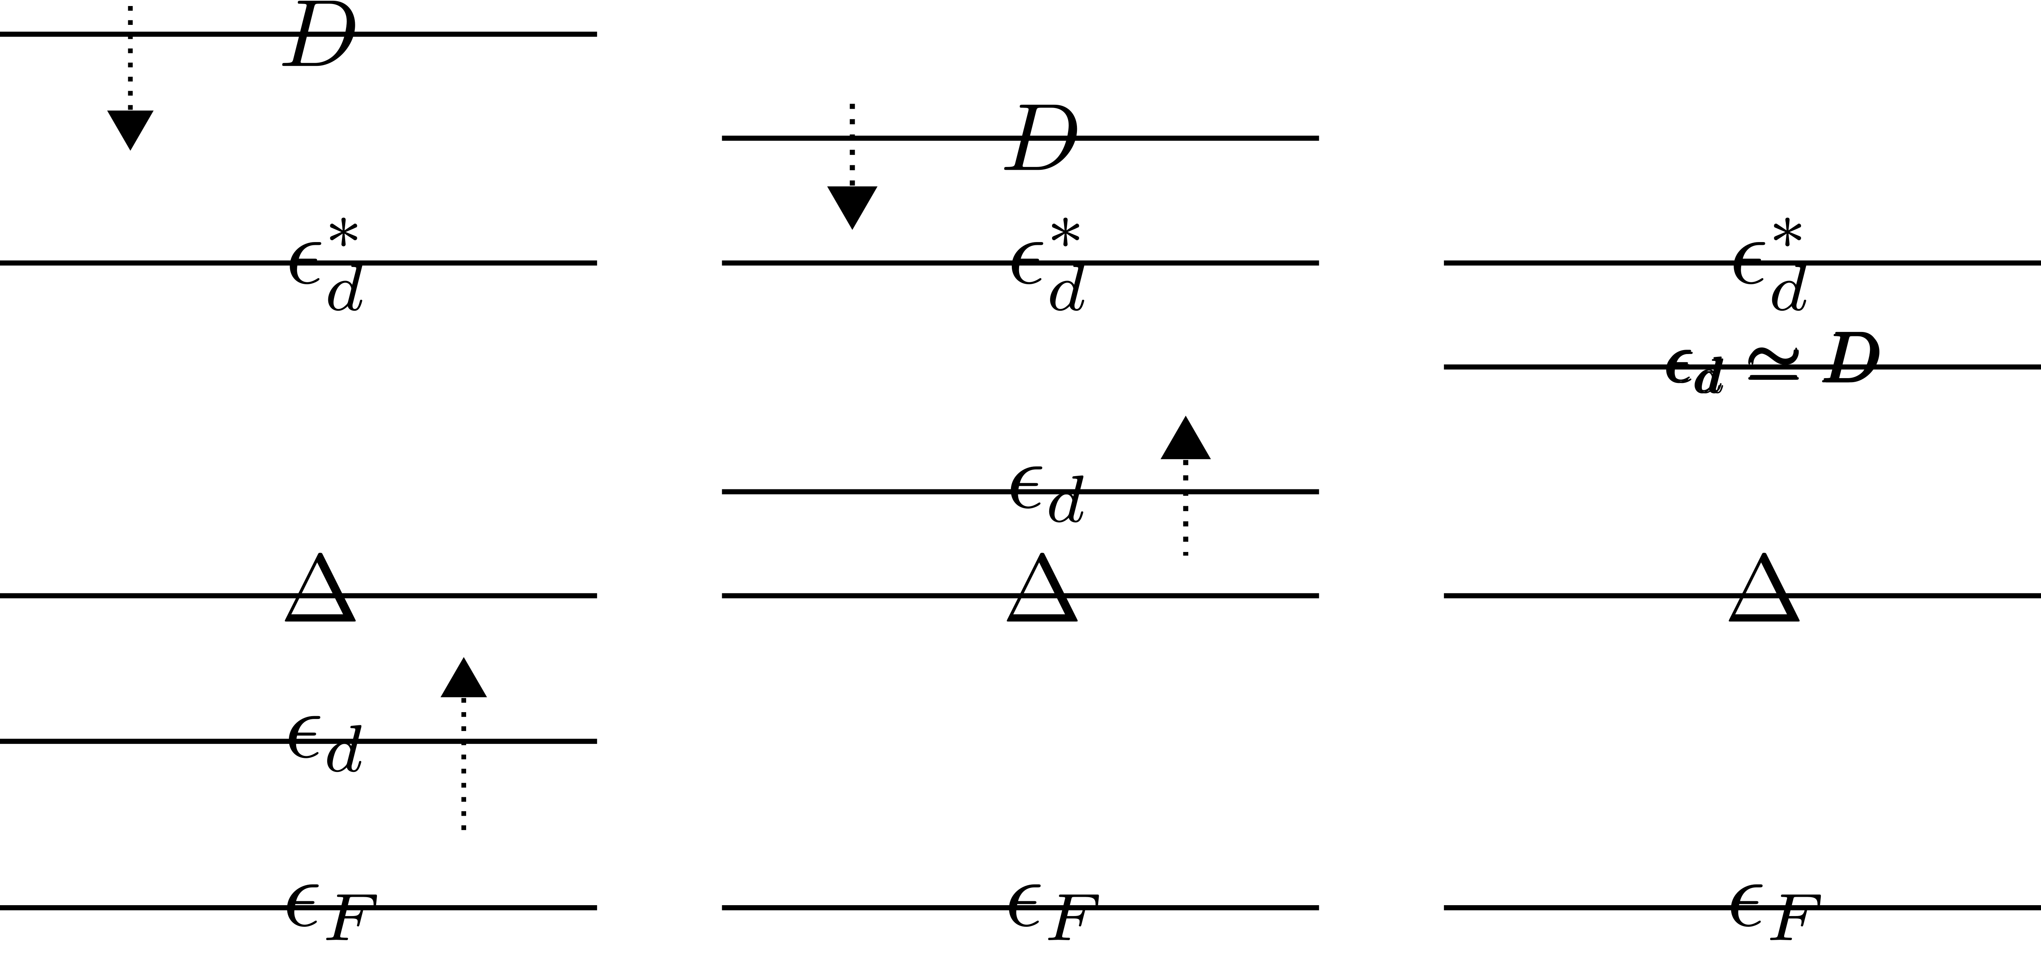



Scaling in

Slide 9
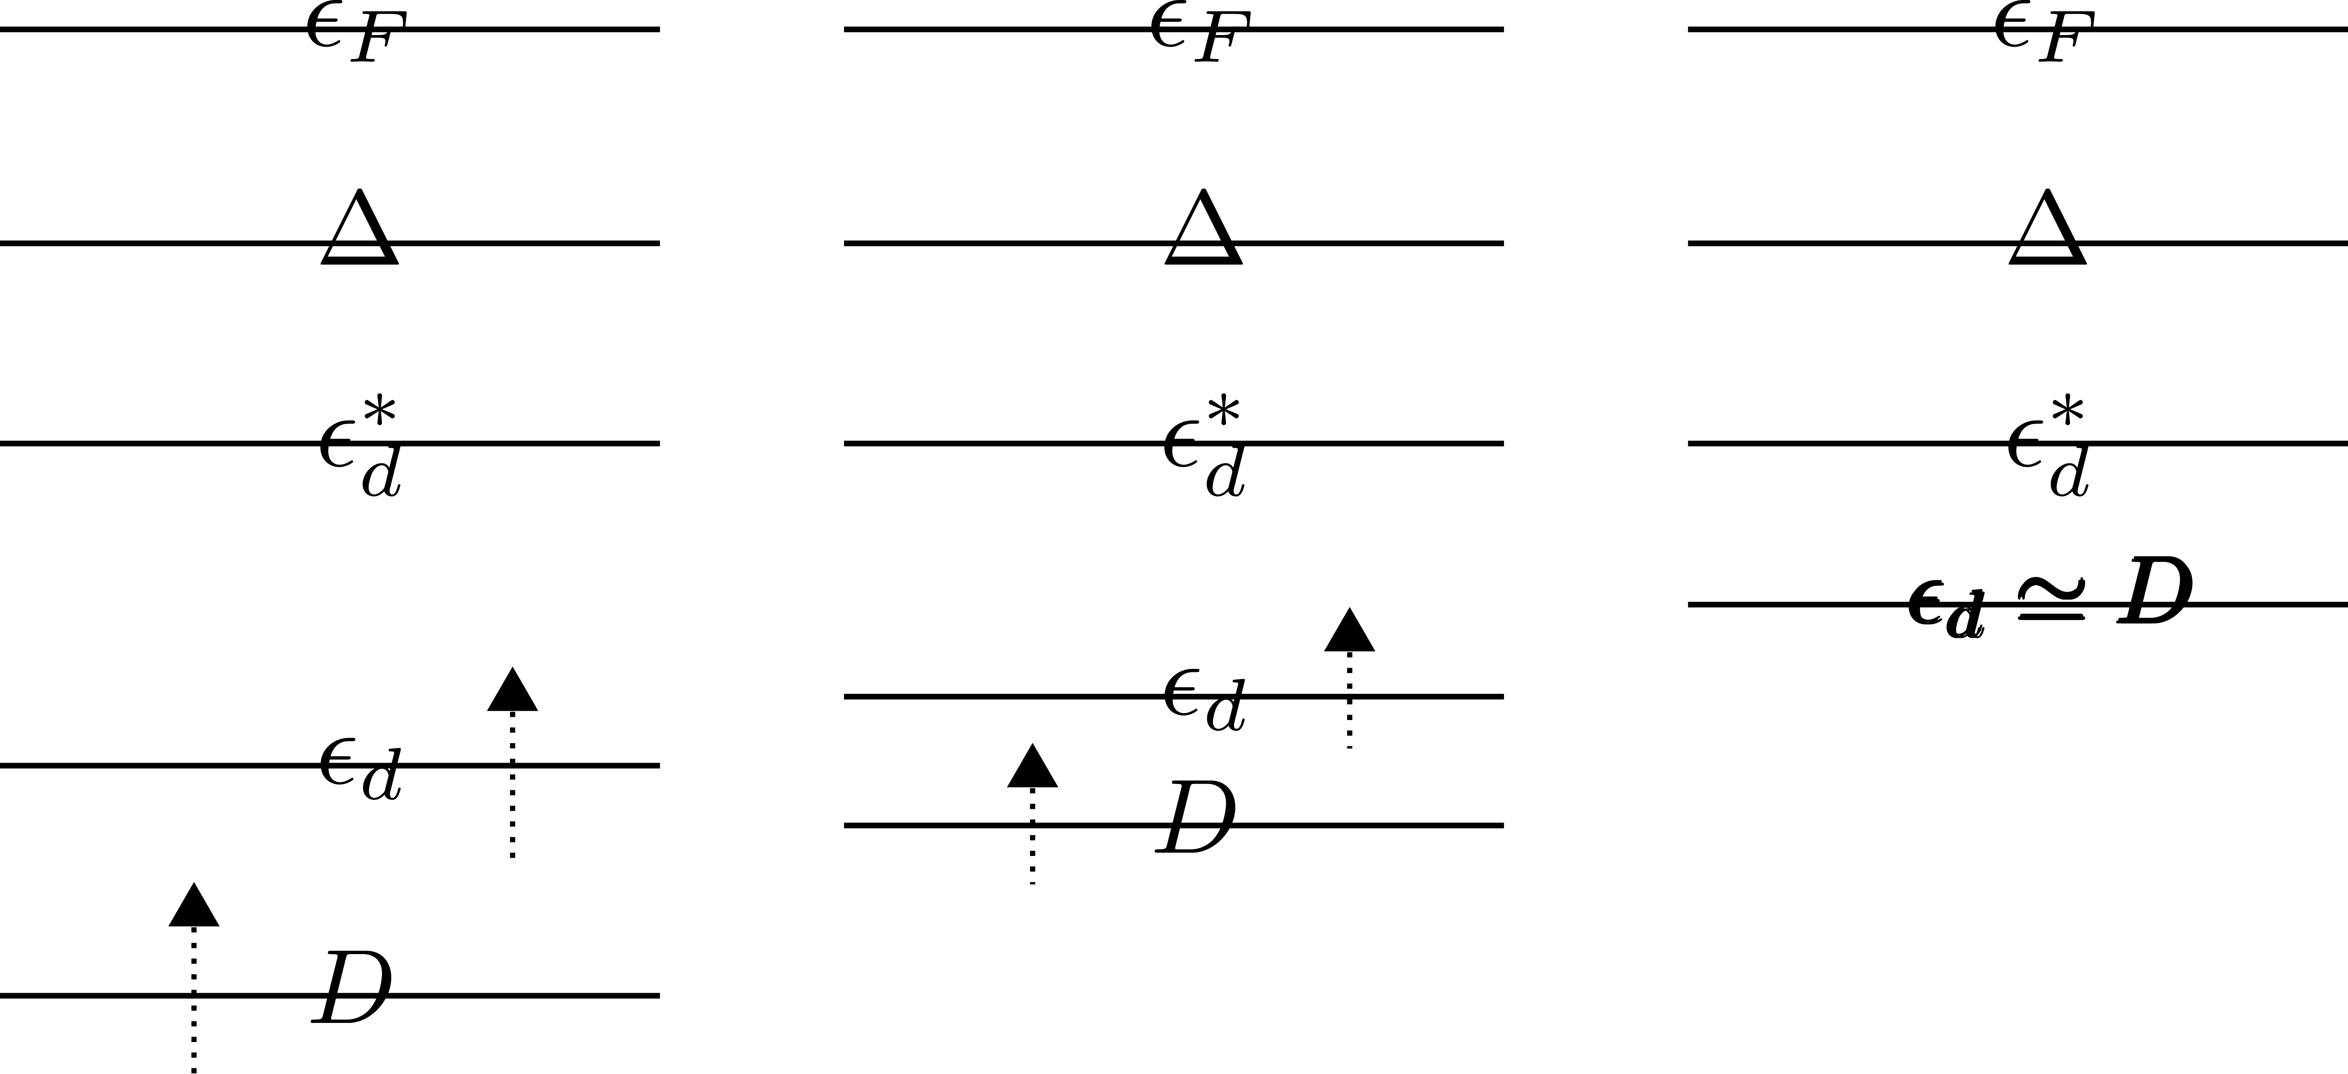


Scaling in
Schrieffer-Wolff Transformation
&
Poor Man’s Scaling
(local moment)
(no local moment)

Slide 10
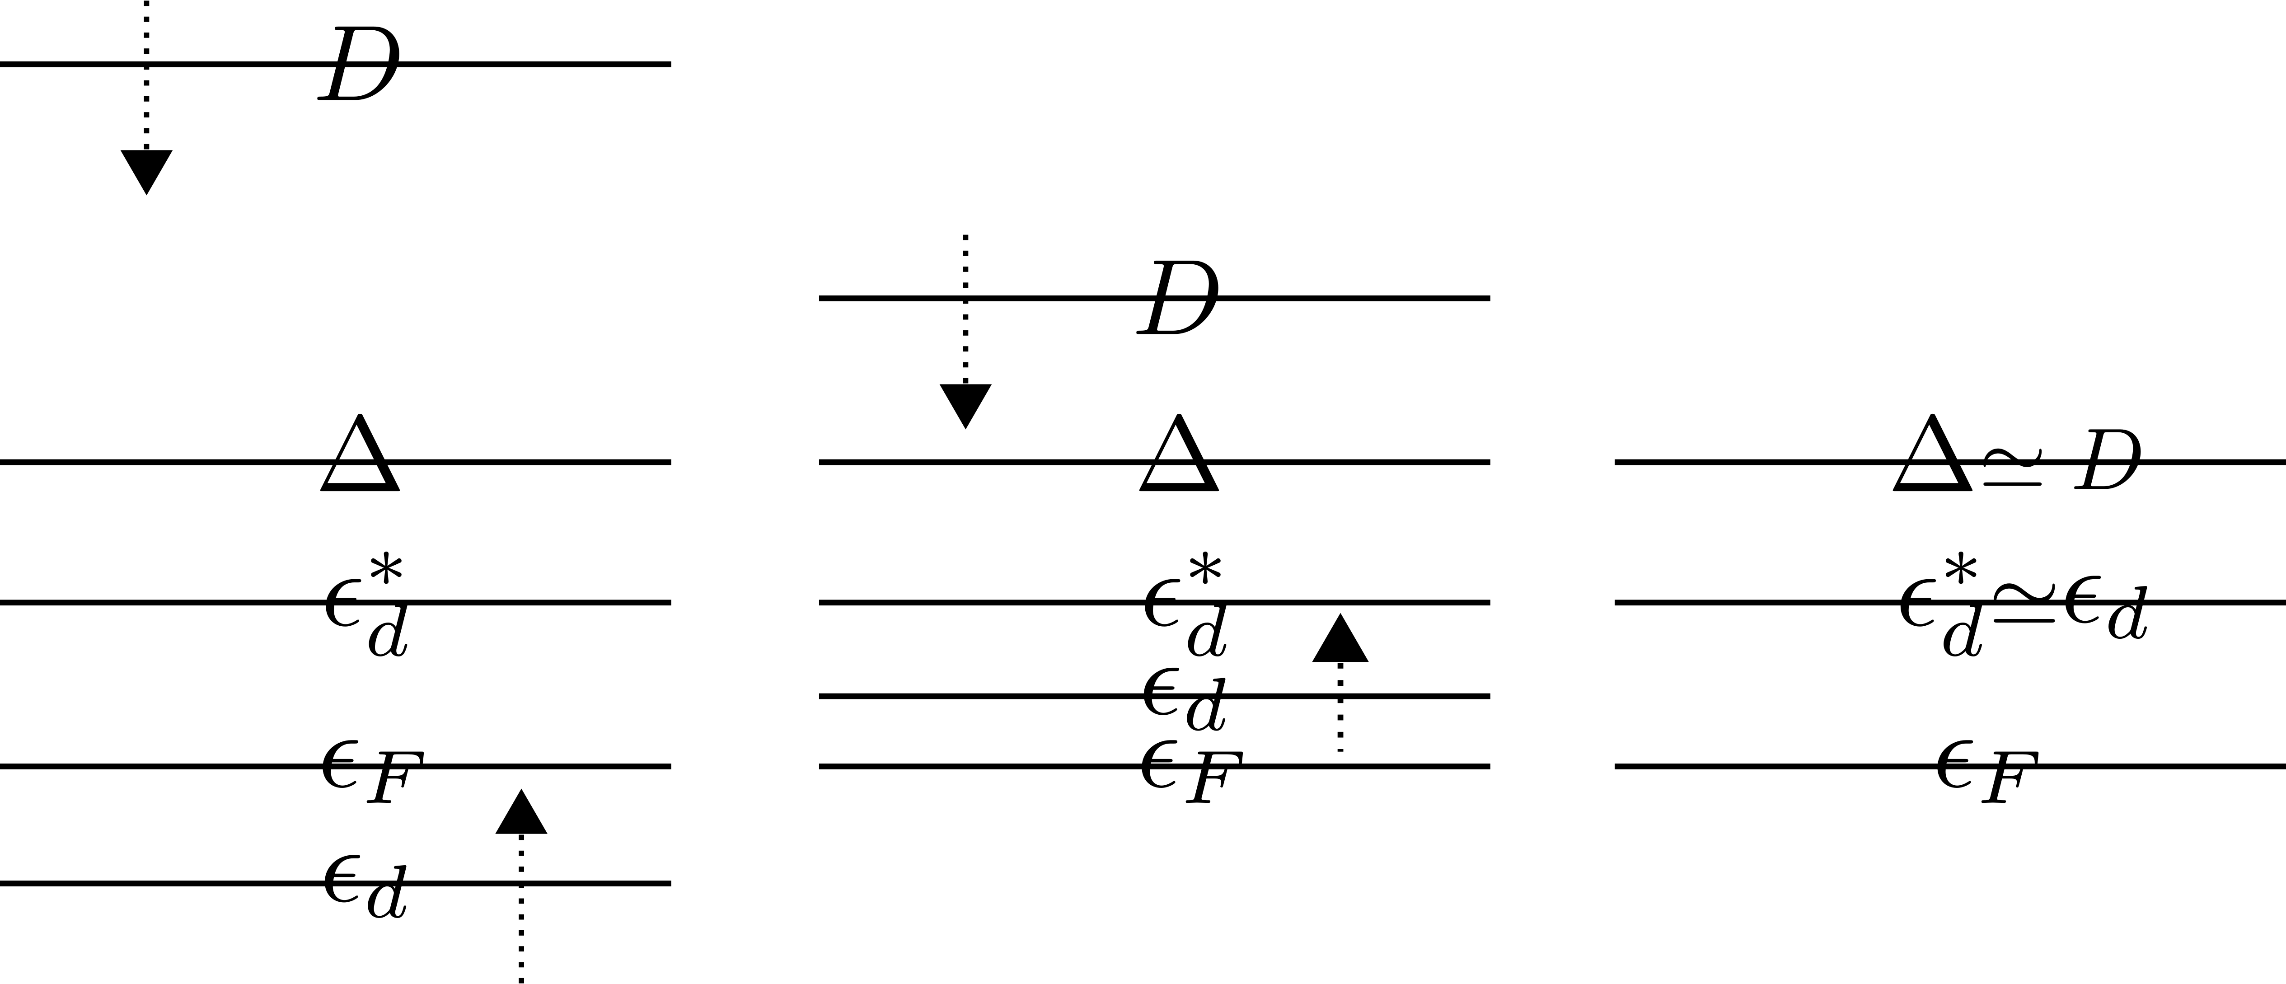


Scaling in
Scaling equation no longer valid
starts increasing

Slide 11
Scaling in Anderson Model

Slide 12
Scaling in Anderson Model

Slide 13
Scaling in Anderson Model

