Slide 1

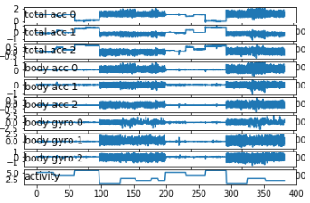
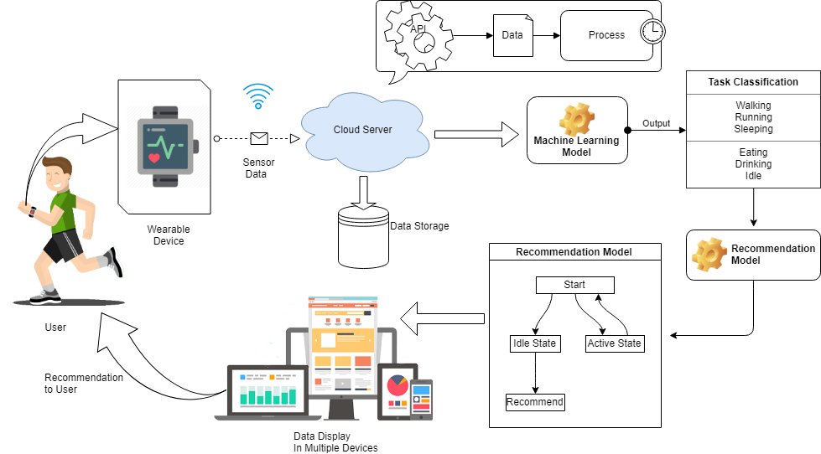
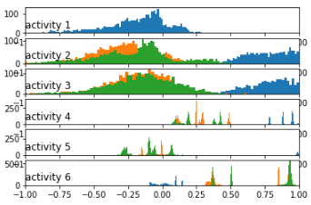
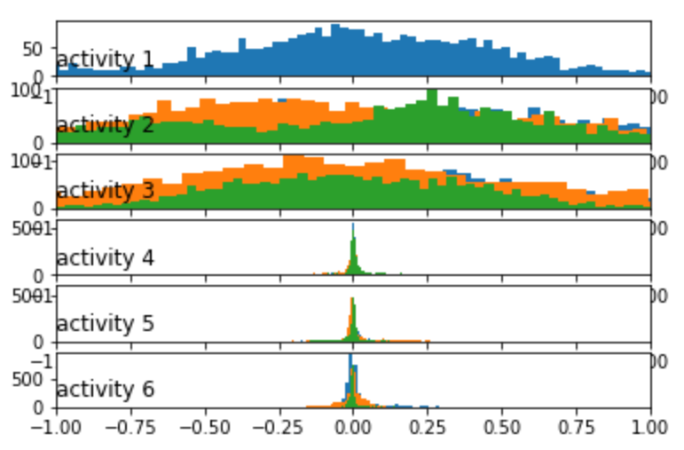
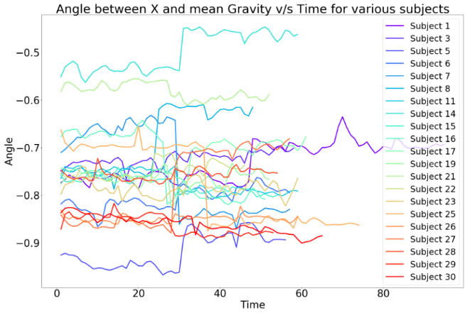
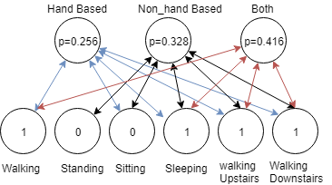

Activity Recognition & Personalised Recommendation System, IoT
Abhirup Dey | Dr. Rajkumar R | SCOPE
Introduction
Results
Identifying the requirements and implementation of a smart and secure system for wearable devices to capture or record human activity data. Analysis of this data will help certain pattern and recommend most suitable activity, based on the personalised data. By applying different machine learning models we have figured out the best possible scenario for this methodology application.
The training dataset loads the data as total acceleration on the basis of x, y and z axis returns a NumPy array and prints the shape of that array. The training data comprises with 7352 rows with each window concluding 128 observations. It can be ensured that each and every file is stacked in a way the features partitioned in another dimension, using dstack() NumPy Function. Running the sample outputs, the shape returns NumPy array by displaying the sampling and time steps for three consecutive features – x, y and z for the dataset.
To confirm if the dataset is actually reaching the expectations or not, we are using a function class_breakdown() to implement this characteristics The result is being summarised in the following tables-
Motivation
Unlike mobile phones Smart wearable devices are placed in our wrist in a particular place without any dislocation. Though there have been experiments using mobile data, but wearable devices yield more accurate result.
SCOPE of the Project
Class | Total | (%)
Class-1 Class-2 Class-3 Class-4 Class-5 Class-6 | 1226 1073 986 1286 1374 1407 | 16.676 14.595 13.414 17.491 18.89 19.137
Class | Total | (%)
Class-1 Class-2 Class-3 Class-4 Class-5 Class-6 | 496 471 420 491 532 537 | 16.831 15.982 14.252 16.661 18.052 18.222
Class | Total | (%)
Class-1 Class-2 Class-3 Class-4 Class-5 Class-6 | 1722 1544 1406 1777 1906 1944 | 16.72 14.992 13.652 17.254 18.507 18.876
Smart wearable devices undoubtedly one of the most trending technological advancement in the modern world. By the invention of foldable screen technology, which is more applicable for devices which are being wear on an uneven surface like human wrists. It is also being targeted to be more durable & cheap. This proposed work is in its earlier stage. We will be keep working for adding more functionalities and better logical implementation so that the whole world can utilise this as an acceptable option, and not only for personal usage but also for business reasons.
TABLE- TRAIN DATASET
TABLE- TEST DATASET
TABLE- BOTH DATASET
The time series data collected from the users may have repetition of data for each variable. So, we had to remove the overlapping possibilities. By using unique() function we were able to retrieve unique objects from the dataset. Once we have data for one subject, we will be able to plot it. By plotting 9 series of the subject activity level, we will have similar number of time steps which will be essential for creating a sub-plot for each variable and aligned them in a vertical manner for comparison of movement or activity.
Methodology
The cloud architecture is established based on a particular model combining several components. Which is resulting creating a hybrid model for IoT and machine learning by connecting them through a web-based platform. By adding more functionalities, we can expand due to scalability.
The whole architecture can be divided into two parts based on the model architecture. The first is the IoT model which is the user interaction model and the other is the machine learning part, which is the server-side model.
The activity recognition unit identifies the activity mainly based on two sensor units which are accelerometer and gyroscope. Now the accelerometer captures the motion and positioning based on the Cartesian coordinate measurement system. It measures the three axis sensor values as x, y and z which are perpendicular to each other. The sensor values will give a similar output as gravitation force ‘g’ (9.81 m/s²). Which is calculated by the equation –
gl = ∑ (x² + y² + z²)^{0,5}
A physical jerk is accompanied to the system for the occurrence of rate of changes, which can represent the derivative of acceleration w.r.t time. Despite of the consideration of the acceleration being zero, low or high it detects the changes regarded. Contrasting with the jerk, the Activity Unit declare the current level of acceleration which is being occurred. We can define the activity unit value by the following equation-
$$AU=\frac{1}{N}\sum_{n=1}^{N}{{\left({(x_{n}−x_{mean})}^{2}+{(y_{n}−y_{mean})}^{2}+{(z_{n}−z_{mean})}^{2}\right)}^{\frac{1}{2}}}$$
Assuming the sensor reading as 32 Hz and sensor rotation by 90 degree, it is required that the force of acceleration on one axis, which had no gravity influence, will be able the acquire the gravity force of one tau, which is about 63.2%, within 2 seconds. This small amount period will provide 64 data triples converted as a usable window frame for activity recognition. The requirement for time leads to an average of 0.95 as a value for ‘a’ using the following equation, where the provided average is analogous to the values of y_{mean} and z_{mean}.
$$x_{mean}\left(n\right)=X_{mean}\left(n−1\right)∙a+X(n)∙(1−a)$$
The calculated estimation is being measured up by the consideration of using mean acceleration values for each axis.
In the plot we can see high frequency in the region of walking activities and low frequency in the range of activities like sitting, standing or laying. Based on the activity data we would be interested to analyse it in a way to determine the activity performed by each subject. This can be achieved by plotting histogram model for each activity relied on the three axis values of x, and z. The plotted graphs are demonstrated horizontally to distinguish between them, accordingly.
Based on the Walking activity over time period for each individual the feature taken as the angle between X axis and mean gravity which is apparently constant, we can plot graphs for all individual. By iterating the list of objects inside parameters we can specify the size of graph in rcParams. In the plotting the first parameter is the X-axis data which is the time data and the second parameter is the Y-axis data which is angle between X-axis and gravity.
Classify Activity-
The classification of activity based on various algorithm differs based on accuracy constrains. We will discuss four models applied for this data set and compare the results to pursue the most suitable choice.
In this experiment we have used four different algorithms – Support Vector Classifier (SVC), Logistic Regression (LR), K Nearest Neighbour (KNN) and Random Forest (RF). We have converted the accuracy score to percentage by multiplying the output with 100 for conversion.
Algorithm | Accuracy (%)
SVC LR KNN RF | 94.02782490668477 96.19952494061758 90.02375296912113 89.68442483881914
So, we can see that the algorithm of Logistic regression reaches the most accuracy among the other models which is around 96%. The comparison data is visualized in the above table.
Conclusion
The Restrictive Boltzmann Machine is a learning model notably applicable for such a scenario we are implementing here. The RBM is a simple neural network consisting of two layers- one is the visible or input layer and the other is the hidden layer.
Here is a simple example calculated probability based on ‘hand’ or ‘non-hand-oriented’ activity applied on six recorded activity data of an individual. As a result, we can see here that the probability for both usage of hand or non-hand orientation is the highest with a value of p=0.416 for this individual. So, it’s obvious to suggest that person to do something which involves both Hand and Non-hand-oriented postures. Now, it is also required to keep on note that, if a particular person is working too hard for a long time, then the recommendation system should suggest to take rest or to relax to that user.
References
[1] Lloyd C.: Time Comes for the Superwatch, The Times, Newspaper, 3 Thomas More Square, London.
[2] Sensor requirements for activity recognition on smart watches, Conference: Proceedings of the 6th International Conference on PErvasive Technologies Related to Assistive Environments, May 2013
[3] Smartwatch-based Activity Recognition: A Machine Learning Approach, Gary M. Weiss, Jessica L. Timko, Catherine M. Gallagher, Kenichi Yoneda, and Andrew J. Schreiber
[4] SI - International Bureau of Weights and Measures, The International System of Units (SI), Brochure (8th ed.), 2006, ISBN 92-822-2213-6
[5] I. H. Witten, and E. Frank - Data Mining: Practical Machine Learning Tools and Techniques, 2nd ed., Morgan Kaufmann.

