Slide 1
Introduction to Artificial Intelligence
Intelligent Agents
Intelligent Agents
Agent → is anything that can be viewed as perceiving its environment through sensors and acting upon that environment through actuators
Agent
Environment
Percepts
Sensors
?
Actions
Actuators
The agent view is quite generic.
Examples:
Human
A robot with cameras and motors
A thermostat detecting room temperature.

Slide 2
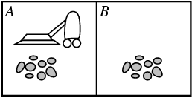
Introduction to Artificial Intelligence
Intelligent Agents
Intelligent Agents
The agent behavior is mathematically described by the agent function
It maps from percept histories to actions: [f: P* → A]
The agent program runs on the physical architecture to produce f
Architecture
Program
Agent
E.g., vacuum-cleaner world
Agent: Vacuum Cleaner
Locations: A and B
Percepts: location and contents, e.g., [A, Dirty] Actions: Left, Right, Suck, NoOp ( do nothing)
Agent’s function: look-up table

Slide 3
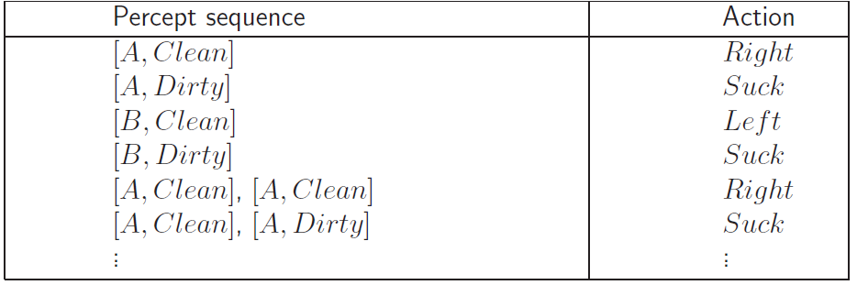
Introduction to Artificial Intelligence
Intelligent Agents
Intelligent Agents
Agent: Vacuum Cleaner
Locations: A and B
Percepts: location and contents, e.g., [A, Dirty] Actions: Left, Right, Suck, NoOp ( do nothing)
Agent’s function: look-up table
Function Reflex-Vacuum-Agent([location,status]) return an action
If status = Dirty then return Suck
else if location = A then return Right
else if location = B then return left
Artificial Intelligence a modern approach

Slide 4
Introduction to Artificial Intelligence
Intelligent Agents
Intelligent Agents
Rational agent → One that does the right thing based on what:
it can perceive and
the actions it can perform.
What is correct?
The actions that cause the agent to be most successful
We need ways to measure success.
Performance measure: An objective criterion for success of an agent's behavior.
No universal performance measure for all agents
Performance measures of
a vacuum-cleaner agent: amount of dirt cleaned up, amount of time taken, amount of electricity consumed, level of noise generated, etc.
Self-driving car: time to reach destination (minimize), safety, predictability of behavior for other agents, reliability, etc.
game-playing agent: win/loss percentage (maximize), robustness, unpredictability (to “confuse” opponent), etc.

Slide 5
Introduction to Artificial Intelligence
Intelligent Agents
Intelligent Agents
A general rule -- > design performance measures according to
What one actually wants in the environment
Rather than how one thinks the agent should behave
E.g., in vacuum-cleaner world
We want the floor clean, no matter how the agent behave
We don’t restrict how the agent behaves
The performance measure defining the criterion of success
The agent’s prior knowledge of the environment
The actions that the agent can perform
The agents’s percept sequence up to now
Rationality depends on

Slide 6
Introduction to Artificial Intelligence
Intelligent Agents
Intelligent Agents
Rational Agent → For each possible percept sequence, a rational agent should select an action that maximizes its performance measure (in expectation) given the evidence provided by the percept sequence and whatever built- in knowledge the agent has.
In expectation:
Captures actions with stochastic / uncertain effects or actions performed in stochastic environments. We can then look at the expected value of an action.
Performance measure
Actions that can perform
Percept sequences
Awards one point for each clean square
Prior knowledge
e.g., only two squares
The geography of the environment
Left, Right, Suck and NoOp
Where is the agent?
Whether the location contains dirt?

Slide 7
Introduction to Artificial Intelligence
Intelligent Agents
Intelligent Agents
Omniscience Agent
Knows the actual outcome of its actions in advance
No other possible outcomes
However, impossible in real world
Rationality maximizes expected outcome while perfection maximizes actual outcome.
Rationality is distinct from omniscience.
We can behave rationally even when faced with incomplete information.
Agents can perform actions in order to modify future percepts so as to obtain useful information: information gathering, exploration.
An agent is autonomous if its behavior is determined by its own experience (with ability to learn and adapt) rather than knowledge of designer.
Extremes
No autonomy – ignores environment/data
Complete autonomy – must act randomly/no program

Slide 8
Introduction to Artificial Intelligence
Intelligent Agents
Intelligent Agents
Must first specify the setting for intelligent agent design.
PEAS: Performance measure, Environment, Actuators, Sensors
Example: the task of designing a self-driving car
Performance measure → Safe, fast, legal, comfortable trip
Environment → Roads, other traffic, pedestrians
Actuators → Steering wheel, accelerator, brake, signal, horn
Sensors → Cameras, LIDAR (light/radar), speedometer, GPS, odometer, engine sensors
Environment
Fully observable (vs. partially observable)
Deterministic (vs. stochastic)
Episodic (vs. sequential)
Static (vs. dynamic)
Discrete (vs. continuous)
Single agent (vs. multiagent):

Slide 9

Introduction to Artificial Intelligence
Intelligent Agents
Intelligent Agents
Fully observable / Partially observable
If an agent’s sensors give it access to the complete state of the environment needed to choose an action, the environment is fully observable.

Slide 10
Introduction to Artificial Intelligence
Intelligent Agents
Intelligent Agents
Deterministic / Stochastic
An environment is deterministic if the next state of the environment is completely determined by the current state of the environment and the action of the agent;
In a stochastic environment, there are multiple, unpredictable outcomes.
(If the environment is deterministic except for the actions of other agents, then the environment is strategic).
In a fully observable, deterministic environment, the agent need not deal with uncertainty.
Non-deterministic environments
Have aspects beyond the control of the agent
Utility functions have to guess at changes in world

Slide 11
Introduction to Artificial Intelligence
Intelligent Agents
Intelligent Agents
Episodic / Sequential
In an episodic environment, the agent’s experience is divided into atomic episodes. Each episode consists of the agent perceiving and then performing a single action.
Subsequent episodes do not depend on what actions occurred in previous episodes. Choice of action in each episode depends only on the episode itself. (E.g., classifying images.)
In a sequential environment, the agent engages in a series of connected episodes.
Current decision can affect future decisions. (E.g., chess and driving)
Static / Dynamic
A static environment does not change while the agent is thinking.
The passage of time as an agent deliberates is irrelevant.
A dynamic environment does change
The agent should/could consult the world when choosing actions
Alternatively: anticipate the change during deliberation OR make decision very fast
The environment is semi-dynamic if the environment itself does not change with the passage of time but the agent's performance score does.

Slide 12
Introduction to Artificial Intelligence
Intelligent Agents
Intelligent Agents
Discrete / Continuous
If the number of distinct percepts and actions is limited, the environment is discrete, otherwise it is continuous.
Single agent / Multi-agent
If the environment contains other intelligent agents, the agent needs to be concerned about strategic, game-theoretic aspects of the environment (for either cooperative or competitive agents).
Most engineering environments don’t have multi-agent properties, whereas most social and economic systems get their complexity from the interactions of (more or less) rational agents.

Slide 13
Introduction to Artificial Intelligence
Intelligent Agents
Intelligent Agents
Fully Observable
no
yes
no
Deterministic
Uncertainty
yes
Certainty: Search

Slide 14
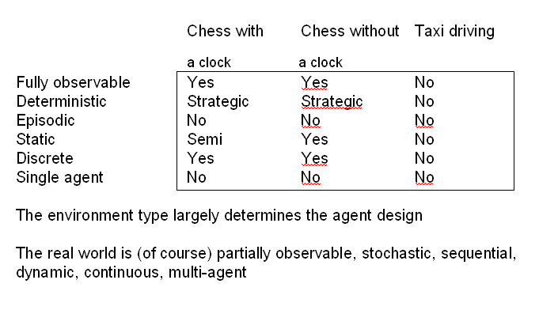
Introduction to Artificial Intelligence
Intelligent Agents
Intelligent Agents

Slide 15
Introduction to Artificial Intelligence
Intelligent Agents
Intelligent Agents
Simple reflex agents
Reflex agents with state/model
Goal-based agents
Utility-based agents
All these can be turned into learning agents
Types of Agents

Slide 16
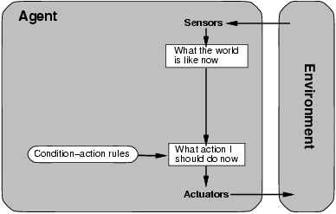
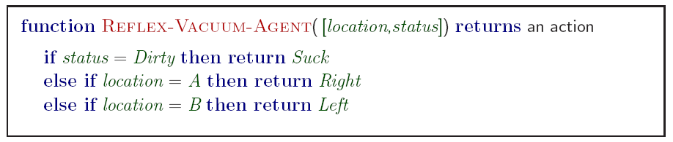
Introduction to Artificial Intelligence
Intelligent Agents
Intelligent Agents
Simple reflex agents

Slide 17
Introduction to Artificial Intelligence
Intelligent Agents
Intelligent Agents
Simple reflex agents
Agents do not have memory of past world states or percepts.
Actions depend solely on current percept.
Action becomes a “reflex.”
Uses condition-action rules.
Simple but very limited intelligence.
Action does not depend on percept history, only on current percept.
Therefore, no memory requirements.
Infinite loops
Suppose vacuum cleaner does not observe location.
What do you do given location = clean? Left of A or right on B -> infinite loop.

Slide 18
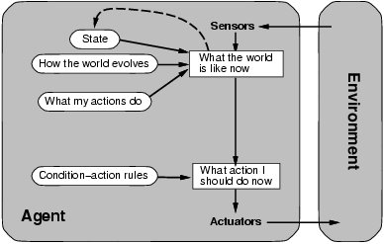
Introduction to Artificial Intelligence
Intelligent Agents
Intelligent Agents
Model-based reflex agents
Agents have internal state, which is used to keep track of past states of the world.
Agents have the ability to represent change in the World.
Requiring two types of knowledge
How the world evolves independently of the agent
How the agent’s actions affect the world

Slide 19
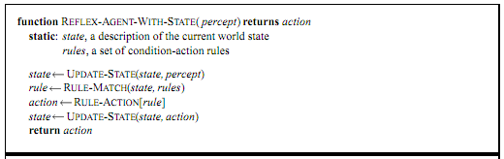
Introduction to Artificial Intelligence
Intelligent Agents
Intelligent Agents
Model-based reflex agents
“Infers potentially
dangerous driver
in front.”
If “dangerous driver in front,” then “keep distance.”

Slide 20
Introduction to Artificial Intelligence
Intelligent Agents
Intelligent Agents
Goal-based agents
In addition to state information, have goal information that describes desirable situations to be achieved.
Agents of this kind take future events into consideration.
What sequence of actions can I take to achieve certain goals?
Choose actions so as to (eventually) achieve a (given or computed) goal.
problem solving and search!

Slide 21
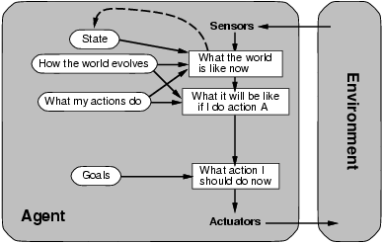
Introduction to Artificial Intelligence
Intelligent Agents
Intelligent Agents
Goal-based agents
A Reflex agent breaks when it sees brake lights.
Goal based agent reasons
Brake light -> car in front is stopping -> I should stop -> I should use brake
More flexible than reflex agents → may involve search and planning

Slide 22
Introduction to Artificial Intelligence
Intelligent Agents
Intelligent Agents
Utility-based agents
When there are multiple possible alternatives, how to decide which one is best?
Goals are qualitative: A goal specifies a crude distinction between a happy and unhappy state, but often need a more general performance measure that describes “degree of happiness.”
Utility function U: State → R indicating a measure of success or happiness when at a given state.
A utility function maps a state onto a real number which describes the associated degree of “happiness”, “goodness”, “success”.
Important for making tradeoffs: Allows decisions comparing choice between conflicting goals, and choice between likelihood of success and importance of goal (if achievement is uncertain).

Slide 23
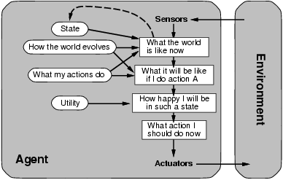
Introduction to Artificial Intelligence
Intelligent Agents
Intelligent Agents
Utility-based agents

Slide 24
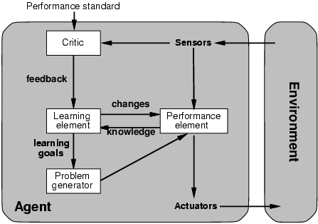
Introduction to Artificial Intelligence
Intelligent Agents
Intelligent Agents
Learning agents
The agents have the ability to improve performance through learning.

