Slide 1

Introduction to Artificial Intelligence
Solving problems by searching
Search?
Determine how to achieve some goal; “what to do”
Logic & inference?
Reason about what to do
Encode knowledge / “expert” systems
Know what to do
Learning?
Learn what to do
Modern view: complex & multi-faceted
Start state
Goal state

Slide 2
Introduction to Artificial Intelligence
Solving problems by searching
Deterministic, fully observable → single-state problem
Agent knows exactly which state it will be in; solution is a sequence
Non-observable → sensorless problem (conformant problem)
Agent may have no idea where it is; solution is a sequence
Nondeterministic and/or partially observable → contingency problem
percepts provide new information about current state
often interleave search, execution
Unknown state space → exploration problem
Problem Types
Start state
Goal state

Slide 3
Introduction to Artificial Intelligence
Solving problems by searching
Start state
We will consider the problem of designing goal-based agents in observable, deterministic, discrete, known environments
The solution is a fixed sequence of actions
Search is the process of looking for the sequence of actions that reaches the goal
Once the agent begins executing the search solution, it can ignore its percepts (open-loop system)
Goal state
A Solution to a problem is an action sequence that leads from the initial state to a goal state.
Optimal solution: measured by the path cost function.

Slide 4
Introduction to Artificial Intelligence
Solving problems by searching
Problem: A set of possible states that the environment can be in. We call this the state space.
Initial state: The initial state that the agent starts in
Actions: The actions available to the agent.
Transition model: describes what each action does
What is the result of performing a given action in a given state?
Goal state: A set of one or more goal states.
Path cost
Assume that it is a sum of nonnegative step costs
The optimal solution is the sequence of actions that gives the lowest path cost for reaching the goal
Search Components
Start state
Goal state

Slide 5
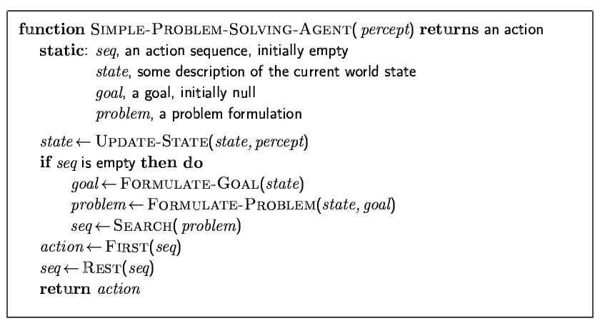
Introduction to Artificial Intelligence
Solving problems by searching

Slide 6
Introduction to Artificial Intelligence
Solving problems by searching
Example: Romania
Oradea
71
Neamt
Start state
87
On holiday in Romania; currently in Arad.
Flight leaves tomorrow from Bucharest
Formulate goal:
be in Bucharest
Formulate problem:
states: various cities
actions: drive between cities
Find solution:
sequence of cities, e.g., Arad, Sibiu, Fagaras, Bucharest
75
Zerind
151
Iasi
Arad
140
Sibiu
92
99
Fagaras
118
Goal state
Vaslui
Timisoara
80
Rimnicu Vilcea
97
211
142
111
Lugoj
Pitesti
70
146
85
98
Hirsova
Mehadia
101
Urziceni
75
138
Bucharest
86
120
Dobreta
Cralova
90
Eforie
Giurgiu

Slide 7
Introduction to Artificial Intelligence
Solving problems by searching
Example: Romania
Start state
Oradea
71
Neamt
A problem is defined by four items:
initial state e.g., "at Arad“
actions or successor function S(x) = set of action–state pairs
e.g., S(Arad) = {<Arad → Zerind, Zerind>, … }
goal test, can be
explicit, e.g., x = "at Bucharest"
implicit, e.g., Checkmate(x)
path cost (additive)
e.g., sum of distances, number of actions executed, etc.
c(x,a,y) is the step cost, assumed to be ≥ 0
A solution is a sequence of actions leading from the initial state to a goal state
87
75
Zerind
151
Iasi
Arad
140
Sibiu
92
99
Fagaras
118
Vaslui
Timisoara
80
Rimnicu Vilcea
111
97
Pitesti
211
142
Lugoj
70
146
85
98
Hirsova
Mehadia
101
Urziceni
75
138
Bucharest
86
Dobreta
120
90
Cralova
Giurgiu
Eforie
Goal state

Slide 8
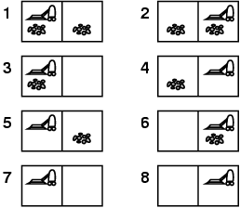
Introduction to Artificial Intelligence
Solving problems by searching
Example: vacuum world
State- Space
The initial state, actions, and transition model define the state space of the problem
The set of all states reachable from initial state by any sequence of actions
Can be represented as a directed graph where the nodes are states and links between nodes are actions

Slide 9
Introduction to Artificial Intelligence
Solving problems by searching
Example: vacuum world
Number of cells
State- Space (2.2^{n})
states? integer dirt and robot location
actions? Left, Right, Suck
goal test? no dirt at all locations
path cost? 1 per action

Slide 10
Introduction to Artificial Intelligence
Solving problems by searching
Example: vacuum world
single-state problem, start in #5.
Solution? [Right, Suck]
Sensorless, start in {1,2,3,4,5,6,7,8}
Solution? [Right,Suck,Left,Suck]

Slide 11
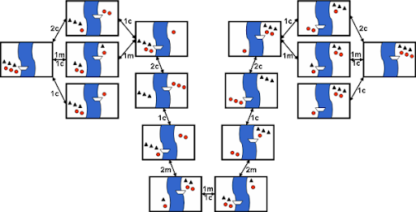
Introduction to Artificial Intelligence
Solving problems by searching
Example: The missionaries and cannibals

Slide 12
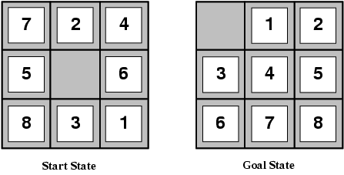
Introduction to Artificial Intelligence
Solving problems by searching
Example: 8-Puzzle
states? locations of tiles
actions? move blank left, right, up, down
goal test? = goal state (given)
path cost? 1 per move
# of states: (n+1)! / 2
8-puzzle: 181,440 states
15-puzzle: 1.3 trillion
24-puzzle: 10^25
Optimal solution of n-Puzzle family is NP-hard

Slide 13
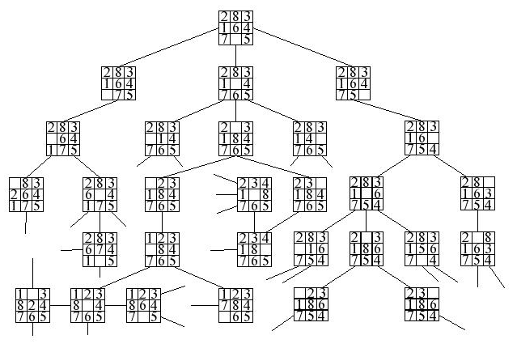
Introduction to Artificial Intelligence
Solving problems by searching

Slide 14
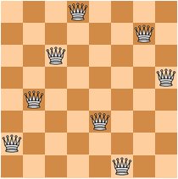
Introduction to Artificial Intelligence
Solving problems by searching
Example: 8-Queens
Place as many queens as possible
on the chess board without capture
states? - any arrangement of n<=8 queens
- or arrangements of n<=8 queens in leftmost n
columns, 1 per column, such that no queen
attacks any other.
initial state? no queens on the board
actions? - add queen to any empty square
- or add queen to leftmost empty square such
that it is not attacked by other queens.
goal test? 8 queens on the board, none attacked.
path cost? 1 per move (not relevant…)

Slide 15
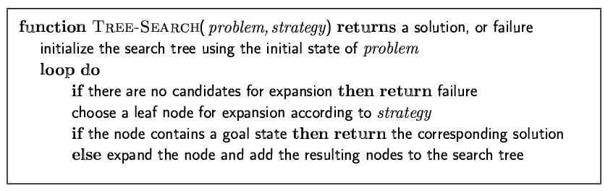
Introduction to Artificial Intelligence
Solving problems by searching
Searching for solutions
A solution (to a formulated problem) is an action sequence:
Search algorithms: considering various possible action sequences.
Search tree:
Root: initial state;
Branches: actions
Nodes: states in the state space of the problem.

Slide 16
Introduction to Artificial Intelligence
Solving problems by searching
Example: Route-finding in Romania

Slide 17
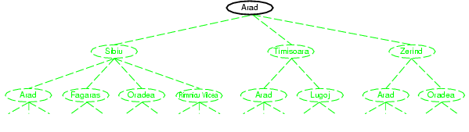
Introduction to Artificial Intelligence
Solving problems by searching
Example: Route-finding in Romania

Slide 18
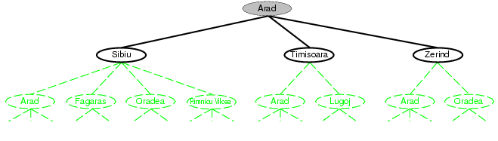
Introduction to Artificial Intelligence
Solving problems by searching
Example: Route-finding in Romania

Slide 19
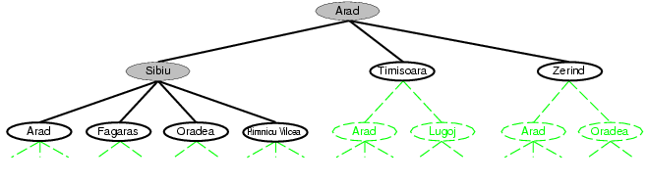
Introduction to Artificial Intelligence
Solving problems by searching
Example: Route-finding in Romania

Slide 20
Introduction to Artificial Intelligence
Solving problems by searching
Example: Route-finding in Romania

Slide 21
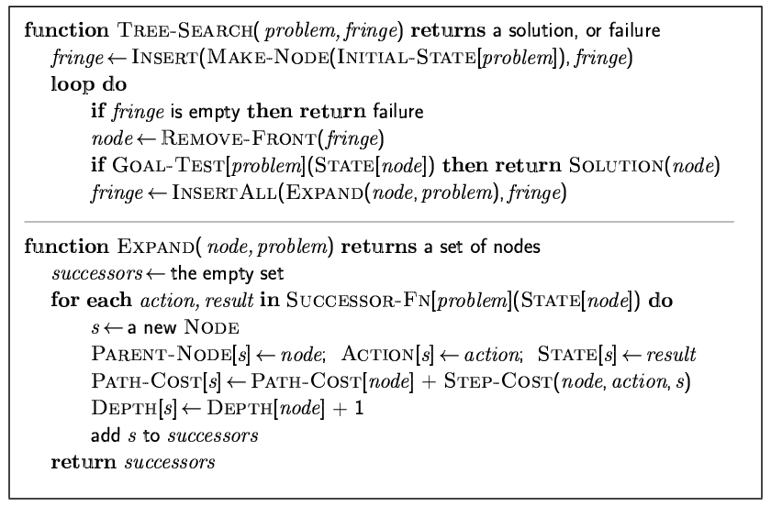
Introduction to Artificial Intelligence
Solving problems by searching
Implementation: general tree search

Slide 22
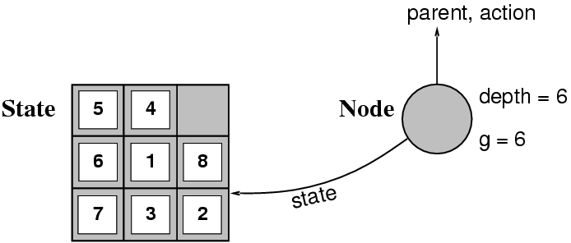
Introduction to Artificial Intelligence
Solving problems by searching
State vs. node
A state is a (representation of) a physical configuration
A node is a data structure constituting part of a search tree includes state, parent node, action, path cost g(x), depth
The Expand function creates new nodes, filling in the various fields and using the SuccessorFn of the problem to create the corresponding states.

Slide 23
Introduction to Artificial Intelligence
Solving problems by searching
Search Strategies
A search strategy is defined by picking the order of node expansion
Strategies are evaluated along the following dimensions:
completeness: does it always find a solution if one exists?
time complexity: number of nodes generated
space complexity: maximum number of nodes in memory
optimality: does it always find a least-cost solution?
Time and space complexity are measured in terms of
b: maximum branching factor of the search tree
d: depth of the least-cost solution
m: maximum depth of the state space (may be ∞)

Slide 24
Introduction to Artificial Intelligence
Solving problems by searching
Uninformed search strategies use only the information available in the problem definition
Breadth-first search
Uniform-cost search
Depth-first search
Depth-limited search
Iterative deepening search
An uninformed search algorithm is given no clue about how close a state is to the goal(s).
Search Strategies

