Slide 1
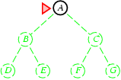
Breadth-first search
Expand shallowest unexpanded node
Implementation:
fringe is a FIFO queue, i.e., new successors go at end

Slide 2
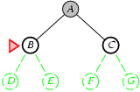
Breadth-first search
Expand shallowest unexpanded node
Implementation:
fringe is a FIFO queue, i.e., new successors go at end

Slide 3
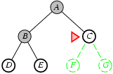
Breadth-first search
Expand shallowest unexpanded node
Implementation:
fringe is a FIFO queue, i.e., new successors go at end

Slide 4
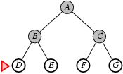
Breadth-first search
Expand shallowest unexpanded node
Implementation:
fringe is a FIFO queue, i.e., new successors go at end

Slide 5
Properties of breadth-first search
Complete? Yes (if b is finite)
Time? 1+b+b²+b³+… +b^{d} + b(b^{d}-1) = O(b^{d+1})
Space? O(b^{d+1}) (keeps every node in memory)
Optimal? Yes (if cost = 1 per step)
Space is the bigger problem (more than time)

Slide 6
Uniform-cost search
Expand least-cost unexpanded node
Implementation:
fringe = queue ordered by path cost
Equivalent to breadth-first if step costs all equal
Complete? Yes, if step cost ≥ ε
Time? # of nodes with g ≤ cost of optimal solution, O(b^{ceiling(C*/ ε)}) where C* is the cost of the optimal solution
Space? # of nodes with g ≤ cost of optimal solution, O(b^{ceiling(C*/ ε)})
Optimal? Yes – nodes expanded in increasing order of g(n)

Slide 7
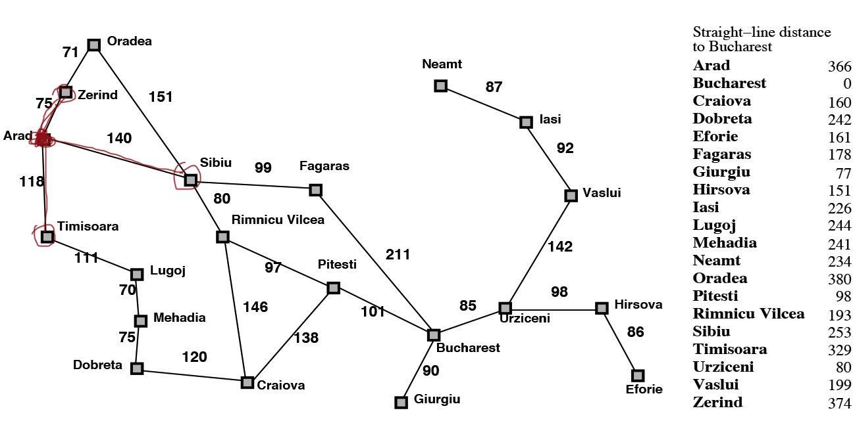
Uniform/cheapest cost search
Let’s start from the initial state (Arad), and we have three options.
Which one are we going to explore next according to the cheapest first rule?

Slide 8

Uniform/cheapest cost search
Which one are we going to explore next according to the cheapest first rule?
Zerind (75)
What’s next?

Slide 9
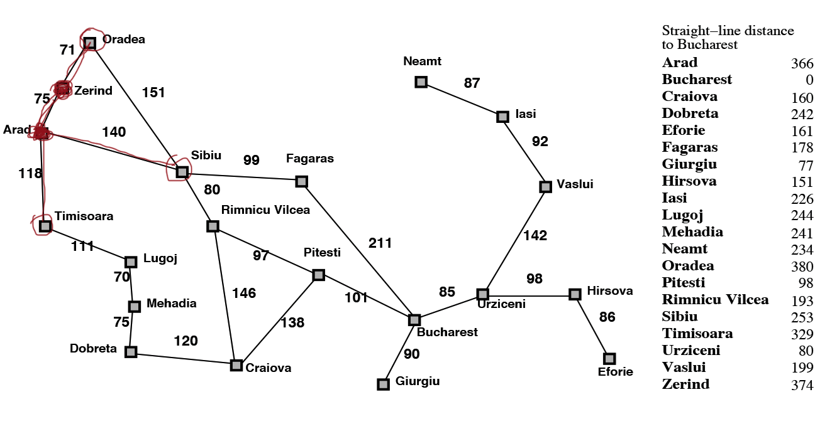
Uniform/cheapest cost search
What’s next?

Slide 10
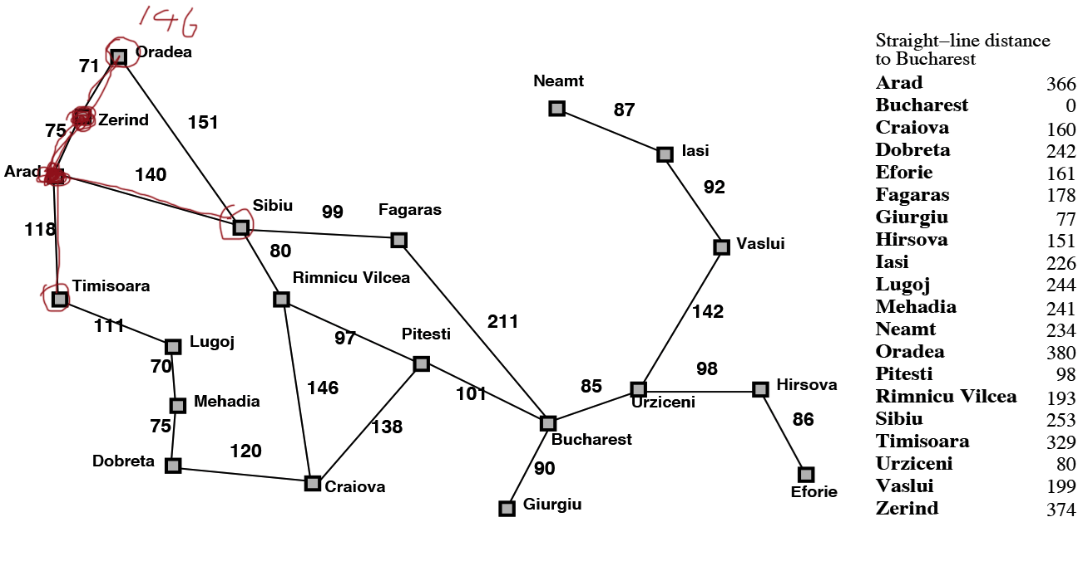
Uniform/cheapest cost search
What’s next?

Slide 11
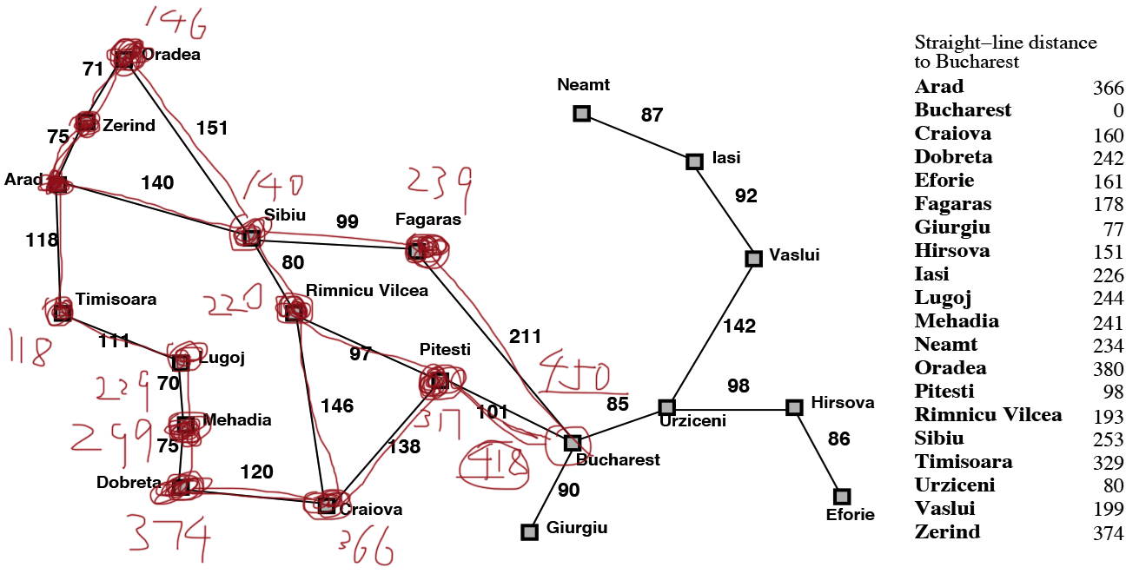
Uniform/cheapest cost search

Slide 12
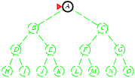
Depth-first search
Expand deepest unexpanded node
Implementation:
fringe = LIFO queue, i.e., put successors at front

Slide 13
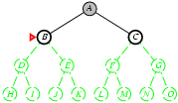
Depth-first search
Expand deepest unexpanded node
Implementation:
fringe = LIFO queue, i.e., put successors at front

Slide 14
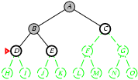
Depth-first search
Expand deepest unexpanded node
Implementation:
fringe = LIFO queue, i.e., put successors at front

Slide 15
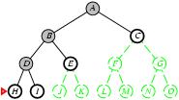
Depth-first search
Expand deepest unexpanded node
Implementation:
fringe = LIFO queue, i.e., put successors at front

Slide 16
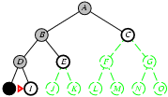
Depth-first search
Expand deepest unexpanded node
Implementation:
fringe = LIFO queue, i.e., put successors at front

Slide 17
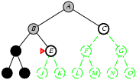
Depth-first search
Expand deepest unexpanded node
Implementation:
fringe = LIFO queue, i.e., put successors at front

Slide 18
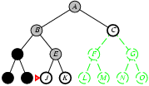
Depth-first search
Expand deepest unexpanded node
Implementation:
fringe = LIFO queue, i.e., put successors at front

Slide 19
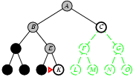
Depth-first search
Expand deepest unexpanded node
Implementation:
fringe = LIFO queue, i.e., put successors at front

Slide 20
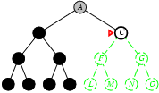
Depth-first search
Expand deepest unexpanded node
Implementation:
fringe = LIFO queue, i.e., put successors at front

Slide 21
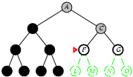
Depth-first search
Expand deepest unexpanded node
Implementation:
fringe = LIFO queue, i.e., put successors at front

Slide 22
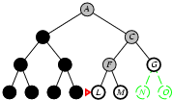
Depth-first search
Expand deepest unexpanded node
Implementation:
fringe = LIFO queue, i.e., put successors at front

Slide 23
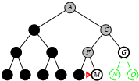
Depth-first search
Expand deepest unexpanded node
Implementation:
fringe = LIFO queue, i.e., put successors at front

Slide 24
Properties of depth-first search
Complete? No: fails in infinite-depth spaces, spaces with loops
Modify to avoid repeated states along path
→ complete in finite spaces
Time? O(b^{m}):
but if solutions are dense, may be much faster than breadth-first
Space? O(bm), i.e., linear space!
Optimal? No
M= max depth of tree
B= branching factor (the number of children at each node)

Slide 25
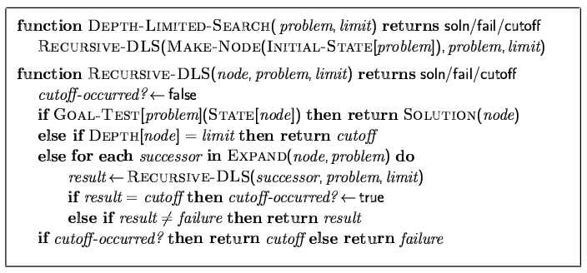
Depth-limited search
= depth-first search with depth limit l,
i.e., nodes at depth l have no successors
Recursive implementation:

Slide 26
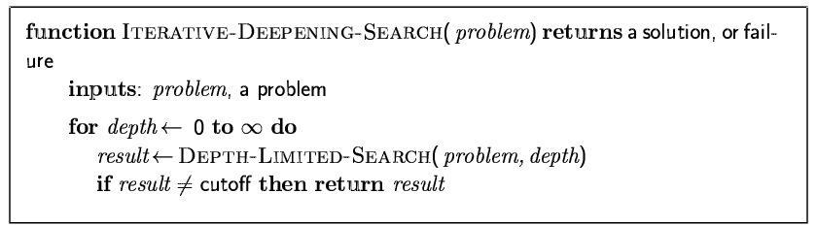
Iterative deepening search

Slide 27
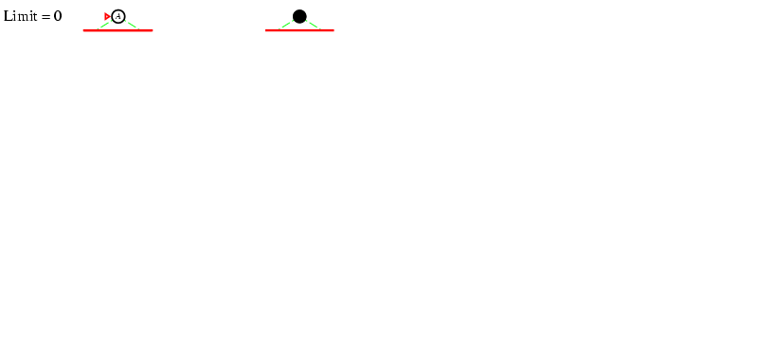
Iterative deepening search l =0

Slide 28
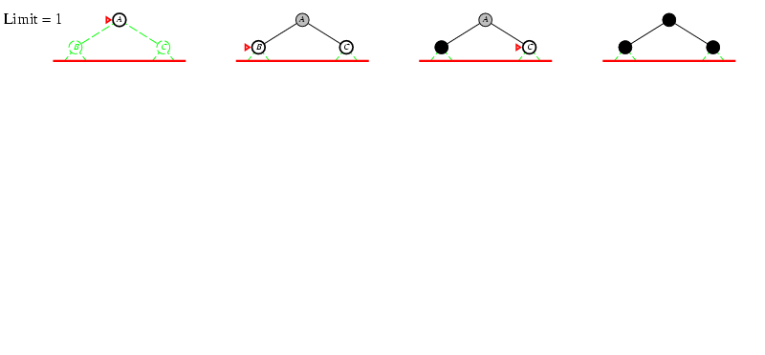
Iterative deepening search l =1

Slide 29
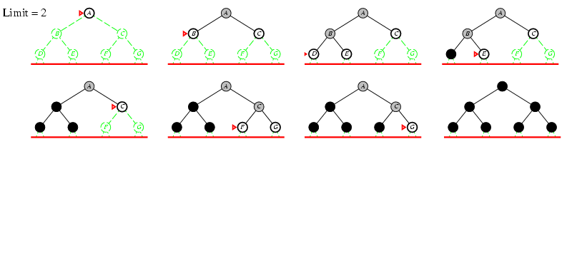
Iterative deepening search l =2

Slide 30
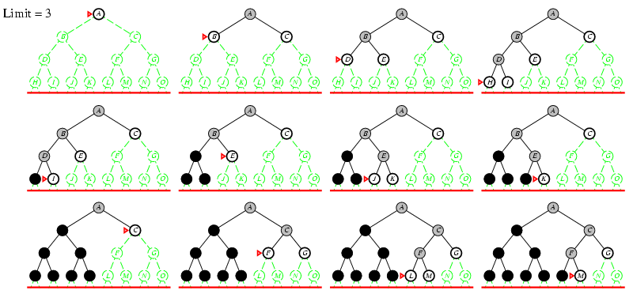
Iterative deepening search l =3

Slide 31
Iterative deepening search
Number of nodes generated in a depth-limited search to depth d with branching factor b:
N_{DLS} = b⁰ + b¹ + b² + … + b^{d-2} + b^{d-1} + b^{d}
Number of nodes generated in an iterative deepening search to depth d with branching factor b:
N_{IDS} = (d+1)b⁰ + d b^¹ + (d-1)b^² + … + 3b^{d-2} +2b^{d-1} + 1b^{d}
For b = 10, d = 5,
N_{DLS} = 1 + 10 + 100 + 1,000 + 10,000 + 100,000 = 111,111
N_{IDS} = 6 + 50 + 400 + 3,000 + 20,000 + 100,000 = 123,456
Overhead = (123,456 - 111,111)/111,111 = 11%

Slide 32
Properties of iterative deepening search
Complete? Yes
Time? (d+1)b⁰ + d b¹ + (d-1)b² + … + b^{d} = O(b^{d})
Space? O(bd)
Optimal? Yes, if step cost = 1

Slide 33
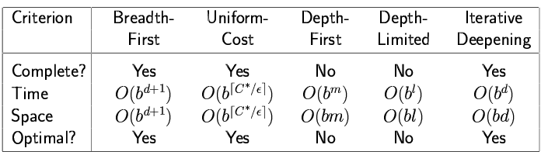
Summary of algorithms

Slide 34
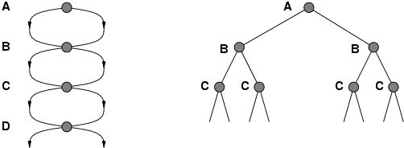
Repeated states
Failure to detect repeated states can turn a linear problem into an exponential one!

Slide 35
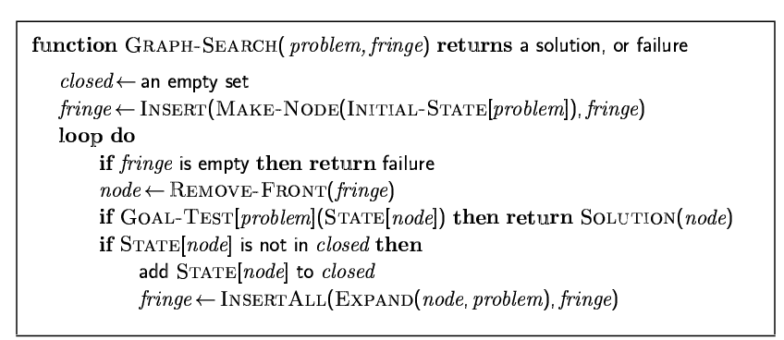
Graph search

Slide 36
Summary
Problem formulation usually requires abstracting away real-world details to define a state space that can feasibly be explored
Variety of uninformed search strategies
Iterative deepening search uses only linear space and not much more time than other uninformed algorithms

