Slide 1
Informed Search Problems

Slide 2
Example of a search tree

Slide 3
How to Improve Search?
Avoid repeated states.
Use domain knowledge to intelligently guide search with heuristics.

Slide 4
Avoiding repeated states
Do not re-generate the state you just came from.
Do not create paths with cycles.
Do not generate any state that was generated before (using a hash table to store all generated nodes)

Slide 5
What are heuristics?
Heuristic: problem-specific knowledge that reduces expected search effort.
Heuristic functions evaluate the relative desirability of expanding a node.
Heuristics are often estimates of the distance to a goal.
In blind search techniques, such knowledge can be encoded only via state space and operator representation.

Slide 6
Examples of heuristics
Travel planning
Euclidean distance
8-puzzle
Manhattan distance
Number of misplaced tiles
Traveling salesman problem
Minimum spanning tree
Where do heuristics come from?

Slide 7
Heuristics from relaxed models
Heuristics can be generated via simplified models of the problem
Simplification can be modeled as deleting constraints on operators
Key property: Heuristic value can be calculated efficiently

Slide 8
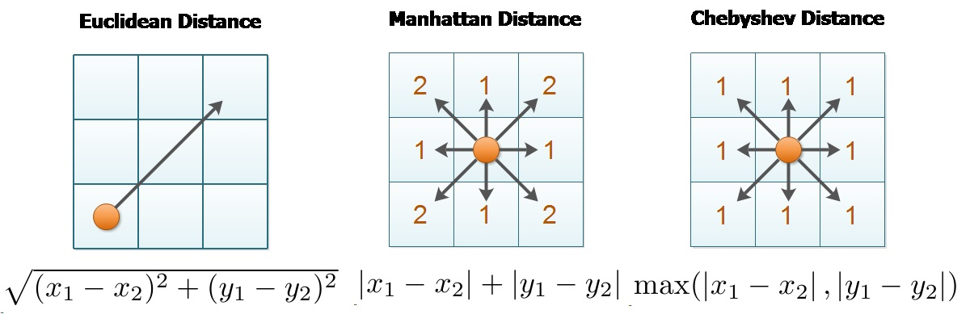
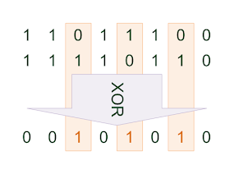
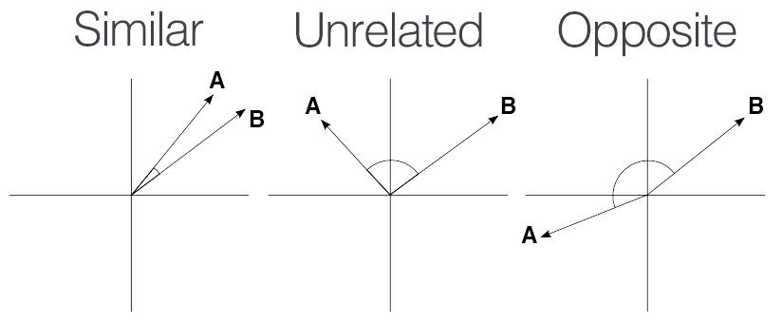
Distance Measures

Slide 9
Distance Measures
2 | 1 | 3
5 | 4
6 | 7 | 8
1 | 2 | 3
4 | 5 | 6
7 | 8
1 | 2 | 3 | 4 | 5 | 6 | 7 | 8
1 | 1 | 0 | 1 | 1 | 3 | 1 | 1
Manhattan distance = Sum(
)=9
3 | 1 | 5
4 | 2 | 6
 | 8 | 7
1 | 2 | 3
4 | 5 | 6
7 | 8
1 | 2 | 3 | 4 | 5 | 6 | 7 | 8
1 | 1 | 2 | 0 | 2 | 0 | 2 | 0
Manhattan distance = Sum(
)=8

Slide 10
Best-first search
1. Start with OPEN containing a single node with the initial state and a value resulting from applying eval-fn(node).
2. Until a goal is found or there are no nodes on OPEN do:
(a) Select the best node on OPEN.
(b) Generate its successors.
(c) For each successor do:

Slide 11
Best-first search cont.
i. If it has not been generated before, evaluate it, add it to OPEN, and record its parent.
ii. If it has been generated before, change the parent if this new path is better than the previous one. In that case, update the cost of getting to this node and to any successors that this node may already have (can be avoided when certain conditions hold).

Slide 12
Greedy Best-First Search
Evaluation of each node is h(n).
Selection of next node is n in OPEN with min(h(n)).
Expand until n is the goal, i.e., h(n) = 0.

Slide 13
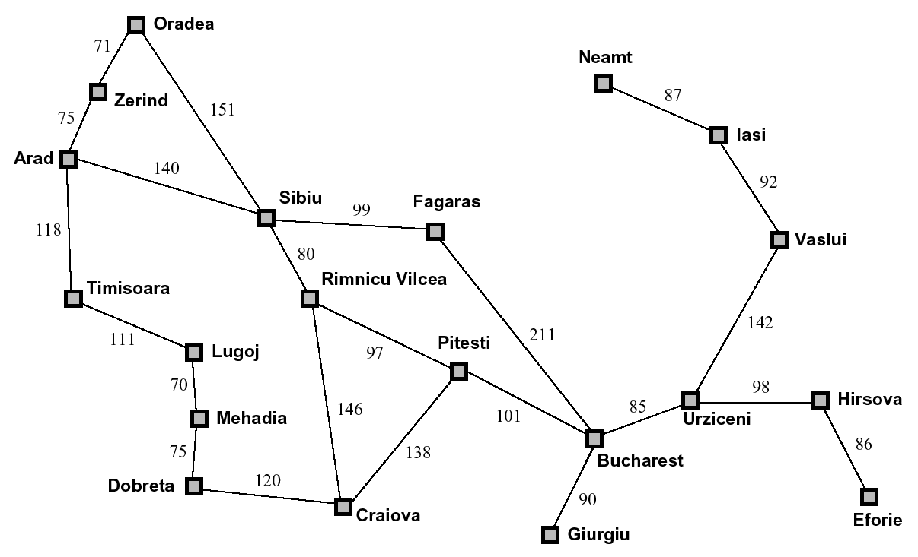

Slide 14
Straight-line Distance to Bucharest
Arad | 366 | Mehadia | 241
Bucharest | 0 | Neamt | 234
Craiova | 160 | Oradea | 380
Drobeta | 242 | Pitesti | 100
Eforie | 161 | Rimnicu | 193
Fagaras | 176 | Sibiu | 253
Giurgiu | 77 | Timisoara | 329
Hirsova | 151 | Urziceni | 80
Iasi | 226 | Vaslui | 199
Lugoj | 244 | Zerind | 374

Slide 15
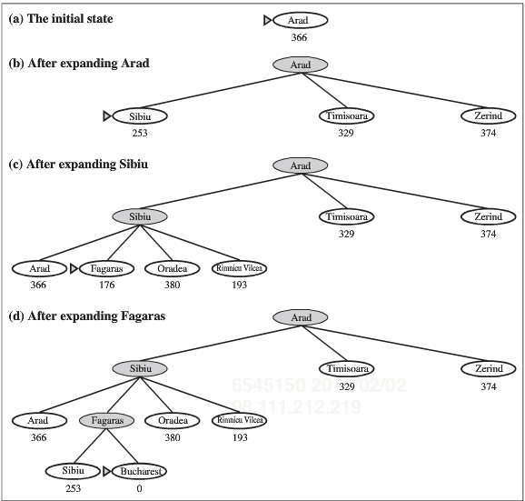

Slide 16
Time and Space Complexity of Best-first Search
Time Complexity = O(b^{m})
Space Complexity = O(b^{m})
High space complexity because nodes are kept in memory to update paths.
These are worst-case complexities. A good heuristic substantially reduces them.

Slide 17
Problems with best-first search
Uses a lot of space
The resulting algorithm is complete but not optimal
Complete if no infinite path explored.
Analogy: water
Problem: rivers are not the shortest path

Slide 18
Minimizing total path cost: A*
Similar to best-first search except that the evaluation is based on total path (solution) cost:
f(n) = g(n) + h(n) where:
g(n) = cost of path from the initial state to n
h(n) = estimate of the remaining distance

Slide 19
Admissibility and Monotonicity
Admissible heuristic = never overestimates the actual cost to reach a goal.
Monotone heuristic = the f value never decreases along any path.
When h is admissible, monotonicity can be maintained when combined with pathmax: f(n′) = max(f(n), g(n′)+h(n′))

Slide 20
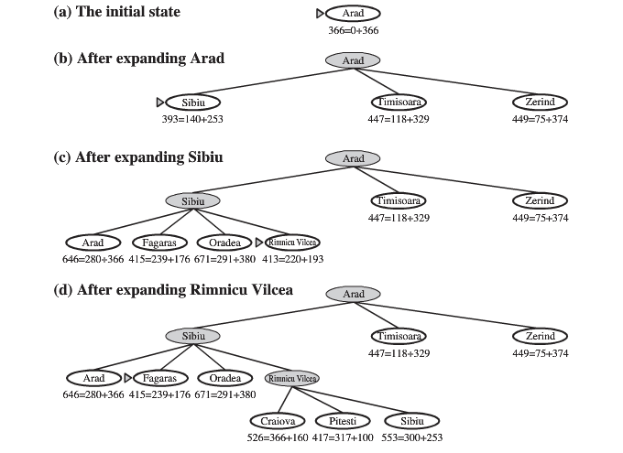

Slide 21
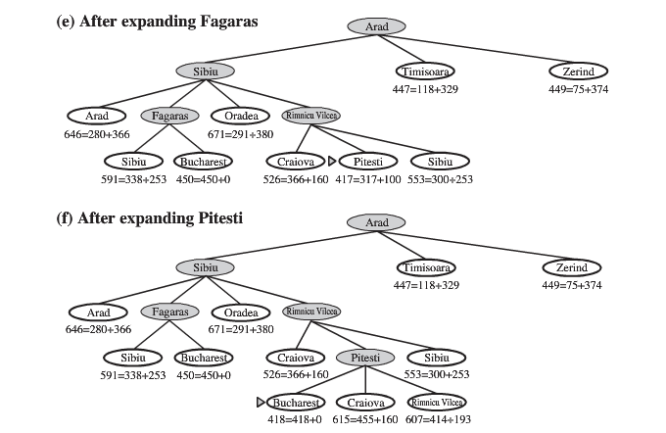
Notes:
Run Piazza Poll.

Slide 22
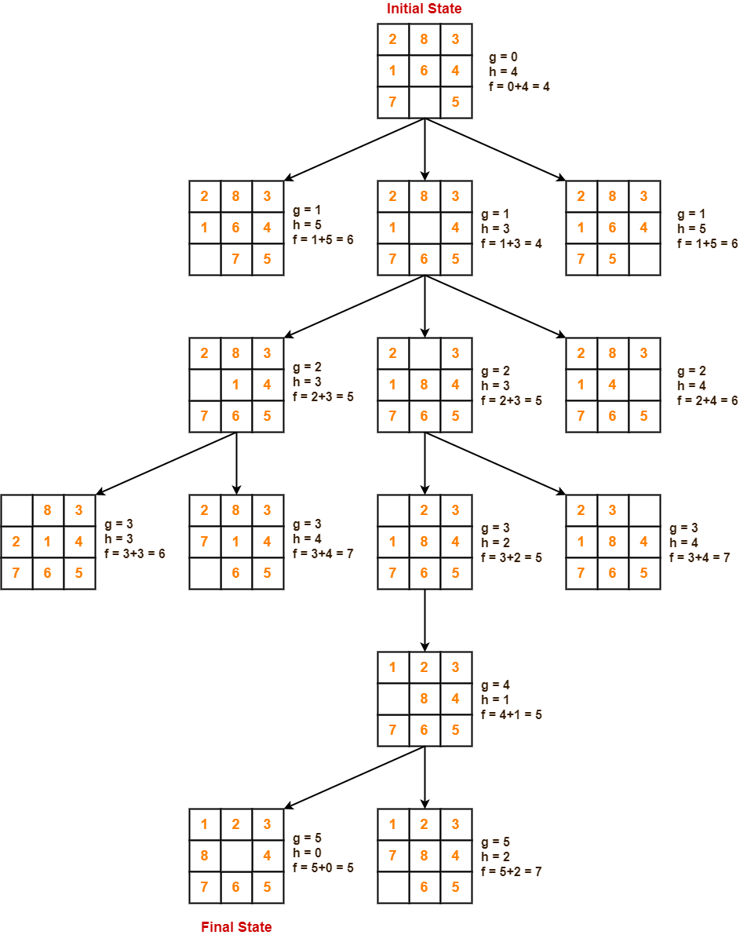
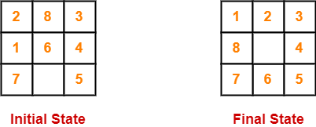
Example: tracing A*

Slide 23
Example: tracing A*

Slide 24
Example: tracing A*

Slide 25
Example: tracing A*

Slide 26
Example: tracing A*

Slide 27
Example: tracing A*

Slide 28
Example: tracing A* with two different heuristics

Slide 29
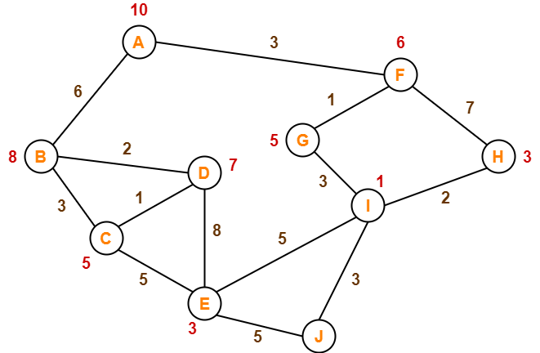
Example: tracing A*
f(F) = 3 + 6 = 9
f(B) = 6 + 8 = 14

Slide 30
Example: tracing A*
f(G) = (3+1) + 5 = 9
f(H) = (3+7) + 3 = 13
f(B) = 6 + 8 = 14

Slide 31
Example: tracing A*
f(H) = (3+7) + 3 = 13
f(B) = 6 + 8 = 14
f(I)(3+1+3) + 1 = 8

Slide 32
Example: tracing A*
f(H) = (3+7) + 3 = 13
f(B) = 6 + 8 = 14
f(I)(3+1+3) + 1 = 8

Slide 33
Example: tracing A*
f(H) = (3+7) + 3 = 13
f(B) = 6 + 8 = 14
f(H) = (3+1+3+2) + 3 = 12
f(J) = (3+1+3+3) + 0 = 10
f(E) = (3+1+3+5) + 3 = 15

Slide 34
Example: tracing A*
f(H) = (3+7) + 3 = 13
f(B) = 6 + 8 = 14
f(H) = (3+1+3+2) + 3 = 12
f(J) = (3+1+3+3) + 0 = 10
f(E) = (3+1+3+5) + 3 = 15

Slide 35
Optimality of A*
Intuitive explanation for monotone h:
If h is a lower-bound, then f is a lower-bound on shortest-path through that node.
Therefore, f never decreases.
It is obvious that the first solution found is optimal (as long as a solution is accepted when f(solution) ≤ f(node) for every other node).

Slide 36
Proof of optimality of A*
Let O be an optimal solution with path cost f*.
Let SO be a suboptimal goal state, that is g(SO) > f*
Suppose that A* terminates the search with SO.
Let n be a leaf node on the optimal path to O
f* ≥ f(n) admissibility of h
f(n) ≥ f(SO) n was not chosen for expansion
f* ≥ f(n) ≥ f(SO)
f(SO) = g(SO) SO is a goal, h(SO) = 0
f* ≥ g(SO) contradiction!

Slide 37
Completeness of A*
A* is complete unless there are infinitely many nodes with f(n) < f*
A* is complete when:
(1) there is a positive lower bound on the cost of operators.
(2) the branching factor is finite.

Slide 38
A* is maximally efficient
For a given heuristic function, no optimal algorithm is guaranteed to do less work.
Aside from ties in f, A* expands every node necessary for the proof that we’ve found the shortest path, and no other nodes.

Slide 39
Measuring the heuristics payoff
The effective branching factor b* is:
N = 1 + b* + (b*)² + ... + (b*)^{d}
Domination among heuristic functions

Slide 40
Measuring the Heuristics Payoff (cont.)
h2 dominates h1 is if, for any node n, h2(n) ≥ h1(n)
As long as h2 does not overestimate.
Intuition: The higher value represents a closer approximation to the actual cost of the solution. Therefore, less states are expanded.

Slide 41
Time and Space Complexity of A* Search
Time Complexity = exponential unless the error in the heuristic function is less than or equal to the logarithm of the actual path cost.
|h(n) – h*(n)| ≤ O(log h*(n))
Space Complexity = O(b^{m})
High space complexity because all generated nodes are kept in memory.
These are worst-case complexities. A good heuristic substantially reduces them.

Slide 42
Search with limited memory
Problem: How to handle the exponential growth of memory used by admissible search algorithms such as A*.
Solutions:
IDA* [Korf, 1985]
SMA* [Russell, 1992]
RBFS [Korf, 1993]

Slide 43
IDA* - Iterative Deepening A*
Beginning with an f-bound equal to the f-value of the initial state, perform a depth-first search bounded by the f-bound instead of a depth bound.
Unless the goal is found, increase the f-bound to the lowest f-value found in the previous search that exceeds the previous f-bound, and restart the depth first search.

Slide 44
Advantages of IDA*
Use depth-first search with f-cost limit instead of depth limit.
IDA* is complete and optimal but it uses less memory [O(bf*/δ)] and more time than A*.

Slide 45
SMA*
Utilizes whatever memory is available.
Avoids repeated states as far as memory allows.
Complete if the available memory is sufficient to store the shallowest solution path.
Returns the best solution that can be reached with the available memory.
Optimal if enough memory is available to store the shallowest optimal solution path.
Optimally efficient when enough memory is available for the entire search tree.

Slide 46
SMA* cont.
A
0+12=12
10
8
B
G
10+5=15
8+5=13
10
10
8
16
C
D
H
I
20+5=25
20+0=20
16+2=18
24+0=24
10
10
8
8
E
F
J
K
30+5=35
30+0=30
24+0=24
24+5=29

Slide 47
SMA* cont.
A
A
A
A
12
12
13
13(15)
B
B
G
G
15
15
13
13
H
18
inf

Slide 48
SMA* cont.
A
A
A
A
15(15)
15
15(24)
20(24)
G
B
G
B
B
24(inf)
15
24
15
20(inf)
I
C
D
24
25
inf
20

Slide 49
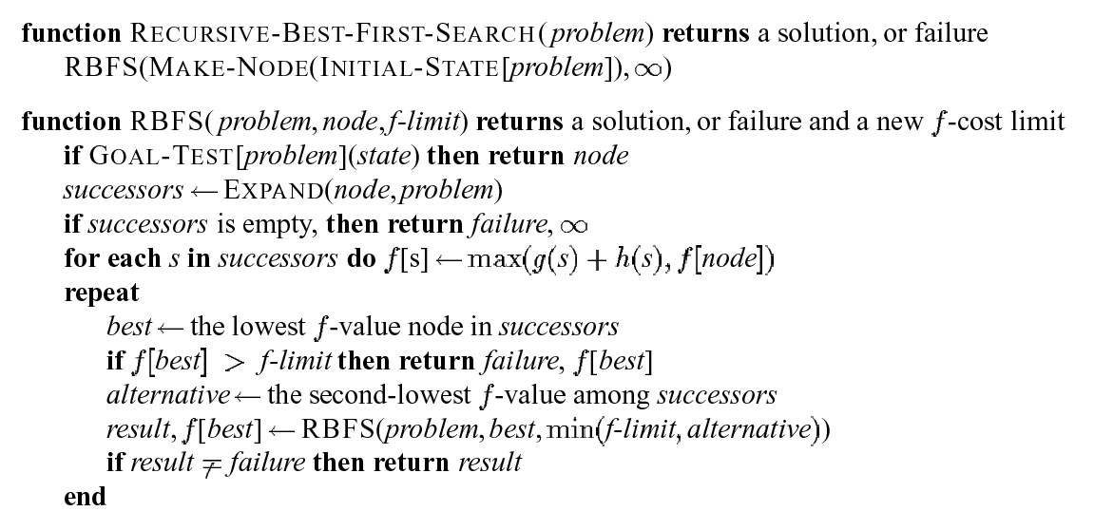
RBFS - Recursive Best-First Search

Slide 51
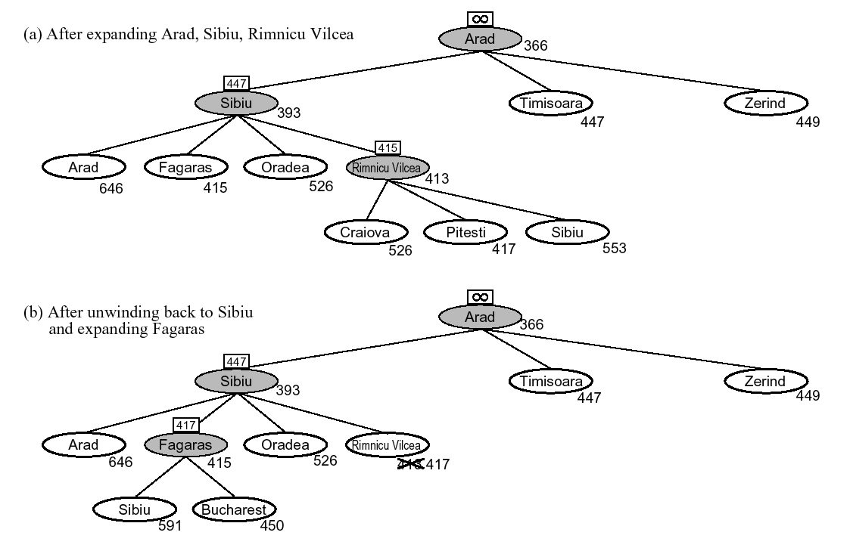

Slide 52
