Slide 1
InDUSTRIAL REVOLUTION 4.0
CREATED By: aBHIRUP dAS
STUDENT id: N01012170
HUMBER COLLEGE

Slide 2
INTRODUCTION
The purpose of this project is to push the current generation of Industry i.e. Industry 3.0 to it's next generation which will be 4.0 where machines in a factory will be operated remotely.
In our project we are trying to simulate a small scale 'smart factory' which is using a Raspberry Pi 3, Raspberry Pi camera, YL-40 sensor on the PCB which measures Temperature and Voltage
The hardware is operated through a Android mobile app that is connected to a online database situated on Amazon Cloud services where the hardware setup will be uploading it's data on to the database that can be accessed from the mobile app.
The hardware scans QR codes with information using the Pi camera and blinks a LED on the PCB and the YL-40 sensor on the PCB measures the voltage of the machine and displays on the Pi terminal.
The problem that will be solved by this project is to eliminate the requirement of constant human presence to monitor and supervise activities going on in the factory.

Slide 3
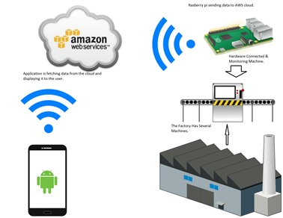
Project diagram
The machines in the factory will gather the data and store it in the Raspberry Pi
The Raspberry Pi will send the collected data from the machines to a database located in Amazon Cloud Services over the network.
Then the android app will fetch that data from the cloud and will display in it.

Slide 4
Budget
The components used to complete the project along with their prices are as follows:
Raspberry Pi 3 Canakit from Amazon.ca - $99.99 CAD
Raspberry Pi Camera module V2 8MP - $45 CAD
YL-40 Sensor on PCB - $40 CAD
Battery Case and 2xAA Battery - $15 CAD
Acrylic Case - $10 CAD
The total cost of the project is $209.99 CAD

Slide 5
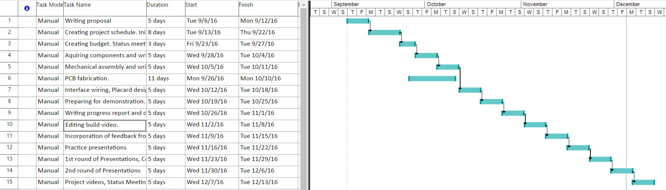
schedule

Slide 6
Build video
https://www.youtube.com/watch?v=Q_f6Z0ZnewQ

Slide 7
Course knowledge used from previous courses
TECH 101, TECH 103, TECH 150 – Electric Circuits 1, Digital Fundamentals, and Electronic Devices and Circuits taught us how to build circuits, test it and read data from it using digital multimeter and oscilloscope.
TECH 104, TECH 153, CENG 212 – Programming Fundamentals, Technical C, and Programming Techniques in JAVA prepared us to code all the programs using the programming logic learned in those courses that are being coded in Python which are used in the Pi.
CENG 215, CENG 252 – Digital and Interface Systems, Embedded Systems has taught us advance circuit design and various sensors and motors that are connected using circuits. Also integrating Assembly programming and C programming language to control the functionality of various motors and sensors.
CENG 200 – Unix Scripting taught us how to use the unix operating system using the command line interface which was very helpful to use the Raspberry Pi as it uses same type of OS on it.
CENG 216 – Intro to Software Engineering prepared us how development cycle of a project happens and essential requirements to start a project, most notably a Project Schedule using Gantt Chart.

Slide 8
THANK YOU

