Slide 1

Finding Periodic Discrete Events in Noisy Streams
Abhirup Ghosh, Christopher Lucas, Rik Sarkar
School of Informatics
The University of Edinburgh

Slide 2


Motivations & Applications (1)
Periodic signals are ubiquitous
Footsteps and heart beats
Helps to detect anomalous events
Useful in medical diagnosis

Slide 3



Motivations & Applications (2)
Designing services customized to users' schedules
Periodic app usage: check weather forecast every morning
Optimize app behaviors using periodic usage pattern
Periodic pattern in traffic congestion
Predict long term traffic behavior

Slide 4
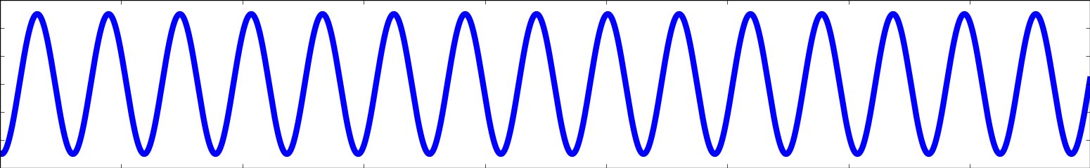
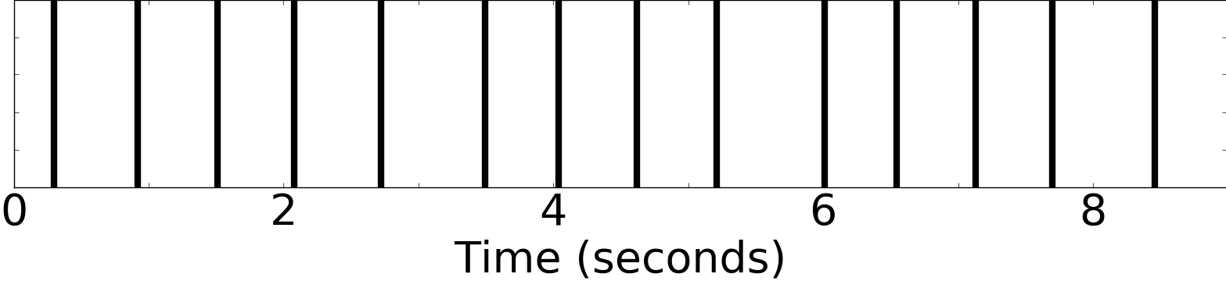
Real signals - approximately periodic
Footstep Event
Delays between footsteps accumulate
– phase changes

Slide 5
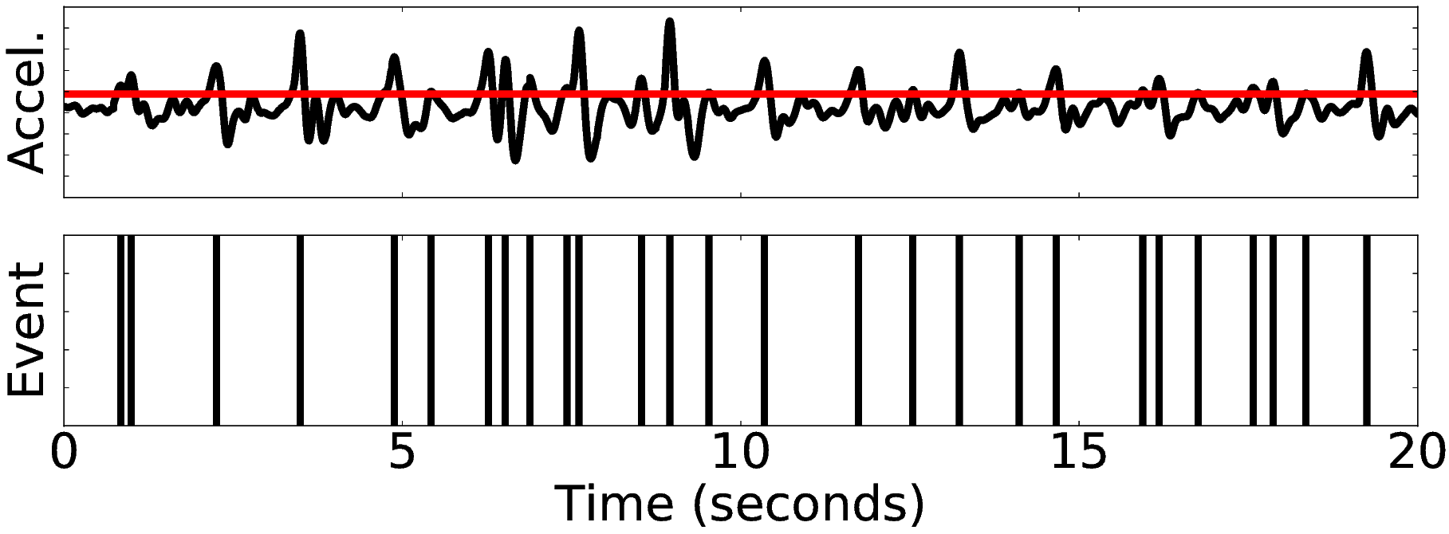
Real signals - noisy
Example: footsteps
Footstep
Event
Spurious events due to noise
Event stream: interleaved periodic and noise events

Slide 6
Problem Statement
Detect Period T in point event streams where
Phase changes
Periodicity changes
Contains noise events

Slide 7
Related Work

Slide 8
Fourier Transform
Decomposes a signal into multiple sine waves
Fails when no global sine wave fits - When phase / periodicity changes
Footstep Event

Slide 9
Segment Periodicity [Li et. al '12, '15]
Histogram of events modulo period
Segment length = period
Otherwise
Doesn't work when phase / periodicity changes
Expensive - tests all periods
Notes:
Gauss proposed Fourier Transform in 1805

Slide 10
Talk Outline
Generic model of periodic event streams
Fast online algorithm to detect periodicity
Works on real and synthetic data

Slide 11
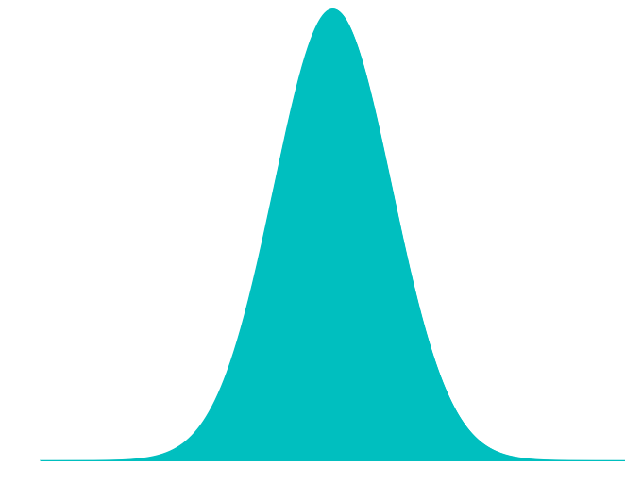

Model - periodic events
Next event occurs in a Gaussian neighborhood at distance T.
Periodic Events
$$T$$
Time
Phase changes: Gaussian delays add up
More variance - faster phase change

Slide 12
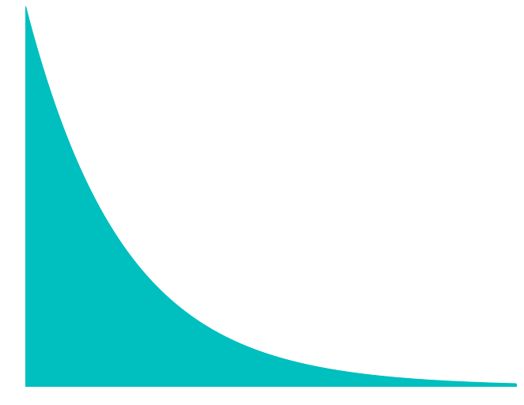
Model - noise events
Noise events are distributed uniformly
Inter event distance - Exponential distribution
Noise event rate - Exponential distribution rate
Noise Events
Time

Slide 13
Model - event stream
Time ordered sequence of periodic and noise events

Slide 14
Algorithm

Slide 15
Particle Filter
Online sequential sampling to estimate latent states
A particle: A guess of period, phase, etc.
Algorithm Steps:
Initialization using priors
Likelihood weighting
Resample
Applying dynamics

Slide 16



Likelihood weighting
Events
$$T_{1}$$
$$T_{2}$$
$$T_{3}$$

Slide 17
Likelihood weighting
Events
Weight
$$T_{1}$$
$$T_{2}$$
$$T_{3}$$
Given a particle how likely is the new event?

Slide 18
Resampling
$$T_{1}$$
$$T_{2}$$
$$T_{2}$$
$$T_{1}$$
$$T_{3}$$
$$T_{1}$$
Weight
Resample 3 particles with replacement proportional to weights

Slide 19
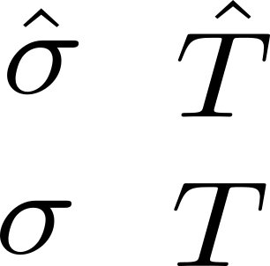
Applying Dynamics
Perturb each resampled particle
Enables to track system dynamics with small number of particles
T

Slide 20
Iterative process
Same steps for each new event

Slide 21
Incorporating noise
A new event
Comes from periodic process
Comes from
noise process
Probabilistically mark the new event as periodic / noise event

Slide 22




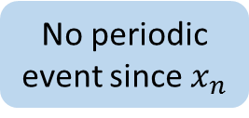
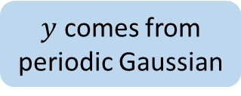
Likelihood weighting
$$x_{n}$$
$$z_{n}$$
$$y$$
$$T_{n}$$
Periodic component
Noise component
$y$ comes from periodic Gaussian
No noise event since
comes from exponential
No periodic event since $x_{n}$

Slide 23
Period estimate
Median of the period values in all particles

Slide 24
Experiments

Slide 25
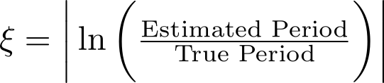
Experiment Setup
Synthetic dataset: generated using the model
Real dataset: Footstep and pulse events
Comparison with Fourier Transform, Autocorrelation, and Segment periodicity
Period estimation error:

Slide 26
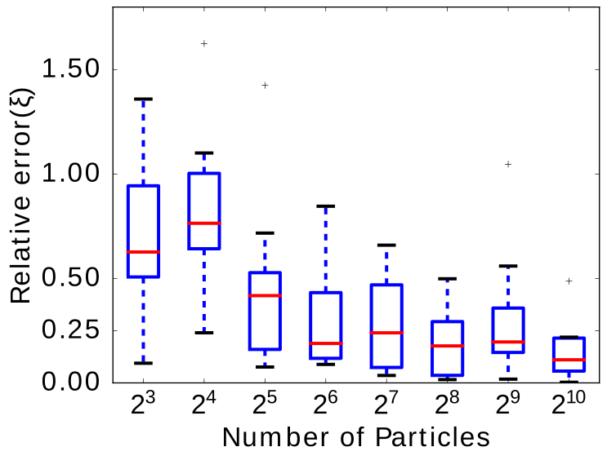

Number of particles
75 percentile
Median
25 percentile
Reasonable accuracy with small number of particles
Notes:
T=10, sigma/T =0.6, noise=1.5

Slide 27
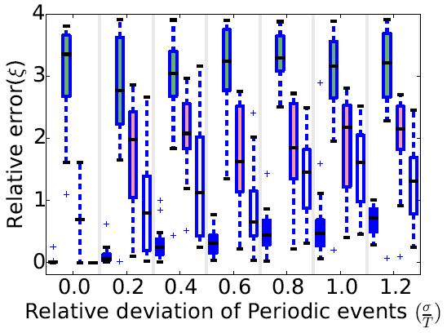
Varying how fast phase changes
Fourier Transform
Segment periodicity
Autocorrelation
Particle Filter
Particle filter has small error even when phase changes quickly
Notes:
T=10, noise=0.05

Slide 28
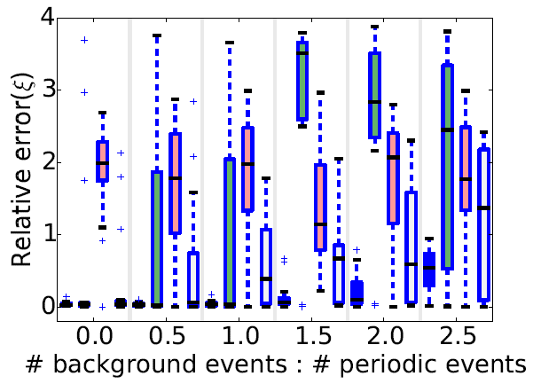
Varying amount of noise
Fourier Transform
Segment periodicity
Autocorrelation
Particle Filter
Average # noise events per periodic event
Particle filter has small error in noisy signal
Notes:
T=10, sigma/T = 0.1

Slide 29
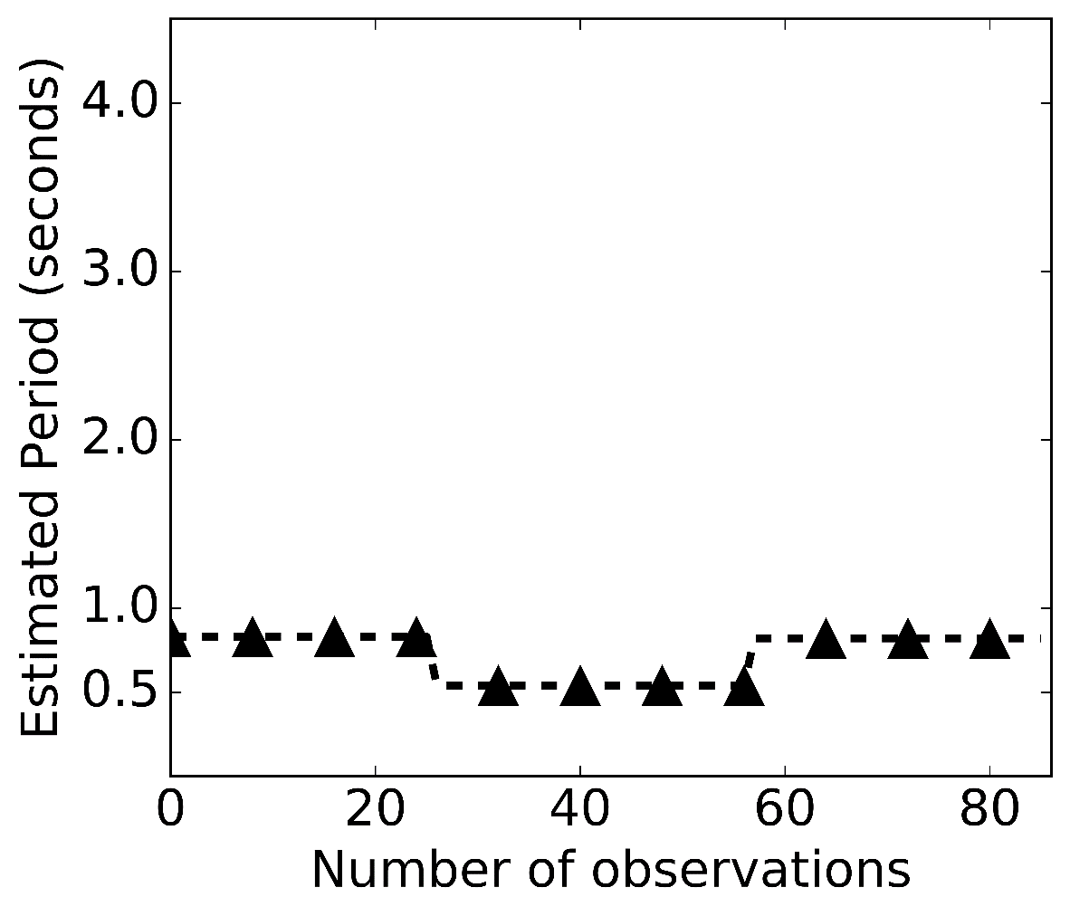
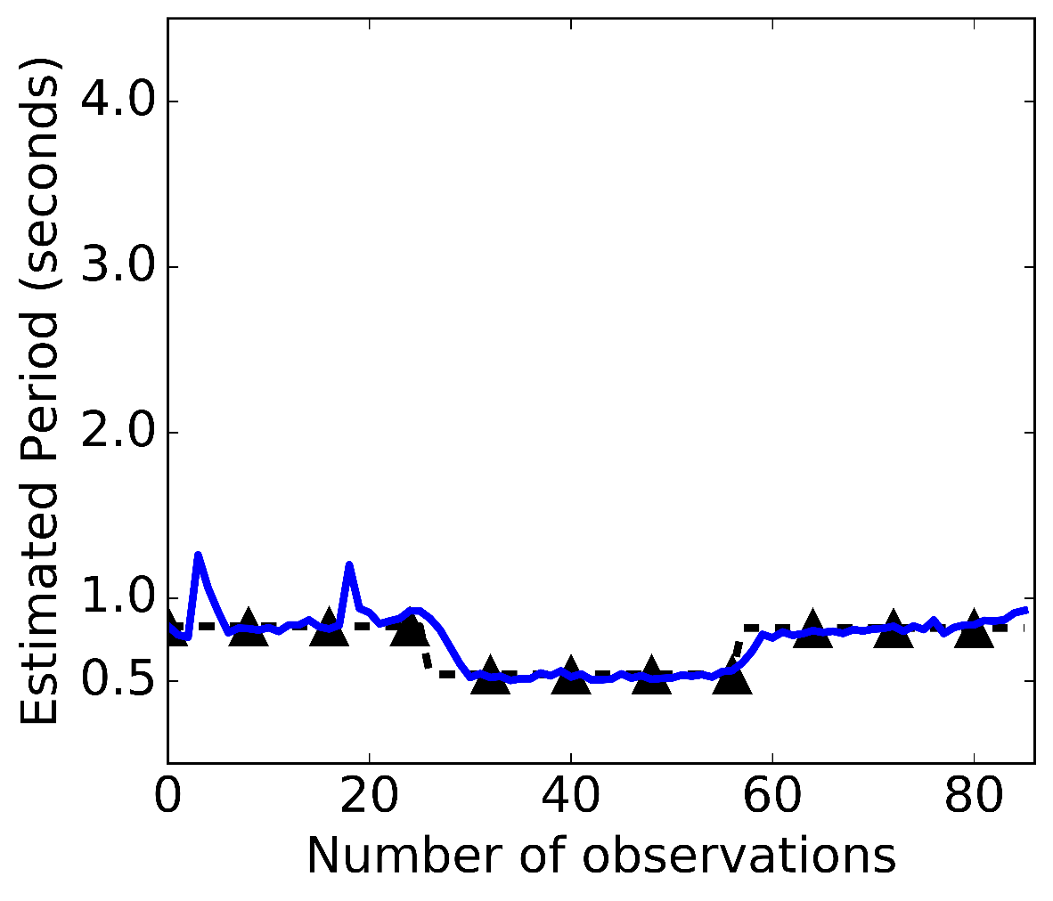
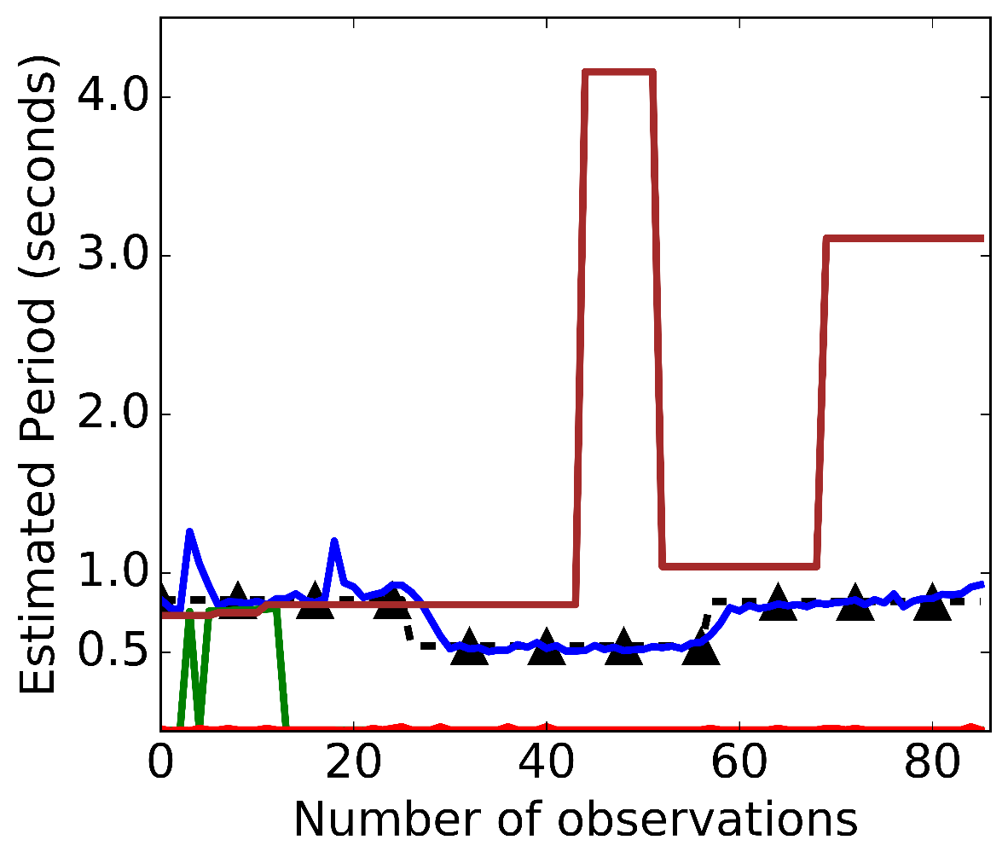
Tracking changing step periodicity
Particle Filter
Autocorrelation
Ground truth
Segment periodicity
Fourier
Transform
Particle filter closely tracks changing step periodicity

Slide 30
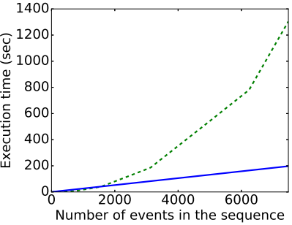
Computation time
Fourier Transform
Particle Filter
Particle Filter is faster than Fourier Transform. Other methods are worse.

Slide 31
Summary
Uses constant and low number of particles
Adapts to system dynamics:
Varying noise and phase change parameters our method outperforms other methods
Provides faster computation
Successfully tracks walking speed & predicts next pulse events

Slide 32
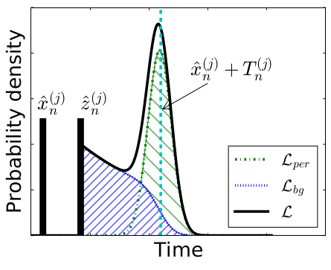
Likelihood Weighting

Slide 33
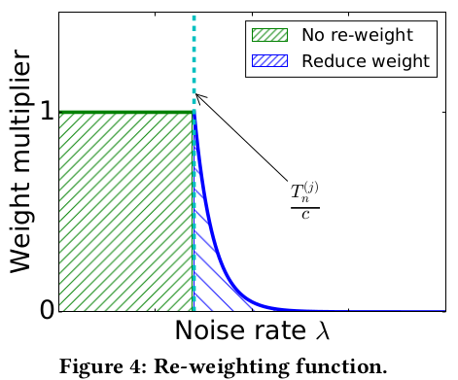
Re-weighting function

Slide 34
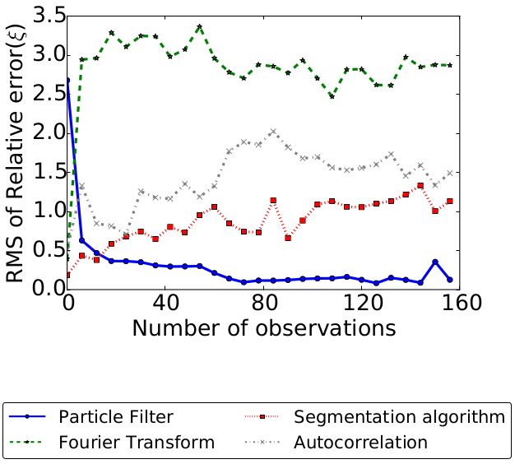
Online experiment

Slide 35
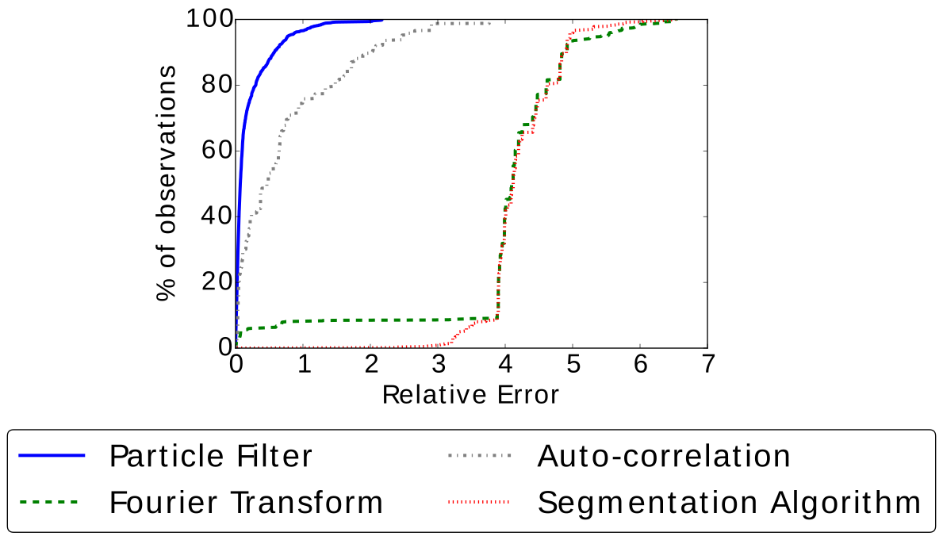
Error in step periodicity

Slide 36
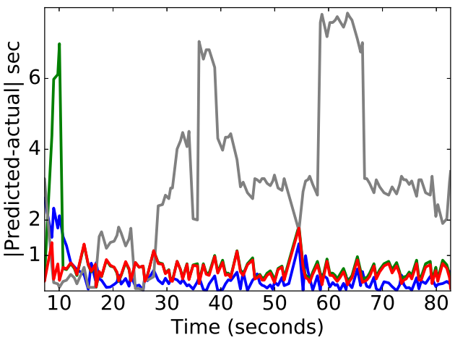
Next pulse prediction
Predicted next pulse = current pulse + period estimate
Fourier Transform
Autocorrelation
Particle
Filter
Segment
periodicity

