Slide 1

Topological Signatures For Fast Mobility Analysis
Abhirup Ghosh, Benedek Rozemberczki, *Subramanian Ramamoorthy, Rik Sarkar
University of Edinburgh,
*FiveAI Ltd., Edinburgh

Slide 2
Mobility analysis
We want to analyze mobility for
Clustering similar trajectories
Predicting motion at large scale
Finding nearest neighbor trajectories

Slide 3
Mobility analysis is challenging
Trajectories are
Complex
Sequential
Have different lengths
Trajectory distances (Fréchet) are expensive to compute
Standard learning and mining tools for point clouds do not apply

Slide 4

Overview: Topological signatures
Fixed dimensional Euclidean vectors
Efficiently compare trajectories using Euclidean distance
Can apply standard learning and mining
?
Nearest neighbor search
Clustering
Motion prediction at large scale
$$500m$$

Slide 5
Related work
Markov model and Neural Networks ^{[IJCAI ‘17]} are popular for modelling mobility
Can predict motion at small scale
But, not accurate for prediction at large scale
Models are compute intensive
Memoryless assumption for a Markov model does not fit for real trajectories
Neural networks are not general enough for other analytical tasks like clustering trajectories

Slide 6


Perspective of obstacles
Complexity of trajectories arise from navigating around obstacles
Homotopy types classify trajectories regarding navigation patterns
Different homotopy
Obstacle
Same homotopy
Notes:
Different from the red

Slide 7
Limitations of topological analysis
Homotopy types cannot compare trajectories with different source-destinations
Homotopy types are categorial – difficult to use in further analysis
Cannot compare using homotopy

Slide 8
Algorithm: Constructing topological signatures

Slide 9
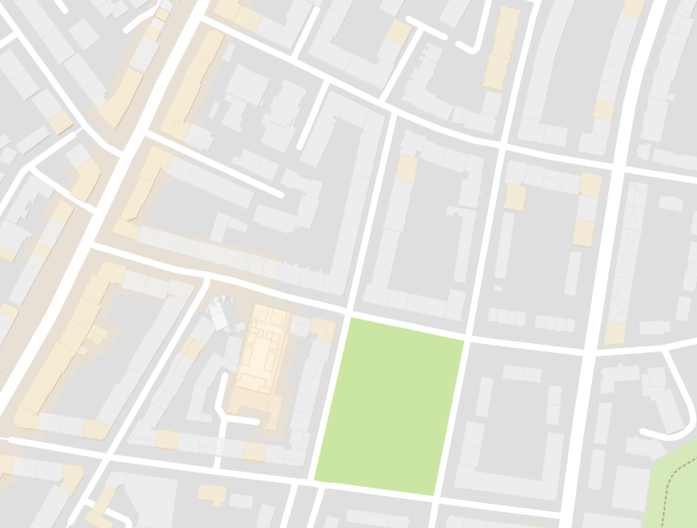










Key observations
A trajectory creates angles at obstacles
Angles are equal for navigating an obstacle similarly
Angles differ for navigating an obstacle differently
$$α$$
$$O_{2}$$
$$O_{2}$$
$$(−π,α)$$
$$(π, α)$$
$$O_{1}$$
$$−π$$
$$O_{1}$$
$$π$$
Signature space
Angles encode how a trajectory navigates obstacles

Slide 10
Method using differential forms
Formalise using differential forms on a graph
Steps to build topological signatures:
Discretize domain – create planar graph
Construct differential forms on edges
Build topological signatures using differential forms
Notes:
More general than angles and work without localization

Slide 11

Discrete domain – Planar graph
Road networks naturally discretize the domain
Triangulation on random points creates planar graph
Trajectories are sequence of edges
Obstacles – Regions with
no / less mobility
Discretization by road network
Triangulating
random points

Slide 12




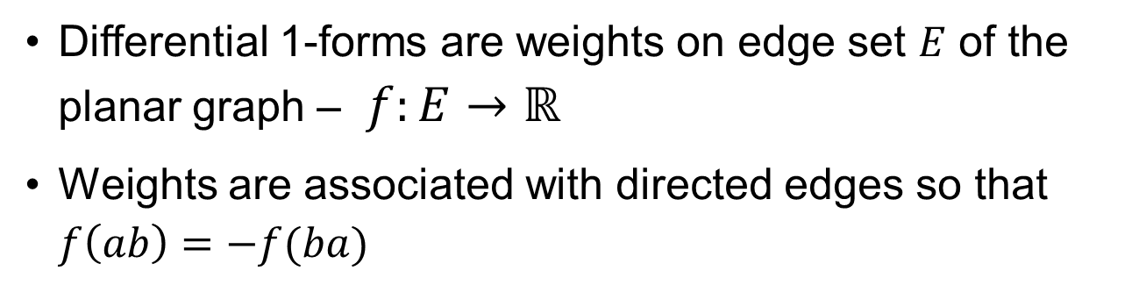
Differential 1-form
Differential 1-forms are weights on edge set $E$ of the planar graph – $f:E→ℝ$
Weights are associated with directed edges so that $f\left(ab\right)=−f(ba)$
$$f\left(ab\right)=1$$
$$a$$
$$b$$
$$f\left(ba\right)=−1$$
Notes:
Connection,

Slide 13

Differential forms on a planar graph
Multiple straight walks from an obstacle to the boundary in random directions
Assign differential forms / directed weights on crossing edges
Weight at an edge is the number of crossing walks
1
Assign directed edge weights
2

Slide 14


Integrate differential forms along trajectory
Integration over a path = Sum the differential forms
$$[−2]$$
$$[5]$$
1
1
1
1
1
1
1
Integration values can separate the trajectories

Slide 15


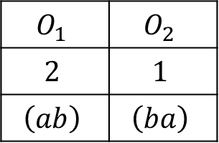

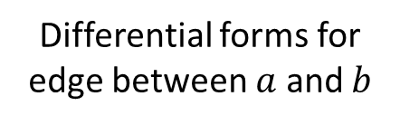
Differential forms for all obstacles
Construct differential forms for all obstacles
Maintain them separately at edges
$$O_{1}$$
$$O_{1}$$ | $$O_{2}$$
$$2$$ | $$1$$
$$\left(ab\right)$$ | $$\left(ba\right)$$
$$O_{2}$$
Differential forms for edge between $a$ and $b$

Slide 16



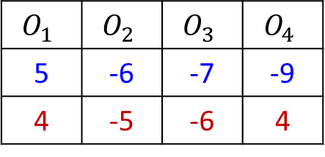

Topological signature
Topological signature: integration of differential forms along a trajectory
Maintain integrations for different obstacles in separate dimensions
$$O_{1}$$
Topological Signatures
$$O_{1}$$ | $$O_{2}$$ | $$O_{3}$$ | $$O_{4}$$
5 | -6 | -7 | -9
4 | -5 | -6 | 4
$$O_{2}$$
$$O_{4}$$
$$O_{3}$$

Slide 17
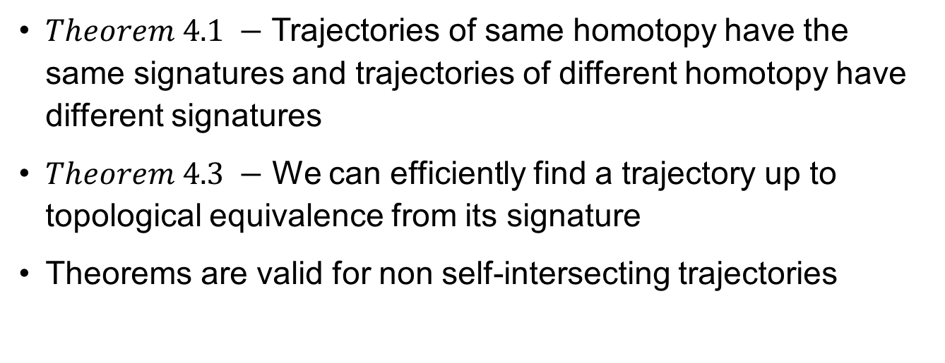


Signatures preserve topological properties
$Theorem 4.1 −$ Trajectories of same homotopy have the same signatures and trajectories of different homotopy have different signatures
$Theorem 4.3 −$ We can efficiently find a trajectory up to topological equivalence from its signature
Theorems are valid for non self-intersecting trajectories
$$start$$
$$end$$
Notes:
Homotopy equal -> same source / dest
Theorems

Slide 18
More on properties of signatures
Signatures are compact representations
Analysis algorithms run efficiently on signatures
Efficient ways to compute signatures
Online
Distributed
Framework is general – flexible ways to create differential forms

Slide 19
Applications & Experiments

Slide 20
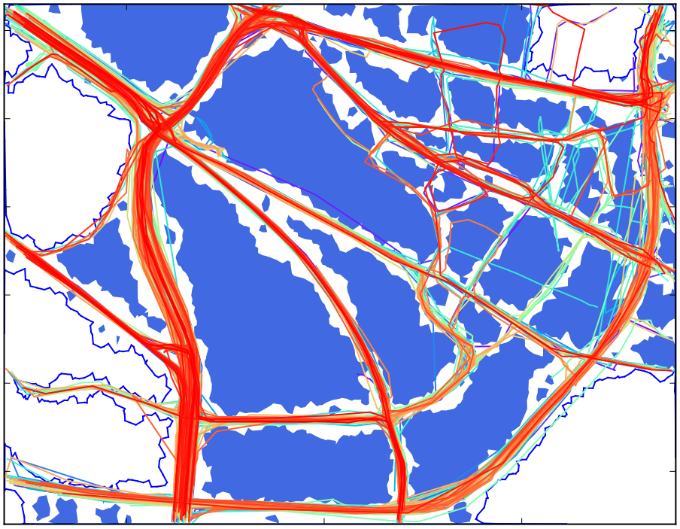
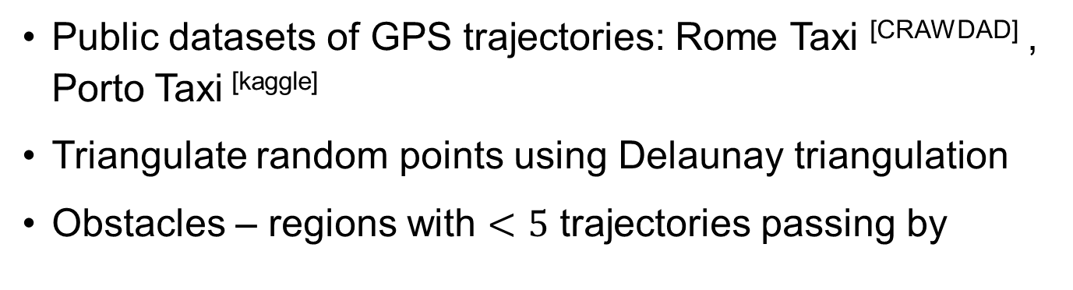
Experimental setup
Public datasets of GPS trajectories: Rome Taxi ^{[CRAWDAD]} , Porto Taxi ^{[kaggle]}
Triangulate random points using Delaunay triangulation
Obstacles – regions with $<5$ trajectories passing by
Notes:
3900 trajectories – 2.5 x 2.1 km. A point every 250 m^2 – 20,000 points.
We construct a planar graph using triangulation by Delaunay triangulation of random points in the points.

Slide 21

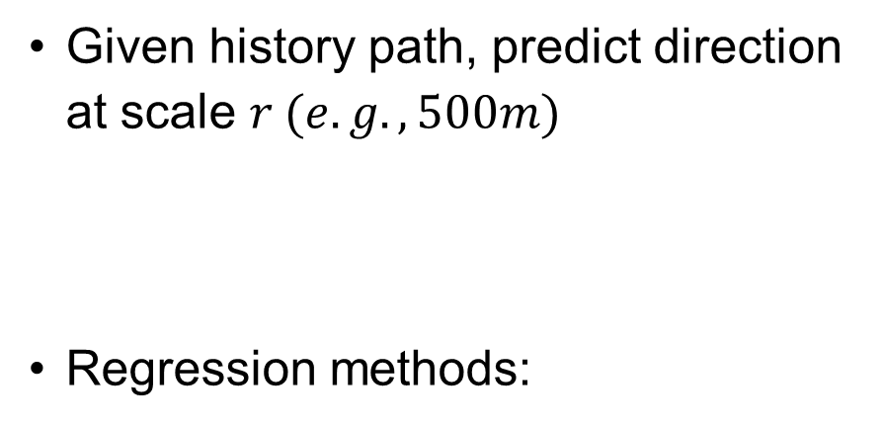
Direction prediction at large scale
Given history path, predict direction at scale $r (e.g., 500m)$
Regression methods:
Error
$$500m$$
Prediction method
LSTM
Standard regressors
Feature
Location history
Topological Signature
Notes:
Neural network for sequence modelling

Slide 22
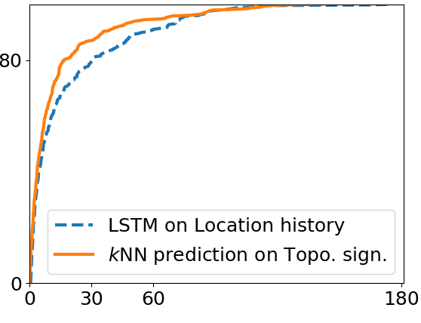
Accuracy – LSTM vs Signature based
% of
test cases
Prediction error in degrees
Even simple KNN prediction outperforms LSTM – Signatures encode powerful features

Slide 23
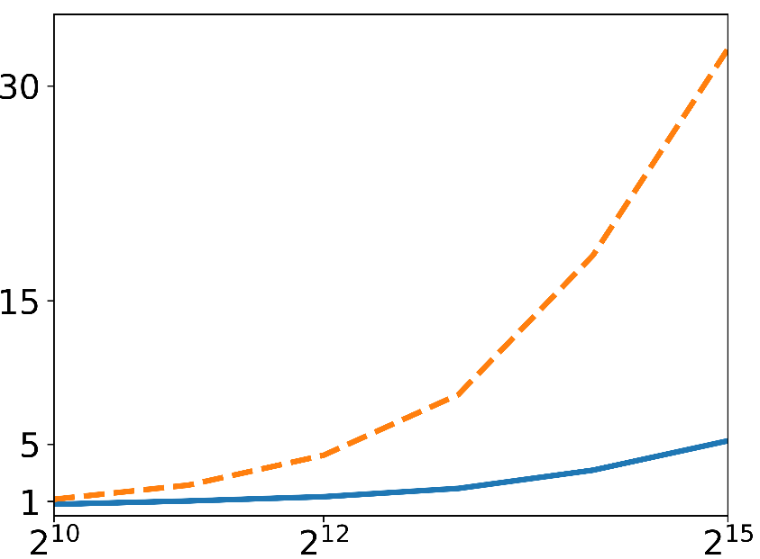
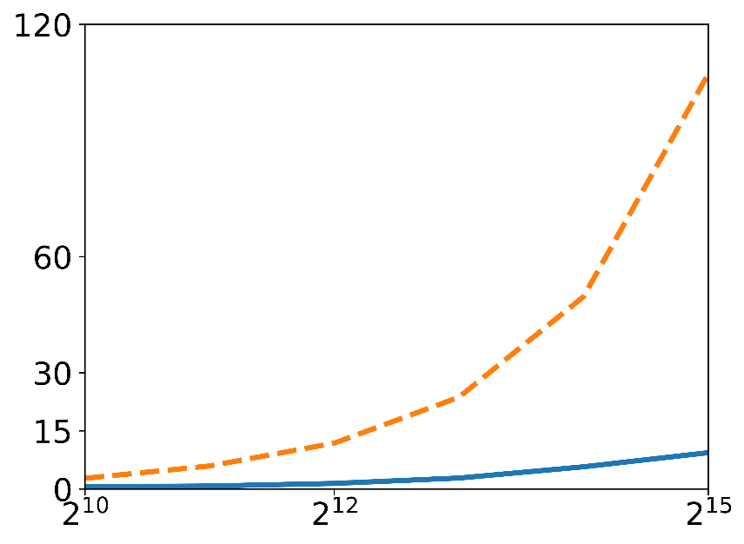

Efficiency – LSTM vs Signature based
Training time (min)
Query time (sec)
# trajectories in dataset
# trajectories in dataset
Signatures enable efficient prediction

Slide 24
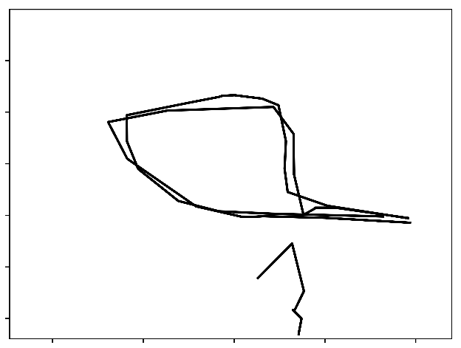
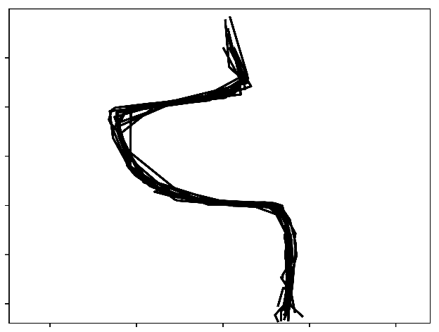
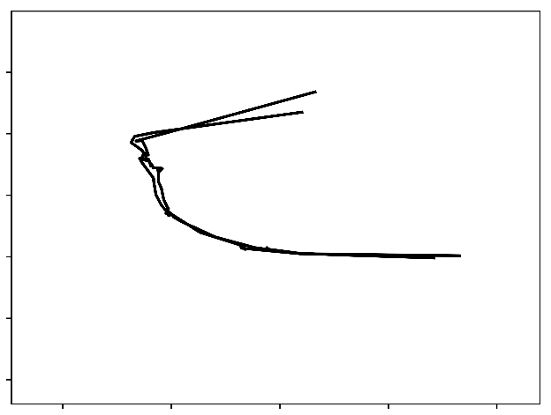
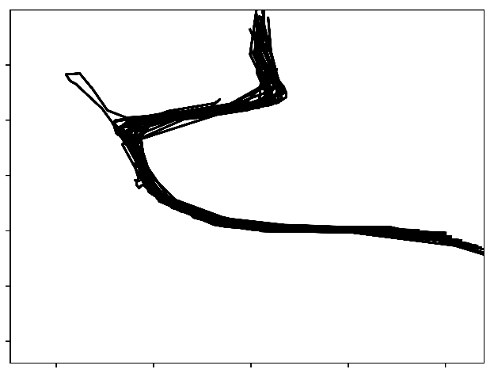
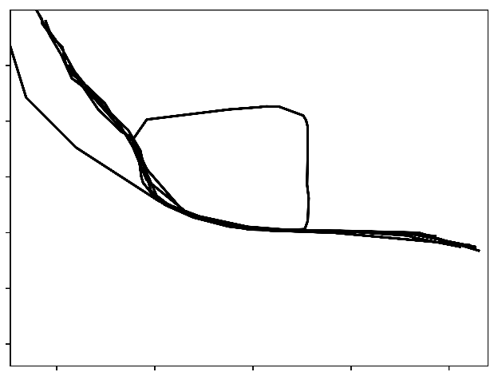
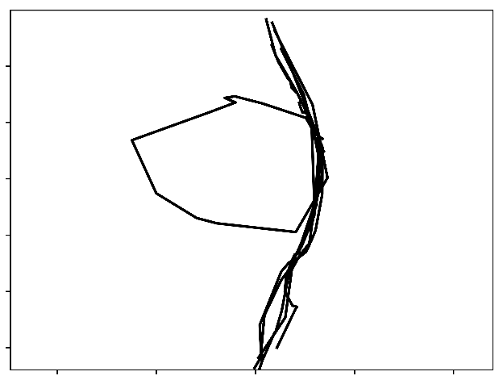
Trajectory clustering
Trajectory clustering – Standard clustering on signatures

Slide 25
Trajectory clustering
DBSCAN on signatures can separate complex overlapping patterns – Signatures contain important features

Slide 26
Searching Fréchet nearest neighbor
Prune using Locality Sensitive Hashing on signatures
Hash function – project signatures on random line and segment the line into buckets
Trajectories in the same bucket with query are similar to query
Query trajectory
Signatures
Project on Random line
A bucket contains similar trajectories
Notes:
Nearest neighbours – Explain a bucket contains similar trajectories

Slide 27
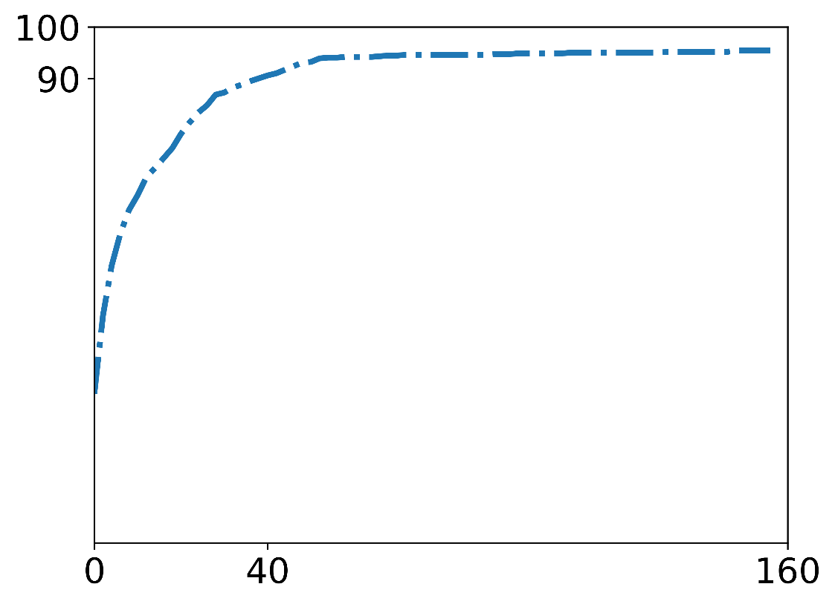
Nearest neighbor search – Accuracy
% success
# trajectories to test using Fréchet
Small # of candidates to find Fréchet nearest neighbor

Slide 28
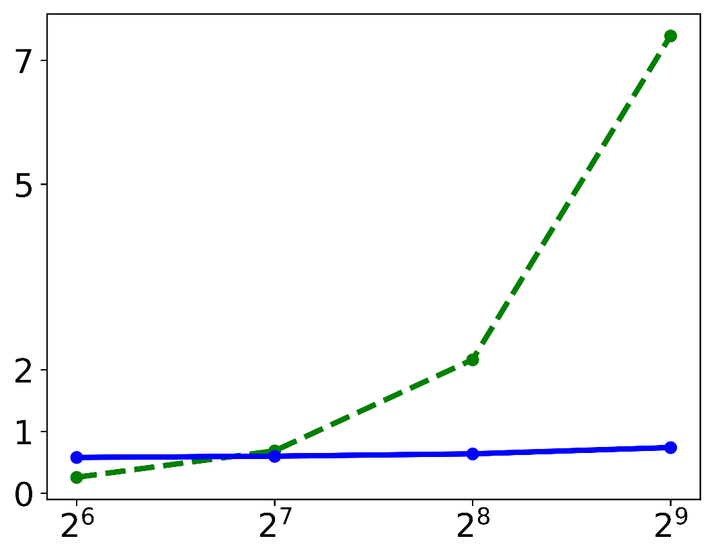
Nearest neighbor search – Efficiency
Pairwise Fréchet
Compute time (min)
LSH
# trajectories in the dataset
Faster nearest neighbor than pair-wise Fréchet

Slide 29
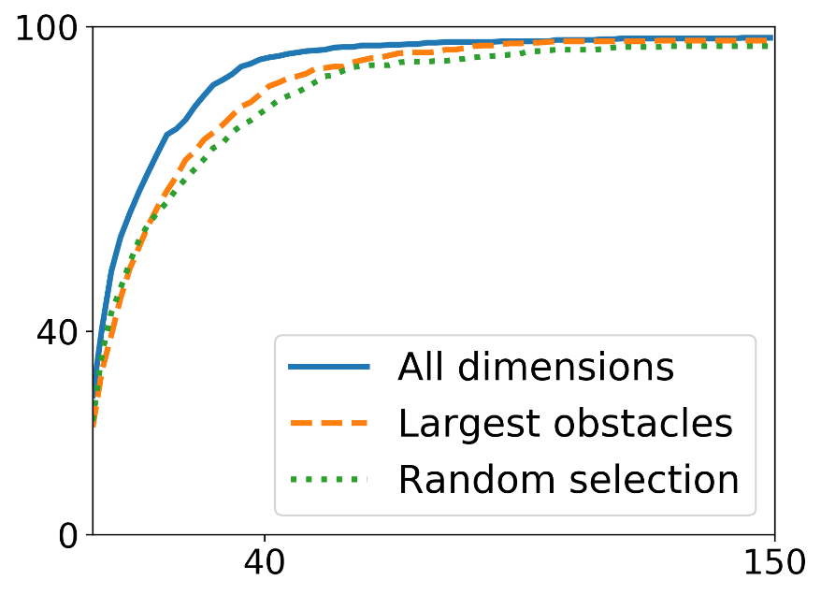
Dimensionality of signatures
Signatures can be high dimensional – many obstacles
% success
# trajectories to test using Fréchet
Selected 5 dimensions out of 67. Low dimensional signatures preserve nearest neighbor accuracy
Notes:
number

Slide 30
Summary
Signatures preserve topological properties
Enable motion prediction at large scale
Enable analytic tools
clustering
nearest neighbor search
density estimate
dimension reduction
Framework to produce signatures is fast and robust
Robust to localization noise and localization frequency
Can be extended multi-resolution signatures
Notes:
Didn’t discuss – mention.
Multi res
Prediction , clustering
Vector x
All same level

Slide 31
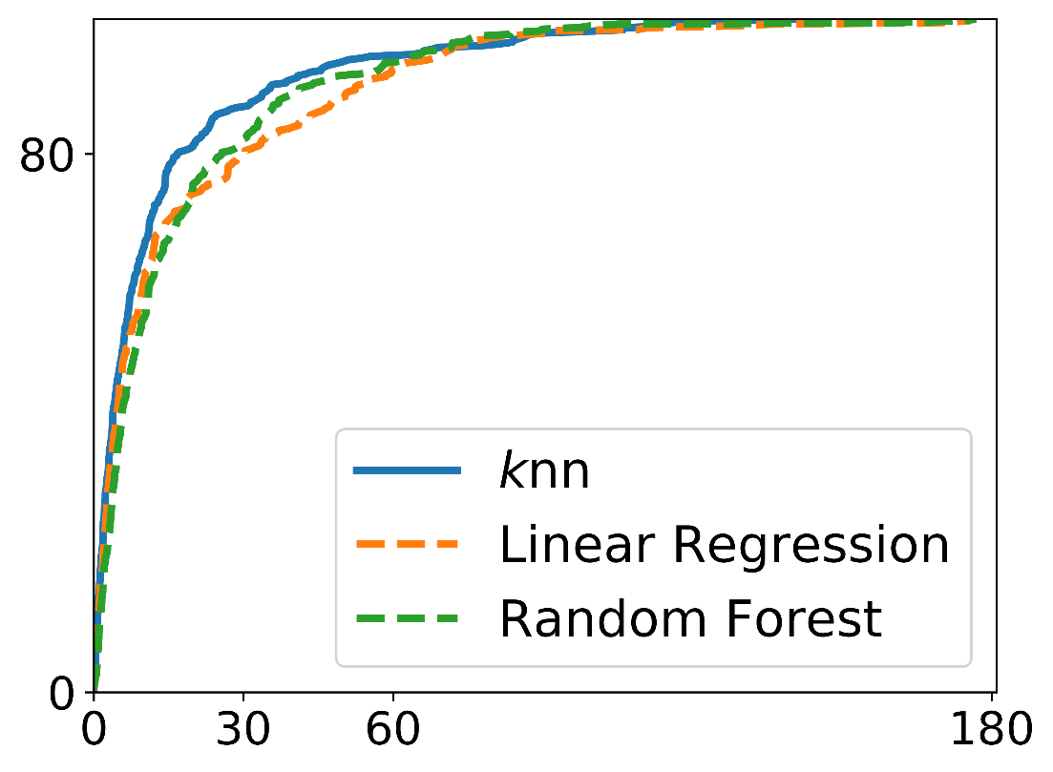
Accuracy – Standard regressors
% of
test cases
Prediction error in degrees
All regressors predict accurately – Signatures encode important features

Slide 32
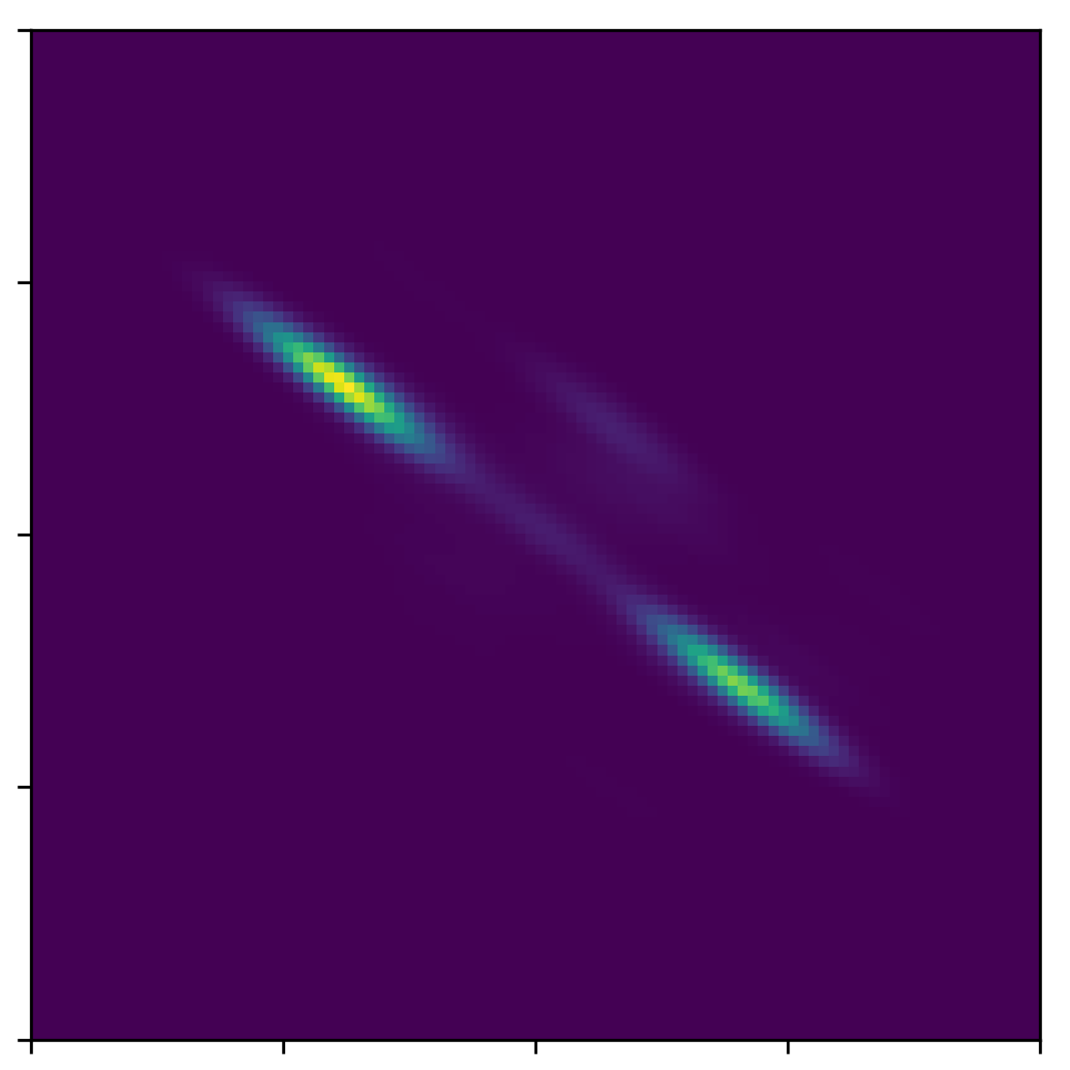
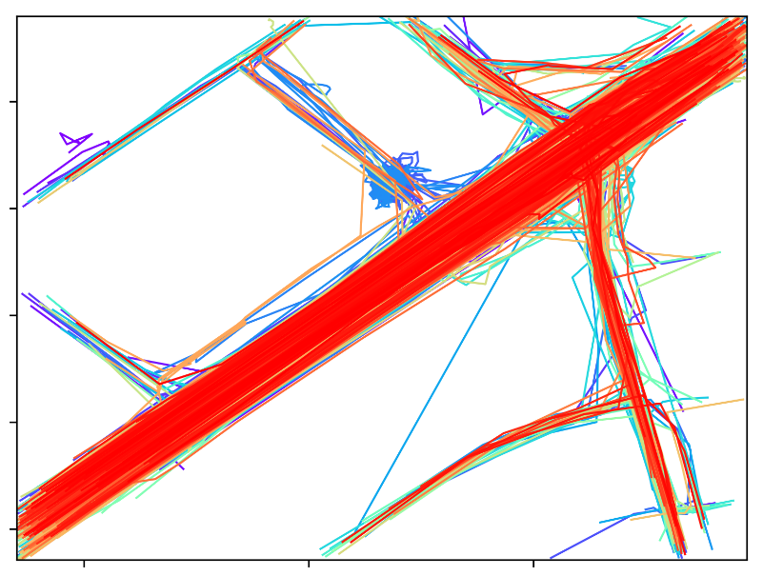
Signature density gives popular paths
Hotspots correspond to bidirectional flow here
Uses standard kernel density method – easier than customised methods

Slide 33
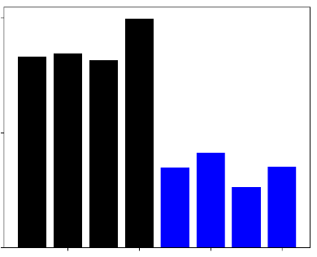
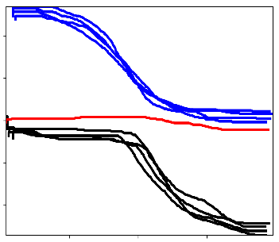
Multiresolution signatures
Blue became recently close
Distance to red trajectory from others
Adapts to recency of locations – Other distances (Fréchet) do not have this flexibility

Slide 34
Trajectories of different homotopy but with same signature

Slide 35
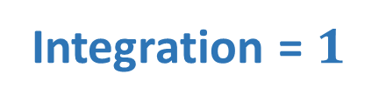


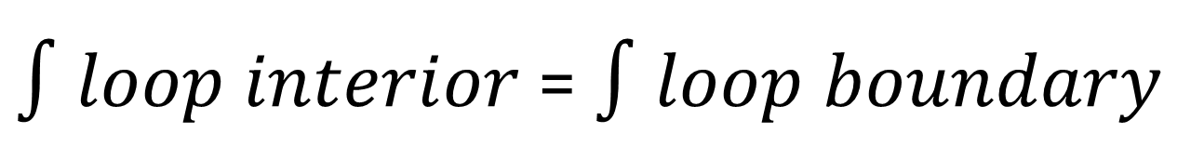



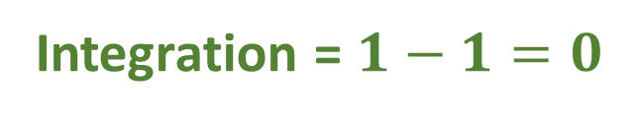
$∫loop interior$ = $∫loop boundary$
Generalization of famous Stokes Theorem in calculus
$$1$$
$$1$$
$$1$$
$$1$$
$$1$$
Integration = $1$
Integration = $1−1=0$
Integration of differential forms sums the weights inside

Slide 36
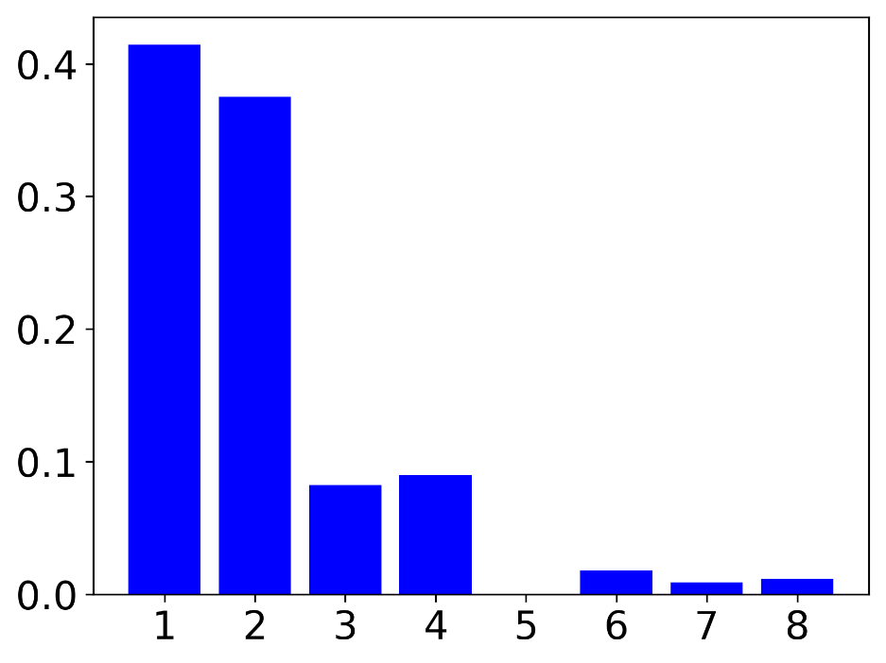
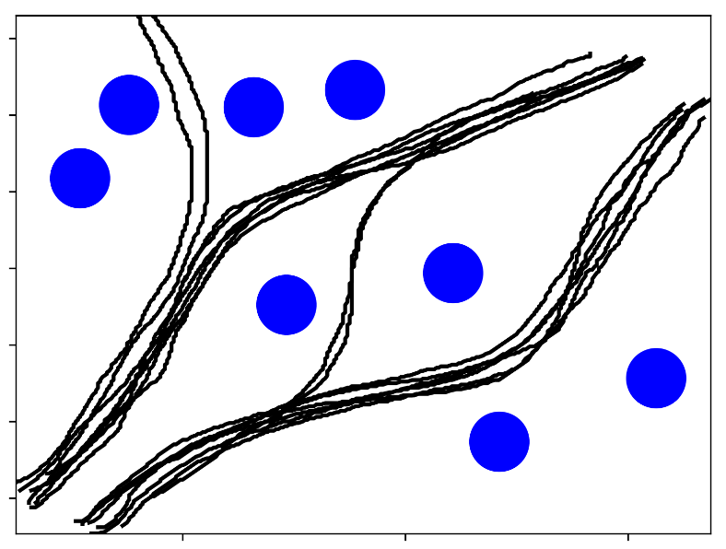
Characterizing obstacles
Normalized PCA weight
5
4
3
6
2
1
7
8
Obstacles / dimensions
PCA on signatures can identify important obstacles

