Slide 1
Architecture · Training · Evaluation
14
177K
64192
Classes
Params
Training Samples

Slide 2
Dataset & Problem Setup
15
DATA SOURCES
MNIST
KAGGLE OPS
+
-
×
÷
~490 images/op 4 operators
60,000 images
28×28 px
Digits 0–9
Total: 14 Classes | Balanced via augmentation
28×28: Grayscale input
Normalize: Pixel ÷ 255
Elastic: Deform augment
Balance: Target per class

Slide 3
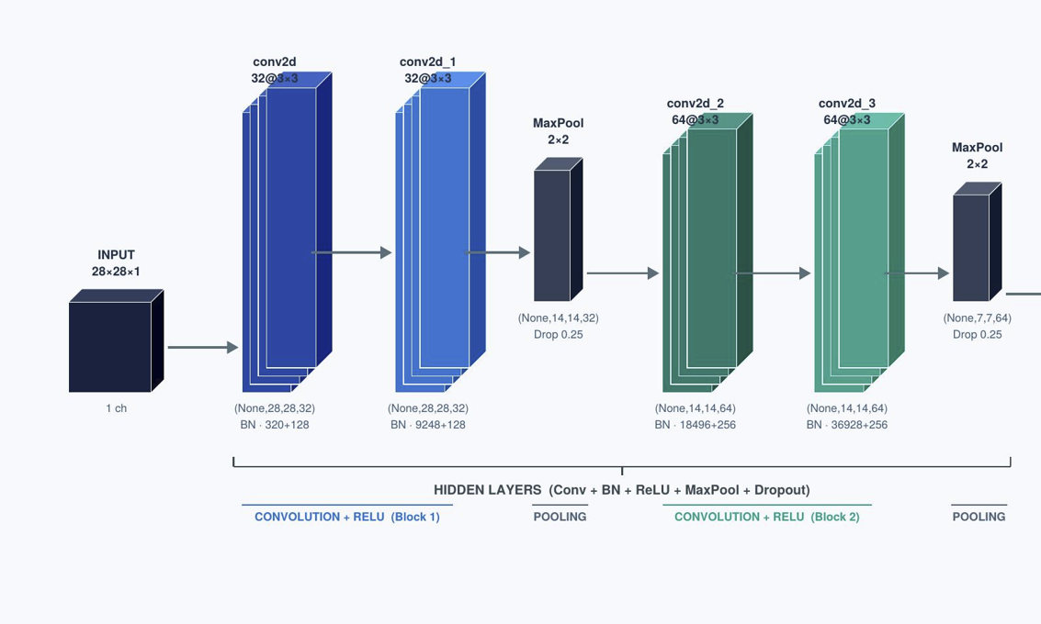
Convolution Neural Network (CNN) Architecture
16
Best epoch: 13 (val acc 99.39%, val loss 0.0186)
ReduceLROnPlateau halved LR at epochs 6 / 10 / 12 / 17

Slide 4
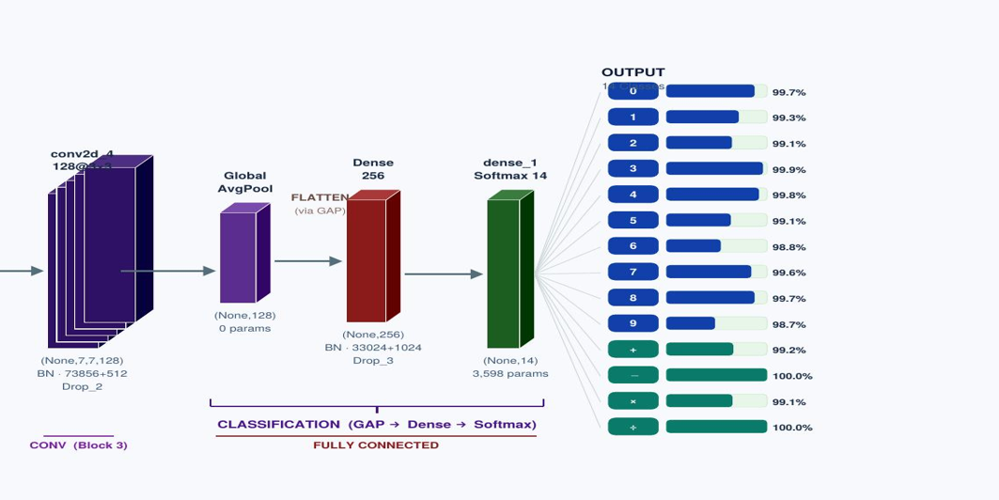
Convolution Neural Network
17
Best epoch: 13 (val acc 99.39%, val loss 0.0186)

Slide 5
Key design choices
18
Batch Normalization Rescales layer outputs to mean zero and unit variance.
Accelerates training by up to 3× and provides mild regularization.
MaxPooling (2×2) Downsamples spatial dimensions to reduce computation costs while making detected features invariant to small translational shifts.
Dropout Regularization Randomly silences 25–50% of neurons during training. This prevents memorization and forces robust, distributed learning.
GlobalAveragePooling Replaces the Flatten layer by averaging feature maps into a compact vector, dramatically reducing model parameter count.

Slide 6
Training Configuration & Data Augmentation
19
HYPERPARAMETERS
AUGMENTATION PIPELINE
Optimizer
AdamW lr=1e-3 wd=1e-4
↻
Random Rotation
±8% (28.8°)
±8% (28.8°)
Loss
Categorical Cross-Entropy
⇄
Random Translation
±8% H & V
Batch Size
128
±8% H & V
Epochs
20 (early stop @ 18)
⊕
Random Zoom
±10%
±10%
Best Epoch
Epoch 13
~
Elastic Transform
α=8 σ=4 p=0.7
α=8 σ=4 p=0.7
Callbacks
EarlyStopping + ReduceLROnPlateau
≡
Pixel Normalize
÷ 255 → [0,1]
÷ 255 → [0,1]
LR SCHEDULE
1e-3
5e-4
(ep6)
2.5e-4
(ep10)
1.25e-4
(ep12)
6.25e-5
(ep17)

Slide 7
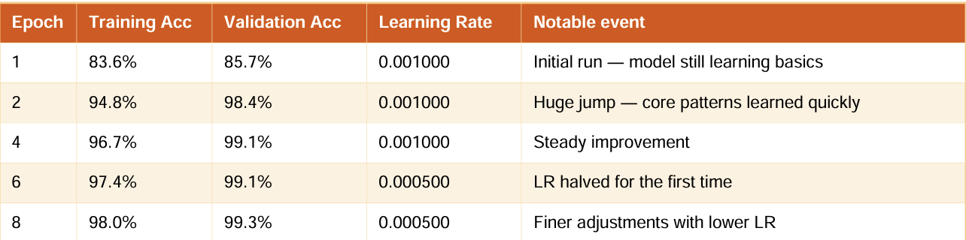
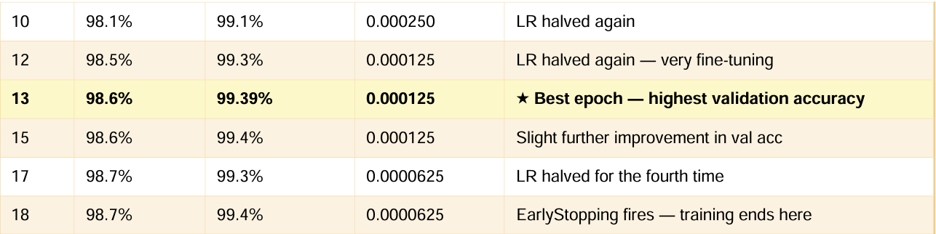
Training Progress
20

Slide 8
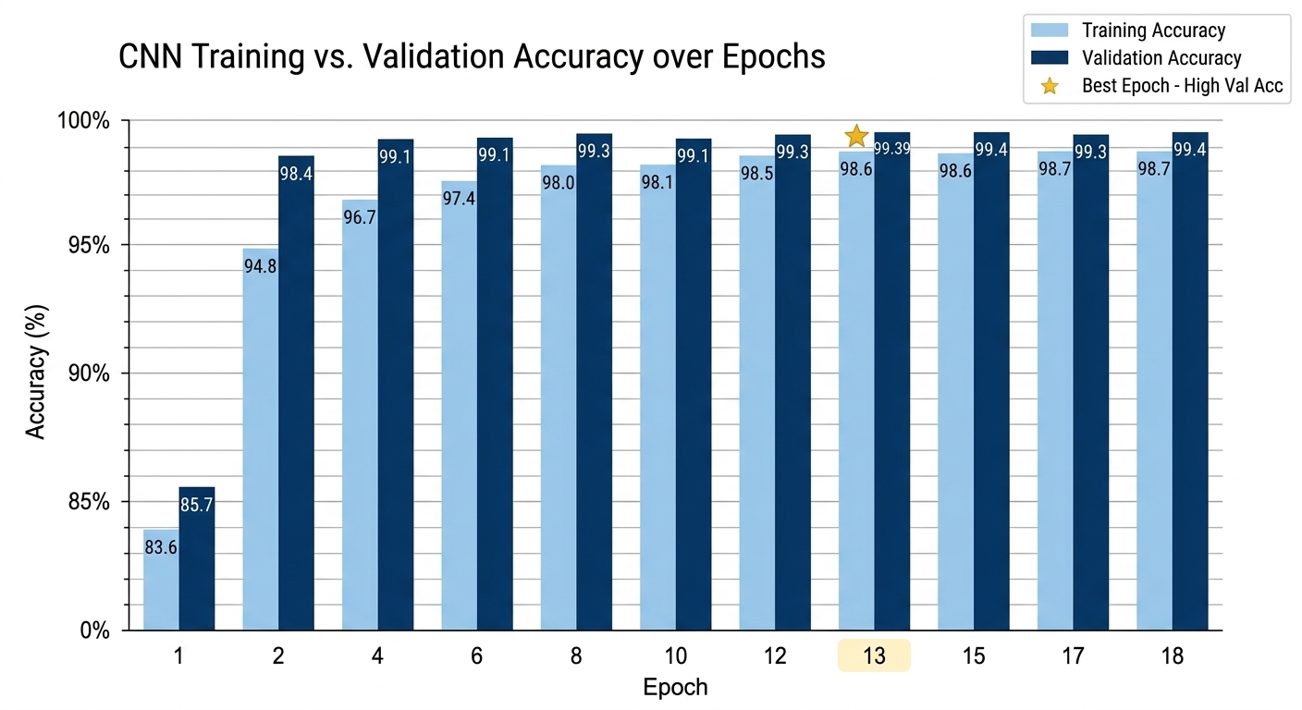
Operator Confusion Matrix
21

Slide 9
Training Progress : Accuracy & Loss Curves
22
Fast convergence: val acc jumped from 85.7% → 98.4% in just 2 epochs
Best epoch: 13 (val acc 99.39%, val loss 0.0186)
Early stopping triggered at epoch 18, no overfitting observed
ReduceLROnPlateau halved LR at epochs 6 / 10 / 12 / 17

Slide 10
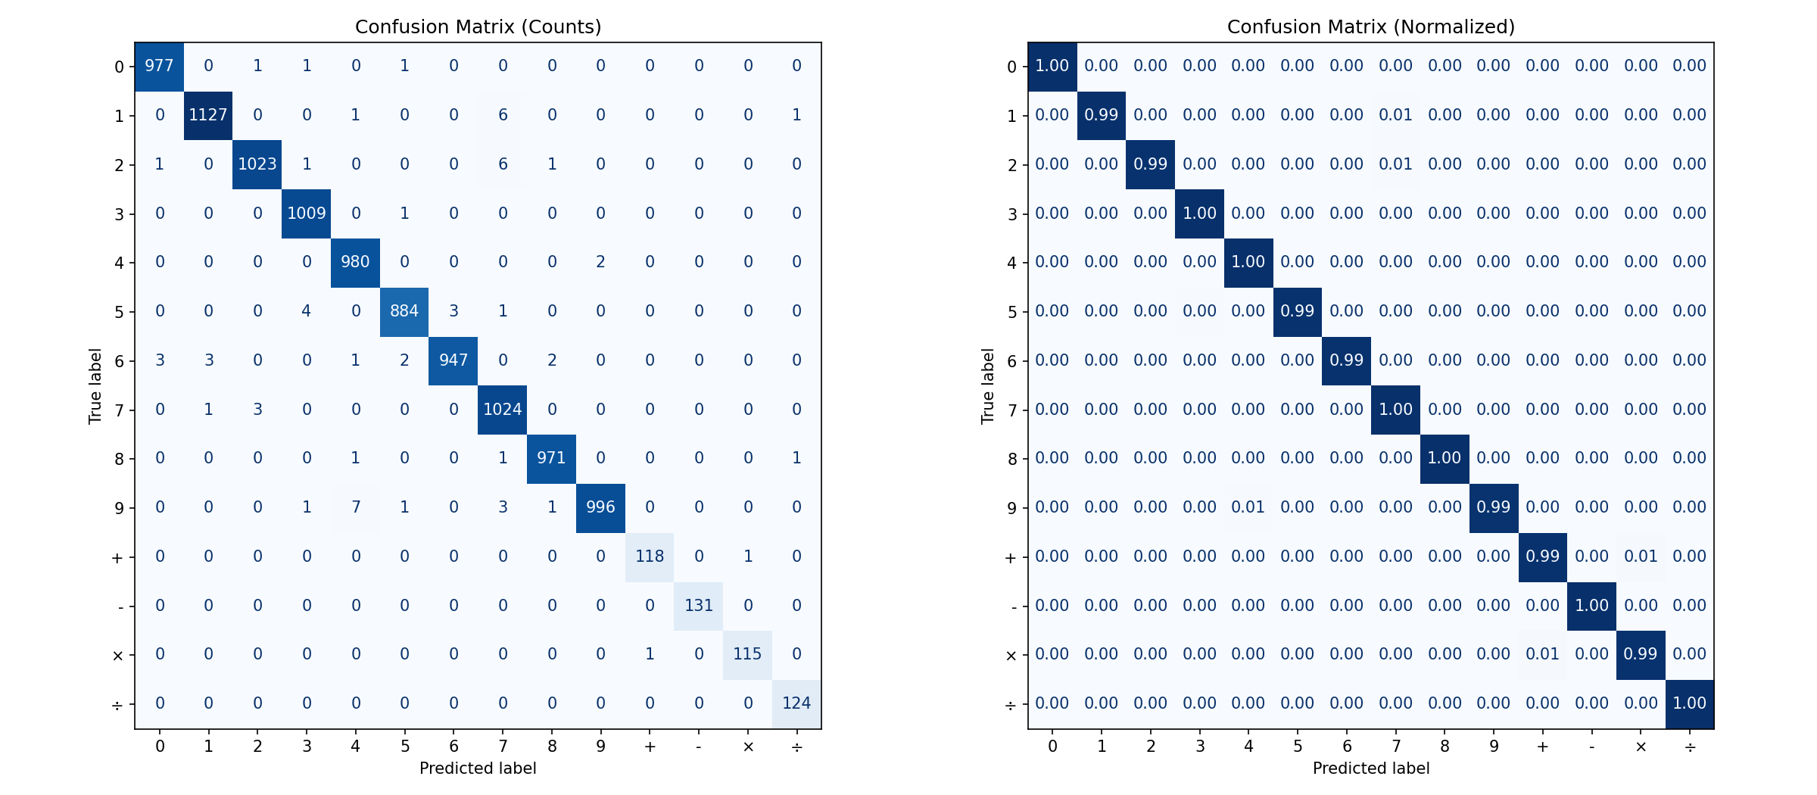
Confusion Matrix
23

Slide 11
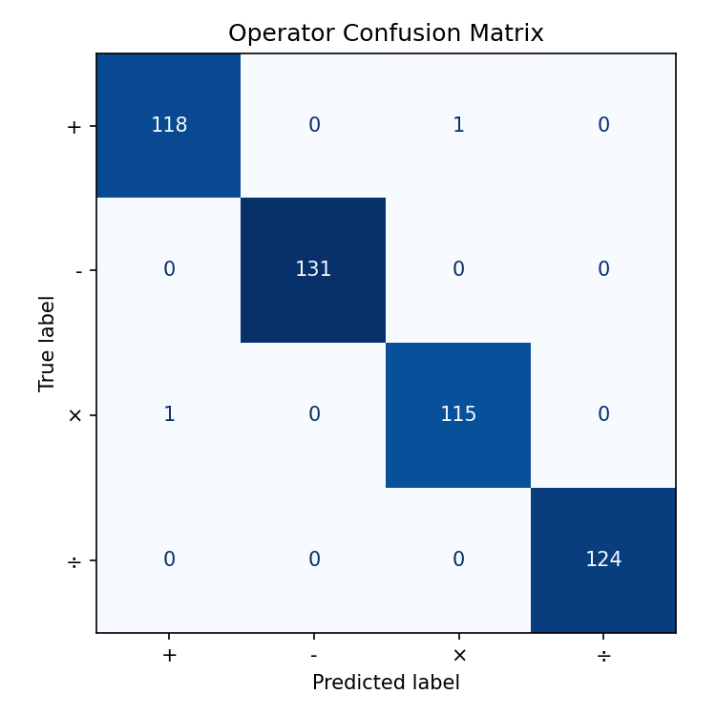
Operator Confusion Matrix
24

Slide 12
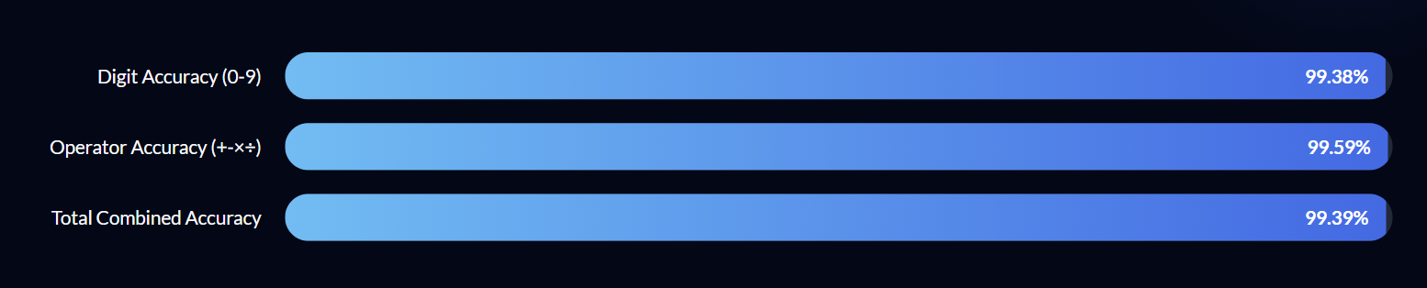
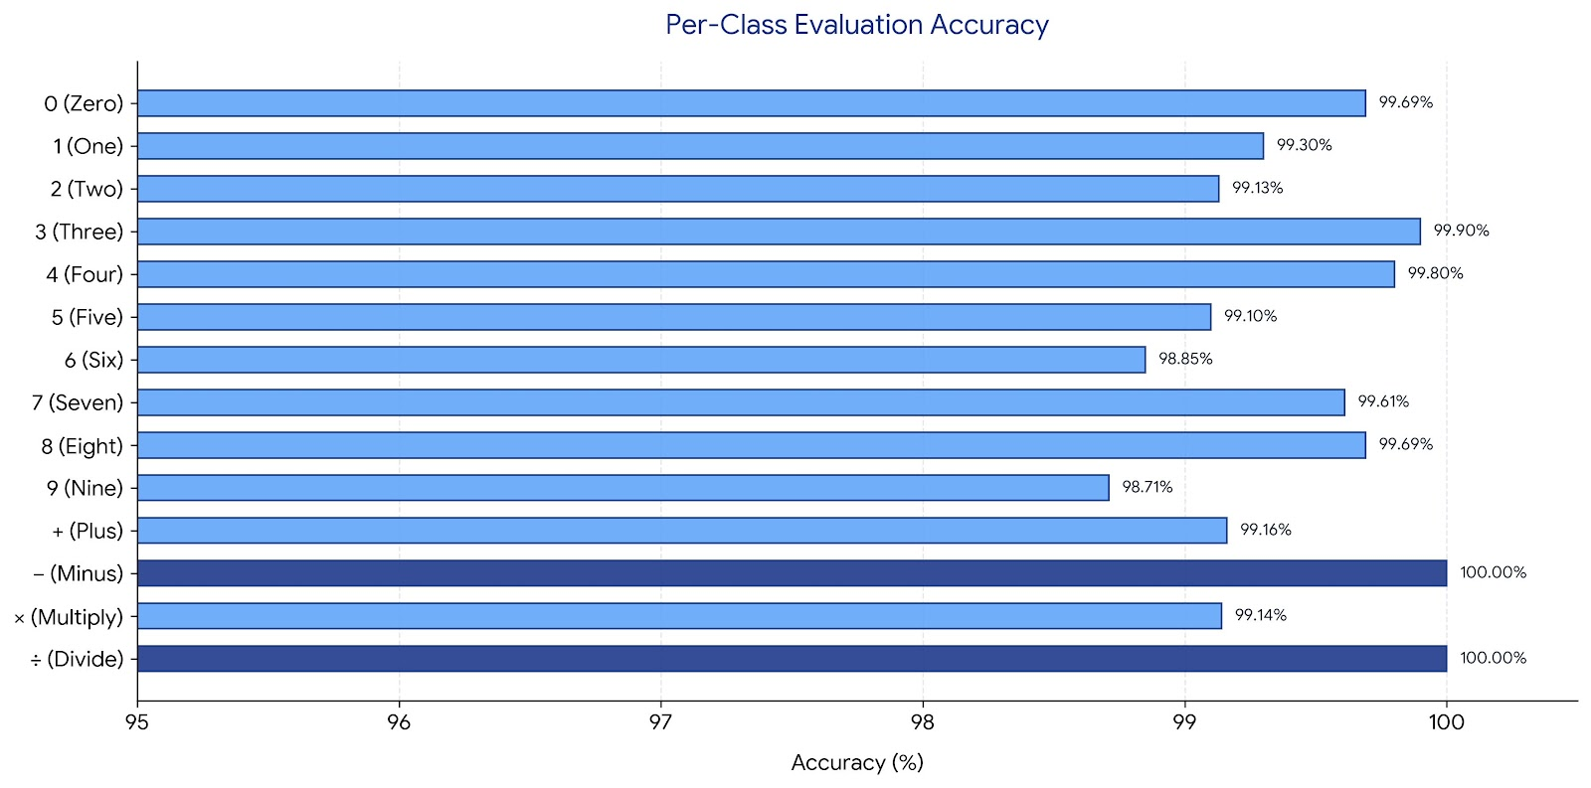
Test Accuracy
25

Slide 13
Prediction Pipeline & Safe Evaluation
26
✏
▣
⊞
⊑
=
Draw
Preprocess
CNN Infer
Softmax
Evaluate
User draws on
Streamlit canvas
Resize 28×28
Normalize ÷ 255
Forward pass
best_model.keras
14-class probs
Argmax → label
Parse equation
Compute result
SAFE EVALUATION DESIGN
✓
Compile guard: model.compile() enforced before evaluate() call — catches ValueError before production
✓
Class-split eval: digit accuracy (99.38%) and operator accuracy (99.59%) measured independently to catch domain imbalance
✓
Round-trip check: best_model.keras reloaded and re-evaluated after save to confirm lossless serialization
✓
Division guard: eval logic checks divisor ≠ 0 before computing; invalid expressions return 'Error' not exception

Slide 14
SUMMARY
27
Architecture
Data Strategy
5 Conv layers (32→32→64→64→128)
GlobalAvgPool → Dense 256 → Softmax 14
177K params, only 694 KB
MNIST (60K) + Kaggle operators (~490/class)
Auto-balanced · Elastic deform · Online aug
Heavy augmentation reduces overfitting
Training
Results
AdamW + ReduceLROnPlateau (×0.5 on plateau)
EarlyStop @ ep18, best weights restored ep13
Fast convergence: 98.4% val acc by epoch 2
Overall: 99.39% | Digits: 99.38%
Operators: 99.59% | − & ÷: 100%
Consistent across all 14 classes ≥ 98.7%

