Slide 1
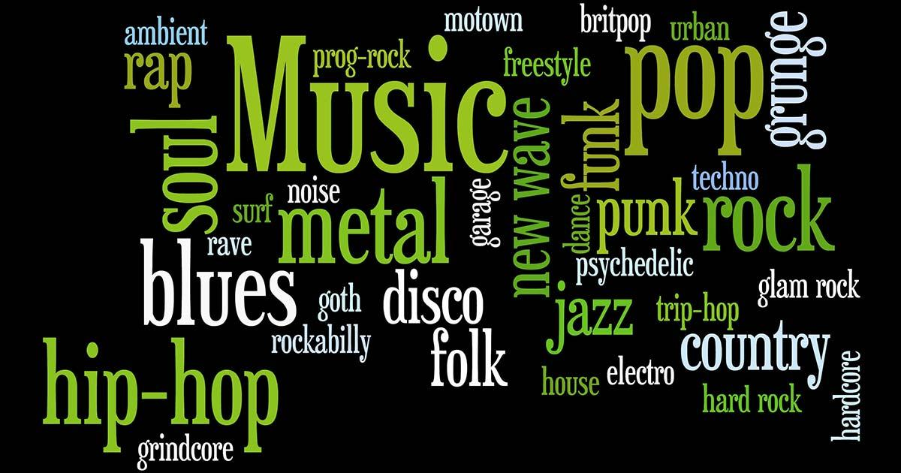
ITS 52000-Applied Machine Learning
Music Genre Classification
Abhishek Singh
Aditya
Sudeep
Mohammed Abdul Muqtadeer

Slide 2
Dataset:
The dataset has ten classes Pop, Metal, Disco, Blues, Reggae, Classical, Rock, Hiphop, Country, Jazz
Each data set has 59 features
Train- 8000, Test- 2000

Slide 3
Librosa library: The Mother of audio files
Librosa.display.waveshow
Librosa.amplitude_to_db
Librosa.display.spectshow
Librosa.effects.hpss

Slide 4
Librosa library
Librosa is a Python library for analyzing and processing audio files.
Librosa provides functionalities for tasks such as loading audio files, extracting various features from audio signals, and performing analysis on audio data.
Librosa is widely used in the fields of music information retrieval, audio analysis, and machine learning applications related to audio processing.
It has become a valuable resource for researchers, developers, and practitioners working with audio data in Python.

Slide 5
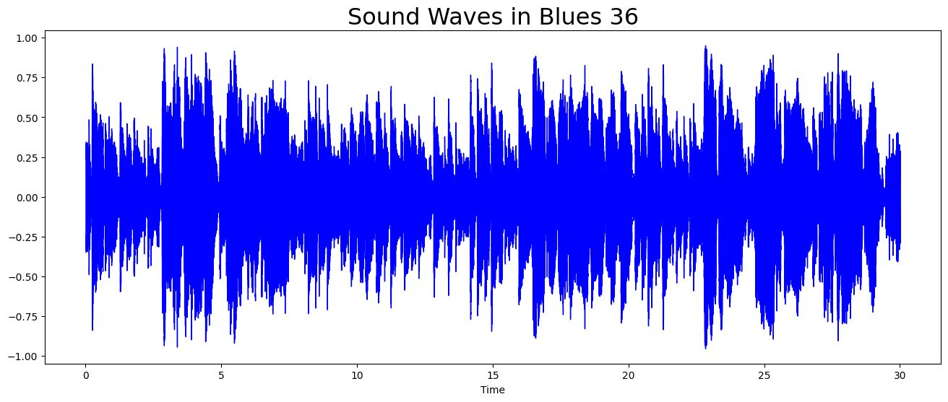
librosa.display.waveshow
librosa.display.waveshow is used to visualize the waveform of an audio signal.
The audio file is loaded using librosa.load(), and the waveform is displayed using the waveshow function from the librosa.display module.

Slide 6
librosa.amplitude_to_db
is used to convert a magnitude spectrogram to dB (decibels).
This function is often used to scale and transform the amplitude values of a spectrogram for better visualization and analysis.
This process is useful for visualizing audio spectrograms in a logarithmic scale, which can highlight details in both low and high amplitude regions.

Slide 7
librosa.display.specshow
This function is used to display a spectrogram.
often used for visualizing the frequency content of audio signals over time, with frequency on the y-axis, time on the x-axis, and color indicating amplitude or power in dB.
The x_axis and y_axis parameters determine the type of scaling used for the axes.

Slide 8
librosa.effects.hpss
The librosa.effects.hpss function in Librosa is used for harmonic-percussive source separation.
It separates an audio signal into its harmonic and percussive components, which can be useful for various audio analysis and processing tasks.
This separation can be useful in various audio processing applications, such as music remixing, transcription, and feature extraction.
The harmonic component typically represents pitched content (e.g., melodies), while the percussive component represents non-pitched content (e.g., drums).

Slide 9
Some of the dataset features include:
Chroma_stft: It converts an audio signal into a time-frequency representation of pitch content using a short-time Fourier transform and chroma filters.
Spectrum_bandwidth: It measures the spread of energy around the spectral centroid for each frame of audio.

Slide 10
Tempo: It calculates the estimated tempo (beats per minute) of an audio signal.
Mfcc: It converts audio to a mel-scaled cepstral representation, capturing spectral and temporal information.
Perceptr: It captures rhythmic information by modeling the percussive components of an audio signal.

Slide 11
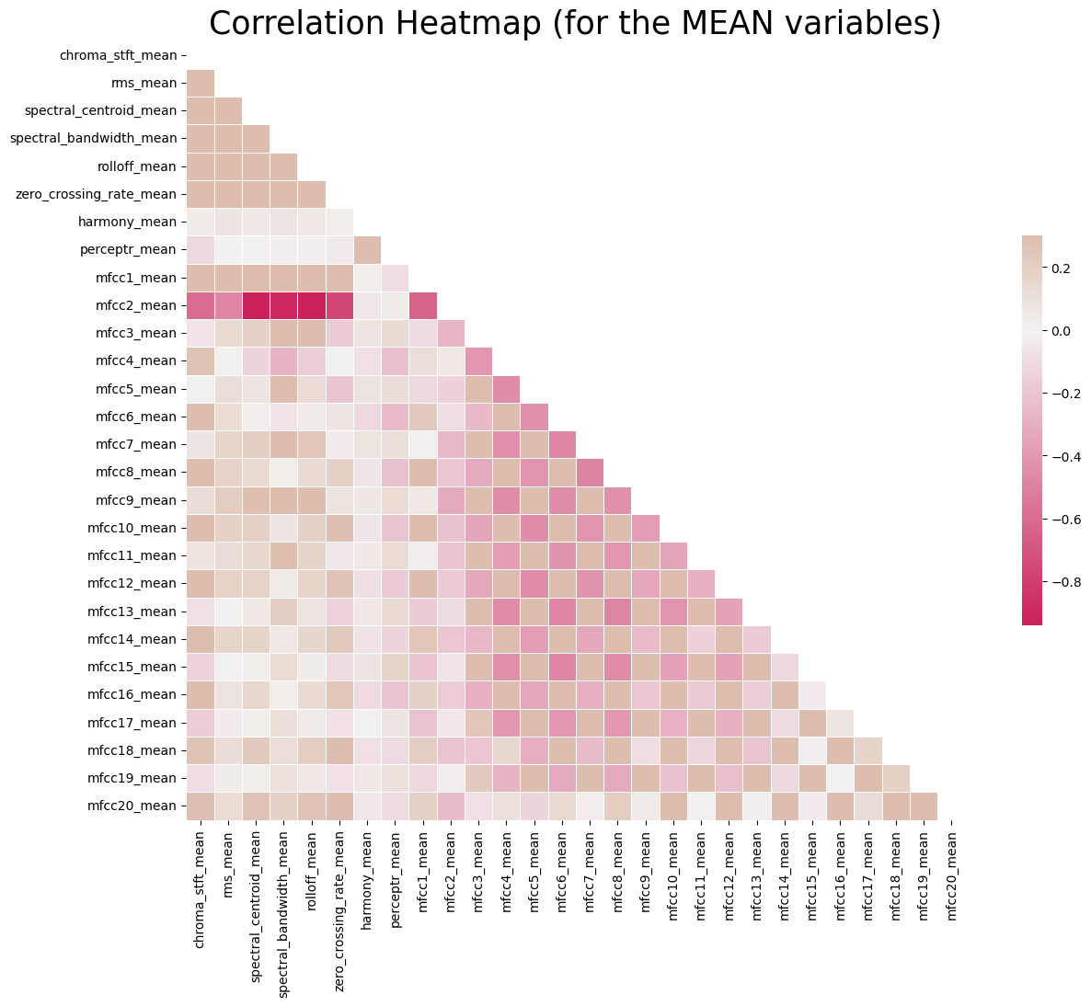
Analysis- Correlation Heat map
Chroma features strongly correlate with spectral centroids and MFCCs (Mel-Frequency Cepstrum Coefficients). This redundancy suggests we could drop chroma mean without significant loss.
Negative bandwidth variance vs rolloff correlation fits theory - increased variability in bandwidth aligns with less consistent high frequencies.
Surprised rms mean and variance aren’t more related. Overall loudness doesn’t directly link with loudness changes.
MFCC features 15-17 have very low correlation, meaning they uniquely capture timbre qualities missed by other descriptors.
Could cluster features by correlation and select representatives from each cluster to minimize redundancy.
We’re presenting lower triangle because it’s the replica of the upper triangle.
Means Heatmap shows clear separation ability for some genres, ambiguity for others based on audio features.
Notes:
Highly Correlated Features: I see chroma_stft_mean is strongly positively correlated with spectral_centroid_mean and mfcc features. This suggests chroma features that represent harmonic content are closely tied to the brightness of the sound and timbral qualities captured in MFCCs. We could likely get away with removing chroma_stft_mean without losing much signal.
Negative Correlations: There is a moderately negative correlation between spectral_bandwidth_var and spectral_rolloff_mean. This makes sense because songs with wider variability in bandwidth would have less consistency in high frequency content. So as bandwidth variance increases, rolled off frequency tends to decrease.
Unexpected Relationships: I was surprised rms_mean and rms_var are not more correlated, since both measure loudness characteristics. The variance of loudness over time seems to not necessarily relate to overall level of loudness. There may be other factors driving rms variance.
Low Correlation Cluster: MFCC features like mfcc15_var, mfcc16_mean and mfcc17_mean have very minimal correlation to other features. This suggests they are capturing unique timbral qualities not well-represented in other spectral measurements.

Slide 12
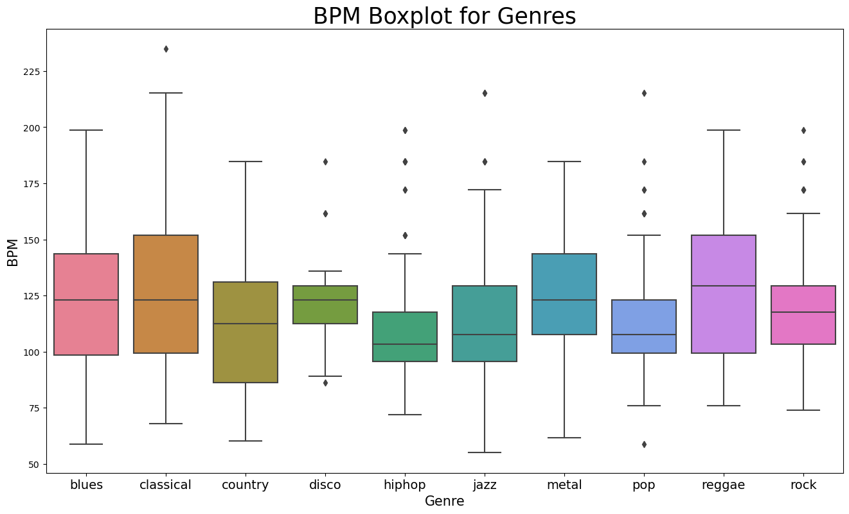
Analysis - Tempo Box Plot
This is beats per min
for every genre.

Slide 13
Creating Baseline Model:
We import libraries as a primary step
Loading “Datasets” to model - Train and Test
Resizing and Normalizing all sound data.
Then we prepare “Data Loaders” to train the model
We used cross gradient boost classifier with epochs=1000 and learning rate=0.05

Slide 14
Train and Test:
We have a Train Dataset of 8000 and Test dataset of 2000
Finally, training of model comes to play.
We run our model through 1000 epochs
Then we use our Test data set to predict and confirm the model
We have used a Validation Dataset to show the final result

Slide 15
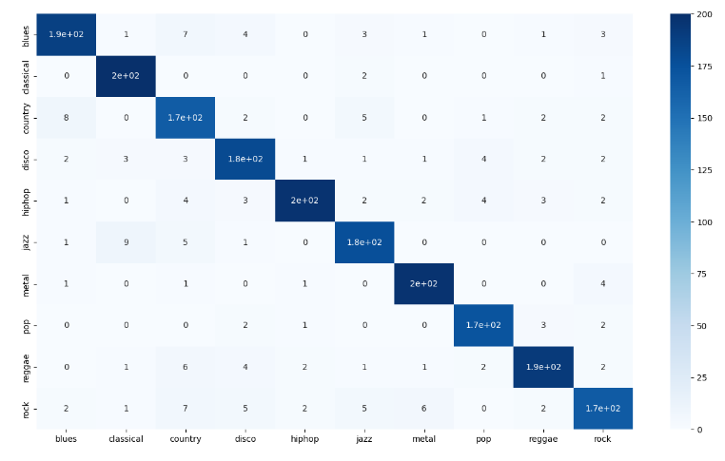
Performance Metrics

Slide 16
Performance Metrics
We define Accuracy using different models
KNN:
Accuracy : 0.822
XGBoost:
Accuracy : 0.918

Slide 17
Thank you !!
We are Open to Questions….

