Slide 1
CREATING A DASHBOARD
Using Microsoft SQL Server & Microsoft Power BI

Slide 2
Project by Binary Beasts
Abhishek Saha (SPOC)
Abir Chakraborty
Angshuman Pal Chowdhury
Arnab Fadikar
Dipanjan Das
Soumalya Karmakar

Slide 3
Microsoft SQL Server
- Microsoft SQL Server, created by Microsoft, is a relational database management system (RDBMS).
- This powerful platform is widely utilized by organizations to efficiently store, manage, and retrieve data.
- SQL Server offers a secure, scalable, and high-performance environment, making it ideal for handling large volumes of data and conducting data analysis.

Slide 4
Key features of Microsoft SQL Server
Database management
SQL Language Support
Data Security
Scalability
Performance Optimization
High Availability and Disaster Recovery

Slide 5
Microsoft Power BI
Microsoft Power BI is a business analytics service and robust data visualization tool created by Microsoft.
- Users can connect to different data sources, perform data transformations, and clean the data with Power BI.
- The tool empowers users to build interactive reports and dashboards to extract valuable insights from the data.
- Power BI is user-friendly and caters to both business users and data professionals, enabling them to create impressive visualizations without advanced technical skills.

Slide 6
Key features of Microsoft Power BI
Data Connectivity
Data Transformation and Modeling
Data Visualization
Interactive Dashboards
Data Sharing and Collection

Slide 7
Process of Importing Data
Opening SSMS and Connecting to Microsoft SQL Server :
Firstly, we launch SQL Server Management Studio (SSMS) and establish a connection to the SQL Server by specifying the Server type, Server name, and Authentication method.
Creating a New Database :
After connecting, we proceed to create a new database and assign a suitable name to it.
Importing Data from Excel File :
Next, we import the desired data into the newly created database. To achieve this, we select the Data Source, which is an Excel file in this case, and ensure the correct Excel file version is chosen.

Slide 8
Process of Importing Data
4. Copying Tables :
Once the Data Source is selected, we copy the relevant tables from the Excel file into the database.
5. Completing the Process :
With the data successfully imported, we are now ready to proceed with the rest of our tasks.

Slide 9
Process of Making Dashboard
1. As we proceed with importing data from a SQL Server, we begin by creating a data view using SQL queries from the tables in the selected database.
2. Leveraging the acquired data, we proceed to craft meaningful visualizations.
3. The data visualization plays a pivotal role in enhancing our comprehension of fluctuations in values and identifying shifts in trends.

Slide 10
Our reason of using Power BI Dashboard
Power BI is utilized because it automatically refreshes data, ensuring that any new entries dynamically alter the view, providing us with real-time insights and enhanced usability.
Once the dashboard is created, if there are no further view updates needed, there is no requirement to modify the dashboard.

Slide 11
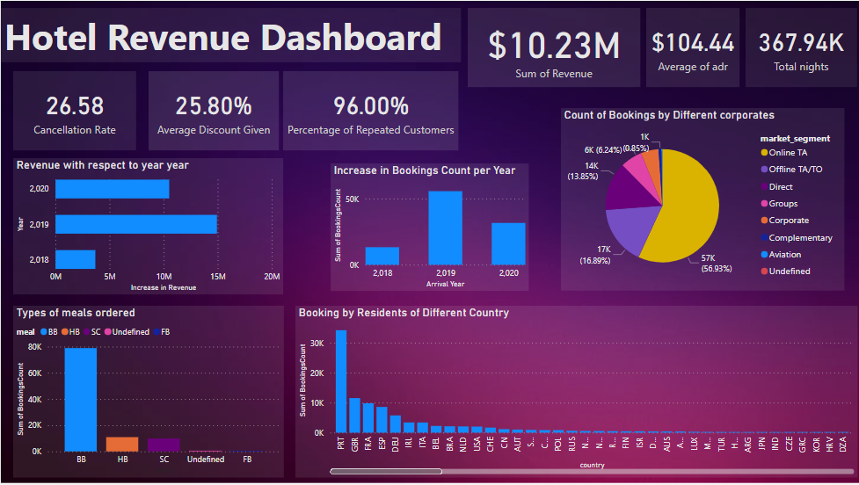
Our Dashboard looks like this

Slide 12
Queries
Preparing the data and joining different table in to single a database
with hotels as ( select * from dbo.['2018$'] union select * from dbo.['2019$'] union select * from dbo.['2020$'])
SELECT * FROM hotels
LEFT JOIN [dbo].[market_segment$]
ON hotels.market_segment = market_segment$.market_segment
LEFT JOIN
[dbo].[meal_cost$]
ON meal_cost$.meal = hotels.meal

Slide 13
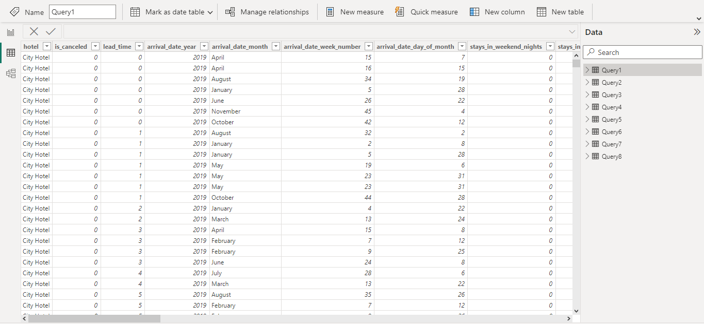
Data Retrieved from the above query

Slide 14
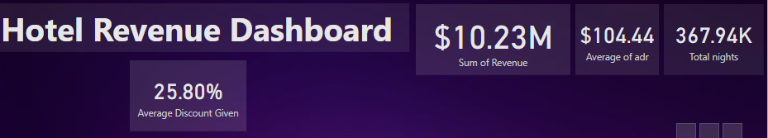
Using the above query Data we are able to retrieve :
Sum of Revenue
Average Daily Revenue
Total nights
Average Discount Given

Slide 15
Queries
REVENUE WITH RESPECT TO YEAR,MONTH AND DATE
with hotels as ( select * from dbo.['2018$'] union select * from dbo.['2019$'] union select * from dbo.['2020$'])
SELECT arrival_date_day_of_month,arrival_date_month,arrival_date_year,ROUND(SUM((hotels.stays_in_weekend_nights +hotels.stays_in_week_nights)*(1-dbo.market_segment$.Discount)*hotels.adr),2) AS revenue FROM hotels
LEFT JOIN [dbo].[market_segment$]
ON hotels.market_segment = market_segment$.market_segment
GROUP BY arrival_date_month,arrival_date_day_of_month,arrival_date_year
order by arrival_date_month,arrival_date_day_of_month,arrival_date_year

Slide 16
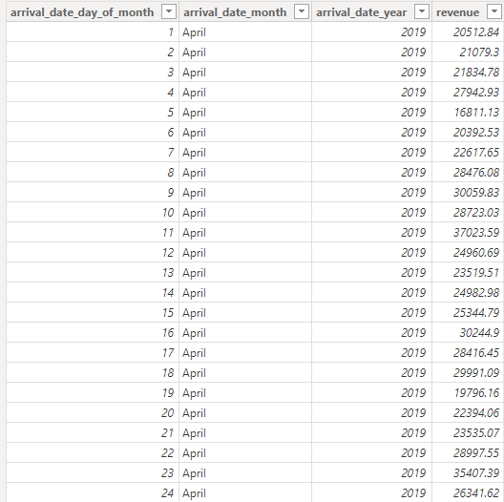
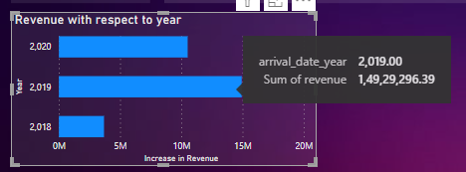
Helps to understand Increase or Decrease in Revenue each year

Slide 17
Queries
To calculate the cancellation rate of bookings, you can use a CASE statement and aggregate functions:
with hotels as (
select * from dbo.['2018$']
union
select * from dbo.['2019$']
union
select * from dbo.['2020$'])
SELECT
ROUND((SUM(CASE WHEN is_canceled = 1 THEN 1 ELSE 0 END) / CAST(COUNT(*) AS FLOAT)) * 100,2) AS CancellationRate
FROM hotels;

Slide 18

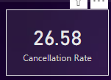
The Rate of cancellation of Pre-Bookings

Slide 19
Queries
Number of bookings per year, month, and week:
with hotels as (
select * from dbo.['2018$']
union
select * from dbo.['2019$']
union
select * from dbo.['2020$'])
SELECT arrival_date_year, arrival_date_month, arrival_date_week_number, COUNT(*) AS BookingsCount
FROM hotels
GROUP BY arrival_date_year, arrival_date_month, arrival_date_week_number;

Slide 20
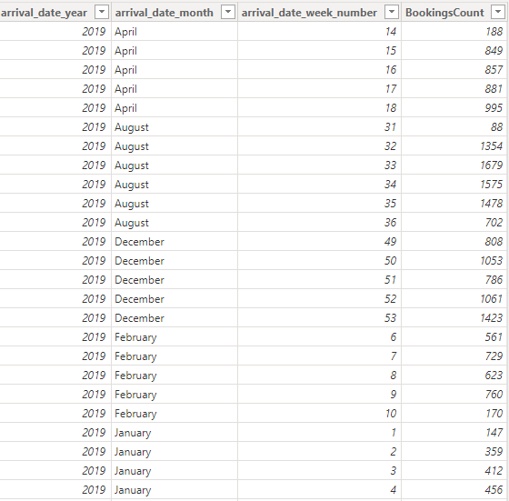
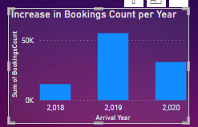
Increase in Booking Count per year

Slide 21
Queries
Number of bookings for each market segment and distribution channel:
WITH hotels AS (
SELECT * FROM dbo.['2018$']
UNION
SELECT * FROM dbo.['2019$']
UNION
SELECT * FROM dbo.['2020$']
)
SELECT market_segment, distribution_channel, COUNT(*) AS BookingsCount
FROM hotels
GROUP BY market_segment, distribution_channel;

Slide 22
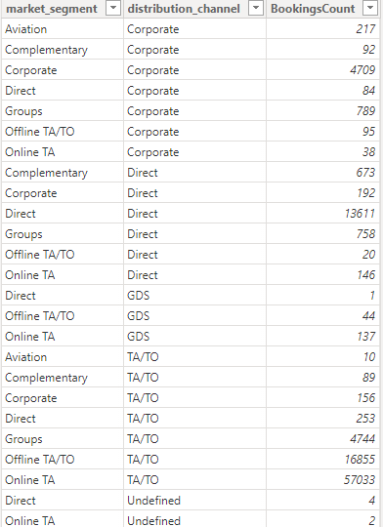
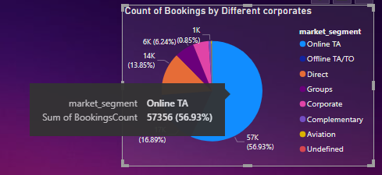
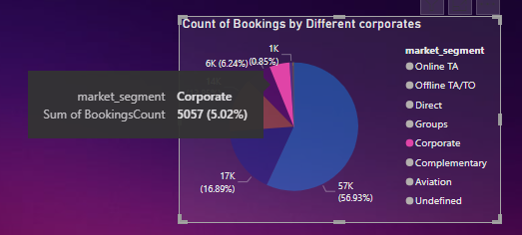
Percentage of Booking by Corporate Sectors

Slide 23
Queries
Number of repeated guests and their percentage:
WITH hotels AS (
SELECT * FROM dbo.['2018$']
UNION
SELECT * FROM dbo.['2019$']
UNION
SELECT * FROM dbo.['2020$']
)
SELECT is_repeated_guest, COUNT(*) AS GuestCount, (COUNT(*) * 100 / (SELECT COUNT(*) FROM hotels)) AS Percentage
FROM hotels
GROUP BY is_repeated_guest;

Slide 24

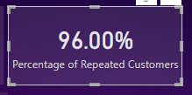
Percentage of Repeated Customers

Slide 25
Queries
Top countries with the most bookings:
WITH hotels AS (
SELECT * FROM dbo.['2018$']
UNION
SELECT * FROM dbo.['2019$']
UNION
SELECT * FROM dbo.['2020$']
)
SELECT country, COUNT(*) AS BookingsCount
FROM hotels
GROUP BY country
ORDER BY BookingsCount DESC

Slide 26
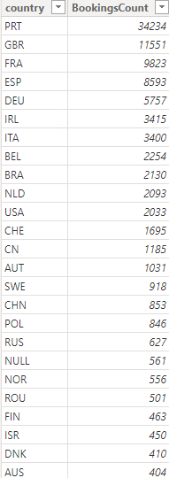
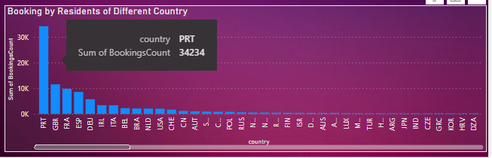
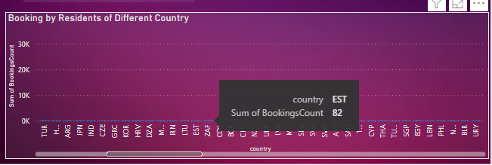
Count of Guests of different countries

Slide 27
Queries
Number of bookings for each meal type:
WITH hotels AS (
SELECT * FROM dbo.['2018$']
UNION
SELECT * FROM dbo.['2019$']
UNION
SELECT * FROM dbo.['2020$']
)
SELECT meal, COUNT(*) AS BookingsCount
FROM hotels
GROUP BY meal;

Slide 28
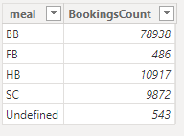
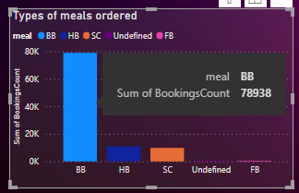
Types of Meals Ordered by Guests

Slide 29
Thanksgiving
In this heartfelt message, a group of aspiring data analysts expresses their deep gratitude to the Organization CSR Box for the exceptional opportunity provided through the Data Analytics Internship Program by IBM Skills Build Network. The organization's generous support and belief in their potential have led to a transformative experience, enabling them to work with cutting-edge data analytics tools and gain valuable insights and skills. The internship has not only prepared them as competent professionals but has also ignited a profound passion for data analytics. The group acknowledges the organization's commitment to empowering the next generation of data analysts and thanks them for the life-changing opportunity, which has set them on a path to make significant contributions in the ever-evolving field of data analytics.

Slide 30
Conclusion
Key Revenue Metrics Unveiled: Valuable Insights into Hotel Financial Performance
Real-time Exploration: Empowers Data-driven Revenue Strategies
Holistic View: Revenue Performance Across Time Frames, Segments, and Regions
Successful Integration of Data Sources and Data Transformation for Accuracy and Reliability
User-friendly Interface: Promoting Collaboration and Informed Decision-making
Future Enhancements: Additional Data Sources and Advanced Analytics
Continuous Updates for Sustainable Growth and Competitiveness in the Hospitality Industry
Data set sourced from: https://absentdata.com/wp-content/uploads/2021/05/hotel_revenue_historical_full-2.xlsx

Slide 31
Thank You

