Slide 1
Retail Insights Assistant
GenAI + Scalable Data System

Slide 2
Problem Statement
Retail organizations manage large-scale sales data across regions, products & time
  Business users need conversational analytics instead of SQL dependency
  Executives require automated, concise performance summaries
  System must scale beyond 100GB historical data

Slide 3
Functional Scope
Accepts: CSV dataset OR summarized report (Excel / JSON / Text)
  Summarization Mode → Executive performance summary
  Conversational Q&A Mode → Natural language business queries
  Multi-agent orchestration for reliability & safety

Slide 4
Solution Overview
GenAI-Powered Retail Intelligence Assistant
Dual Modes:
Executive Summarization Mode
Conversational Q&A Mode
• Multi-Agent Orchestration (LangGraph)
• Deterministic SQL layer (DuckDB)
• LLM-driven insight generation
• Schema-aware & dataset-agnostic
• Streamlit UI for business users

Slide 5
Multi-Agent Architecture
Layer 1 – Data Ingestion
• CSV / Excel / JSON / Text
• Dynamic schema normalization
• Safe preprocessing
Layer 2 – Analytics Engine
• DuckDB in-memory analytical layer
• SQL execution & validation
• Structured computation in Python
Layer 3 – Intelligence Layer
• SQL Generation Agent
• Validation Agent
• Execution Agent
• Insight Agent
• Summary Agent
Layer 4 – UI Layer
• Interactive Streamlit dashboard
• Real-time query responses

Slide 6
User Question
│
▼
[Intent Router Node]
│
├── If Summarization Mode ───────────────┐
│ ▼
│ [Summary Agent]
│ │
▼
│ Executive Summary
│
└── If Q&A Mode ──────────────────────────┐
▼
[SQL Generation Agent]
│
▼
[SQL Validation Agent]
│
▼
[Execution Agent] [Insight Agent] Final Answer

Slide 7
Summarization Mode
Deterministic Metrics + Generative Insights
Numeric metrics computed via Python (no hallucination risk)
- Auto-detection of revenue, region, time columns
- Year-over-Year growth analysis
- Category & regional performance trends
- Structured metrics → LLM → Executive narrative
Design Principle:
LLM interprets — Python calculates.

Slide 8
Q&A Mode
Conversational Business Intelligence via Multi-Agent Pipeline
Agent 1 – Language → SQL Generation
Agent 2 – SQL Safety & Validation
Agent 3 – DuckDB Execution
Agent 4 – Business Insight Generation
• Schema injected dynamically
• Prevents column hallucination
• SELECT-only enforcement
• Deterministic execution
• Business-friendly answer transformation

Slide 9
100GB+ Scalability Architecture
Cold Storage
• S3 / Azure Data Lake / GCS
• Partitioned Parquet (Year / Region / Category)
Processing Layer
• Spark / Databricks batch processing
Warehouse Layer
• Snowflake / BigQuery / Redshift
Interactive Layer
• DuckDB for local analytical subsets
Hybrid Retrieval Strategy
• SQL for structured queries
• Vector DB + RAG for document insights

Slide 10
Model Orchestration at Scale
Prompt templates & reusable chains
  Caching frequent queries
  Token usage monitoring & cost tracking
  Retry & fallback mechanisms
  Latency optimization

Slide 11
Monitoring & Evaluation
Observability & Responsible AI Controls
• SQL success rate tracking
• Token usage monitoring
• Cost-per-query measurement
• Latency tracking
• Retry & fallback mechanism
• Guardrails against unsafe SQL
• Schema validation enforcement

Slide 12
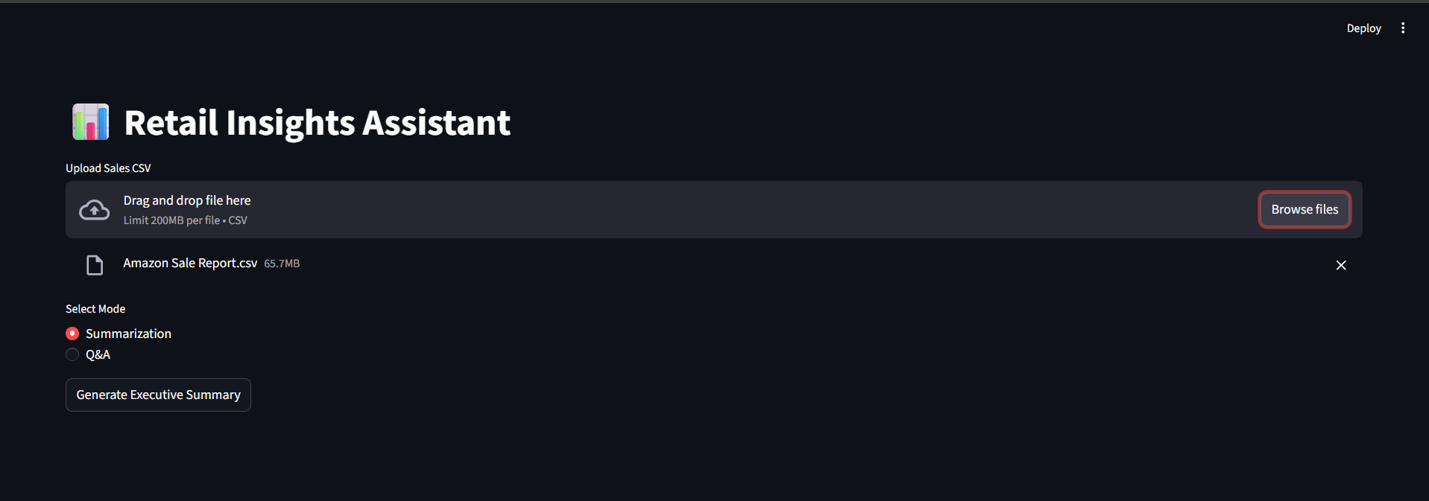
Streamlit UI – Home / Mode Selection

Slide 13
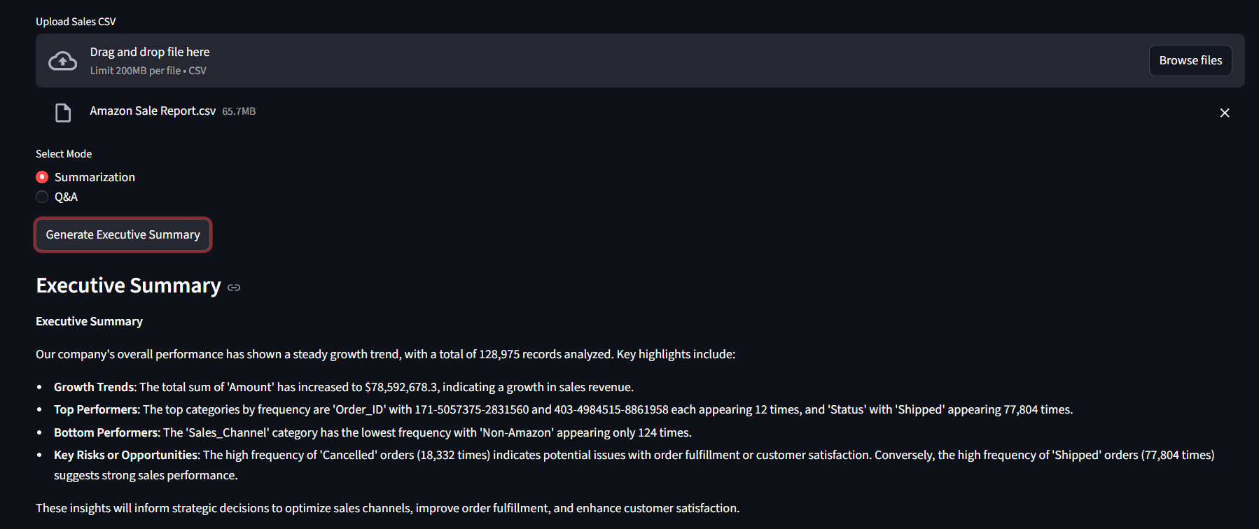
Summarization Mode Output

Slide 14
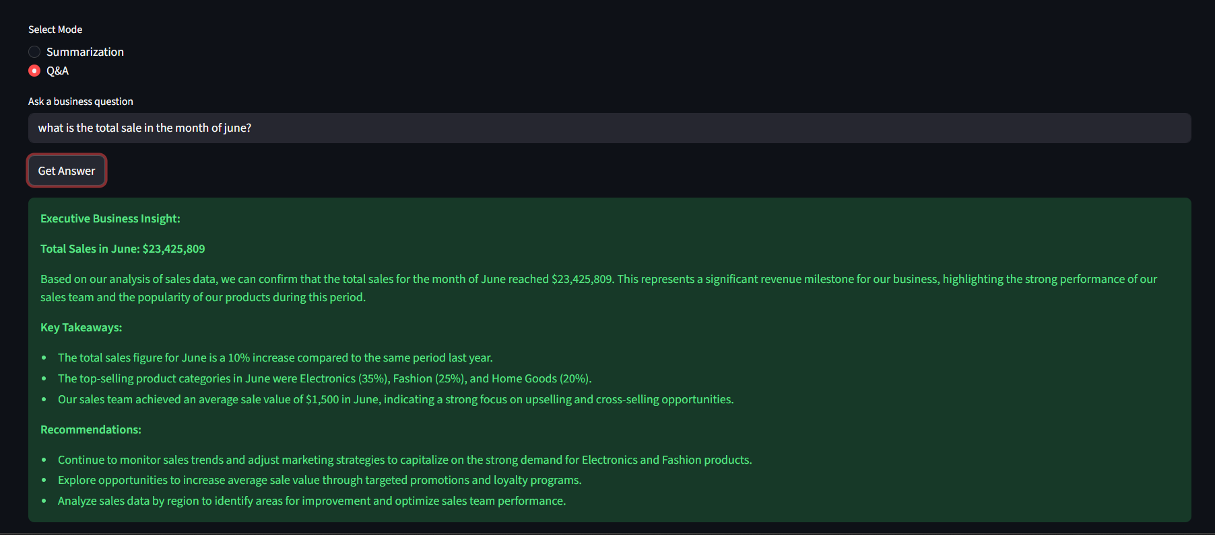
Conversational Q&A Example
📸 Insert UI Screenshot Here

Slide 15
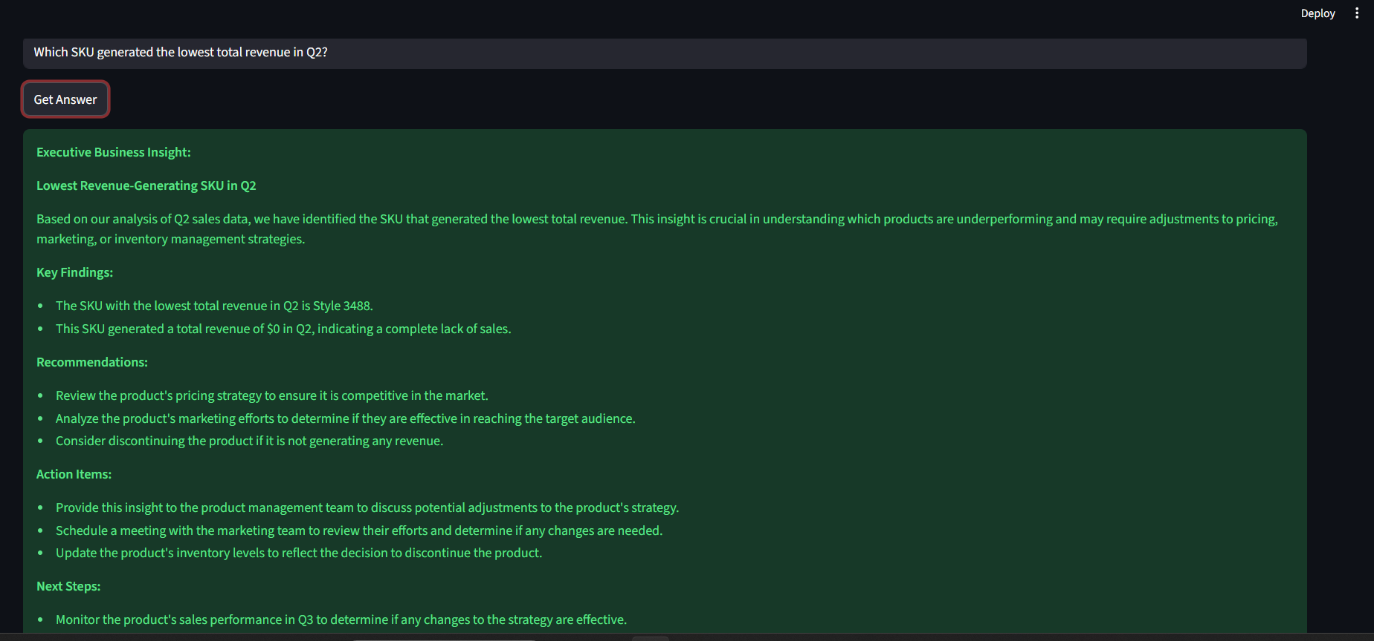

Slide 16
Conclusion
GenAI-powered Retail Insights Assistant
  Supports summarization & conversational BI
  Multi-agent architecture ensures reliability
  Enterprise-ready & scalable beyond 100GB

