Slide 1
Week 1 Project Report
Traffic Volume Prediction & Analysis
Using Machine Learning
Tools: Python | Pandas | NumPy | Matplotlib | Scikit-learn
Dataset: 33,750 hourly traffic records
Submitted by: Abhishek

Slide 2
Project Overview
🎯 Goal
Predict traffic volume using ML and identify key influencing factors
📊 Dataset
33,750 hourly records with weather, holiday, and time features
🔧 Methods
Data cleaning, EDA, Feature Engineering, ML Modeling
🤖 Models
Linear Regression vs. Random Forest Regressor
📈 Key Result
Random Forest MAE: 259.5 vs. Linear Regression MAE: 1607

Slide 3
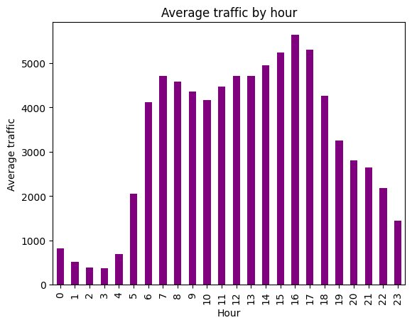
EDA: Traffic Volume by Hour of Day
Key Observations
• Late night (12–4 AM): Lowest traffic ~400/hr
• Morning peak at 7–8 AM: ~4,700/hr
• Evening peak at 4–5 PM: ~5,500/hr
• Sharp drop after 8 PM
Figure 1: Average Traffic Volume by Hour

Slide 4
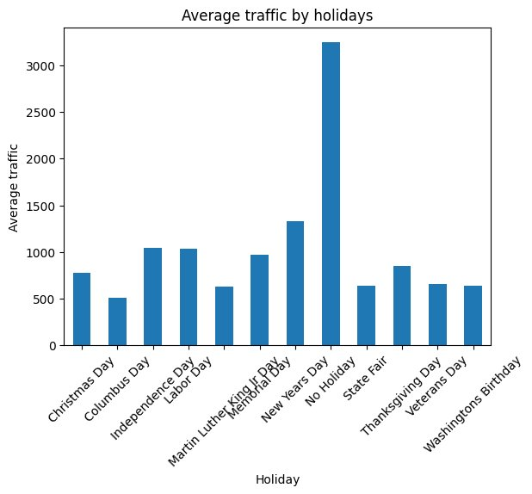
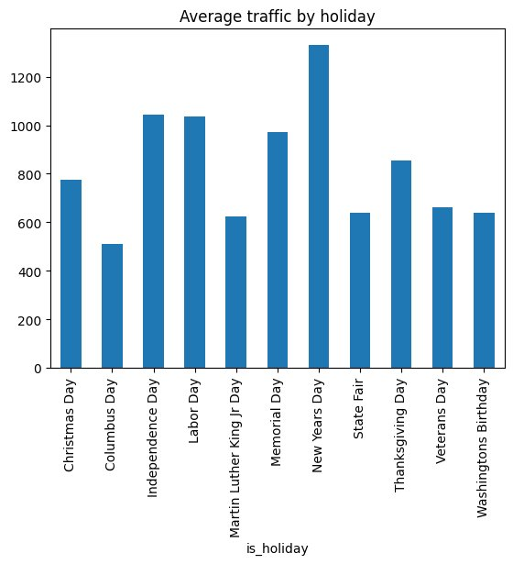
EDA: Traffic by Holiday
Fig 2: All categories (incl. No Holiday)
Fig 3: Holidays only
Non-holiday days dominate traffic • New Year's Day highest among holidays • Columbus Day lowest

Slide 5
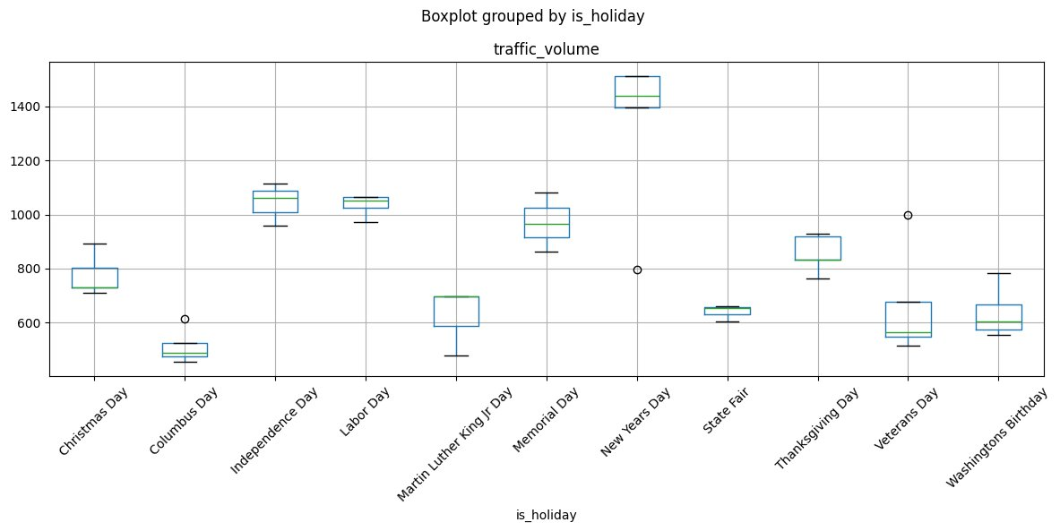
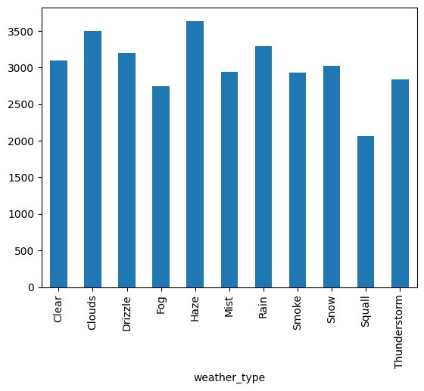
EDA: Boxplot & Weather Analysis
Fig 4: Boxplot grouped by Holiday
Fig 5: Traffic by Weather Type
Boxplot: New Year's Day shows highest variability. Weather: Haze=highest, Squall=lowest. Overall weather impact is minimal.

Slide 6
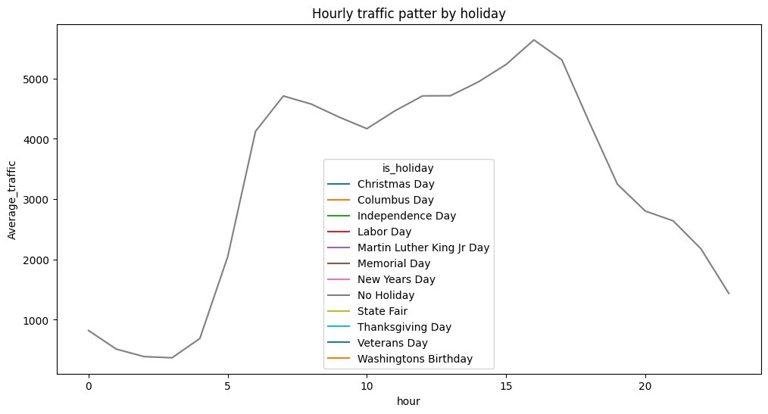
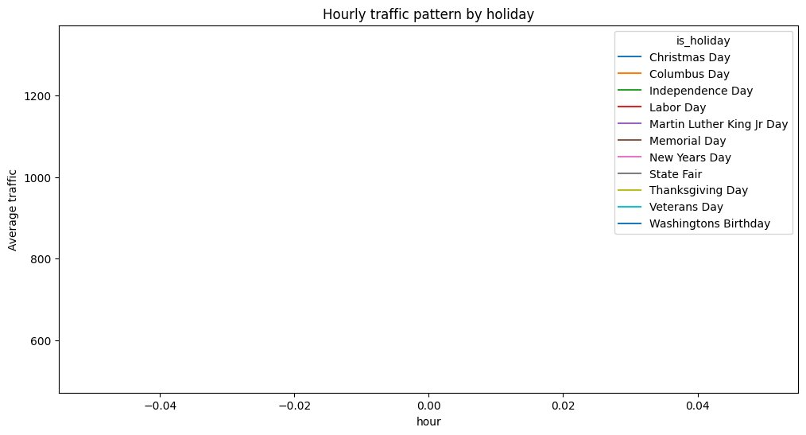
EDA: Hourly Pattern by Holiday
Fig 6: All Holiday Categories
Fig 7: Holiday categories only (bug: axis issue)
⚠️ Bug Identified: Fig 7 shows fractional hour values (−0.04 to 0.04) instead of 0–23. This is due to sparse holiday data causing incorrect aggregation. Identified for future fix.

Slide 7
Machine Learning Results
Linear Regression
Random Forest
MAE
MAE
1607.06
259.50
vehicles/hr
vehicles/hr
❌ Cannot capture nonlinear patterns
✅ 83.8% improvement over Linear Regression
→ 83.8% reduction in prediction error

Slide 8
Feature Importance Analysis
Hour of the day
82.49%
Day of week
10.87%
Temperature
2.80%
Humidity
1.40%
💡 Time features (Hour + Day) explain ~93% of traffic behavior — it's TIME-driven, not weather-driven!
Weather features
2.44%

Slide 9
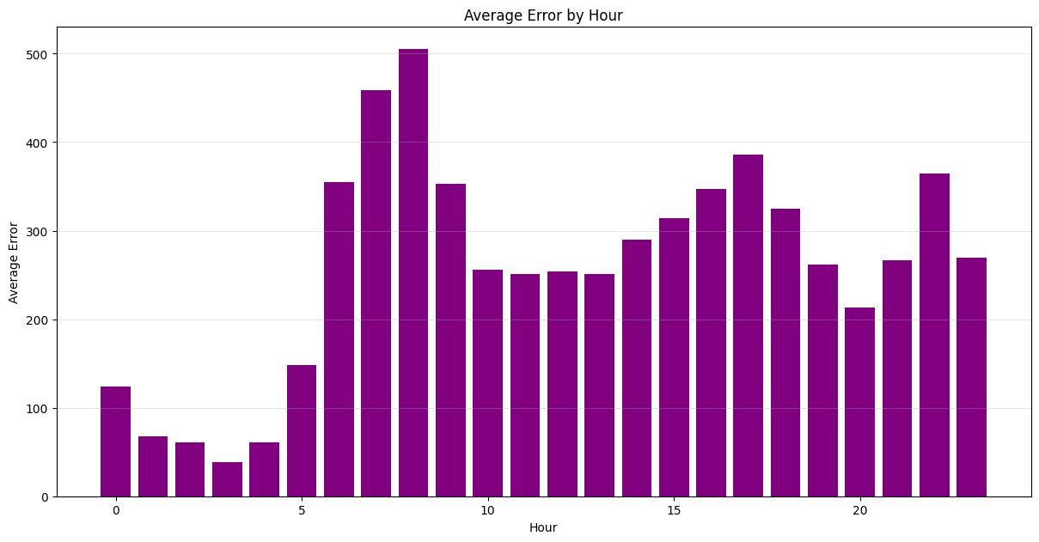
Model Error Analysis by Hour
✅ Lowest Error Hours
1–4 AM: Only 38–67 vehicles/hr error
(Stable, low traffic)
⚠️ Highest Error Hours
7–8 AM: ~458–505 error
5 PM: ~385 error
(Rush hour volatility)
Fig 8: Average Prediction Error by Hour

Slide 10
Key Insights & Practical Implications
🕐 Time Dominates
✅ Good for Planning
Hour (82%) + Day (11%) = 93% of prediction. Weather barely matters.
Weekly traffic planning, peak-hour identification, route capacity analysis
❌ Not for Real-time
⚠️ Rush Hour Caution
Cannot replace real-time signal control or emergency deployment
Predictions during 7-8 AM and 5 PM need safety buffers
🔮 Future Improvement
⚡ Simplify Model
Add lag features (prev hour traffic) to capture traffic momentum
hour + day_of_week alone may achieve similar accuracy

Slide 11
Conclusion
1. Random Forest MAE of 259.50 vs. Linear Regression MAE of 1607 — 83.8% better
2. Traffic is a TIME-driven phenomenon: Hour (82%) + Day of week (11%) = 93% importance
3. Weather conditions have minimal impact on traffic volume prediction
4. Model is production-ready for strategic planning but not real-time control
5. Rush-hour predictions (7–8 AM, 5 PM) carry highest uncertainty — add safety buffers
6. Future: Lag features, K-fold CV, and simplified 2-feature model recommended
Week 1 Project | Traffic Volume Prediction | Abhishek

