Slide 1

CALENDAR v1.0
A Calendar Application With To-Do List Feature
Team AAKAR

Slide 2
Motive Behind Calendar V1.0 :
Have you missed an important deadline?
Have you forgotten an important family event?
Have you missed a meeting?
Have you forgotten the date to attend a schedule?

Slide 3

Now, here comes our Calendar V1.0 to serve the purpose.

Slide 4

Key Features of Calendar v1.0 :
1. Simple UI
2. Easily switch months and year in the calendar view.
2. Ability to add an event on any particular date easily.
3. User can see all the events for any particular year all at once.
4. Ability to delete a saved event.

Slide 5
Key Features of Calendar v1.0 ( backend ):
1. The C programming language is used to code this program.
2. File handling part is used to store and show the events.
3. Array, Pointers, Strings, Preproceesors are used to generate and run various tasks the calendar effectively.
4. We have made use of basic DSA for fast and efficient logging of data.

Slide 6
How things function?

Slide 7

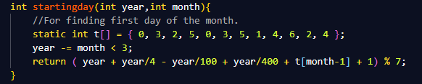
startingday() function :
Lets’ discuss all the parts of our program one-by-one.
Let’s start from the start.
This function takes year and month as parameter and returns starting index of the day for that particular month of that year.
Static keyword is used to store these index in which 0 means Sunday, 1 means Monday and so on.
And finally return statement will return the index of first day of the month accordingly by checking for the year to be a leap year or not by that formula used.

Slide 8
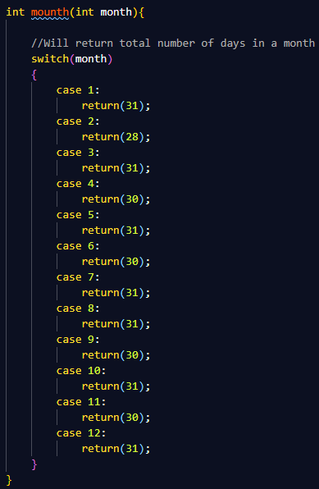
mounth() function :
This function takes Month number as parameter and then return total number of days in that month, it simply uses switch-case statements.
For example: Suppose the we wish to check for the month August, so the parameter value will be 7 as August is the 7th month of the calendar and thus it’ll return 31, which will be the total number of days of that month.

Slide 9
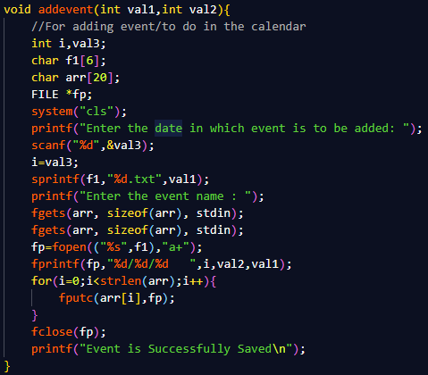
addevent() function :
This function is used for adding an event and then saving it in local storage. We are using File Handling operations available in C language for that purpose.
This function comes into play when a user wish to save an event. This function asks user to enter the date in which user wants to add an event for that particular month and year and then prompts for details of event.
After getting the required details this function generates a text file in the local folder and renames it to the name of that year and then saves the event in that file with respective date/month/year.

Slide 10
addevent() function :
sprintf sprintf stands for “String print”. Instead of printing on console, it store output on specified char buffer..
fgets reads a line and stores it into the string pointed to by str. It stops when either (n-1) characters are read, the newline character is read, or the end-of-file is reached, whichever comes first.
fprintf is used to print the content of the file on console.
fopen and fclose are used to open and close the file respectively.

Slide 11
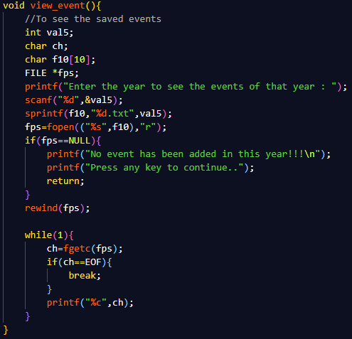
view_event() function :
This function is used for viewing a saved event. We are using File Handling operations available in C language for that purpose.
When user wish to see the saved events this function starts working. First of all this function asks the user to enter the year for which he/she wants to see the evets. After entering the year, the function checks in the local folder if there is any file saved by that name if it is there then it’ll show the events saved in it else will show the message saying no event has been saved for that year.

Slide 12
view_event() function :
Pointer fps is used to read the contents of the text file. If there will be anything saved in that file it’ll show it else will show no events message.
rewind function sets the file position indicator of an input stream back to the beginning of the file. It also clears the error and end-of-file indicators for stream.
fgetc() is used to obtain input from a file single character at a time.
EOF represents End Of File.

Slide 13
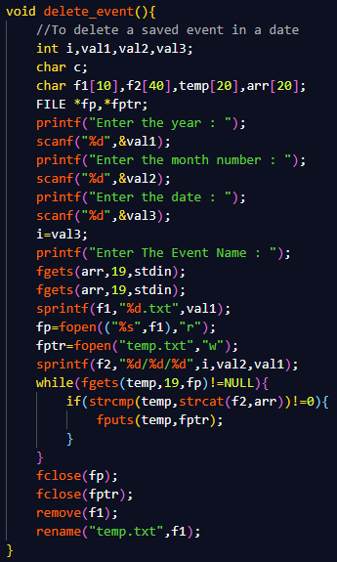
delete_event() function :
This function is used for deleting a saved event. We are using File Handling operations available in C language for that purpose.
rewind function sets the file position indicator of an input stream back to the beginning of the file. It also clears the error and end-of-file indicators for stream

Slide 14
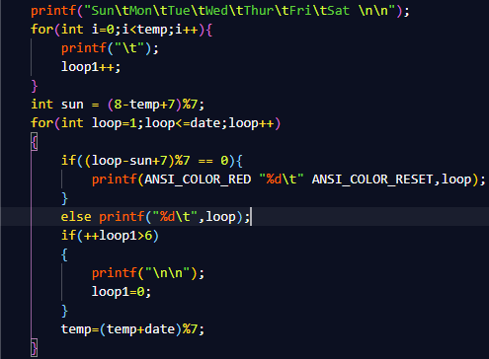
c_month function :
This part of the c_month function is used to print the calendar of any month of any year. Basic loop operations are used for that purpose.
int sun statement stores the date of Sunday and ANSI_COLOR_RED statement is used to change the text color of sundays to red and ANSI_COLOR_RESET switches back the color to default. These colors are ansi escape code for that color defined in preprocessor of the program.

Slide 15
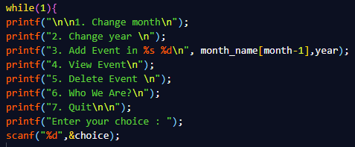
Menu printing part of c_month function :
This part of the c_month function is used to print the menu again and again when required, until user enters 7 from the menu to exit the program.
Scanf function takes user input and then switch to that case accordingly.

Slide 16
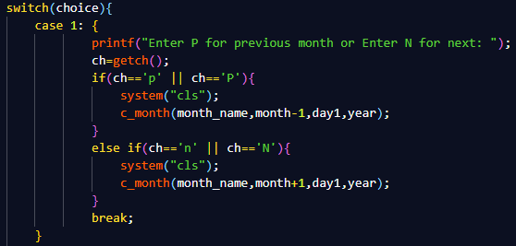
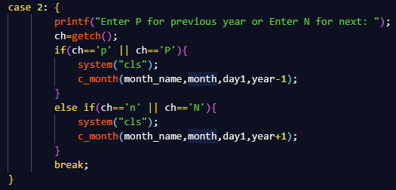
Switch-case part of c_month function:
These parts of the c_month function are used to initiate the switch case statement which switch to that case as per user input..
These cases i.e. case 1 and Case 2 are there to switch between months and year respectively for that input.

Slide 17
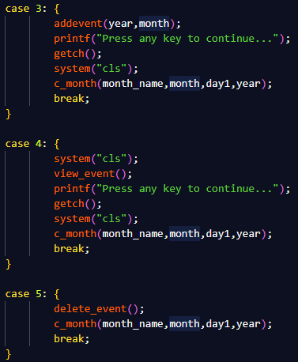
Switch-case part of c_month function:
Case 3 is there to call the add event function to add and save an event entered by user and then again calls c_month function. System(“cls”) is used to pass the string argument into system by executing operating system’s command processor.
Case 4 calls the view_event function to show the saved events.
Case 5 calls the delete_event function to delete a saved event from the text file saved in local storage.

Slide 18
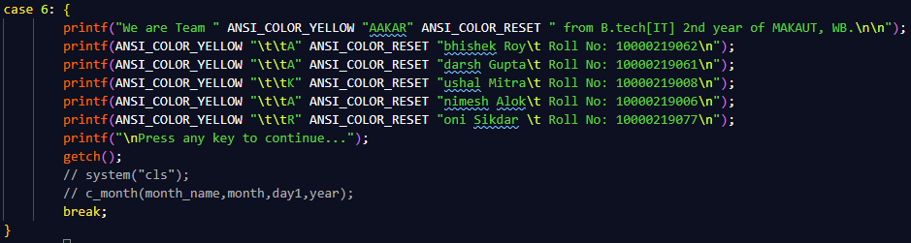
Switch-case part of c_month function:
Case 6 is there to show who we are. It will simply show the details of the programmers of this calendar application i.e. us.
Here ANSI_COLOR_YELLOW is used to change the text color of text and again ANSI_COLOR_RESET to reset the text color to default in console output. These ANSI_COLOR_YELLOW and ANSI_COLOR_RESET are the statements which have been defined in preprocessors as the ansi escape codes of those colors.

Slide 19
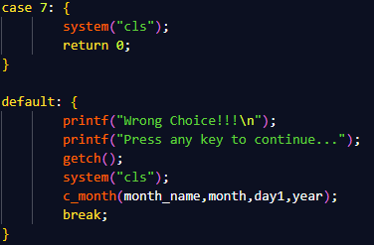
Switch-case part of c_month function:
Case 7 will simply terminate the program..
And the default case will print wrong choice and then will prompt again for any key to go back to the home page.

Slide 20
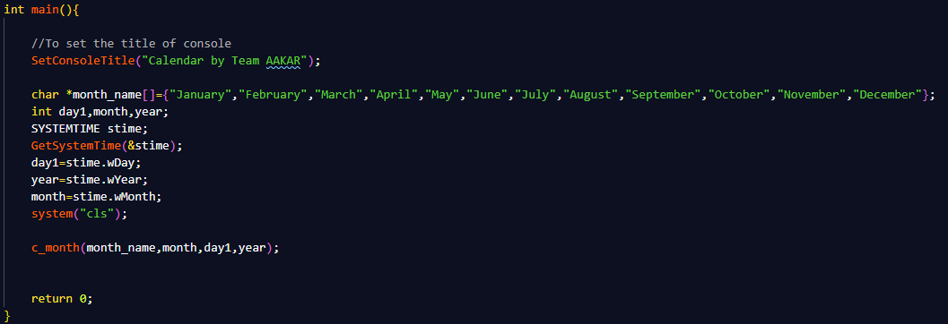
main() function :
This is the main function that will be executed first while running the program.
In this function, we are automatically printing today’s calendar by taking current date, month and year from system and using these data it will print the calendar of current month showing current date.

Slide 21
main() function :
GetSystemTime will acquire the the current date from system and will store it in respective variables using struct.
And finally c_month function will be called using those data and other operations will be done.
(a) SetConsoleTitle will change the title of the console to given name.
*month_name[] is the pointer pointing to respective months using month’s number.

Slide 22
Conclusion:
Calendar is a series of pages showing the days, weeks, and months of a particular year. As we are getting digital day by day, there should be a calendar also which is digital. That’s why we have made this digital calendar, which not only shows us the dates, but also allow us to add any task or event (which is important for us), on any date of a calendar.
In developing this calendar we have used the “C programming language”, in which we have used data structure’s like Array, Pointers, File Handling etc which is taught by our Data Structure teacher Sayantani Saha Ma’am, for which we all are thankful to her.
The main thing of this calendar is that, it not only shows you the dates but also allows you to add any event on any date of any year or month, and you can later on check the saved events on any date. Despite carrying a paper pocket calendar, we should use the digital calendar, which is more easy to carry and it’s also reduces the wastage of paper.

Slide 23
Future Scope :
The future scope of this project is to improve or to add new features to this project, like adding a feature of sending reminder of the event, one day before the event(so that you do not forget the event you saved)

Slide 24
Team AAKAR
Name | Roll No.
Abhisek Roy | 10000219062
Adarsh Gupta | 10000219061
Kushal Mitra | 10000219008
Animesh Alok | 10000219006
Roni Sikder | 10000219077

Slide 25

Thank You!

