Slide 1

Explore Locality-wise restaurants dataset in the city of New Delhi

Slide 2
Introduction
Capstone Project — The Battle of Neighbourhoods
Introduction New Delhi is the capital city of India. The city itself has a population of 257,803. From different parts of India many people goes to Delhi for different purposes like construction work, IT Job, Business, Travel with family,Students etc.. First thing which people encounter in which area they will stay. Now staying in an area depends on different aspects too like availability for food,most importantly if you are foodie, budget and bviously other amenities. So, we need to build this code to check which area is best for different category of people.For example, most north indian persons like chinese food so they can easily get the exact recommendation according to their need.
With it’s diverse culture , comes diverse food items,ethnicity. There are many restaurants in New Delhi City, each belonging to different categories like Chinese , Italian , French etc. So as part of this project , we will list and visualise all major parts of New Delhi City .

Slide 3
Objectives
Questions that can be asked using the above mentioned datasets
What is best location for Chinese food ?
Which area is having large number of north indian foods ?
Which area is not having sufficient restaurants ?
Best place to stay as per chinese cuisine selection ?
In New delhi what are the best restaurants?

Slide 4
Data
For this project we need the following data :
New Delhi Resturants data that contains list Locality, Resturant name,Rating along with their latitude and longitude. Data source : https://www.kaggle.com/shrutimehta/zomato-restaurants-data Description : This data set contains the required information. And we will use this data set to explore various locality of new delhi city. Nearby places in each locality of new delhi city. Data source : https://developer.foursquare.com/ Description : By using this api we will get all the venues in each neighborhood.

Slide 5
Approach
Collect the new delhi city data from Zomato kaggel dataset Using FourSquare API we will find all venues for each neighborhood. Filter out all venues that are nearby by locality. Using aggregative rating for each resturant to find the best places. Visualize the Ranking of neighborhoods using folium library(python)

Slide 6
Results

Slide 7
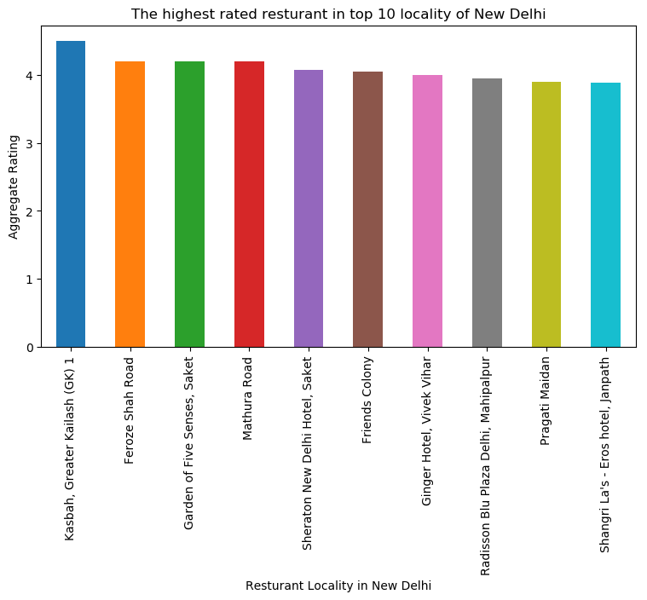

Slide 8
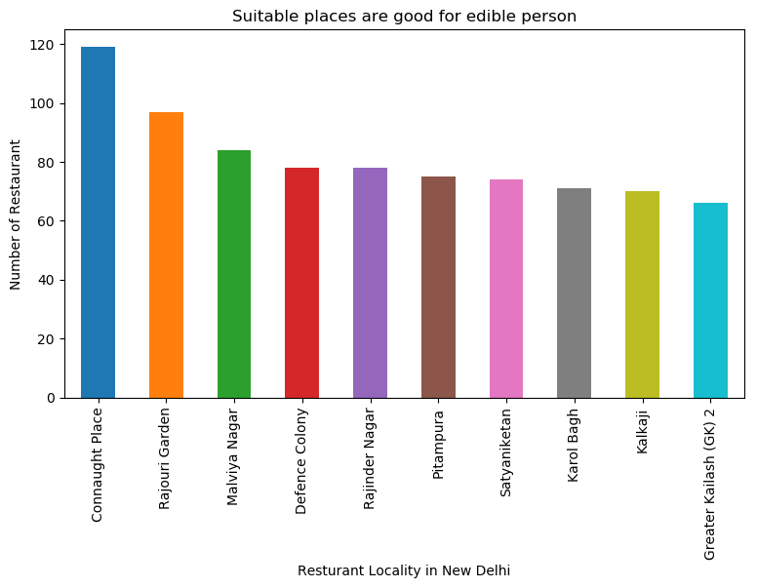

Slide 9
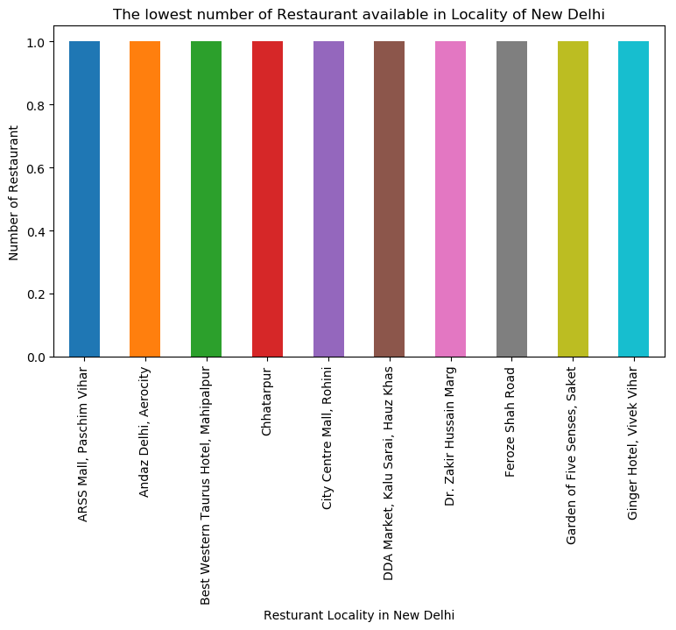

Slide 10
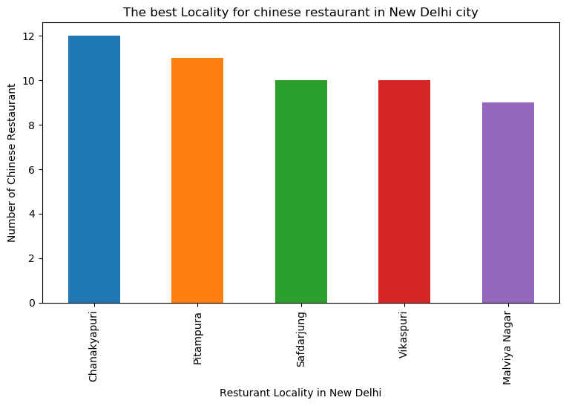

Slide 11
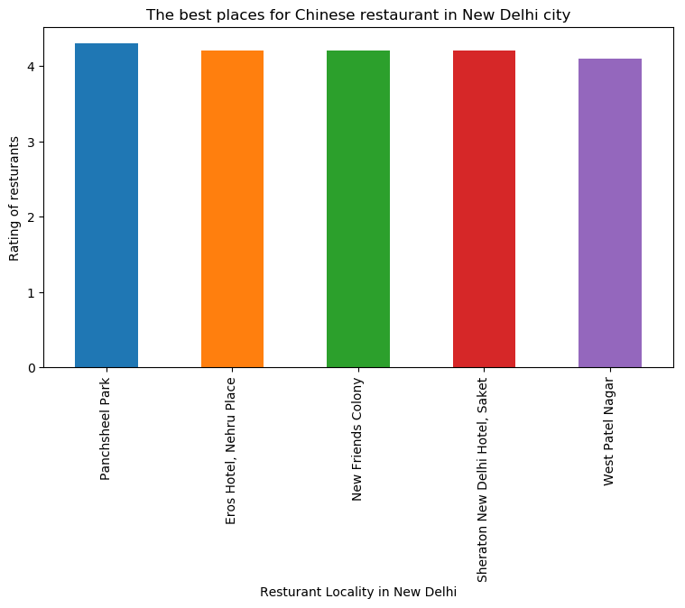

Slide 12


Slide 13
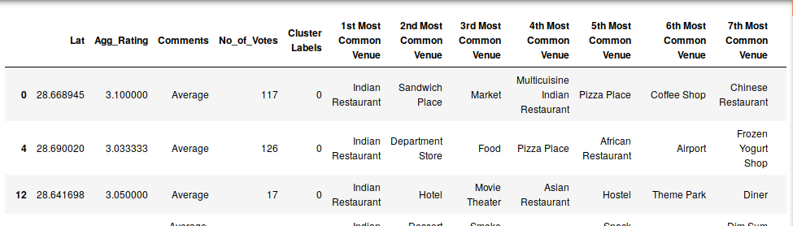
Cluster 1:
The Indian restaurants are most recommended venues nearby the locations.

Slide 14
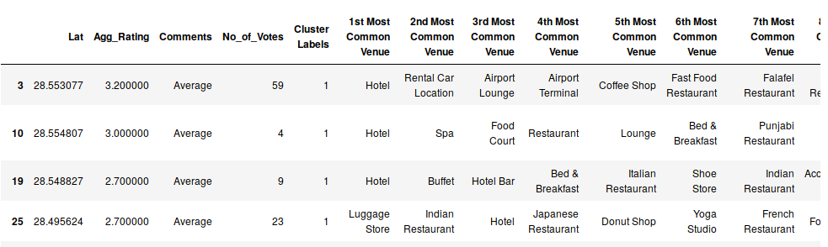
Cluster 2:
It is recommended for the Hotel and Nightclubs venues areas:

Slide 15
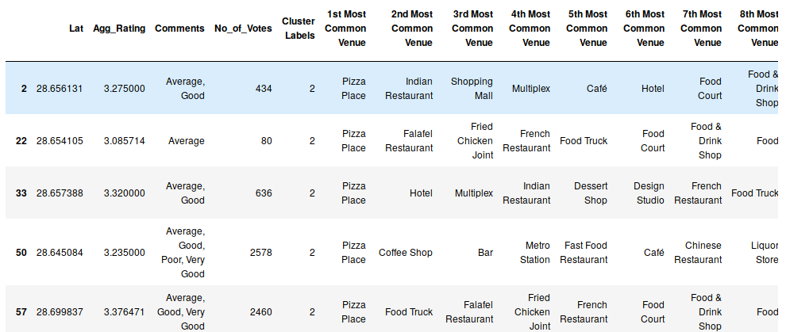
Cluster 3:
It seems like pizza place,

Slide 16
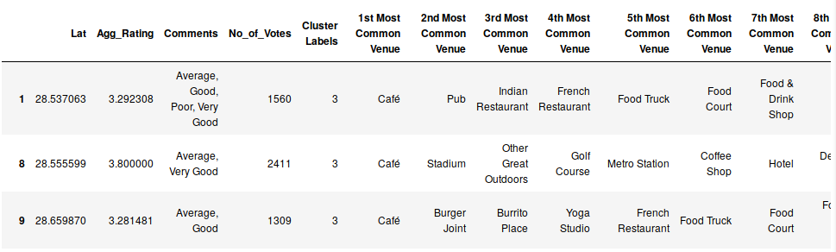
Cluster 4:
It’s most recommended for cafes

Slide 17
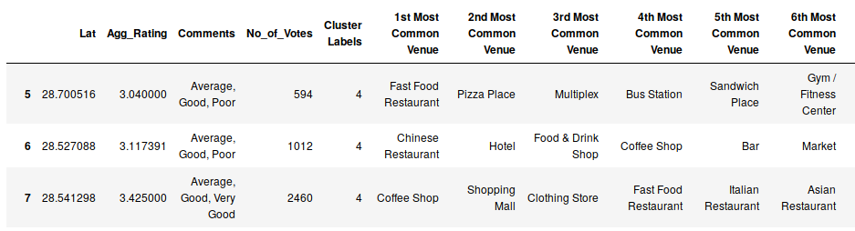
Cluster 5:
Fast food, cafes are the most recommended venues

Slide 18
Conclusion
Chanakyapuri, Pitampura, Safdarjung are some of the best neighborhoods for Chinese cuisine.
Pancsheel park, Nehru place have the best Chinese Resturant.
Cannaught place, Rajouri garden, Malviya nagar are the best places for edible person.
Greater kailash, Feroze shah road, Saket have best resturants in New Delhi.
Cluster 1: It is most recommended for Indian Restaurants.
Cluster 2: It is most recommended for Hotels and nightclub.
Cluster 3 and Cluster 5: It is most recommended for Fast food.
Cluster 4: It is most recommended for the cafe and pizza.

