Slide 1

Best place to stayin the city of London(Based on crime history data)

Slide 2
Introduction
The objective of this project is to identify the best area to stay where any person who is relocating from any corner of the world to London for business purpose or Job change. Criteria for a place to be safe is not only amenities like Hospital,park,gym,pool etc but a safe place where crime rate is minimal.
The main question aims to select the safest place in London is based on the total crimes, need to explore the neighborhoods of that borough to find the 10 most common venues in each neighborhood and finally cluster the neighborhoods using k-mean clustering.
This report will be targeted to people who are looking to relocate to London. Inorder to finalise a neighborhood to hunt for an apartment, safety is considered as a top concern when moving to a new place. If you don’t feel safe in your own home, you’re not going to be able to enjoy living there. The crime statistics will provide an insight into this issue.
We will focus on the 10 most common venues in each neighborhood so that the best neighborhood suited to an individual's needs can be selected.

Slide 3
Data
As per the problem, factors that will influence our decision are:
The total number of crimes commited in each of the borough during the last year.
The most common venues in each of the neighborhood in the safest borough selected.
Below is the data sources which will be needed to populate the required information:
Part 1: Preprocessing a real world data set from Kaggle showing the London Crimes from 2008 to 2016: A dataset consisting of the crime statistics of each borough in London obtained from Kaggle
Part 2: Scraping additional information of the different Boroughs in London from a Wikipedia page.: More information regarding the boroughs of London is scraped using the Beautifulsoup library
Part 3: Creating a new dataset of the Neighborhoods of the safest borough in London and generating their co-ordinates.: Co-ordinate of neighborhood will be obtained using Google Maps API geocoding

Slide 4
Results

Slide 5
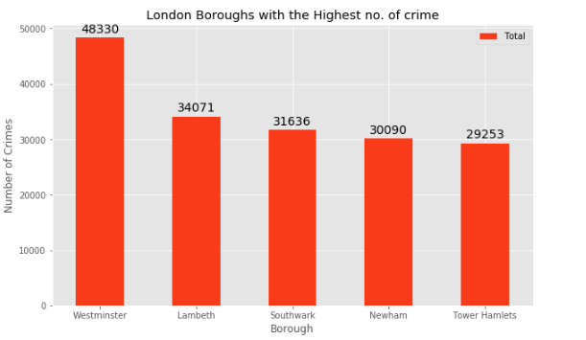

Slide 6
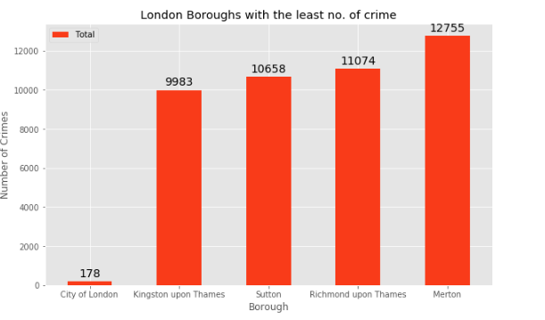

Slide 7
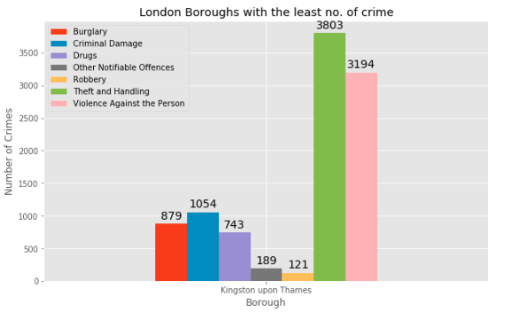

Slide 8
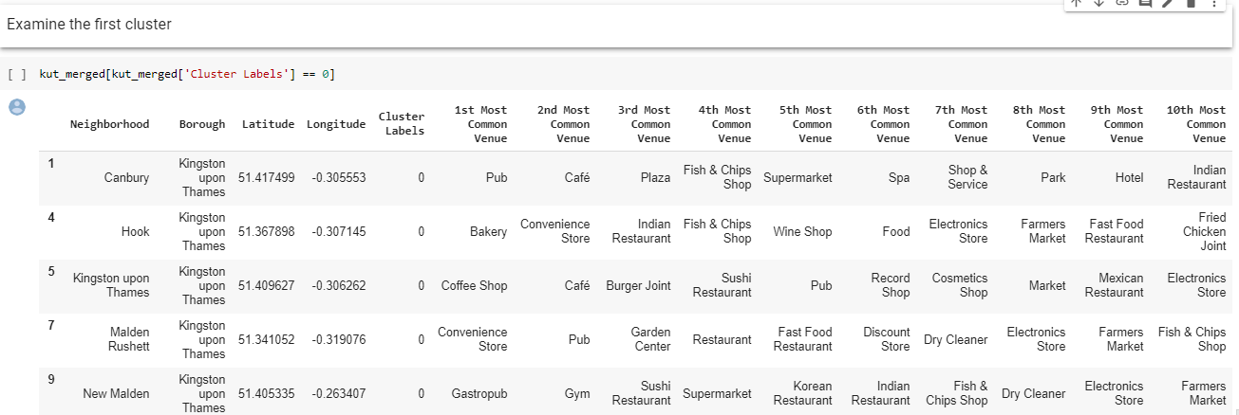

Slide 9
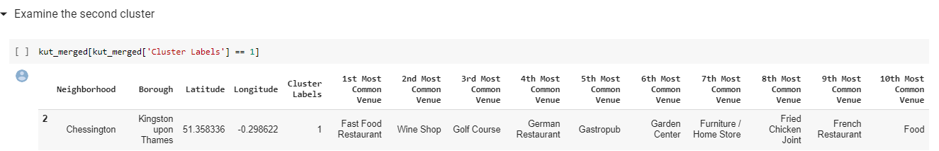

Slide 10
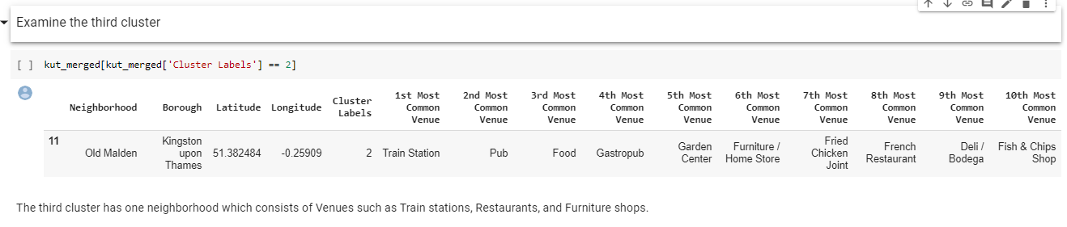

Slide 11
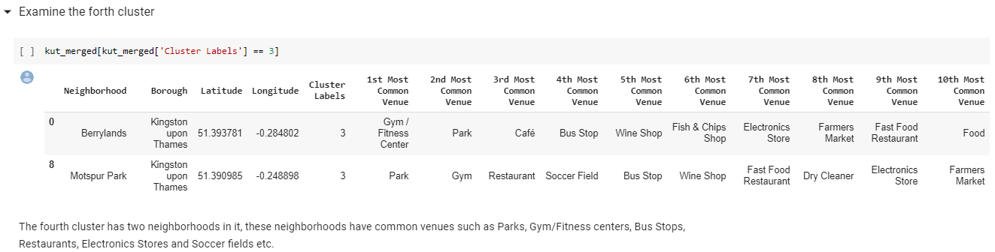

Slide 12
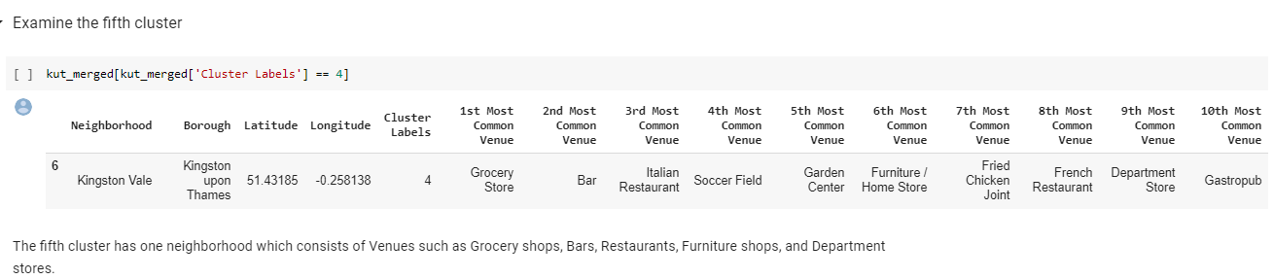

Slide 13
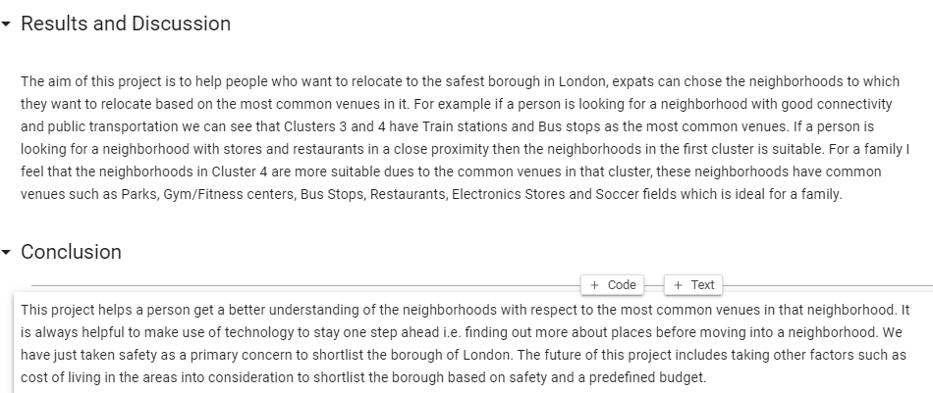
Conclusion
Chanakyapuri, Pitampura, Safdarjung are some of the best neighborhoods for Chinese cuisine.
Pancsheel park, Nehru place have the best Chinese Resturant.
Cannaught place, Rajouri garden, Malviya nagar are the best places for edible person.
Greater kailash, Feroze shah road, Saket have best resturants in New Delhi.
Cluster 1: It is most recommended for Indian Restaurants.
Cluster 2: It is most recommended for Hotels and nightclub.
Cluster 3 and Cluster 5: It is most recommended for Fast food.
Cluster 4: It is most recommended for the cafe and pizza.

