Slide 1
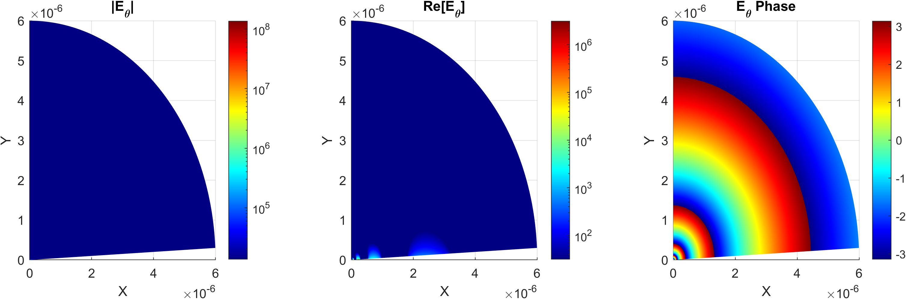
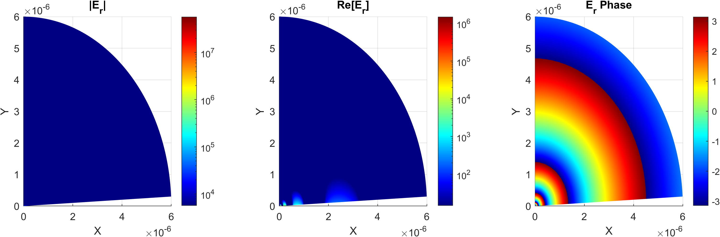
1 um

Slide 2
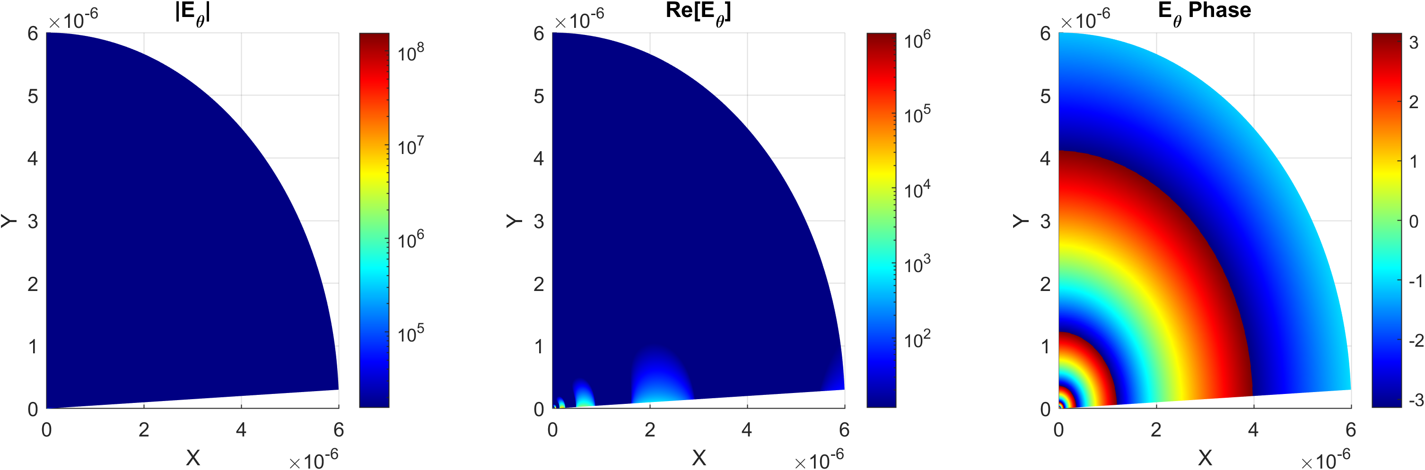

3 um

Slide 3
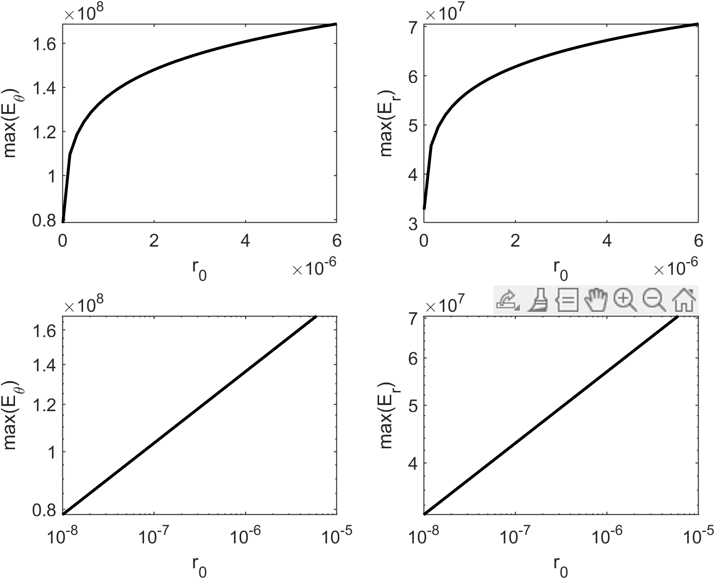
X axis (r0) is the excitation distance from the tip. Y axis is the max of the Field square. As the excitation point is moved farther from the tip, the local field increases logarithmically. The lower row is the same plot as the upper row, only in log-log scale.

