Slide 1
CS646 term paper presentation
Abhijit Sharang(10007)

Slide 2
Problem statement
We are given a pair of rectified stereo images such that their epipolar line is horizontal
We need to perform stereo matching on the images for construction of disparity map(not a part of the paper)
Feature based matching done to obtain corresponding interest points in the two images

Slide 3
Algorithm overview
Apply Harris corner detection to obtain interest points in the left and the right images
Match the corresponding interesting points using correlation measure
Apply RANSAC for outlier rejection and obtain the disparity seeds
Grow the disparity seeds until no further strong correspondences are obtained

Slide 4
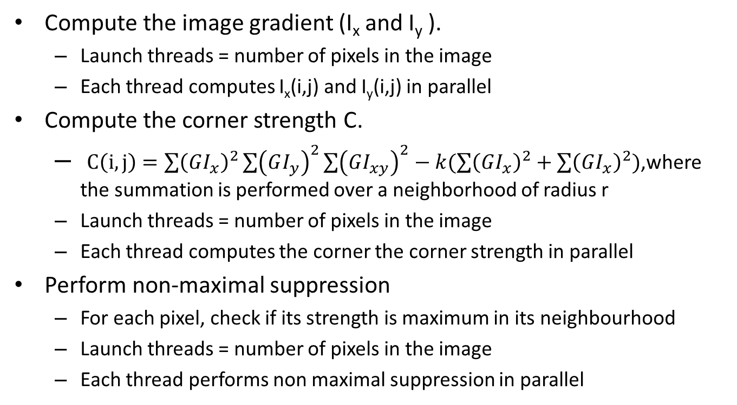
Harris corner detection
Compute the image gradient (I_{x} and I_{y} ).
Launch threads = number of pixels in the image
Each thread computes I_{x}(i,j) and I_{y}(i,j) in parallel
Compute the corner strength C.
$C\left(i,j\right)=\sum{{\left(GI_{x}\right)}^{2}}\sum{{\left(GI_{y}\right)}^{2}}\sum{{\left(GI_{xy}\right)}^{2}}−k(\sum{{\left(GI_{x}\right)}^{2}}+\sum{{\left(GI_{x}\right)}^{2}})$,where the summation is performed over a neighborhood of radius r
Launch threads = number of pixels in the image
Each thread computes the corner the corner strength in parallel
Perform non-maximal suppression
For each pixel, check if its strength is maximum in its neighbourhood
Launch threads = number of pixels in the image
Each thread performs non maximal suppression in parallel

Slide 5
Establishing correspondences
For each interest point in the left image,obtain the point in the right image which gives the maximum normalised cross correlation value and vice-versa
Since the epipolar line is horizontal,the search for each interest point is restricted to a single dimension
Launch number of threads = number of interest points
For each interest point,scan through all interesting points in the other image which have the same y-coordinate as the point
Retain those pairs which match each other and discard other points

Slide 6
RANSAC
RANSAC robust estimation: repeat for N samples, where N is determined adaptively.
Select a random sample of eight correspondences and compute the homography matrix F
Calculate the distance d for each putative correspondence.
Compute the number of inliers consistent with H by the number of correspondences.
Choose the matrix H with the largest number of inliers.

Slide 7
RANSAC(cont..)
4 pairs of points are sufficient for the computation of homography matrix
Keep the number of samples as N/4,where N is the number of correspondences obtained.
Launch number of threads = number of samples
Each thread obtains the number of inliers consistent with the homography matrix in parallel
Do a linear scan to retain the sample which gives the highest number of inliers

Slide 8
Region growing

Slide 9
Dataset
France
Cmu
swiss

Slide 10
Results

