Slide 1

VISHNUMIST R&D

Slide 2
Our objective of the project is to ensure the safety system. For enhancing the safety, we are detecting the eye blinks of the driver and estimating the driver status and control the car accordingly we are implementing the system as a prototype by capturing the live images of the eyes and fed them in to the microcontroller in which software is used to process the video and convert it into frames.

Slide 3
Task Completion

Slide 4
Organized Team:
Circuit Designer : Manish
Web Development : Nitish
Content Writer : Keha

Slide 5
3-D Model

Slide 6
Task Completion
Survey Report
Driver Drowsiness has been one of the major causes of road accidents and can lead to severe physical injuries, deaths and significant economic losses. Statistics indicate the need of a reliable driver drowsiness detection system which could alert the driver.
Methods for measuring Drowsiness
Subjective measures
Vehicle based Measures
Behavioral Measures
Physiological Measures

Slide 7
Outcome of the survey

Slide 8
Represents the average age distribution of drivers

Slide 9
Represents driver’s working hours
hours according to survey shown in Graph 3.
hours according to survey shown in Graph 3.
Driver’s working hours

Slide 10
Represents cause-wise distribution of road accidents and major requirements of drivers .

Slide 11
Represents the installation of GPS devise in the vehicle

Slide 12
Alpha Model

Slide 13
Website

Slide 14
Website is successfully working and also in progress to add some more useful features.
Website provides all features that are required to access the devise.

Slide 15
Website Features

Slide 16
Website Features
Website provides a basic idea behind the science and methodologies used in the devise.
Features
Devise can measure eye blinking rate by IR transmitter results in identifying the status of the driver.
Built on principles of cloud computing, machine learning and statistic that assists quick services.
Devise measures head movement through accelerometer placed on driver’s forehead.

Slide 17
Challenges

Slide 18
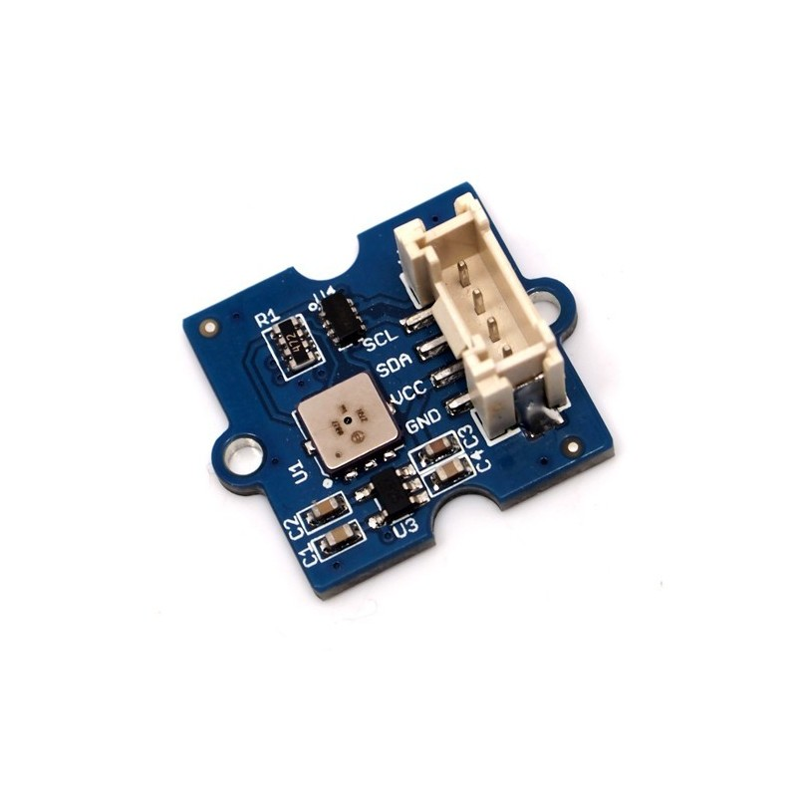
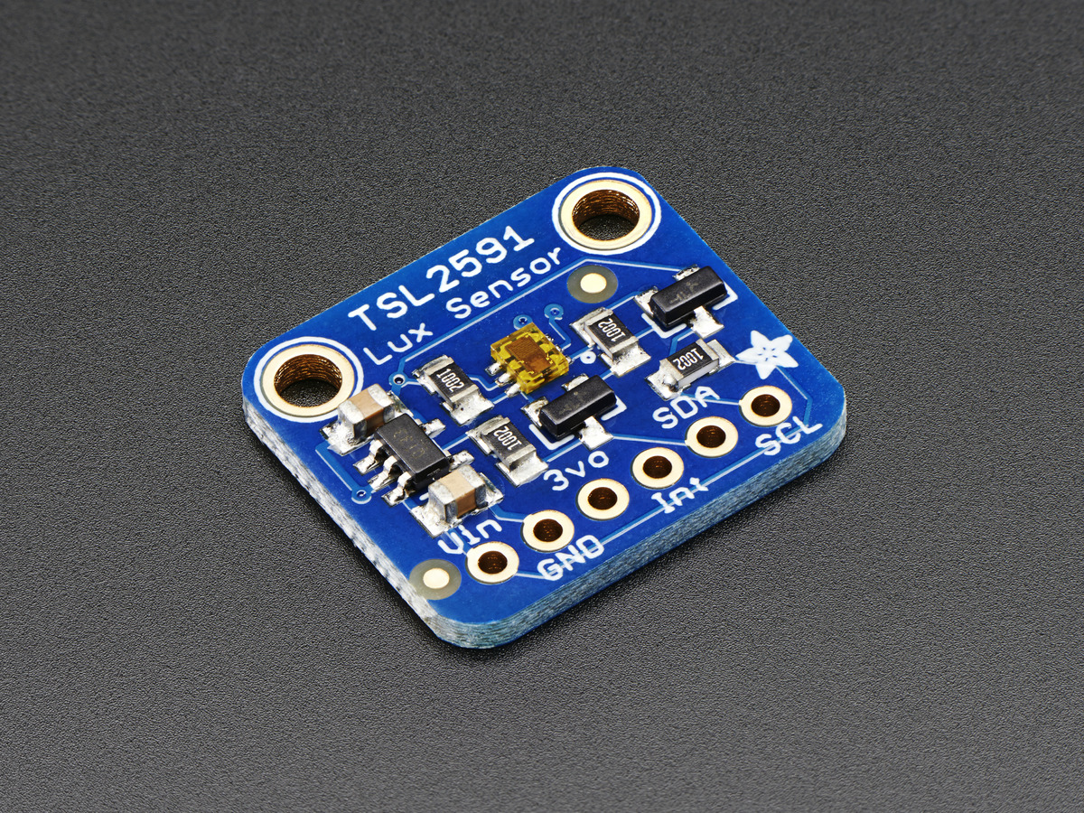
Low availability of electronic sensors in Indian market.

Slide 19
Need a programming expert or mentor to manage work more efficiently and smoothly.

