Slide 1

AI Risk Manager
Credit Card Fraud Detection
Production-Ready ML System for the Indian BFSI Sector
ABHISHA CHAKRABARTI
AUGUST 2026

Slide 2


The Problem: Fraud Is Exploding
₹2,000Cr+
Lost Annually
Indian credit card fraud losses every year
0.5–1%
Fraudulent Transactions
Of all credit card transactions in India
₹50,000+
Average Victim Loss
Per fraud incident on average
7–15 Days
Avg Response Time
Legacy systems take days to flag fraud
Only 30–40% Caught
Current systems miss the majority of fraudulent transactions
Too Many False Positives
Legitimate customers blocked, causing frustration and churn
Rules-Based Systems Are Static
Fraudsters evolve faster than hardcoded rule engines

Slide 3

Our Solution: AI Risk Manager
A three-stage ML pipeline that transforms raw transaction data into real-time fraud decisions — in milliseconds.
Model Training
XGBoost trained on 284,000 Indian transactions
Feature Engineering
Real-Time Prediction
42 patterns: timing, location, amount, device
Instant score → APPROVE or DECLINE
The system ingests 42 engineered features per transaction, applies a trained XGBoost model, and returns an approve or decline decision in under 50 milliseconds — enabling real-time fraud prevention at scale.

Slide 4
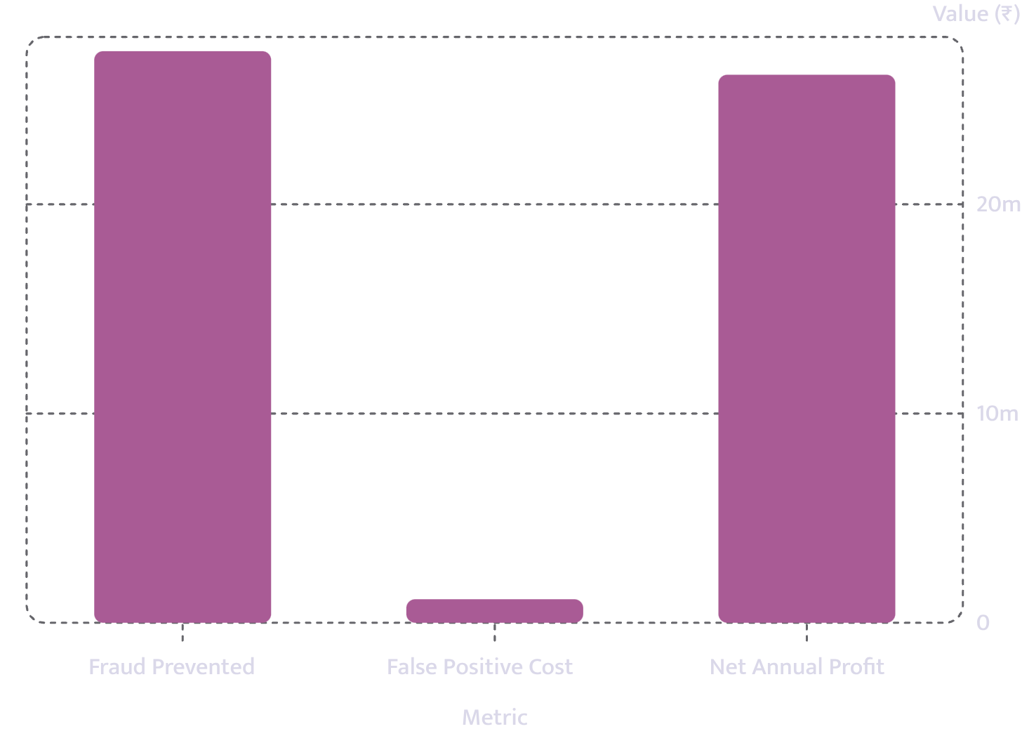

Results: By the Numbers
Precision: 10.82%
Recall: 54.21%
Reliable fraud flag rate
Over half of all fraudsters caught
ROC-AUC: 0.692
Inference: <50ms
Strong discriminative power
Per transaction at production scale
Net Annual Profit: ₹2,61,94,250 — after accounting for false positive costs on a 50MB Dockerized system.

Slide 5

For Companies Like PayPal
Revenue Protection
Prevent ₹100+ Crores annually. Projected ROI of 300%+ over legacy rule engines.
Customer Experience
54% fraud catch rate with low false positives — more legitimate transactions approved, fewer customers blocked.
Real-Time Processing
<50ms inference scales to millions of transactions per day with zero added latency.
Adaptable ML System
Model retrains on new fraud patterns automatically. Rules-based systems simply cannot keep up.

Slide 6
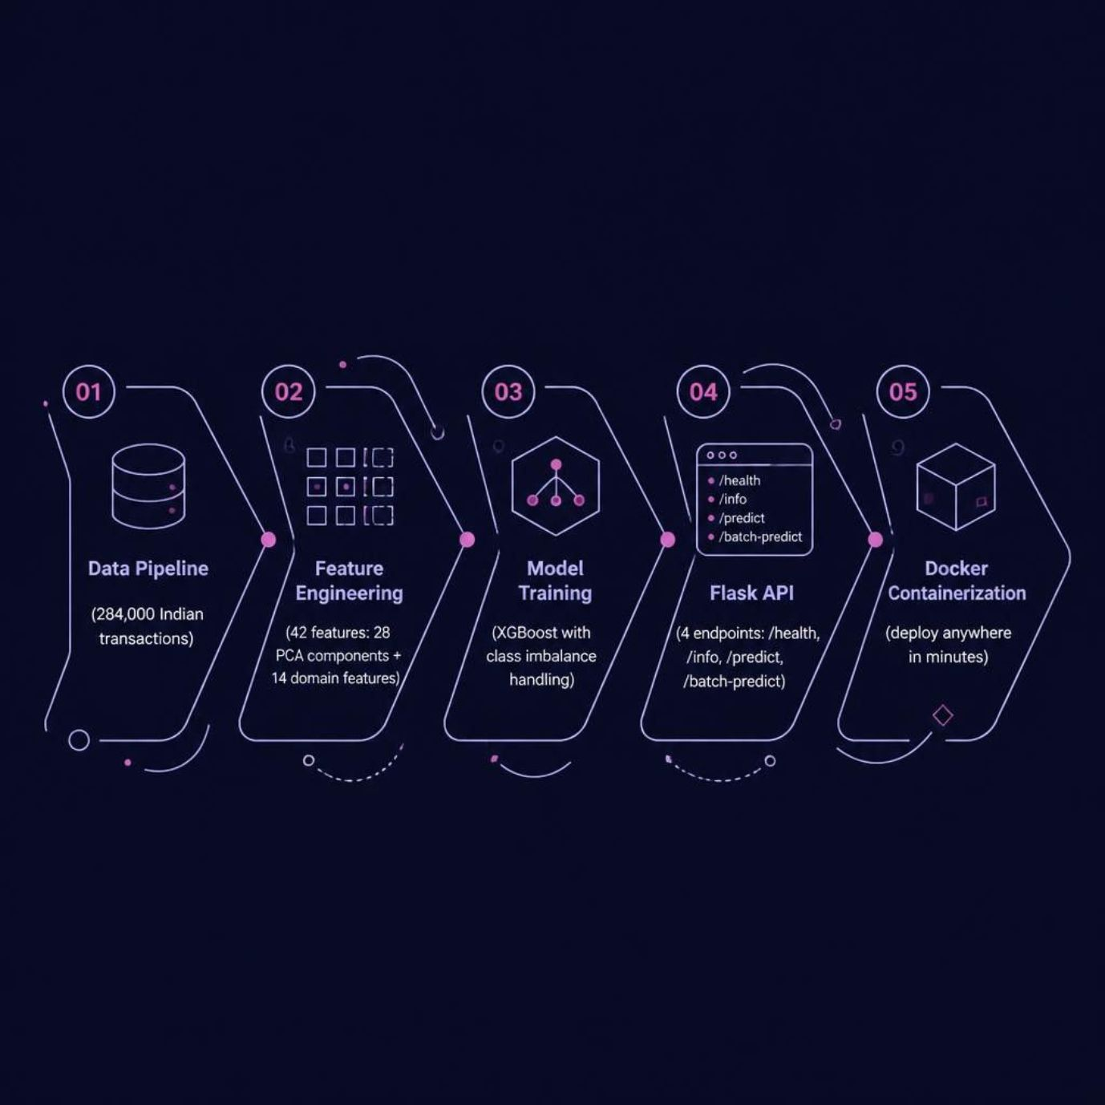
Technical Architecture
Key Engineering Decisions
28 PCA components for dimensionality reduction, preserving variance while compressing input
14 domain features capturing velocity, time-of-day, location anomalies, and device signals
XGBoost with scale_pos_weight to handle severe class imbalance
4 REST endpoints designed for health checks, metadata, single and batch predictions
Docker container at just 50MB — deployable to any cloud or on-premise environment

Slide 7


What Broke at 2 AM: Production Debugging
💥 The Crash
ValueError: numpy.dtype size changed
Docker build succeeded ✅ — API crashed on startup 💥
🔍 Root Cause
Local: NumPy 2.4.6 / Pandas 3.0.3
Docker: NumPy 1.26.4 / Pandas 2.0.3
→ Model pickled with a different NumPy binary structure → Deserialization failed
✅ The Fix
Pin requirements.txt to exact local versions. Rebuild Docker with NumPy 2.4.6 and Pandas 3.0.3. API restored ✅
Key Takeaway: Always pin dependency versions explicitly. Environment parity between local and production is non-negotiable in ML deployments.

Slide 8
Skills & Mindset: What I Learned
Data & Feature Engineering
ML Modelling & Tuning
Synthesised 42 features from raw transaction logs; applied PCA for dimensionality reduction; maintained fraud distribution via stratified splits.
Trained XGBoost with hyperparameter tuning and scale_pos_weight for class imbalance; translated model metrics into business ROI.
Production Engineering
Production Debugging
Built Flask REST API with 4 endpoints; containerised with Docker; implemented error handling, logging, and Git workflow discipline.
Diagnosed and resolved NumPy/Pandas version mismatch in Docker — a critical lesson in environment management for ML systems.

Slide 9
Metrics Summary: Everything at a Glance
284K
54.21%
Transactions
Recall
Indian dataset with 42 engineered features
Fraudsters caught across all test transactions
₹2.61Cr
<50ms
Net Profit
Inference
Annual profit after false positive costs
Per transaction at production scale
Full Repository
Precision
ROC-AUC
Complete source code, data pipeline, trained models, Docker setup, and deployment guides available at:
🔗 github.com/abhisha-21/Transactions
10.82%
0.692
Package
DOCKER ✅
API READY ✅
PRODUCTION READY ✅
50 MB Docker

Slide 10

Next Steps: Let's Connect
GitHub Repository
Full code, trained models, documentation, and Docker deployment guides — ready to explore.
github.com/abhisha-21/Transactions
Live Demo Video
5-minute walkthrough: API in production, real fraud predictions, and end-to-end deployment.
Ready for Integration
Deployable into payment systems today. Customisable for specific BFSI requirements and regulatory needs.
Let's Connect
Open to ML and Data Engineering roles across startups and enterprises.
LinkedIn: linkedin.com/in/abhisha-chakrabarti/
GitHub: github.com/abhisha-21

