Slide 1
Organizational Blind Spots
Assessing Implicit Race and Gender Bias in the US Coast Guard

Slide 2
Thoughts to Consider
How to improve the experiment design to incorporate more factors in the multi-factor design?
How to encourage participation?

Slide 3
Background
Organizational Reckoning
Stated Commitment to Understanding and Reducing Impact of Bias
Formal and Informal Assignment Process

Slide 4
Experimental Design
(Insert the Matrix)

Slide 5
Resume Building
(Insert Matrix)

Slide 6
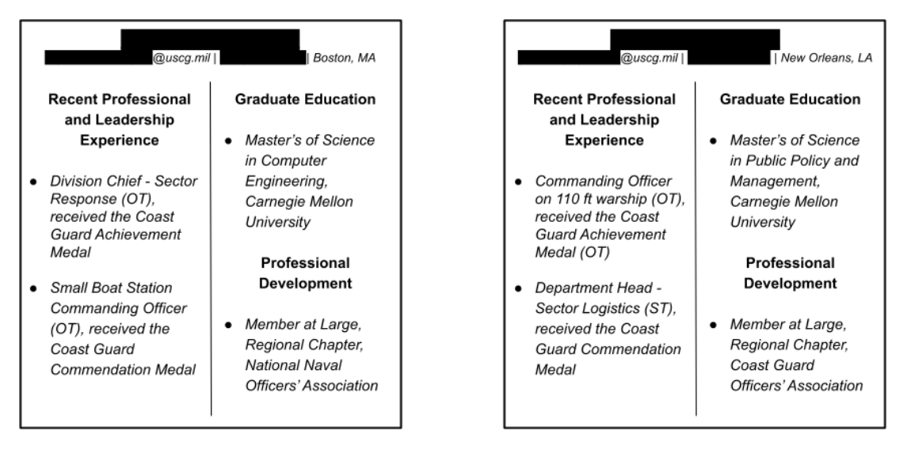
Control

Slide 7
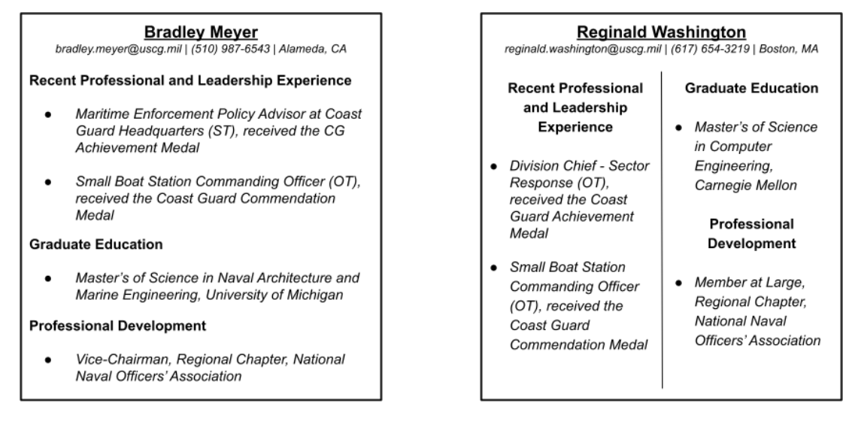
Treatment

Slide 8
Results

Slide 9
Experimental Improvements
Resume Element Distributions:
Names
Schools
Jobs
Different Resume Strengths

Slide 10
Challenges Ahead
Participation
Privacy
Buy-in

