Slide 1

Flight Delay Prediction Michael Bollig, Emily Brantner, Sarah Iranpour, Abhi Sharma
M SE
AIRLINES

Slide 2
Agenda
1 | Business Case
2 | Data Overview
3 | Feature Selection and Engineering
4 | Model Selection and Preparation
5 | Model Evaluation

Slide 3
Section page title goes here
Business Case

Slide 4
Business case 20% of flights are delayed yearly
The cost estimate for delays in 2019 was $33 billion
$18B Passenger
$10B Airline / Lost Demand
$4B Indirect
Passengers are most impacted by flight delays
Delays cause airline reputation and credibility to decrease due to poor service quality
A portion of airline loss is directly related to passengers due to decreased service quality
*Information from Federal Aviation Administration
Notes:
While there may not be much we can do about certain flight delays (we can’t control weather, etc.), we can try to improve delay predictions to keep customers happy.

Slide 5

Business case What are we measuring?
Predict departure delay/no delay two hours ahead of departure to minimize impact to airlines and passengers
*Delay is defined as 15-minute or greater with respect to the planned time of departure

Slide 6
Section page title goes here
Data overview

Slide 7
Data Overview
— Airlines
—
— Open Flights
—
Bureau of Transportation Statistics Database
2015 – 2019 flight performance data
~32M rows with 109 columns (flight and airline information, location, delay type, etc.)
Openflights.org
Airport codes and time zone
~7.7K rows with 14 columns
— Weather
—
— Stations —
National Oceanic and Atmospheric Administration
2015 – 2019 weather data collected every hour
~631M rows with 177 columns (station, wind, temperature, cloud, etc.)
Maps distance between weather stations and neighboring airports
~5M rows with 12 columns (station, airport, distance, etc.)

Slide 8



Data Cleansing

Slide 9

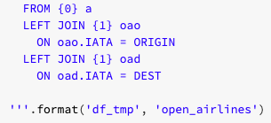
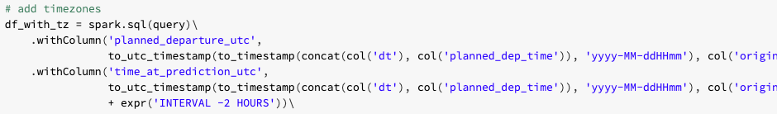
Function: Cleaning Airline Data
Dropping Duplicates
Canceled = Delayed
Joining OpenAirlines for time zones and codes

Slide 10
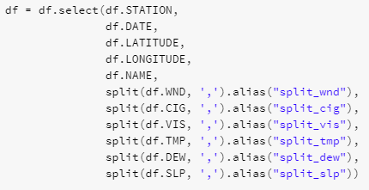

Function: Cleaning Weather Data
Select and Split Relevant Columns
Define split columns

Slide 11
Code: Cleaning Station Data
Remove stations not at airports
Write to Parquet

Slide 12
Data Joining

Slide 13


Joining Overview Diagram
Airlines
OpenAirlines
Joined on IATA codes
Stations
Joined on ICAO codes
Weather
Joined on station IDs and datetimes

Slide 14


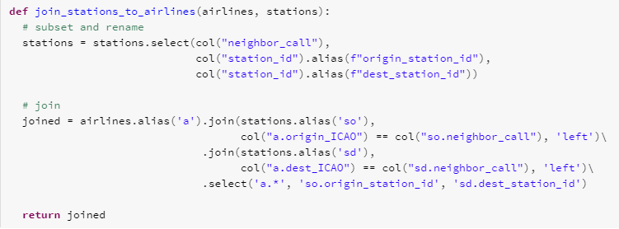
Function: Joining Airlines and Stations

Slide 15

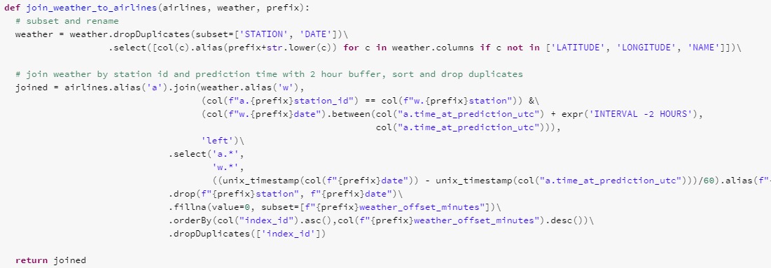
Function: Joining Airlines to Weather

Slide 16
Data Cleaning Mean Imputation
Option 1
Feature with Nulls
Existing Only
Filled means
index | feature | feature_null
1 | 2 | 0
2 | 4 | 0
3 |  | 1
4 | 3 | 0
5 | 1 | 0
6 |  | 1
7 | 5 | 0
index | feature | feature_null
1 | 2 | 0
2 | 4 | 0
4 | 3 | 0
5 | 1 | 0
7 | 5 | 0
index | feature | feature_null
1 | 2 | 0
2 | 4 | 0
3 | 3 | 1
4 | 3 | 0
5 | 1 | 0
6 | 3 | 1
7 | 5 | 0
Mean: 3
Option 2
Feature with Nulls
Normalize existing
Filled normalized means
index | feature | feature_null
1 | 2 | 0
2 | 4 | 0
3 |  | 1
4 | 3 | 0
5 | 1 | 0
6 |  | 1
7 | 5 | 0
index | feature | feature_null
1 | -0.707 | 0
2 | 0.707 | 0
4 | 0 | 0
5 | -1.414 | 0
7 | 1.414 | 0
index | feature | feature_null
1 | -0.707 | 0
2 | 0.707 | 0
3 | 0 | 1
4 | 0 | 0
5 | -1.414 | 0
6 | 0 | 1
7 | 1.414 | 0

Slide 17



Data Fully joined dataset
31,745,270 rows of data
Mean delay of 9.7 minutes
56 features
6,166,129 delayed flights

Slide 18
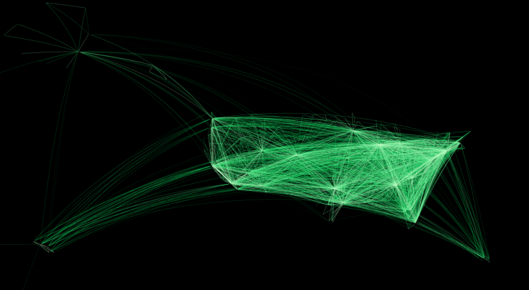

Full Dataset: Flight map

Slide 19
Section page title goes here
Feature Selection Engineering

Slide 20
Feature Selection and Engineering Numeric Features overview
Dataset (Correlation)
Feature Engineering (Correlation)
Dataset (Correlation)
Dataset (Correlation)
Flight Distance (0.01)
Origin Temperature (-0.007)
Origin Cloud Angle (-0.06)
Origin Visibility Distance (-0.08)
Origin Dew (-0.001)
Origin Wind Speed (0.09)
% delay from origin (0.09)
% delay to destination (0.08)
% delay for route (0.11)
% delay from state (0.07)
% delay to state (0.06)
Mean delay from origin (0.08)
Mean delay to destination (0.07)
Mean delay for route (0.08)
Mean delay from state (0.07)
Mean delay to state (0.07)
% delay from origin (0.09)
% delay to destination (0.08)
% delay for route (0.11)
% delay from state (0.07)
% delay to state (0.06)
Mean delay from origin (0.08)
Mean delay to destination (0.07)
Mean delay for route (0.08)
Mean delay from state (0.07)
Mean delay to state (0.07)
Flight Distance (0.01)
Origin Temperature (-0.007)
Origin Cloud Angle (-0.06)
Origin Visibility Distance (-0.08)
Origin Dew (-0.001)
Origin Wind Speed ()
Flight Distance (0.01)
Origin Temperature (-0.007)
Origin Cloud Angle (-0.06)
Origin Visibility Distance (-0.08)
Origin Dew (-0.001)
Origin Wind Speed ()

Slide 21
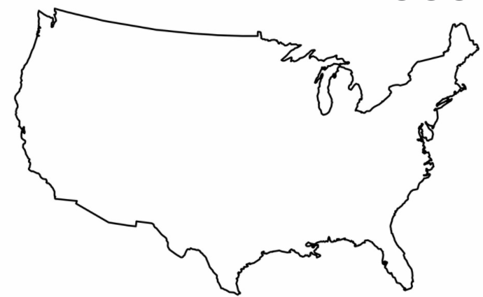


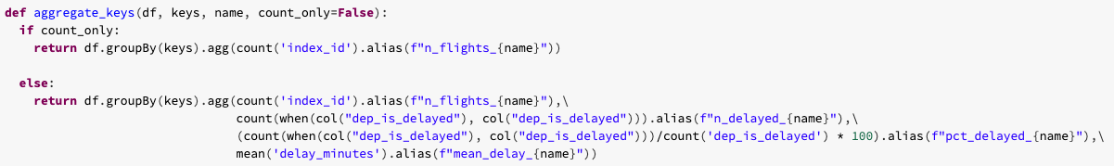
Feature Engineering overall avg and % delay
Aggregated by
Origin Airport
Origin State
Route
Destination Airport
Destination State

Slide 22
Feature Selection and Engineering Categorical features Overview
Dataset
Feature Engineering
Dataset
Engineered
Dataset (Correlation)
Dataset (Correlation)
Month
Day of the Week
Departure Hour
Arrival Hour
Origin Airport
Destination Airport
Carrier
Distance Group
Origin Wind Type
Origin Visibility Variance
Holiday Indicator
Prior Flight Delay Indicator
Potential for Delay Indicator
Average delay 2-4 hours prior to planned departure (airport and carrier)
Average weather, carrier, late aircraft, security, and NAS delay 2-4 hours prior to planned departure
Holiday Indicator
Prior Flight Delay Indicator
Potential for Delay Indicator
Avg delay 2-4 hours prior to planned departure (airport and carrier)
Avg weather, carrier, late aircraft, security, and NAS delay 2-4 hours prior to planned departure
Flight Distance (0.01)
Origin Temperature (-0.007)
Origin Cloud Angle (-0.06)
Origin Visibility Distance (-0.08)
Origin Dew (-0.001)
Origin Wind Speed ()
Flight Distance (0.01)
Origin Temperature (-0.007)
Origin Cloud Angle (-0.06)
Origin Visibility Distance (-0.08)
Origin Dew (-0.001)
Origin Wind Speed ()
% delay from origin (0.09)
% delay to destination (0.08)
% delay for route (0.11)
% delay from state (0.07)
% delay to state (0.06)
Mean delay from origin (0.08)
Mean delay to destination (0.07)
Mean delay for route (0.08)
Mean delay from state (0.07)
Mean delay to state (0.07)

Slide 23
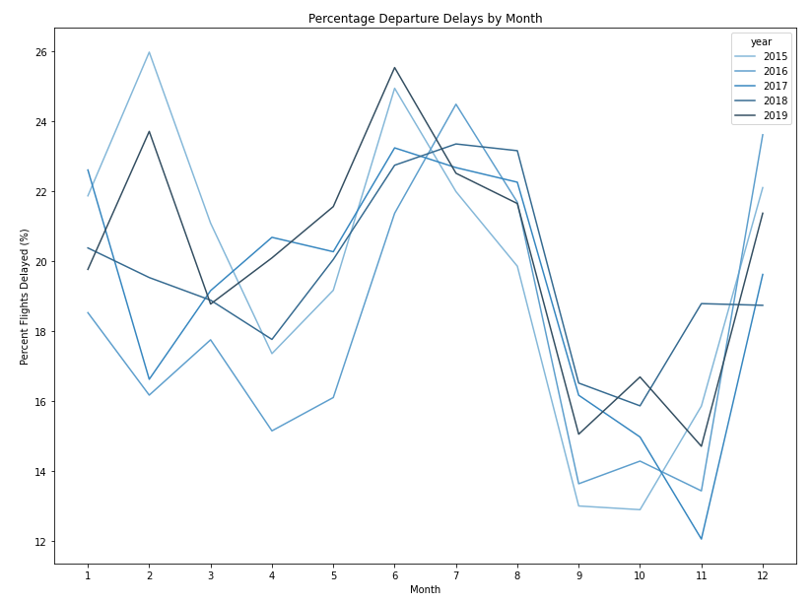
Feature Selection Month
Delay by Month
Comments
Travel is seasonal, and delays follow the trend
Certain months see more traffic and longer delays, such as June, February, and December

Slide 24
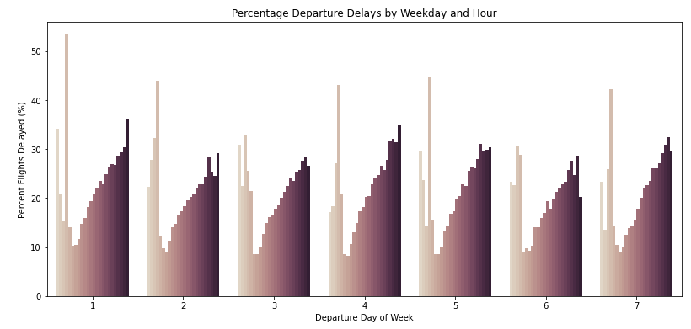
Feature Selection day of week and departure hour
Day of the week – certain days see more delays
Departure Hour – delays accumulate throughout the day

Slide 25
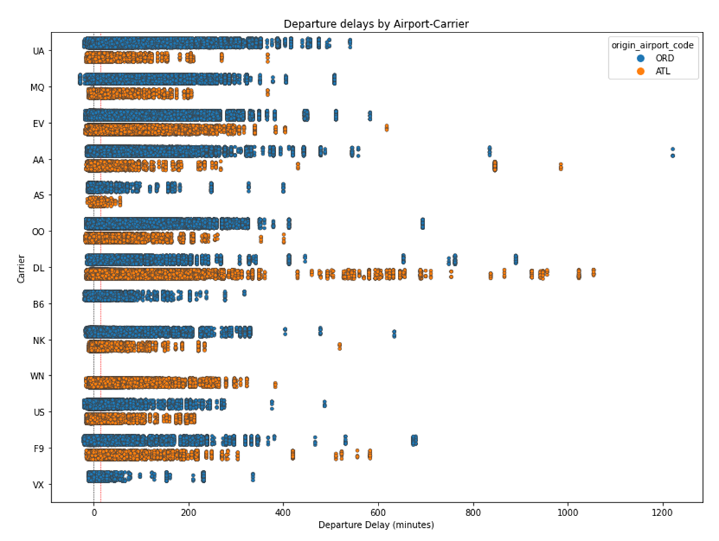
Feature Selection Carrier and Airport
Comments
Different airports/carriers have unique protocols and procedures that may contribute to delay
Features: origin airport, destination airport, and carrier
Plot is generated from subset three month dataset in order to demonstrate differences between carriers between even 2 airports

Slide 26
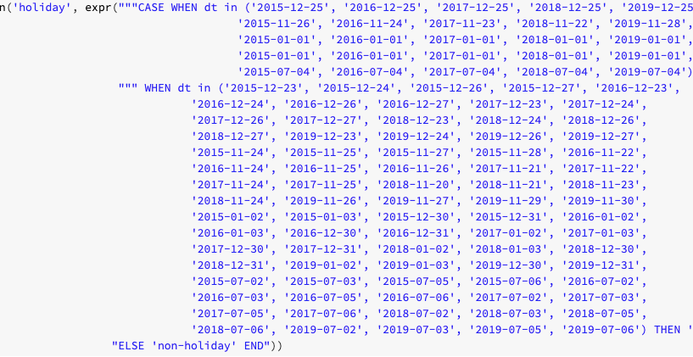
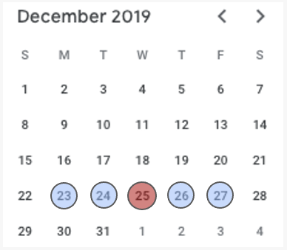
Feature Engineering Holiday Indicator
Comments
Holiday Indicator – there are more flights around the holidays, which can lead to more delays

Slide 27




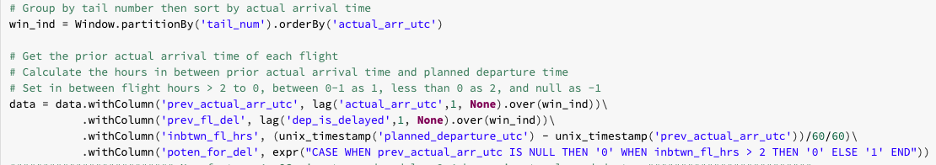
Feature Engineering Prior delay and potential for delay
FL0261
FL0261
6:35 PM
Threshold
8:35 PM
Flight Departure
Previous Flight Delay
Potential for Delay
Comments
Prior Delay Indicator – if the previous flight is delayed, the likelihood of delay for the next flight may be higher
Potential for Delay Indicator – indicates if the previous flight arrives at least 2 hours before planned departure time

Slide 28
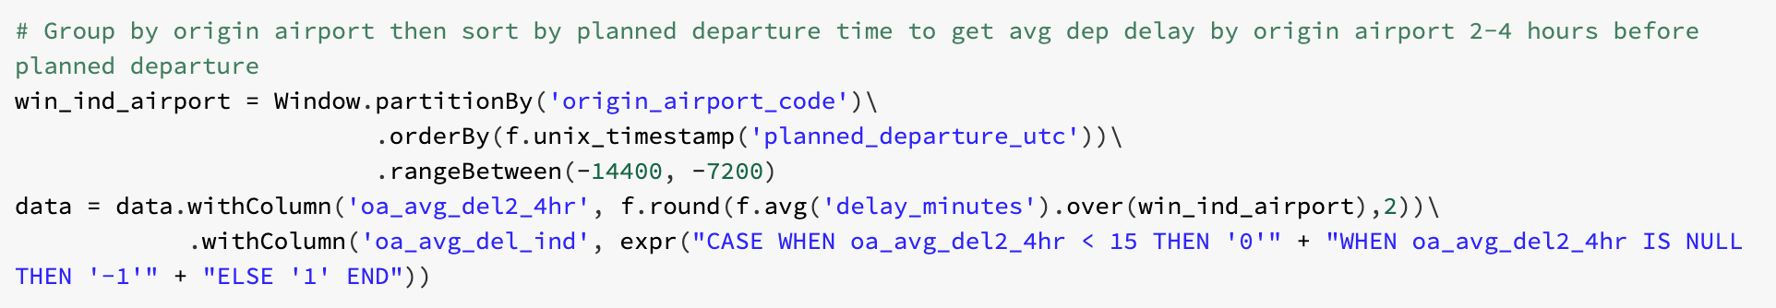
Feature Engineering Average delay 2-4 hours before departure
Measurement Window
4:35 PM
Threshold
6:35 PM
Prediction Time
8:35 PM
Flight Departure
Comments
If there is a weather or security issues, etc., the entire airport should be delayed
Features: oa_del_ind, da_del_ind, carrier_del_ind, security_del_ind, nas_del_ind, etc.

Slide 29
Section page title goes here
Model Preparation and Selection

Slide 30
Model Preparation Hypothesis
Core
Weather
Percent/Mean
Indicators
Set 1
Month, day of week, day of month
Departure/arrival hour
Origin airport, destination airport, city, carrier
Distance group, flight distance, planned duration
Set 2
Flight distance, distance group
Month, day of week
Departure hour, arrival hour
Origin/destination airport, carrier
Set 1
Origin CIG cavok, wind type, temperature, dew, wind speed, visibility distance, cloud angle, slp, visibility variance
Set 2
Origin temperature, dew, wind speed, visibility distance, cloud angle
Set 1 / Set 2
Mean delay from origin*
Mean delay to destination*
Mean delay for route*
Mean delay from state*
Mean delay to state*
% delayed from origin*
% delayed to destination*
% delayed for route*
% delayed from state*
% delayed to state*
Set 1 / Set 2
Holiday*
Previous flight delay*
Potential for delay*
Average 2-4 hours before departure by origin airport, destination, security, weather, NAS, carrier*
*feature engineering

Slide 31
Model Selection
Logistic Regression
Gradient Boost Tree
Support Vector Machine
Random Forest

Slide 32
Model Preparation Pipeline
Label Indexer
String Indexer
One Hot Encoder
Standard Scalar
Estimators
Pipeline Transformers
Logistic Regression
Random Forest
Gradient Boost Tree
SVM

Slide 33
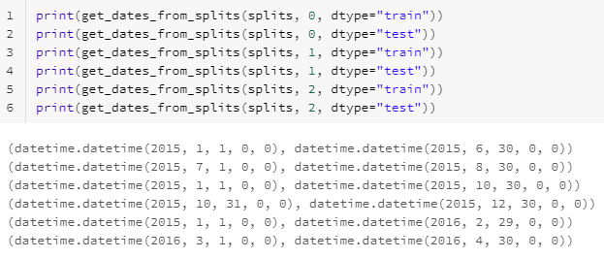
Cross Validation Time series 6-month train & 2-month test
January 2015
December 2015
January 2016
1/1 - 6/30
7/1 - 8/30
1/1 - 10/30
10/31 - 12/30
1/1 – 2016-2/29
3/1 - 4/30
Train Range
Test Range
Train Range
Test Range
Train Range
Test Range

Slide 34
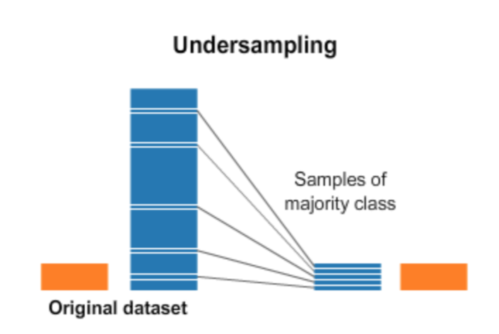
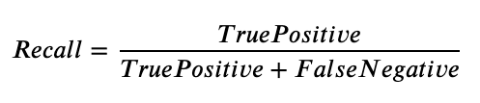
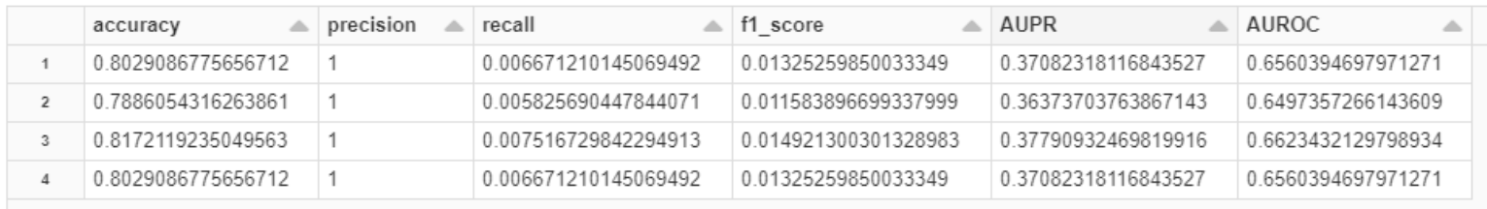
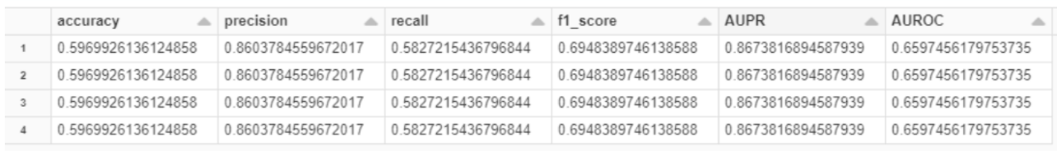
Imbalanced data Undersampling
Comments
The dataset is imbalanced. Approximately 80% of flights are not delayed
Looking at 1st 6 months of 2015 - 21.57% flights were delayed / cancelled
Unbalanced data leads to low recall scores
Undersample - because of excess data
RF - 2 Iterations - Unbalanced and Balanced (Mean, Min, Max, Median)

Slide 35
Section page title goes here
Model Evaluation

Slide 36
Model Evaluation Run-times
Iterations | Logistic Regression | Random Forest | Gradient Boost Tree | Support Vector Machine
1 | 5.99 min | 3.34 min | 20.18 min | 5.03 min
2 | 10.42 min | 6.05 min | 1.10 hour | -
3 | 26 min | 35.55 min | 1.30 hour | 23.45 min
4 | 36 min | 25 min | 1.49 hour | 35.37 min
Comments
Gradient Boosted Trees are the slowest to run, however, they scale fairly well with large datasets
Random Forests are the fastest and require very little pre-processing and yield good “enough” results
Logistic Regression and SVM have similar performance - SVM is slightly unreliable and may need edge case handling in features

Slide 37



Discussion Evaluation Metrics
Review
Precision measures how often a predicted delay ends up actually being delayed
Recall measures how often a true delay is accurately predicted
F1 score balances these two measures
Comments
For our business case, it is important that we balance both precision and recall, so we place an emphasis on F1 score
When a flight is delayed without warning (low recall), passengers will be unhappy and less likely to book with the airline again
When a flight is predicted as a delay, but ends up being on time (low precision), passengers may miss their flights and revenue may be lost due to alternative arrangements being made

Slide 38
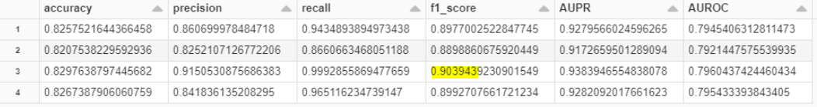
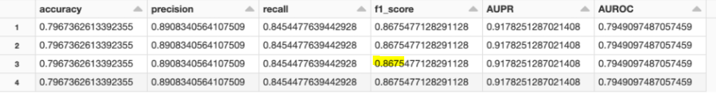
Model Evaluation Logistic Regression
Core Set 1 + Indicators (Categorical) + Mean / Percentage (Numeric)
Core Set 2 + Indicators (Categorical) + Mean / Percentage (Numeric) + Partial Weather (Numeric)
Comments
Image Above: Gain in F1 Score from next best model (Difference of Max Scores): 9.85%
Below Image: Gain in F1 Score from next best model (Difference of Max Scores): 6.17%
Absolute highest F1 score: 0.9039
Read rows as mean, min, max, median

Slide 39
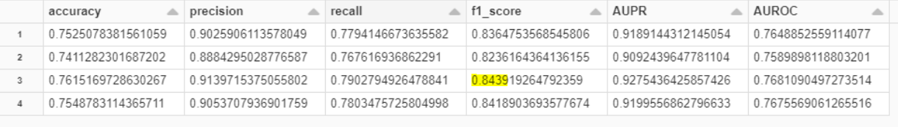
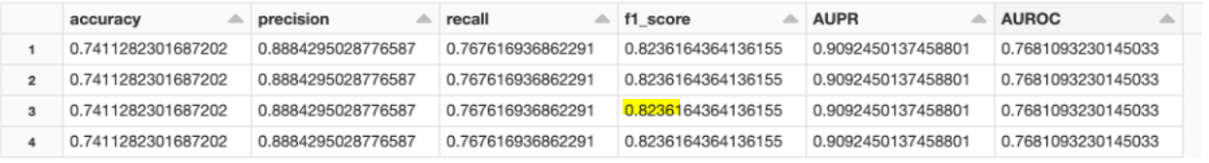
Model Evaluation Random Forest
Core Set 1 + Indicators (Categorical) + Mean / Percentage (Numeric)
Core Set 2 + Indicators (Categorical) + Mean / Percentage (Numeric) + Partial Weather (Numeric)
Comments
Image Above: Gain in F1 Score from next best model (Difference of Max Scores): 5.22%
Below Image: Gain in F1 Score from next best model (Difference of Max Scores): 15.609%
Absolute highest F1 score: 0.8439
Read rows as mean, min, max, median

Slide 40
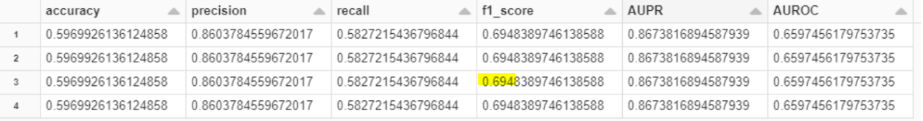
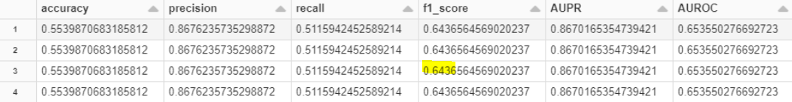
Model Evaluation Random Forest
Core Set 1 Only (Without Quantizer)
Core Set 2 Only (With Quantizer)
Comments
Ran the above models with 1 iteration only (6 month training period)
Quantizer didn’t prove to be very useful - may need testing over larger hypothesis space
Variables Quantized: 'pct_delayed_from_origin', 'pct_delayed_to_dest', 'pct_delayed_for_route', 'pct_delayed_from_state', 'pct_delayed_to_state', 'flight_distance', 'origin_tmp_c'
Read rows as mean, min, max, median

Slide 41
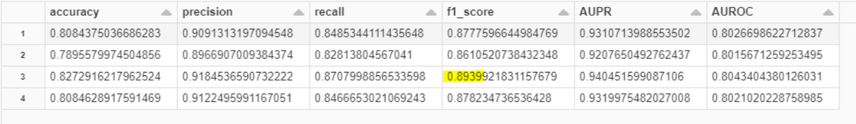
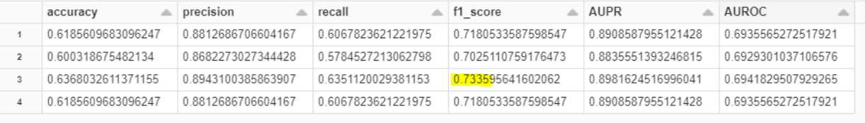
Model Evaluation Gradient Boost Tree
Core Set 1 + Indicators (Categorical) + Mean / Percentage (Numeric)
Next Best Model: Core Set 1 + Weather (Categorical) + Weather (Numeric)
Comments
Compared our optimal model against weather factors
Gain in F1 Score from next best model (Difference of Max Scores): 21.8%
Read rows as mean, min, max, median
Absolute highest F1 score: 0.8939
Not an entirely fair comparison because “next best model” had fewer iterations (data) to train on, but gives an indication

Slide 42
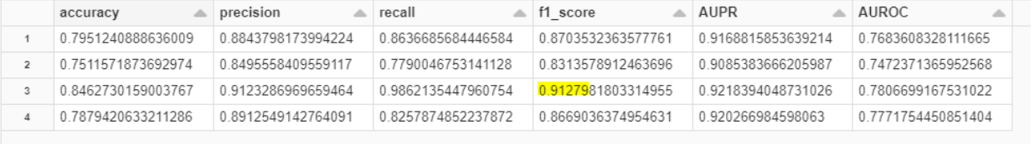
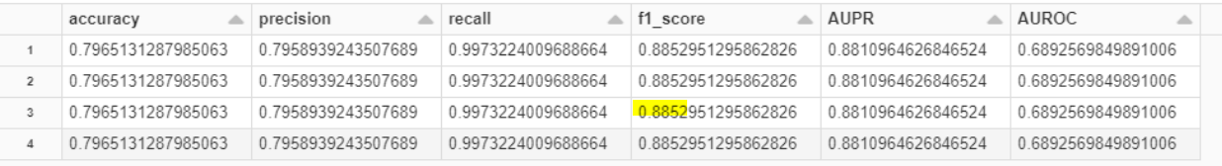
Model Evaluation Support Vector Machine
Core Set 1 + Indicators (Categorical) + Mean / Percentage (Numeric)
Next Best “working” Model: Core Set 1 Only
Comments
Compared our optimal model against working SVM model
Gain in F1 Score from next best model (Difference of Max Scores): 3.1%
Read rows as mean, min, max, median
Absolute highest F1 score: 0.9127
Optimal model trained on much larger data set - showing that SVM converges quickly without much additional gain!

Slide 43
Discussion Challenges at Scale/Best Practices
Need for Framework
Processing 31 Million rows cannot be done on a single machine - needs managed distributed framework (Spark)
Need for Preprocessing
To facilitate joins we cleaned everything ahead of time, removing duplicate records to reduce the size
Identified all origin/dest airports and subset the weather dataset to only include relevant measurements
Made use of date splits to make training feasible
Must write data to cloud storage in appropriate formats (parquet) to avoid repeated processing
Use cache!
Need for Scalable Stable Algorithms
Have to select algorithms that will scale and distribute well and preferably require no pre-processing

Slide 44
Selected Model Conclusion
Model Selection
We choose to go with Logistic Regression because it is simple, scalable and performs surprisingly well on large datasets
The downside with Logistic Regression is we need to pre-process data (scaling / null handling)
SVM is a close second choice - however, its stability needs to be tested more
Trees / GBT were disappointing although they did perform quite well, behind Logistic Regression
Next Steps
Stabilize SVM
Choose more hyper-param tuning for Trees

