Slide 1
INTERNSHIP PROJECT
-ABHISHA OLI

Slide 2
OBJECTIVE:
The primary goal of this project is to analyze sales data to identify key trends and patterns that could help the retail chain optimize its operations, improve customer satisfaction, and boost profitability.
Tools Used:
Python: For data manipulation, cleaning, and advanced analysis.
SQL: For database management, querying, and basic analysis.
Excel: For final reporting and data visualization

Slide 3
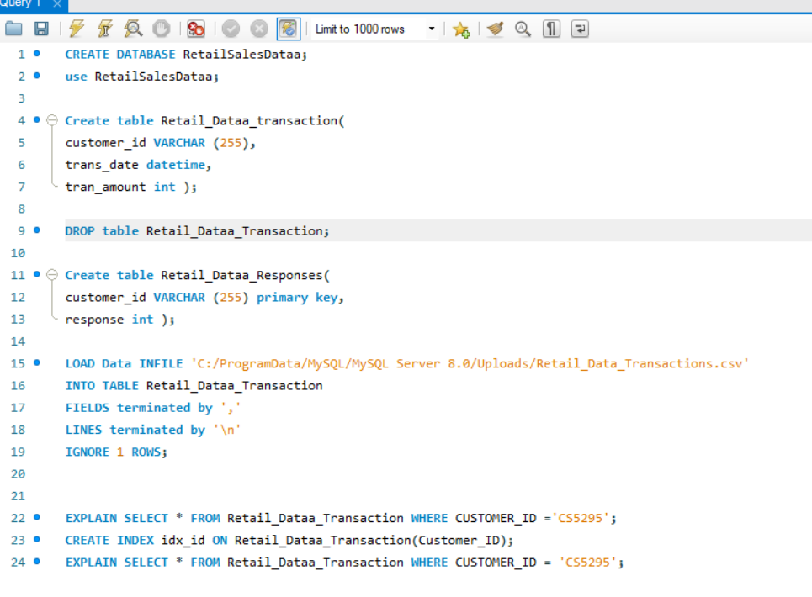
SUMMARY TABLE BY USING SQL QUERIES Doing basic analysis:

Slide 4
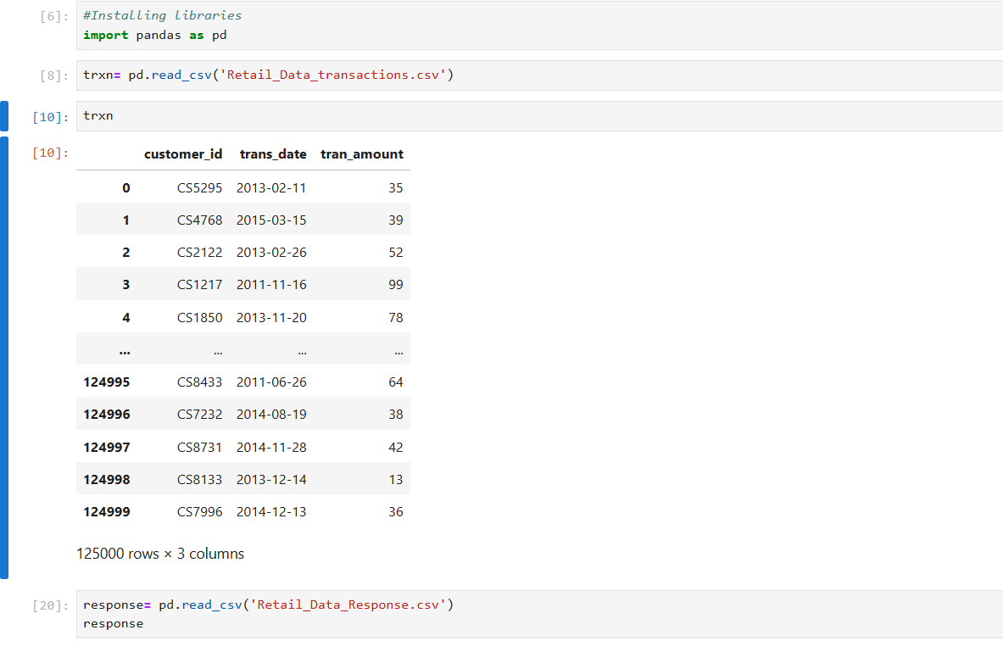
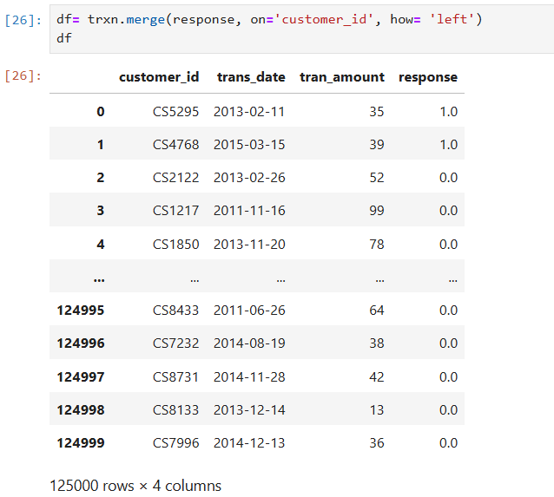
Exported the results to CSV and directly loaded them into Python for further processing.
Used pandas to clean and format the data:

Slide 5
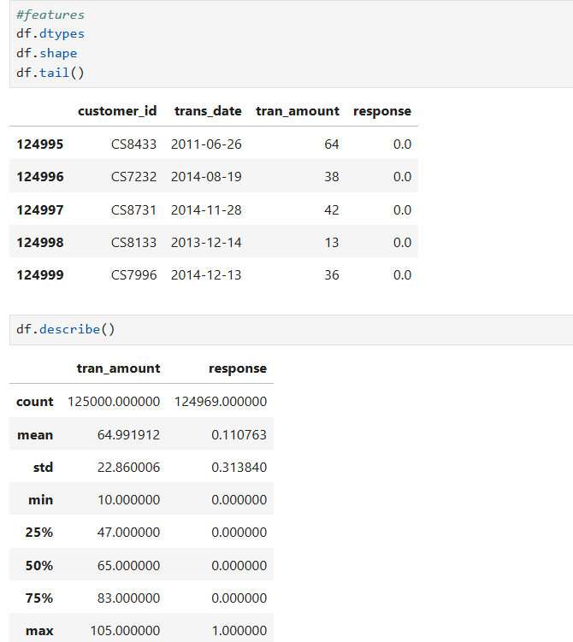
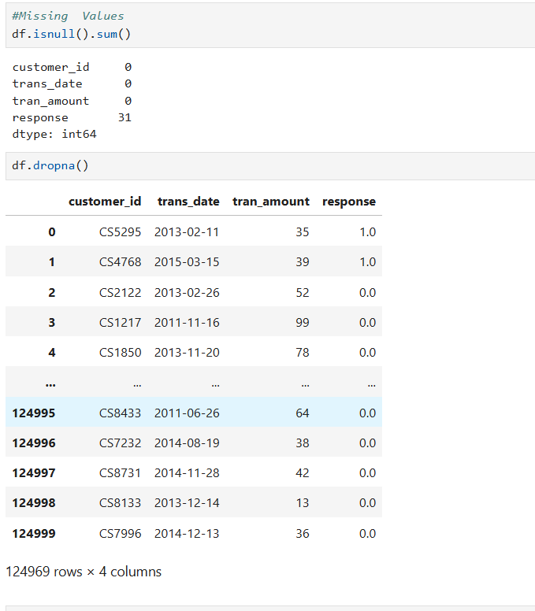
Exploring Data types, shape, head &tail Finding missing values and droping the null values and statistical values of the data.

Slide 6
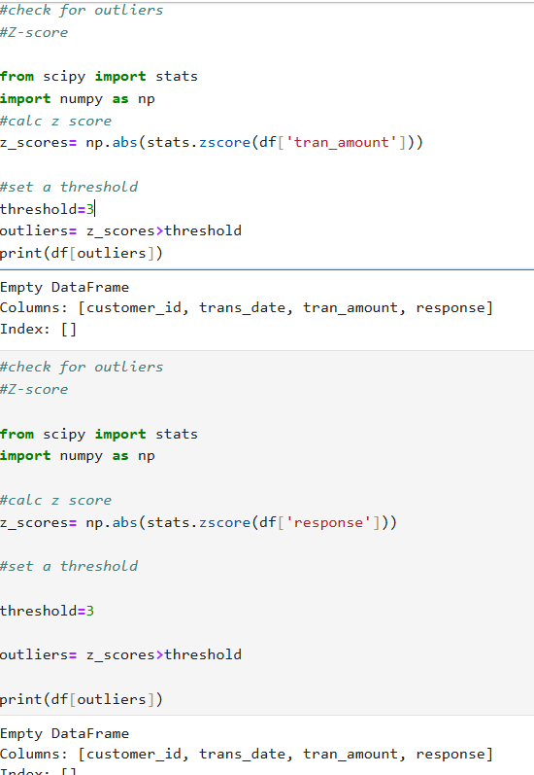
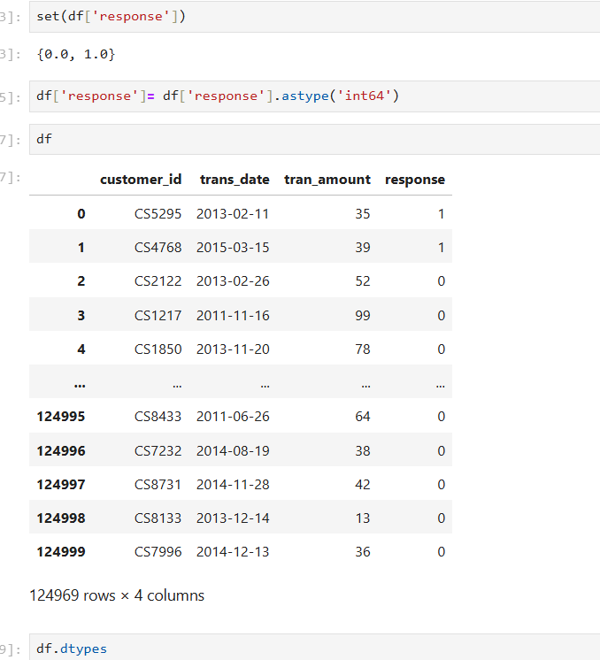
Changing data types:
Checking outliers using z-score by importing numpy:

Slide 7
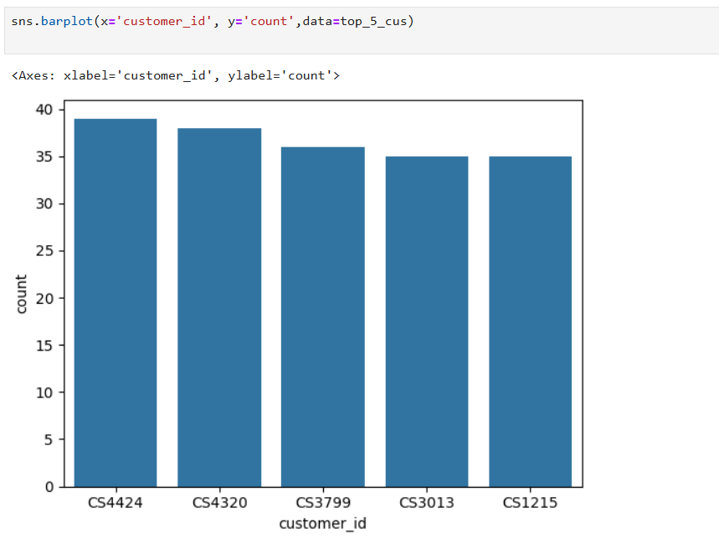
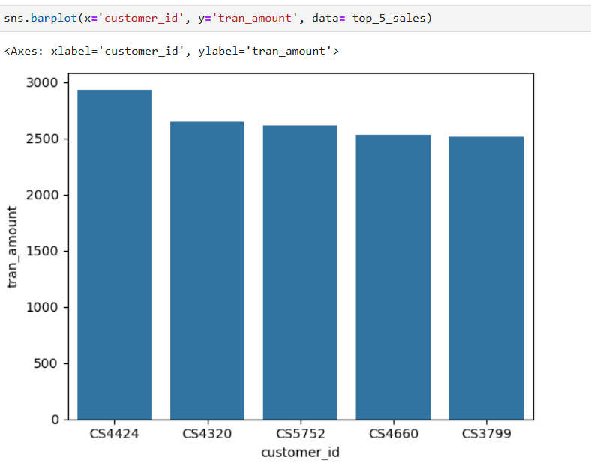
Sales trend over time: #Customers having highest no of orders using python:
#Customer having highest value of orders:

Slide 8
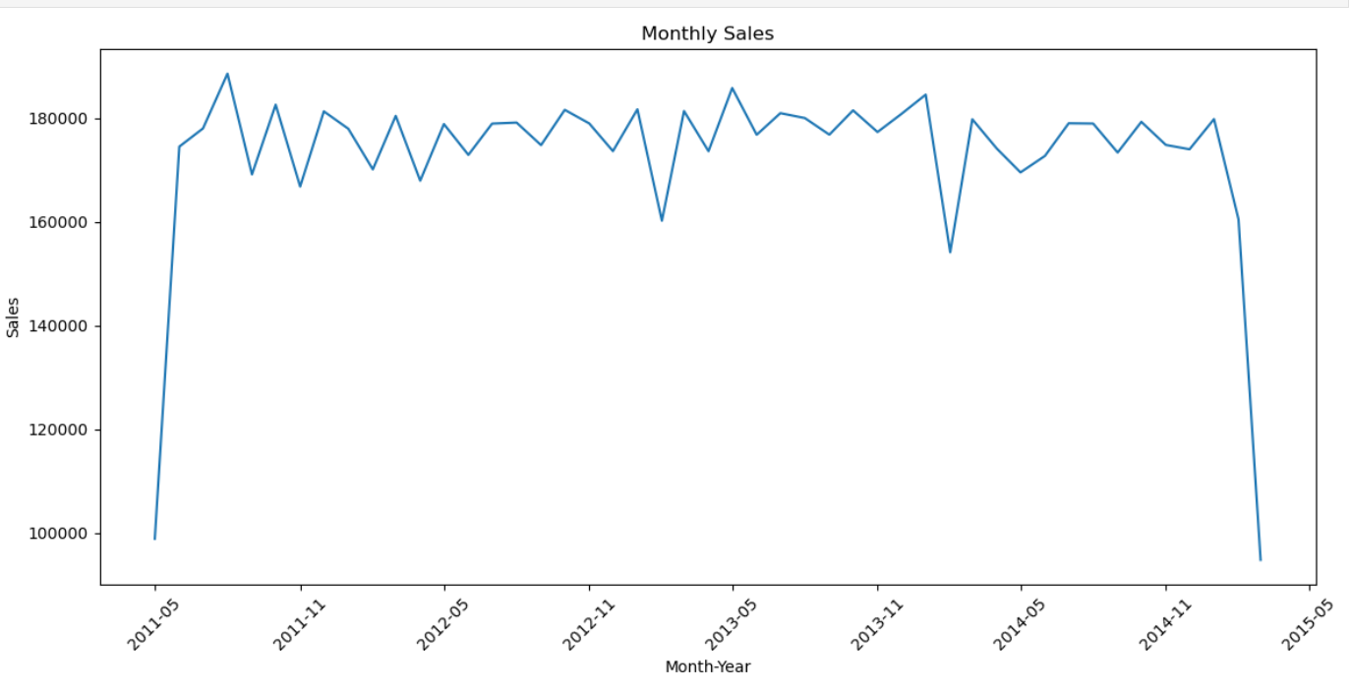
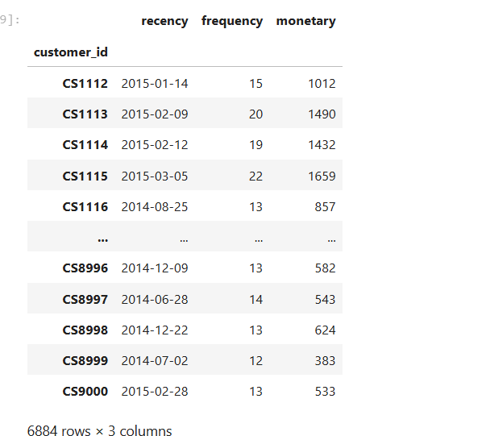
Time series analysis: Monthly Sales in month-year:
Analysing Customer Behaviour:

Slide 9
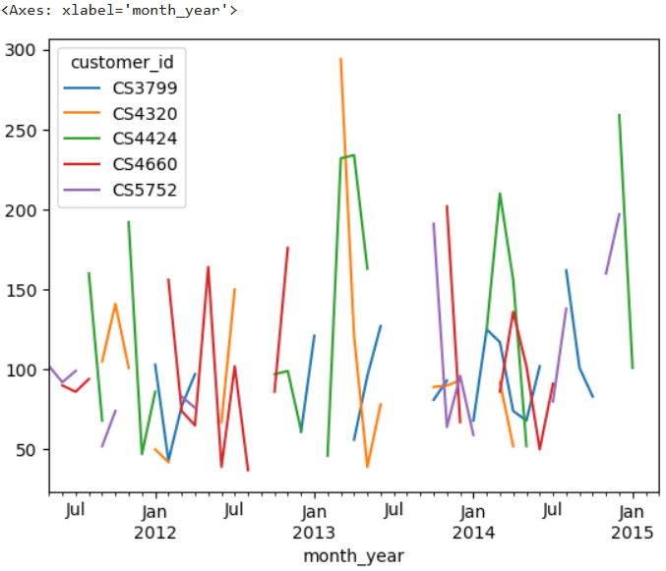
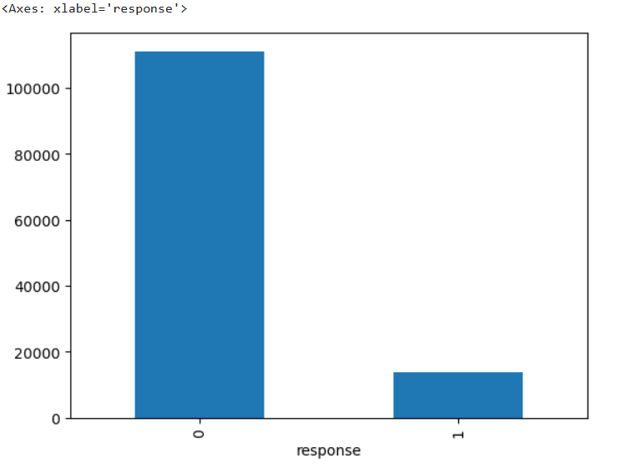
Churn analysis: Counting no of churn and active customers:
Analysing Top customers of particular month-year:

Slide 10
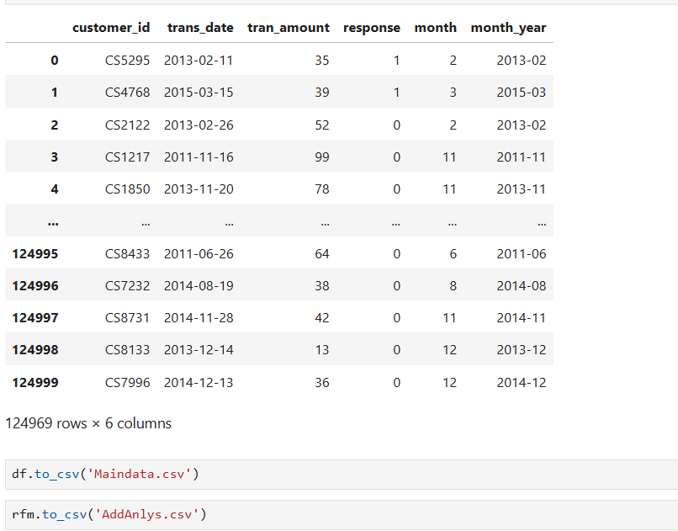
Summarized data: Converted to csv file and exported to excel

Slide 11
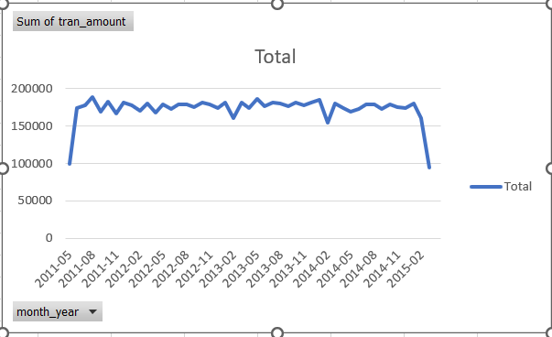
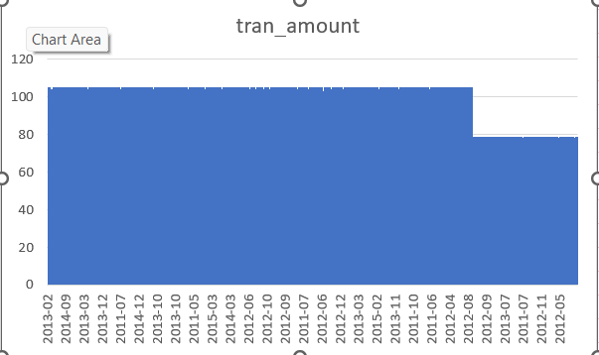
Time Series plot using pivot table in Excel: Line Graph:
Column Graph:

Slide 12
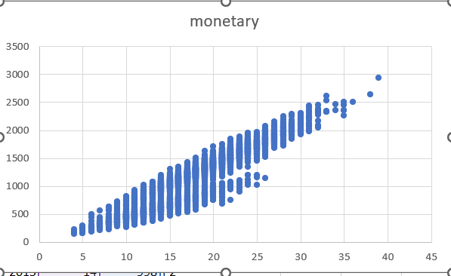
Scatter plot to show extend of monetary values in excel:
Like this, we can plot different types of graphs and chart to show key findings include significant sales trends, seasonal patterns, and customer purchasing behaviors that can inform strategic decisions.

Slide 13
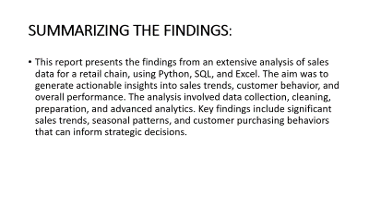
SUMMARIZING THE FINDINGS:
This report presents the findings from an extensive analysis of sales data for a retail chain, using Python, SQL, and Excel. The aim was to generate actionable insights into sales trends, customer behavior, and overall performance. The analysis involved data collection, cleaning, preparation, and advanced analytics. Key findings include significant sales trends, seasonal patterns, and customer purchasing behaviors that can inform strategic decisions.

