Slide 1
Introduction to Containerization

Slide 2





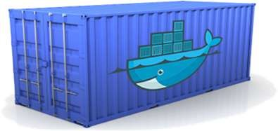





Containers
Containers are an executable unit of software in which application code is packaged, along with its libraries, dependencies and related configuration files, in common ways so that it can be run anywhere, whether it be on desktop, traditional IT infrastructure, or the cloud.
Static website
User DB
Web frontend
Queue
Analytics DB
Build once, run anywhere
Configure once, run anything
Development VM
QA Server
Data Centers
Public Cloud
Production Cluster
Build, Ship and Run

Slide 3
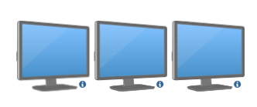

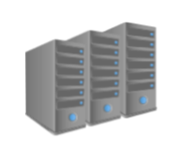
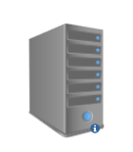
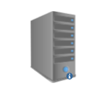


Evolution of Containerization
Say, you have three different Java based application that you plan to host it. Each of these application make use of different versions of Java as well as associated libraries and dependencies, differ from one application to application.
Traditional Model
Virtualization
Containerization
Dev Team
Dev Team
Dev Team
Ops Team
Ops Team
Ops Team

Slide 4
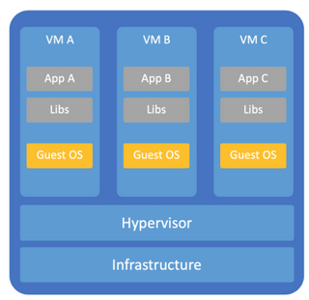
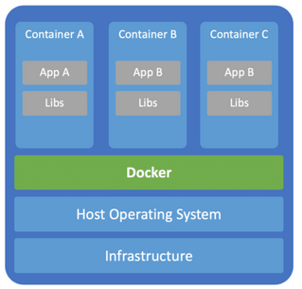
Containers vs VM’s
Containers and virtual machines have similar resource isolation and allocation benefits, but function differently because containers virtualize the operating system instead of hardware. Containers are more portable and efficient.

Slide 5
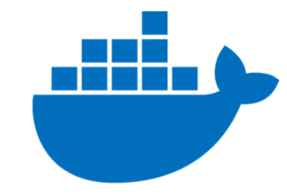

Containers vs VM’s
Abstraction
Application Layer Abstraction | Hardware Layer Abstraction
Application + Libraries | Operating System + Application + Libraries
Fraction of seconds | 10 to 12 minutes
Consumes less resource | Consumes more resource
Smaller in size, easily to ship | Larger in size
Bundling Strategy
Performance
Resource
Size

Slide 6


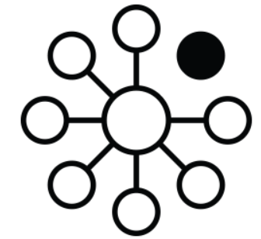


Benefits of Containers
Lightweight
Portability
Fault Isolation
DevOps Friendly
Cost
Ease Of Mgmt
Containers share the machine OS kernel, eliminating the need for a full OS instance per application and making container files small and easy on resources. Their smaller size, especially compared to virtual machines, means they can spin up quickly.
Containers carry all their dependencies with them, meaning that software can be written once and then run without needing to be re-configured across the cloud, and on-premises computing environments.
Each containerized application is isolated and operates independently of others. The failure of one container does not affect the continued operation of any other containers. This makes the technical team easy to debug.
Containers offers the benefit of reproducibility, meaning each container components remain static and unchanging from development to production
Containers helps in reducing the number of servers, enterprise can dramatically reduce their infrastructure and also number of resources needed to maintain them. This leads to reduction in server cost along with employee cost.
Container orchestration platform automates the installation, scaling. It can ease management tasks such as scaling ,rolling out new versions of apps, and providing monitoring, logging and debugging.

Slide 7
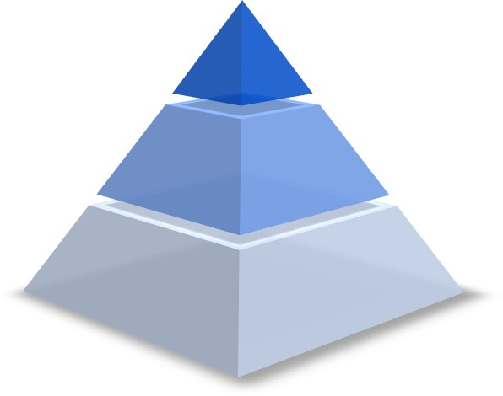
Who sees the benefit?
Management
Cost effective
Faster time to market
Happy engineers
Ops Team
Configure once, run anything
Eliminate inconsistencies between the IT environment
Improves speed and reliability of CI/CD
Developers
Build once, run anywhere
Environment standardization for the entire application lifecycle
No headaches in installing bunch of compatible versions of s/w

Slide 8
Knowledge Check
Containers and its usage
Its nothing but a executable software that packages up code and its all dependencies so the application runs quickly and reliably from one computing environment to another
VM’s vs Containers
Abstraction Level
System Boot up
Bundling Strategy
Size
Benefits of Containers
Lightweight
Portable
Cost effective
DevOps Friendly
Isolated work environment

Slide 9
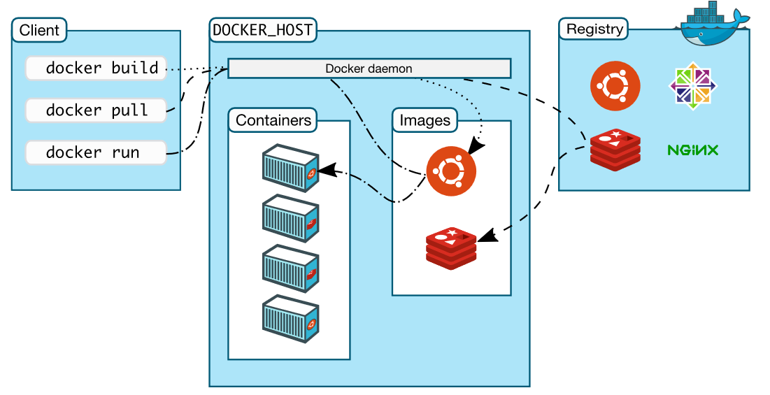
Docker Architecture
Docker user client-server architecture with these major components,
Docker Client
Docker daemon
Docker Registry

Slide 10
Components
Docker Daemon
Docker Client
Docker Registry
Docker Engine
Docker Deamon is a long running background process that manages Docker images, containers, networks, and storage volumes. It constantly listens for Docker API requests and processes them. It can also communicate with other daemons to manage its services.
Docker client provides a command line interface (CLI) that enables users to issue build, run, and stop commands to a Docker daemon. It can reside on the same host as the daemon or connect to a daemon on a remote host. Communication between client and server is handled by REST API calls.
Docker registry is where Docker images are stored. The Registry can be either a user’s local repository or public repository like a Docker Hub allowing multiple users to collaborate. During docker pull or docker run, the required images are pulled from the configured registry.
Docker Engine is heart of the entire Docker system. In simpler terms, it is nothing but the application that you installed on your host machine. This enables the containerization in your machine.

Slide 11
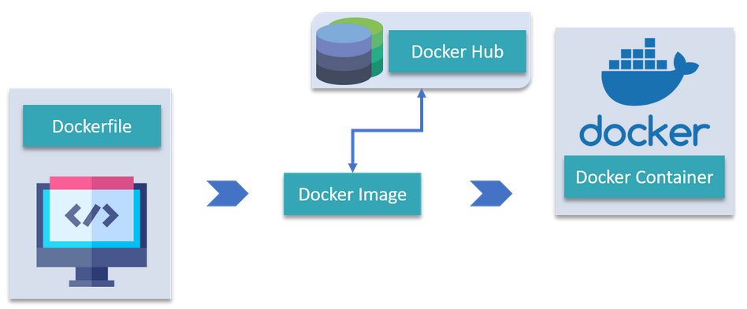
Docker Objects
DockerFile :
A Dockerfile is a text document which contains all the commands that a user can call on the command line to assemble an image. So, Docker can build images automatically by reading the instructions from a Dockerfile.
Images :
Images are nothing but a template which is used to create Docker containers. It also contain metadata that describe the container's capabilities and needs.
Containers :
Docker Container is a running instance of a Docker Image and they hold the entire package needed to run the application.
Pull/Push
Build
Run

Slide 12
Docker Objects
Storage :
Containers are ephemeral, meaning it will never persist the data. Once the container is exited/ removed, the data which it is dealing with will be gone. Docker offers couple of option in terms of persistent storage,
Data Volumes
It’s a specially designed directory in the container.
It is initialized when the container is created. By default, it will neither get deleted nor even garbage collected when container is stopped.
It can be shared across other containers too.
Data Volume Containers
It’s very useful in the case of sharing the data between the containers

Slide 13
Demo Time!
Problem Statement: It takes longer time for developers to set up MIST local environment. This ideally delays the development lifecycle.
Solution: Application Containerization
Steps Followed:
Identify the software dependencies of MIST application.
Apache Tomcat
Apache Ant
Java
Browse over SRES to check for the docker image which suits our needs.
Once the image is available, prepare the script to perform configuration changes, build and deployment to web server.
Mounting MIST source code as data volumes to the container.
Defining the port number to expose the services to the host machine
docker run -it --name <CONTAINER_NAME> -p <HOST_PORT>:<CONTAINER_PORT> -v <MIST_SRC_CODE_LOCATION>:/usr/mist/ <IMAGE_NAME>

Slide 14
Docker commands
docker -version | To check installed version of docker
docker pull <IMAGE_NAME> | To download the images from docker registry
docker run <IMAGE_NAME> | To create container from the image
docker ps -a | To list down the containers irrespective of its state
docker images | To list down all the images
docker exec -it <CONTAINER_ID> bash | Used to access the container in interactive mode
docker commit <CONTAINER_ID> <NEW_IMAGE> | Creates new image of edited container
docker build <DOCKER_FILE> | To build the image from docker file
docker start/stop <CONTAINER_ID> | Starts/Stop the container
docker push <IMAGE_NAME> | Push an image to docker registry

Slide 15
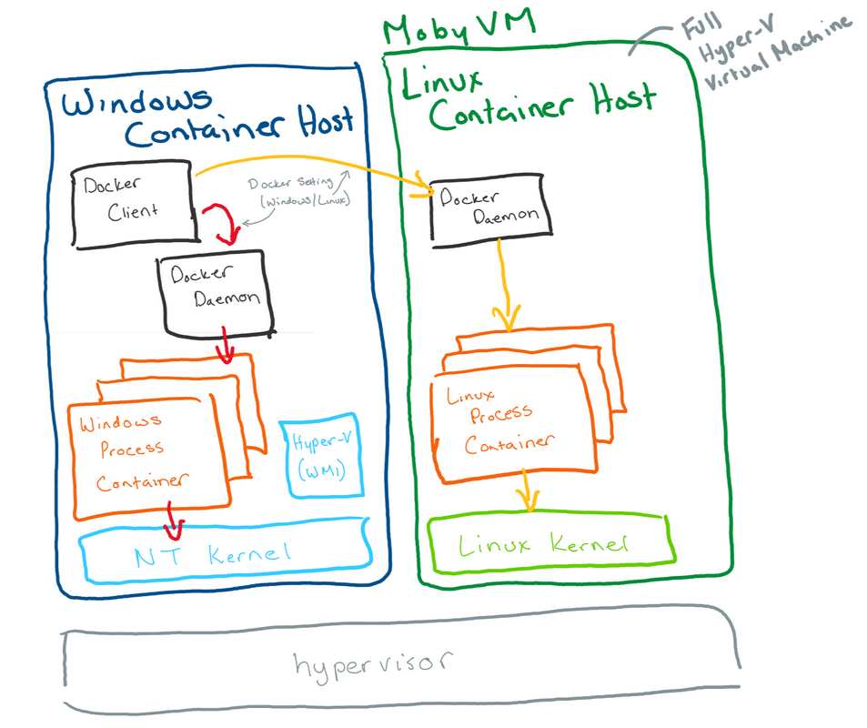
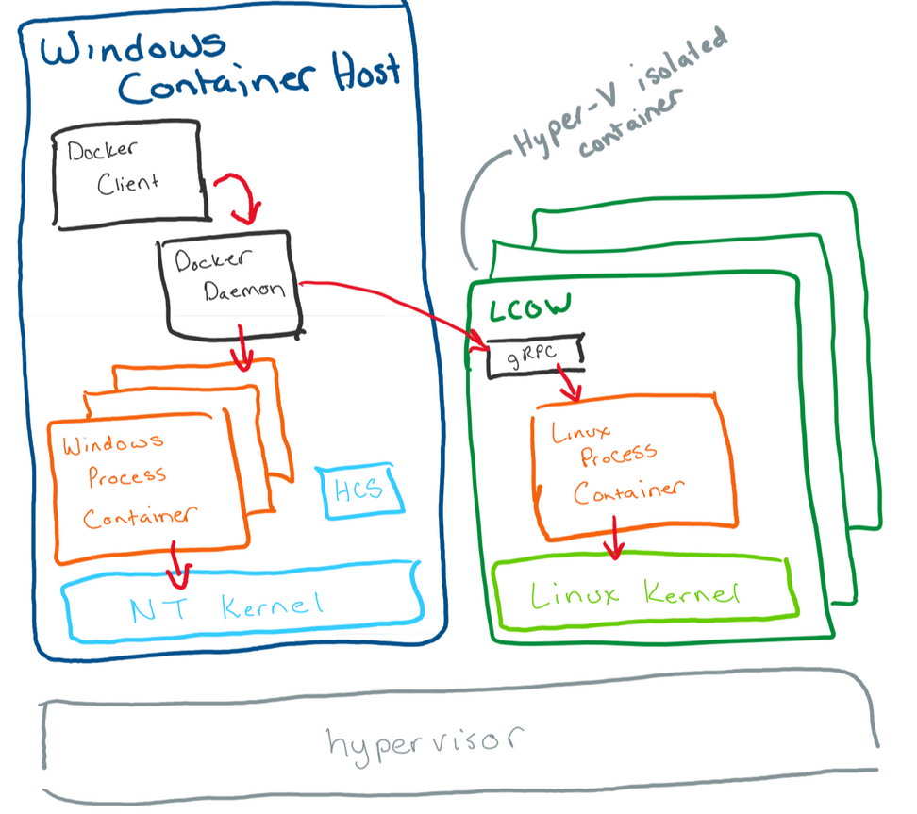
FAQ
How Linux Containers are running on Windows host?
As containers share a kernel with the host machine , however, running Linux containers directly on Windows isn't an option*. This is where virtualization comes into the picture.
Run Linux containers in a full Linux VM
Run Linux containers with Hyper-V isolation (LCOW) on Windows 10

Slide 16
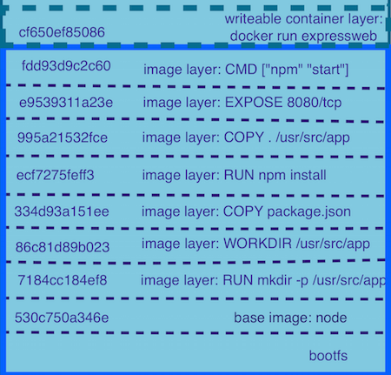
FAQ
Docker Layer and its Caching mechanism?
Layers of a Docker images are essentially just files generated from running some commands
Docker images consists of one or more layers. Each layer corresponds to specific instruction in DockerFile
Layers are neat because they can be re-used by multiple images saving disk space and reducing time to build images
FROM node:argon
RUN mkdir -p /usr/src/app
WORKDIR /usr/src/app
COPY package.json /usr/src/app/
RUN npm install
COPY . /usr/src/appEXPOSE 8080
CMD [ "npm", "start" ]
Run

Slide 17
FAQ
Where the Docker images/layers will get stored ?
docker run --privileged --pid=host -it debian nsenter -t 1 -m -u -n -i sh It basically runs a container, based on the debian image, and launches a nsenter command
Options used,
-it : adds a tty and leaves the standard input opened
--privileged : provides all capabilities to the container, it also lifts all the limitations enforced by cgroups
--pid=host : allows the containers to use the Docker host Process ID Namespace
nsenter : allows the container to run in existing namespace
-t : target process Id to get namespace from
-m : mount namespace
-u : UTS namespace
-n : network namespace
-i : IPC namespace

Slide 18
Additional topics
Internal working of Docker - namespaces, cgroups and UFS
Docker Compose
Docker Swarm
Linux Container on Windows(LCOW)
Docker for Continuous Delivery Mechanism
Kubernetes

