Slide 1
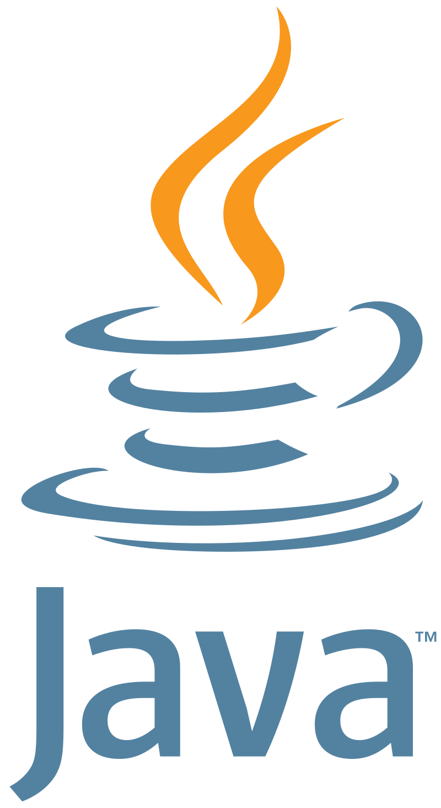



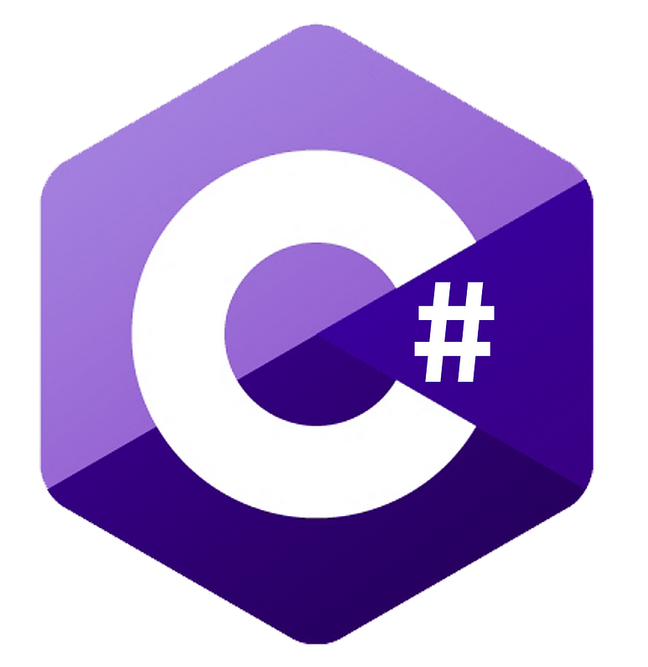
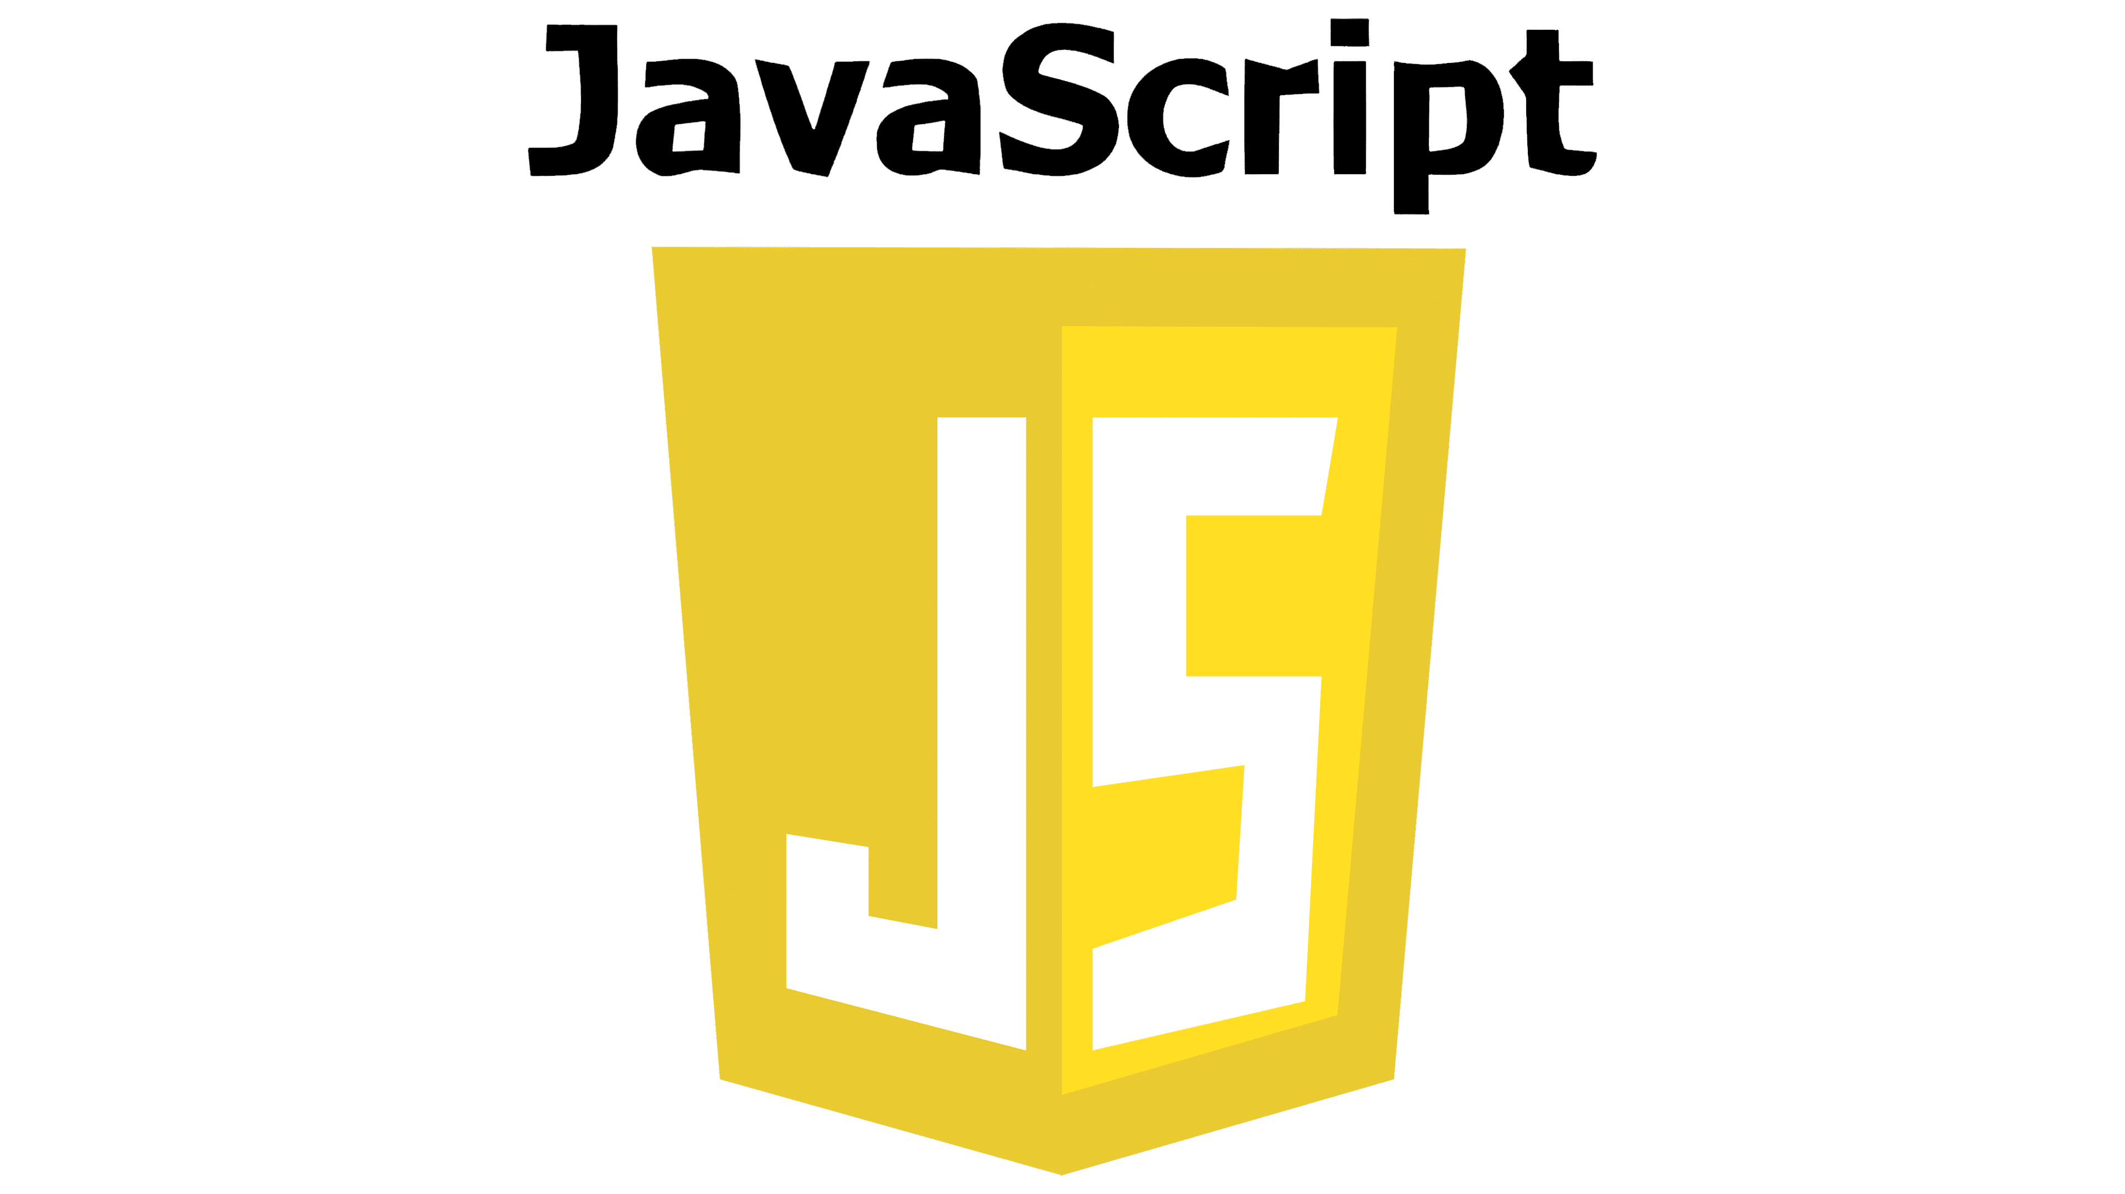
Boeing’s CodeWhisperer Experience
Key Observations and Learnings
Overall very easy to get started and excellent visibility to usage
Engaged and inquisitive users saw the most value
Expectations need to be managed (lowered) due to hype
There is a significant prompt engineering learning curve
Strategy needed for technical controls – no ITAR, no fly away, plagiarism, licenses
Programming Languages Tested
Potential Next Steps
Finalize an approach to scalable deployment and training
Properly attribute costs & bill back
Ensure technical controls and safeguards in place
Mitigate potential IP concerns
By The Numbers
60+ users across IT&DA, Software Engineering & BR&T
18%+ efficiency gain observed in a formal experiment (Java)
Up to 30% efficiency gain through anecdotal observation (Python)

Slide 2
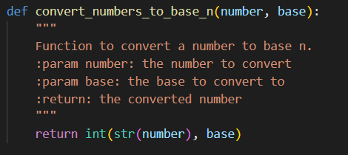
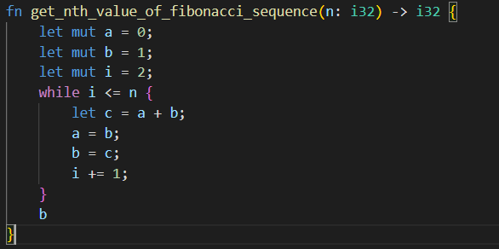
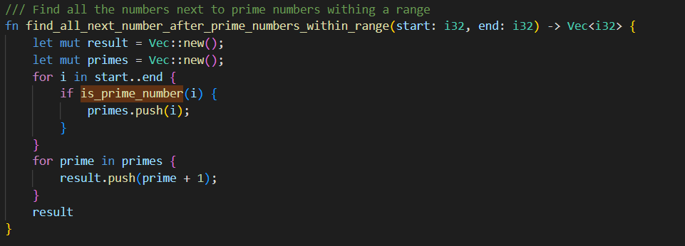
Boeing’s CodeWhisperer Experience
Highlights
Function level suggestions are good and accurate
Proper guidance leads to useful complex function suggestions
Code Optimization good for Python
Python Example
Enhancement Opportunities
Reduced latency for suggestions
Eliminate syntax errors in suggestions to reduce debug time
Multi-suggestion usability improvements
Ability to ensure / verify data guardrails for IP protection
Localized instance to enable training with Boeing code
Rust Example

