Slide 1
DevSecOps & Automation – EP&S Monthly Report Out - September 2023

Slide 2
CONTENTS
Vision
2023 DevSecOps Progress
Automation Progress
Training and references

Slide 3
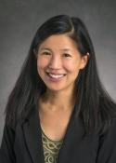



Vision
Implement Lean practices through DSO maturity coverage and IT Automation.
Increased operating speed and flexibility, release-on-demand, and first-time quality of secure-by-design applications.
Reduced hours and improved efficiency through automation

Slide 4
2023 DevSecOps progress

Slide 5
DevSecOps 2023
OKR
Implement Lean practices through DSO maturity coverage for 70% of High ROI products
Target
Complete DSO Assessments for new applications 120 Apps
[Overall – 280 apps (~30%) ]
Re-Assessments - 40 apps
Implementation roadmap for 40% Applications - 120 apps
[Overall – 200 (~20%) ]
Improved overall maturity to 3.0 from 2.8. Focus on High ROI and business critical Applications.
ROI Calculation - 50 Apps

Slide 6
Progress
On Track
Watch Item
Off Track
2023 OKR Targets
Q1
Q2
Q3
Target
Completed
Target
Completed
Target
Completed
Complete DSO Assessments for new applications 120 Apps
30
34
30
25 + 60 AMaaS
30
8
Implementation roadmap for Applications that have completed assessments- 90 Apps
30
28
30
21 + 57 AMaaS
30
4
Roadmap implementation , Re-Assessment & ROI calculation for 15% Apps with roadmap created: - 40 apps
10
0
10
4
10
13
*DSO Improvements pending
*40 app reassessment in pipeline
*28 app reassessment in pipeline
Maturity improvement and maintain Score 3.0+
Maturity Score 3
Maturity Score 3
Maturity Score 3.0 (Non-AMaaS)
Overall Score with AMaaS 2.82

Slide 7
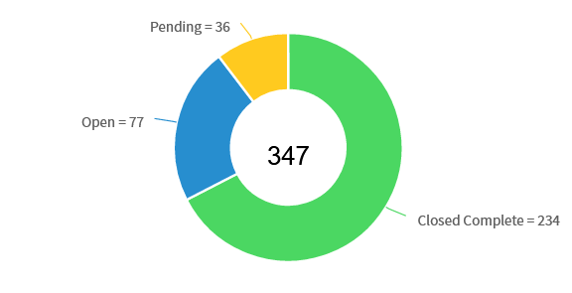
Overall Assessment progress
Look Ahead
Prioritize the application list for 2024 and initiate assessment
for all the applications.
Working on strategy and best practices of DevSecOps for
supporting Tech Debt and Compliance.
Focus on re-assessment for improved DevSecOps maturity and
automations h savings.
Bringing success stories, case study and training for
application teams.
Tableau dashboard rollout with integrated view from Infocenter
and GSEP.
Open (Blue): Assessment has been sent to the Application Manager but has not been completed.
Pending (Yellow): Assessment has been sent to the Application Manager and has been completed without a roadmap..
Closed Complete (Green): Assessment has been sent to the Application Manager and has been completed and the roadmap added.

Slide 8


Savings identified after reassessment 2023
9512 Hrs. (As of Sep 2023)
28 Applications in pipeline for reassessment in 2023

Slide 9
Engineering Products
153

Slide 10
Product support and services
75

Slide 11
AUTOMATION PROGRESS

Slide 12




Automation 2023
Implement automation capabilities through out the applications and achieve 80000 automation hours
OKR
Objective
Accomplishments:
Automate repetitive processes
Automation hours of 157542 has been accounted in the CoP.
Capture automation to Return On Investment.
Knowledge sharing and bring culture of Automation

Slide 13
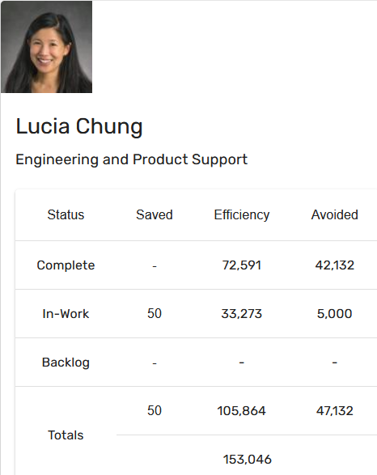
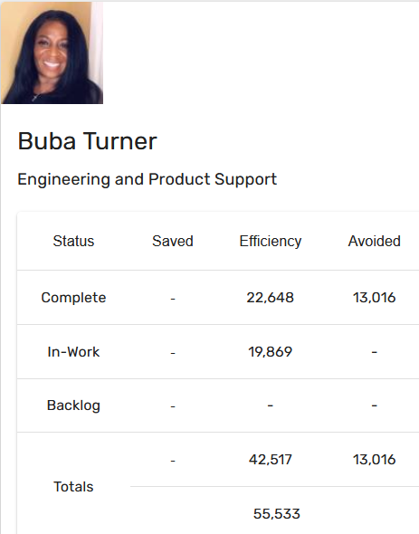
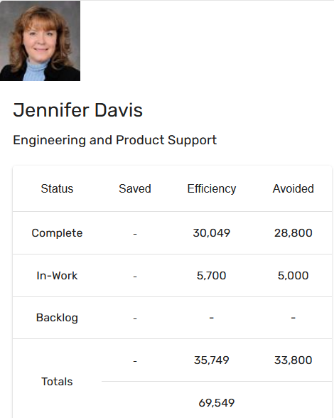
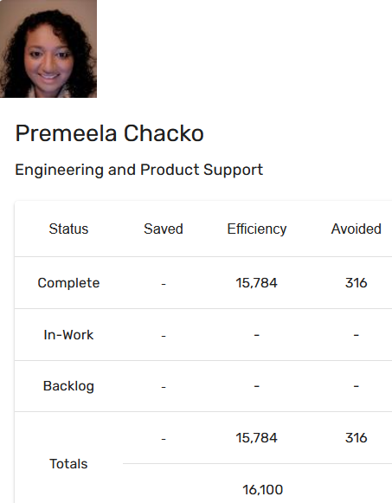
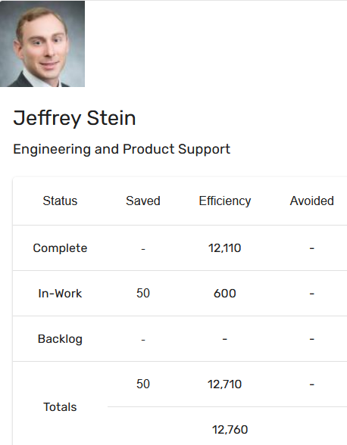
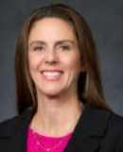
Automation Status - 2023
Target: 80k hrs
Current status: 157k hrs
Total : 157,542 hours
Tatum Shannon

Slide 14
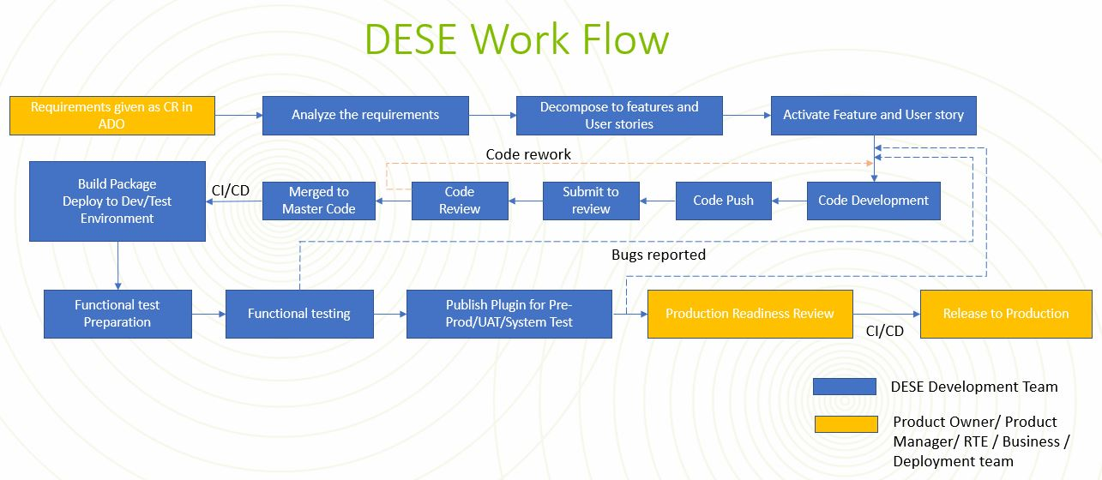
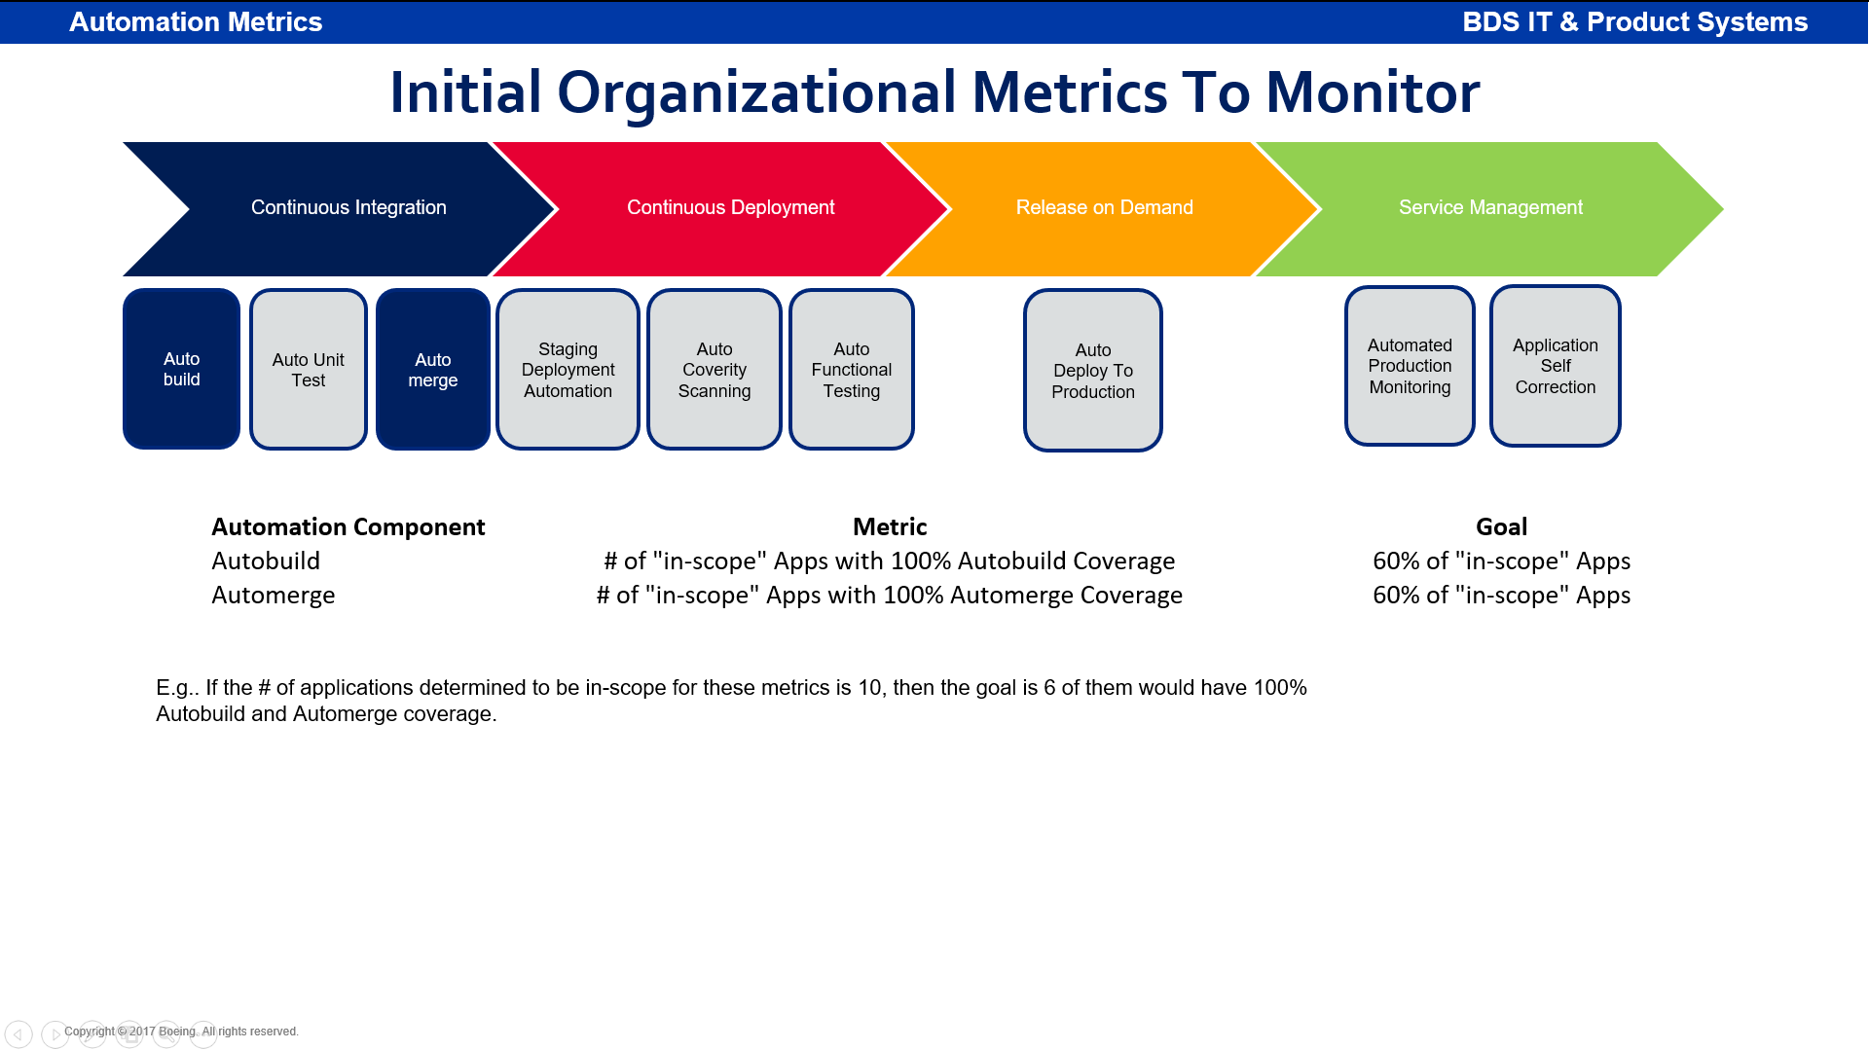
Automation success story
Project Name: DESE (Digital Environment for System Engineering)
Problem Statement: DESE creates solution, job aids, starter kit/models and training environment and deliver them to different Boeing Commercial and Defense Airplane programs and create an environment for integration with other MBSE tools like 3dxperience, Capital, etc.. They required tool to test plugin functionality, as manual testing was taking too much time
Solution: DESE MBSE team has delivered DESE 4.0 objectives for fps and 777-8F programs which includes Configuration Management capabilities and Safety FHS plugin. The software implementation of this capabilities has been saved around 4120 hours. The calculations are as below. Team has achieved 76 PBI in the 23.3 PI.
Automation Hours Calculation:
The calculations for the of saved Automation hours: 4120
Savings is 4 hours per build
DESE has 15 engineers actively working on code development on a daily basis by running the tests and making fixes to either the code and/or test procedures.
Hours saved: 322 build + 280 UT + 100 merge + 322 deployment + 106 Coverity + 1442 FT = 4120 hours saved

Slide 15
Training and references

Slide 16
Training and support
Automation COP
https://devsecops.web.boeing.com/index.html [DevSecOps Enterprise Website]
Training:
https://devsecops.web.boeing.com/trainings.html
https://insite.web.boeing.com/culture/viewMedia.do?mediaId=428840
Insite: DevSecOps related video series
Degreed: https://degreed.com/pathway/mpl66o5r9d/pathway
Oreilly: https://learning.oreilly.com/library/view/the-devops-handbook/9781457191381/
Enterprise Support
In case of any queries interested teams can register themselves through EMC (check for the session with the name “DevSecOps Office Hours (India)”).
For Product Teams in US, Click Here to block your slot
For Product Teams in India, Click Here to block your slot
DSO Support Systems | Description | URL
ATOMS | Platform to onboard to some of the commonly used tools like Coverity, Netsparker, SonarQube | https://atoms.web.boeing.com/home
ATOMS-CI | Saves your team time by generating an automated continuous integration pipeline and integrating different tools | https://atoms-ci.web.boeing.com/ci
DevSecOps | Official DevSecOps website | https://devsecops.web.boeing.com/index.html
AppDynamics | Monitoring tool documentation | https://itms.pages.boeing.com/wiki/appdynamics/
Enablement kit | Architecture Checklist to improve maturity | https://devsecops.web.boeing.com/assessment/enablementKit.html
DSO Mattermost channel | Join this channel for any questions/updates | https://mattermost.web.boeing.com/dso/channels/town-square
DSO Consultation | Connect with the experts | DL DSO Consulting
DSO COE InSite Group | Join this group for any questions/updates | https://insite.web.boeing.com/culture/viewGroup.do?groupId=168061
DevSecOps Video Library | Videos on different implementation | https://insite.web.boeing.com/culture/displayGroupMedia.do?groupId=168061

Slide 17
Assessment Process
DevSecOps Assessment Process Flow (Swimlane)
Please refer to the attached PDF.
GSEP Process for Dashboard Access
Please use the link to get access to the assessment dashboard. This is an auto approval process. Please select the first option for Business Stakeholder group.
Try to access this Dashboard Link after few minutes.
Info center Dashboard Link

Slide 18
Contact us
 | DRI | Project Management | Core Team Focal | Enterprise collaboration
DevSecOps | Abhishek Singh Kenneth C Shew | Pramithi R Karimpanakkal | Singh, Abhishek K Valiyarayil, Siby Pattanaik, Anup K Ammata, Sudhakar Bakhedi, Bharati Bahubali Balraj, Bharath K Ghosh, Saikat Ghosh, Subhabrata Gundupalli, Rajesh Reddy H D, Sarika K L, Bharath Karri, Ram Sai K-R, Rahul Kuriakose, Tintu M Kurian, Abhijith Kuruba Chandra Kumar Mistry, Ashok Nagaraju, Ganesh Nagziriya, Anshika Nair, Aathira Manikandan Padmanaban Shunmugam, Nihila Abhishek Kumar Prabhat, Kumar Radhakrishnan, Chinjumol Reddy, V Sanjeev Rompicherla, Rakesh Sawant, Swapnil Ravindra Varghese, Jessy Vinukonda, Basha Jayanta Mondal DL Product Systems - DevSecOps Core Team | Karthik Tirukkoylur Sekhar Dolly Bhaskara Arun Prakash Jeyaprakash Anandapadmanabhan Gopalakrishnan Sushil Mishra Donald R Wellington DL DSO DRIs
Automation | Kenneth C Shew Naga Harsha Kaggallu | Priyanka Dhanpal Chougule

Slide 19
Thank You

