Slide 1
DevSecOps & Automation – EP&S Monthly Report Out - December 2023

Slide 2
CONTENTS
Vision
2023 DevSecOps Progress
DSO Status per director
Automation Progress
2024 Strategy
2023 Success Stories
Training and references

Slide 3




Vision
Implement Lean practices through DSO maturity coverage and IT Automation.
Increased operating speed and flexibility, release-on-demand, and first-time quality of secure-by-design applications.
Reduced hours and improved efficiency through automation

Slide 4
2023 DevSecOps progress

Slide 5
DevSecOps 2023
Implement Lean practices through DSO maturity coverage for 70% of High ROI products
OKR
Target
Achievement
Complete DSO Assessments for new applications 120 Apps
84 Apps planned with High ROI ((All Productions apps + Frequency (Very High, High) + AEC 3,4 ,5)
148
Implementation roadmap for Applications that have completed assessments- 90 Apps
123
100% of High ROI have roadmap created
Roadmap implementation , Re-Assessment & ROI calculation for 15% Apps with roadmap created: - 40 apps
41
More than 10K hrs of savings demonstrated with success stories
Maturity improvement and maintain Score 3.0+
3+
3 + Maturity level for reassessed and new apps

Slide 6
Progress
On Track
Watch Item
Off Track
2023 OKR Targets
Q1
Q2
Q3
Q4
Target
Completed
Target
Completed
Target
Completed
Target
Completed
Complete DSO Assessments for new applications 120 Apps
22
30
34
30
21 + 57 AMaaS
30
6
30
Implementation roadmap for Applications that have completed assessments- 90 Apps
9
30
33
30
17 + 57 AMaaS
30
4
30
Roadmap implementation , Re-Assessment & ROI calculation for 15% Apps with roadmap created: - 40 apps
24
10
0
10
4
10
13
20
*DSO Improvements pending
Maturity improvement and maintain Score 3.0+
Maturity Score 3
Maturity Score 3
Maturity Score 3.0 (Non-AMaaS)
Overall Score with AMaaS 2.82
Maturity Score 3.0 (Non-AMaaS)
Overall Score with AMaaS 2.82

Slide 7
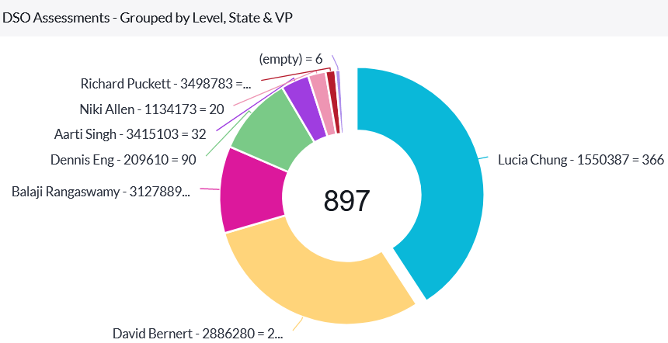
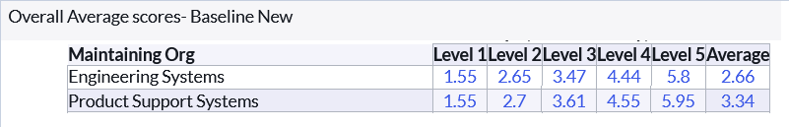
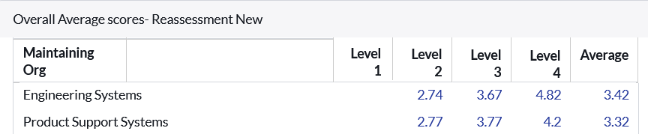
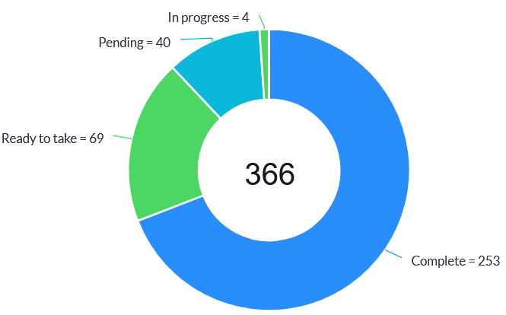
Assessment progress
Maturity for Assessment
Overall IT&DA Status
Maturity for Re-Assessment
E&PS Status

Slide 8
Summary
Accomplishments
DSO Assessment, Re-assessment and Automation target achieved for 2023
Look Ahead
Focus on Savings and integrated strategy approach for 2024
GSEP migration and integration updates to InfoCenter completed
Bringing success stories, case study and training for application teams.
Bring improved DevSecOps maturity and automations savings.

Slide 9
DSO STATUS PER DIRECTOR( till NOV 2023)

Slide 10
Engineering Products(Jennifer)
On Track
Watch Item
Off Track
65
** Reassessment target for 2023 – 10

Slide 11
Engineering Products (Tatum)
On Track
Watch Item
Off Track
87
**Reassessment target for 2023 – 10

Slide 12
Engineering Products (Buba)
On Track
Watch Item
Off Track
30
**Reassessment target for 2023 – 10

Slide 13
Engineering Products (Jeff)
On Track
Watch Item
Off Track
29
**Reassessment target for 2023 – 10

Slide 14
AUTOMATION PROGRESS

Slide 15




Automation 2023
Implement automation capabilities through out the applications and achieve 80000 automation hours
OKR
Objective
Accomplishments:
Automate repetitive processes
Automation hours of 184270 has been accounted in the CoP.
Capture automation to Return On Investment.
Knowledge sharing and bring culture of Automation

Slide 16
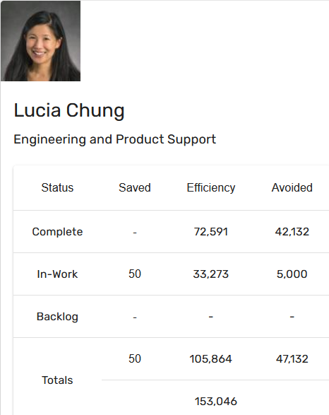
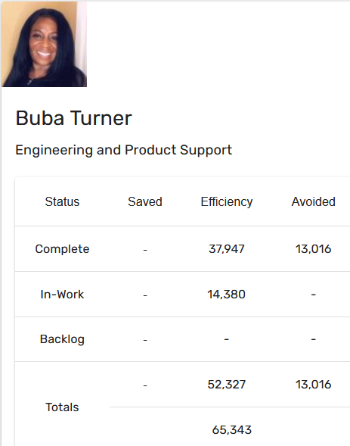
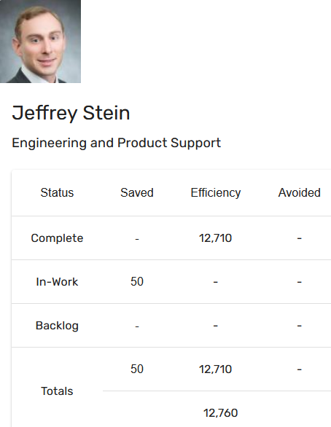
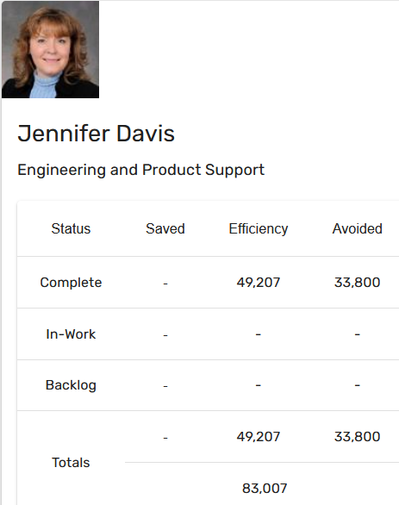
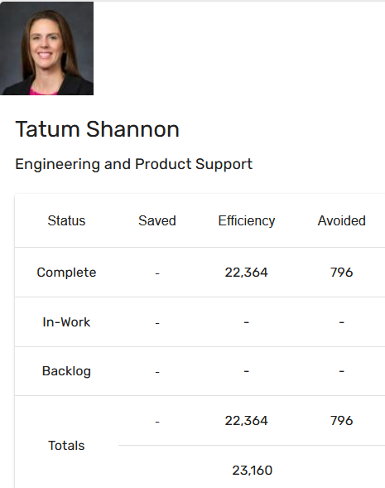
Automation Status - 2023
Target: 80k hrs
Current status: 184k hrs
Total : 184270 hours

Slide 17
2024 Strategy

Slide 18
Improvement areas suggested
Application Team
Why to implement DevSecOps & Priority ?
Help to make actual product maturity improvements along with assessments.
DSO Focal
Governance of assessments don’t provide technical learning opportunity.
Leaders
Larger product centric approach
How am I making impact to larger objectives?
Automation in process to better governance.
No funding or resource.

Slide 19
2024 Planning
Opportunity for technical leaders and Product/Project managers to be part Initiative.
Continue collaboration with EA Team for governance and improvements at IT&DA
DORA metrics integration
DevSecOps & Automation
Governance & Collaboration
Product Centricity
Rewards
Training & upskilling
Communication
Communication to all employees on progress and importance Initiative.
Establish OKR at products
Product manager to drive higher maturity for applications and Track status in QBR
Focal to be assigned and collaborate with Product leaders to help on product maturity improvements
Resources and sessions for all employees.
Focused trainings for focal.
Hands-on experience to focal for their development and growth
Rewards for products & application team
Rewards for Core team
Bring ROI at the E&PS level

Slide 20
Bringing efficiency at product
Product Efficiency
Compliance
Tech Debt
Compute
DevSecOps & Automation
Application Roadmap
/retirement
Cloud, HPC
Look ahead
Need DRI support across areas of initiative to identify opportunities of automations

Slide 21
2023 SUCCESS Stories

Slide 22


Savings identified after reassessment 2023
9512 Hrs. (As of Dec 2023)

Slide 23
MIST – (Modular instrumentation setup tool) Success stories (l1 to l3) Total Savings In A Year 2304 hours = (1536 CI/cd + 768 development)
Configuration Management Practice followed which increases agility, both on the part of individual developers and the application as a whole.
Features:
Externalized
Environment Specific
Consistent
Version History
CI/CD
Development
4 Non-Production Deployment
Configuration Management Practice followed.
Manual Effort = 5 hr
Automated = 1.5 hr
Per Sprint(4env*4hr*8build=128 hr)
SAST tool in pipeline helps to ensure no new security vulnerabilities go to Production. Address security and quality defects early in the software development.
8 Story Point Task X 8 hrs = 64 hrs

Slide 24
CASTeam (Commercial Aviation Services Tool & Equipment Applications for Maintenance) Success stories (l3 to l4) Total Savings in a year 4047 hours = (102 Prod CI/cd + 3195 dev CI/CD + 750 coverity pipeline automation)
CI/CD
Development
3 Production Releases
Manual Effort = 4.5hrs
Automated = 0.25hrs
50+ Non Prod Deployments
(30 dev + 10 stage+10 test )
Per sprint (50 * 4.25) = 213hrs
23 to 84% Unit test Coverage improvement
Automated Protractor tests during Releases.
Coverity Pipeline savings
Per Sprint
( 50 scans * 1 hr) = 50 hrs

Slide 25
Automation Success story
Project Name: Linux-based LDRA Licenses Implementation
Problem Statement: BFMS is working hard on their development productivity to meet 737MAX and FAA milestone schedules. They required more LDRA licenses as they were maxing out. Their current Windows-based LDRA licenses allowed them to perform instrumented builds weekly due to slow cycle time.
Solution: BFMS learned they could increase their team’s productivity by using Linux-based LDRA licenses, which cycled in a quarter of the time of Windows-based LDRA. This permits them to perform daily builds vs weekly and thus increase their output.
Automation Hours Calculation:
The calculations for the conversion of saved Automation hours to dollars is illustrated below:
Savings is 3 hours per build
BFMS has 80 engineers actively working on structural code coverage analysis on a daily basis by running the tests and making fixes to either the code and/or test procedures.
Hours saved formula: 80 users X 1 build per day X 3 hours saved X 240 days = 57600 hours of saved
Engineer hourly rate is ~$215/hr
$215 x 57,600 hours saved = $12,384,000

Slide 26
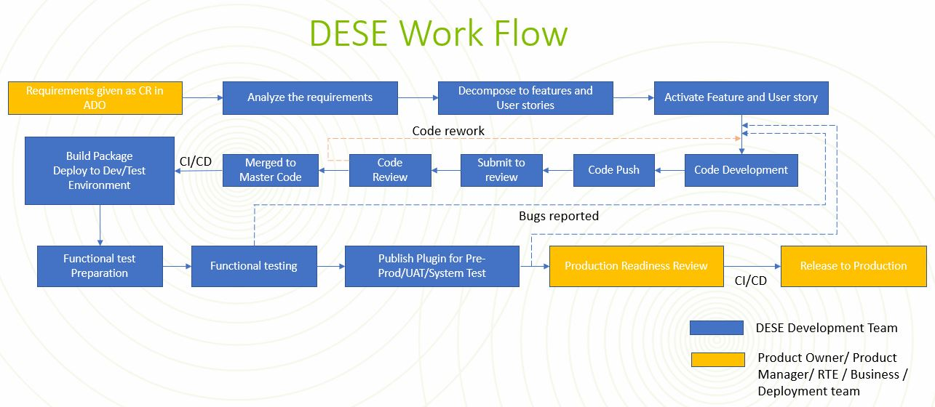
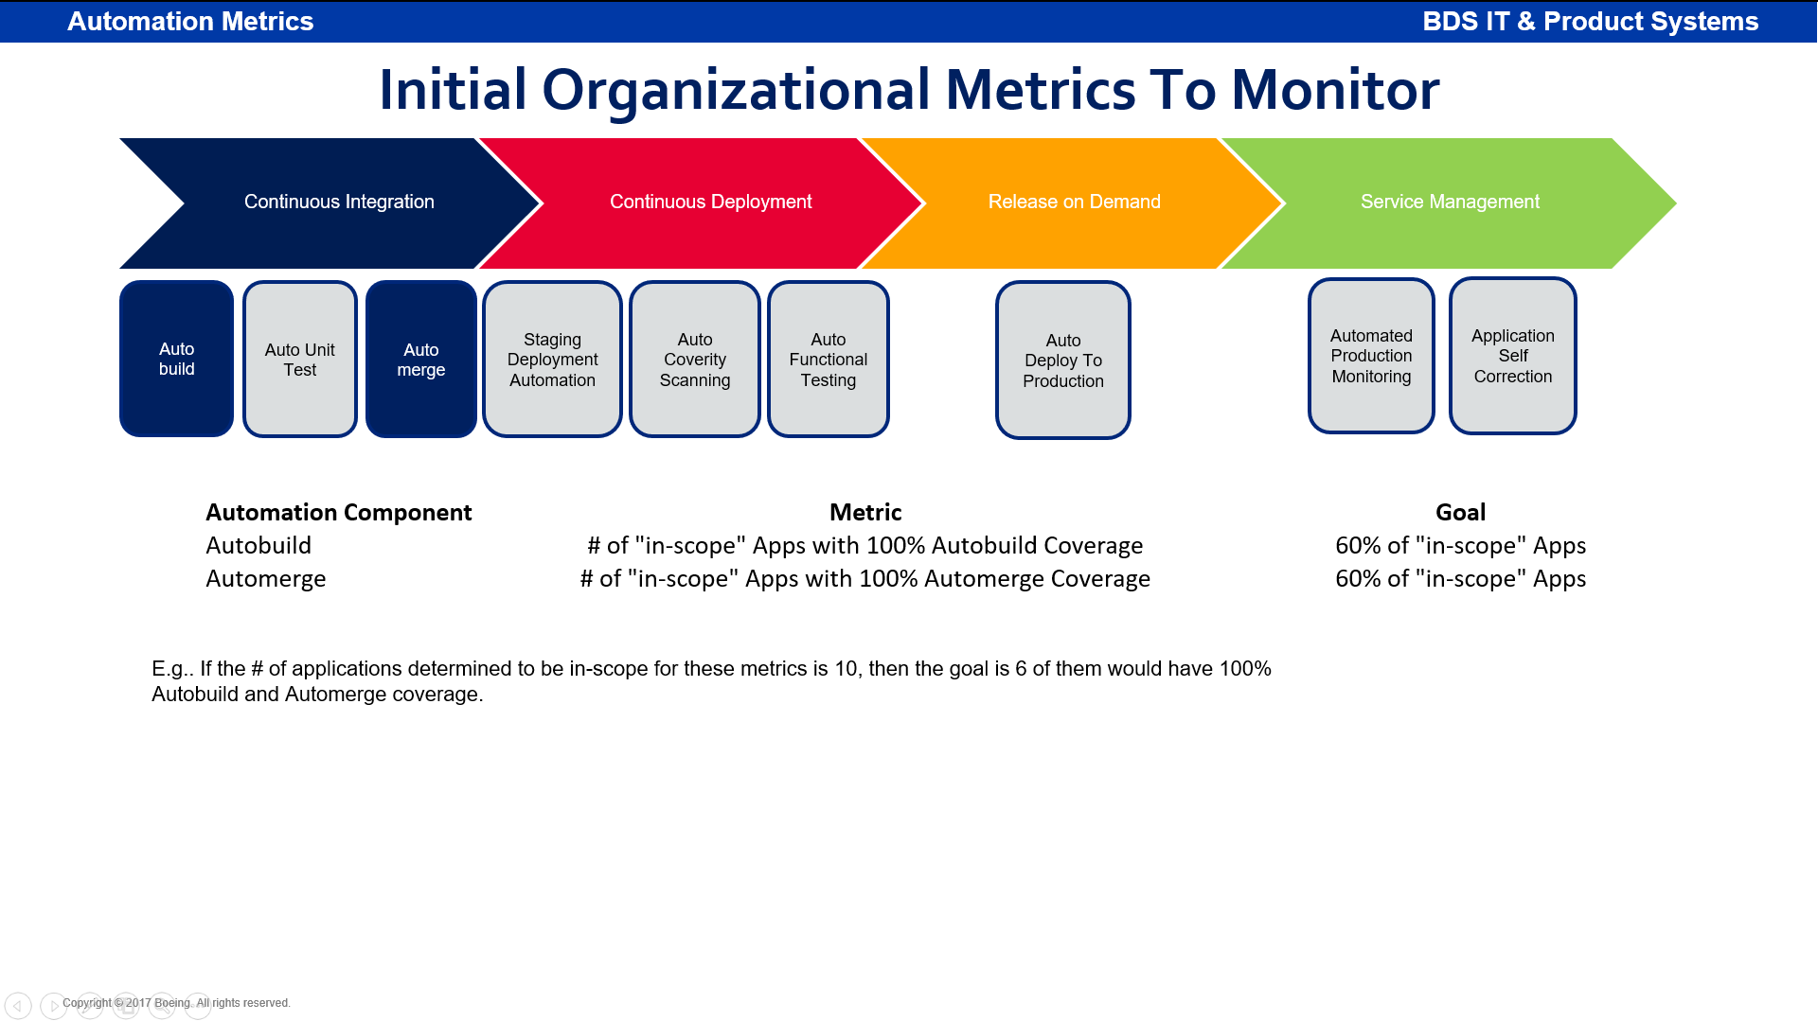
Automation success story
Project Name: DESE (Digital Environment for System Engineering)
Problem Statement: DESE creates solution, job aids, starter kit/models and training environment and deliver them to different Boeing Commercial and Defense Airplane programs and create an environment for integration with other MBSE tools like 3dxperience, Capital, etc.. They required tool to test plugin functionality, as manual testing was taking too much time
Solution: DESE MBSE team has delivered DESE 4.0 objectives for fps and 777-8F programs which includes Configuration Management capabilities and Safety FHS plugin. The software implementation of this capabilities has been saved around 4120 hours. The calculations are as below. Team has achieved 76 PBI in the 23.3 PI.
Automation Hours Calculation:
The calculations for the of saved Automation hours: 4120
Savings is 4 hours per build
DESE has 15 engineers actively working on code development on a daily basis by running the tests and making fixes to either the code and/or test procedures.
Hours saved: 322 build + 280 UT + 100 merge + 322 deployment + 106 Coverity + 1442 FT = 4120 hours saved

Slide 27
Training and references

Slide 28
Training and support
Automation COP
https://devsecops.web.boeing.com/index.html [DevSecOps Enterprise Website]
Training:
https://devsecops.web.boeing.com/trainings.html
https://insite.web.boeing.com/culture/viewMedia.do?mediaId=428840
Insite: DevSecOps related video series
Degreed: https://degreed.com/pathway/mpl66o5r9d/pathway
Oreilly: https://learning.oreilly.com/library/view/the-devops-handbook/9781457191381/
Enterprise Support
In case of any queries interested teams can register themselves through EMC (check for the session with the name “DevSecOps Office Hours (India)”).
For Product Teams in US, Click Here to block your slot
For Product Teams in India, Click Here to block your slot
DSO Support Systems | Description | URL
ATOMS | Platform to onboard to some of the commonly used tools like Coverity, Netsparker, SonarQube | https://atoms.web.boeing.com/home
ATOMS-CI | Saves your team time by generating an automated continuous integration pipeline and integrating different tools | https://atoms-ci.web.boeing.com/ci
DevSecOps | Official DevSecOps website | https://devsecops.web.boeing.com/index.html
AppDynamics | Monitoring tool documentation | https://itms.pages.boeing.com/wiki/appdynamics/
Enablement kit | Architecture Checklist to improve maturity | https://devsecops.web.boeing.com/assessment/enablementKit.html
DSO Mattermost channel | Join this channel for any questions/updates | https://mattermost.web.boeing.com/dso/channels/town-square
DSO Consultation | Connect with the experts | DL DSO Consulting
DSO COE InSite Group | Join this group for any questions/updates | https://insite.web.boeing.com/culture/viewGroup.do?groupId=168061
DevSecOps Video Library | Videos on different implementation | https://insite.web.boeing.com/culture/displayGroupMedia.do?groupId=168061

Slide 29
Assessment Process
DevSecOps Assessment Process Flow (Swimlane)
Please refer to the attached PDF.
GSEP Process for Dashboard Access
Please use the link to get access to the assessment dashboard. This is an auto approval process. Please select the first option for Business Stakeholder group.
Try to access this Dashboard Link after few minutes.
Info center Dashboard Link
Refer attached excel for pending reassessments and assessments.

Slide 30
Contact us
 | DRI | Project Management | Core Team Focal | Enterprise collaboration
DevSecOps | Abhishek Singh Kenneth C Shew | Kolhar Laxmidevi Kumar Anand | Singh, Abhishek K Valiyarayil, Siby Nair, Aathira Manikandan P, Ashwini Pattanaik, Anup K Ammata, Sudhakar Bakhedi, Bharati Bahubali Balraj, Bharath K Ghosh, Saikat Ghosh, Subhabrata Gundupalli, Rajesh Reddy H D, Sarika K L, Bharath Karri, Ram Sai K-R, Rahul Kuriakose, Tintu M Kurian, Abhijith Kuruba Chandra Kumar Mistry, Ashok Nagaraju, Ganesh Nagziriya, Anshika Padmanaban Shunmugam, Nihila Abhishek Kumar Prabhat, Kumar Radhakrishnan, Chinjumol Reddy, V Sanjeev Rompicherla, Rakesh Sawant, Swapnil Ravindra Varghese, Jessy Vinukonda, Basha Jayanta Mondal DL Product Systems - DevSecOps Core Team | Karthik Tirukkoylur Sekhar Dolly Bhaskara Arun Prakash Jeyaprakash Anandapadmanabhan Gopalakrishnan Sushil Mishra Donald R Wellington DL DSO DRIs
Automation | Kenneth C Shew Naga Harsha Kaggallu | Priyanka Dhanpal Chougule

Slide 31
Thank You

