Slide 1
DevSecOps & Automation – EP&S P2P- 7/25

Slide 2
Progress
Status
Objectives – E&PS
Automation Savings Achieved : 128,203 Hrs.
DevSecOps Assessments :
Completed - 34
In-Progress(Roadmap Pending) - 24
DevSecOps Maturity Improvements (Re-assessments)
Completed - 8
In-Progress(Roadmap Pending) - 7
Upskill Sessions
Completed - 5
Scheduled - 2
Automation Savings 2024: 140 K Hrs.
DevSecOps Assessments: 130 Apps
DevSecOps Maturity Improvement - 50 Apps
Upskill Sessions - 12
Highlights & Look Ahead
Help Needed
Focal working with product team to work on prioritizations
Work in brining efficiencies through product maturity
Working with DSO Pioneer team to bring leanings & Savings for pilot projects completed
Tableau Dashboard LINK
Prioritization on DevSecOps adoption in products
Automation Savings updates on COP

Slide 3
Engineering Progress
 |  |  |  | 2024 Target |  |  |  | 2024 Actuals
Director | Product Name | Application # | Total assessments Completed | Assessments | Reassessments | Automation Savings Target(70000) | DSO Focals Assigned | Assessments |  | Reassessments
 |  |  |  |  |  |  | Primary Focal | Completed | In-Progress | Completed | In-Progress
Jennifer | TOTAL | 177 | 39 | 27 | 6 |  |  | 6 | 3 | 2 | 1
 | Regulatory and Safety | 29 | 12 | 3 | 2 | 11285 | Radhakrishnan, Chinjumol | 2 |  | 1
 | Research and Technology | 11 | 9 |  | 1 |  | Singh, Abhishek K
 | Test and Evaluation | 43 | 14 | 7 | 2 |  | Jha, Ravi N | 4 | 3 | 1 | 1
 | IPDM PLM | 94 | 4 | 17 | 1 |  | Singh, Omji Kunjbihari
Tatum | TOTAL | 333 | 149 | 56 | 22 |  |  | 14 | 8 | 3 | 1
 | Authoring Process Planning | 27 | 16 | 1 | 2 | 16450 | Urimindi, Sreenivasulu | 3
 | Data Distribution and Management | 57 | 19 | 8 | 3 |  | Urimindi, Sreenivasulu Vinod Thomas |  | 2 | 1
 | Automation Programming | 24 | 4 | 4 | 1 |  | Chougule, Priyanka Dhanpal |  | 1
 | Customer Engineering (CE) | 9 | 0 | 2 | 0 |  | Nair, Aathira Manikandan | 1
 | 3DX PLM | 12 | 14 | 1 | 2 |  | Kaur, Harmeet |  | 1
 | Electrical Engineering | 44 | 6 | 11 | 1 |  | K L, Bharath | 4 |  | 1
 | Flight Engineering and Propulsion | 51 | 62 | 14 | 9 |  | Mohiddin Basha, Mahammed Gulam | 1 | 4 | 1
 | Mechanical and Structural Engineering | 50 | 6 | 8 | 1 |  | P, Ashwini | 3
 | Systems Engineering | 46 | 5 | 6 | 1 |  | Kandan, Narendran | 2 |  |  | 1
 | Production System Simulation | 1 | 1
 | Visualization and xR | 12 | 16 | 1 | 2 |  | Rompicherla, Rakesh
 | TOTAL | 510 | 188 | 83 | 28 | 27735 |  | 20 | 11 | 5 | 2

Slide 4
Product support Progress
 |  |  |  | 2024 Target |  |  |  | 2024 Actuals
Director | Product Name | Application # | Total assessments Completed | Assessments | Reassessments | Automation Savings Target(70000) | DSO Focals Assigned | Assessments |  | Reassessments
 |  |  |  |  |  |  | Primary Focal | Completed | In-Progress | Completed | In-Progress
Buba | TOTAL | 147 | 70 | 20 | 10 | 35000 |  | 4 | 9 |  | 4
 | Digital Market Products | 43 | 22 | 6 | 3 | 77683 | Popeck (US), John |  | 6 |  | 1
 | Customer Operations | 24 | 16 | 2 | 2 |  | Balraj, Bharath K |  | 3 |  | 2
 | Technical Publications | 55 | 23 | 7 | 4 |  | Prabhat, Kumar | 2 |  |  | 1
 | Training & Other | 25 | 9 | 5 | 1 |  | Rooge, Padma Prasad | 2
Jeff | TOTAL | 226 | 76 | 30 | 12 | 35000 |  | 10 | 4 | 3 | 1
 | Automation Programming | 26 | 26 |  | 4 | 21307 | H D, Sarika
 | Innovation Hub
 | Material Management | 20 | 9 | 3 | 1 |  | Jenkins (US), Renee M | 2 | 1
 | Maintenance Repair and Overhaul | 27 | 12 | 3 | 2 |  | Fink (US), Brendan A
 | Integrated Logistics Planning and Management | 33 | 11 | 5 | 2 |  | Nadampalli Kumarraju, Lavanya | 2 | 1
 | Product Support Analysis | 31 | 7 | 5 | 1 |  | Varghese, Jessy | 1 |  | 2
 | Embedded Program Support | 89 | 11 | 14 | 2 |  | Amaragatti, Sharanappa | 5 | 2 | 1 | 1
 | TOTAL | 373 | 146 | 50 | 22 | 98990 |  | 14 | 13 | 3 | 5

Slide 5
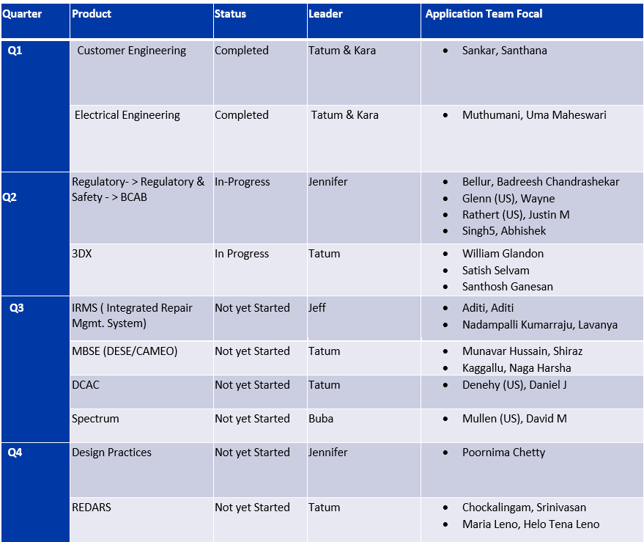
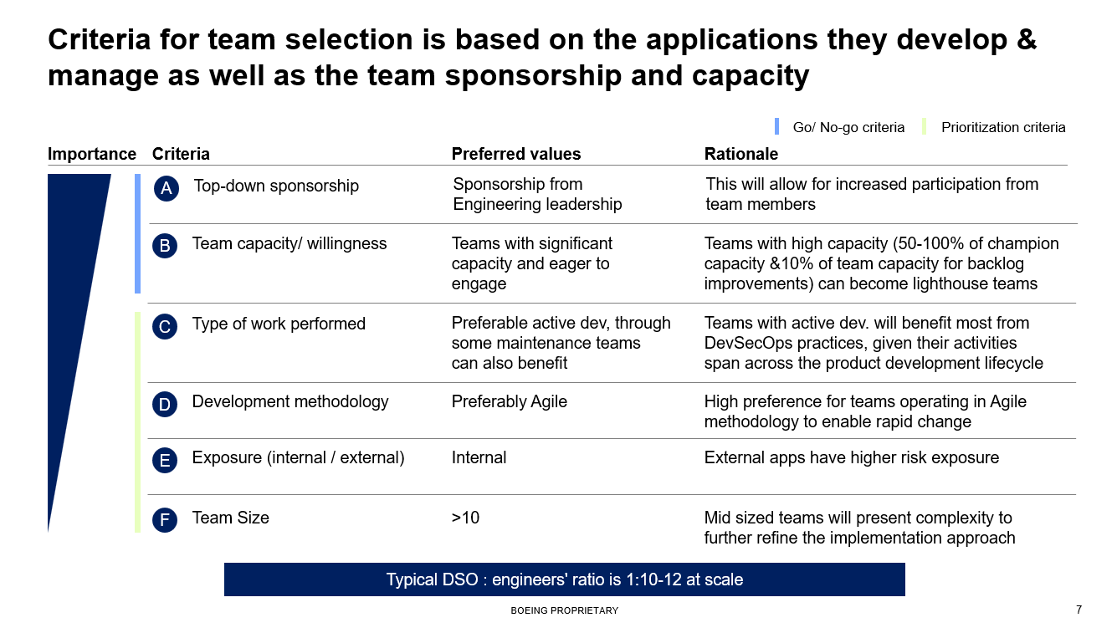
DevSecops Pilots( Embedded Support)
Next Steps
Adopt learnings to larger applications and share strategy in upcoming sessions
Identify High ROI application that need embedded support
Criteria for embedded Support

Slide 6
Amazon Q & Code Whisperer Updates
Capabilities identified and POC worked
In progress for capability identification
Not Achievable by Amazon Q
Background
Boeing is evaluating Amazon Web Services (AWS) CodeWhisperer through a Proof of Concept exercise with the intent of implementing the tool in various business operations.
Teams from IT&DA M&Q, DPACS, Software Engineering, and BR&T Math formed to evaluate
USE CASE | STATUS
Unit test case creation capability
New services planning and creation using /Dev functionality
Optimizing, refactoring and understanding complex existing legacy codebase
Mitigating the Coverity high and medium security vulnerability using /optimize capability
Actual business usecase like NIMT, Redars line darkening
Generate oracle forms methods into java/.net (cross-platform possible)
Creating UI frontend code & unit test cases for Vue.JS application.
Goal
To validate and understand the use cases and terms of service of the tool while also measuring the efficiency of the code generated
Objective
Test several use cases and quantify the impact on accuracy and productivity across different functions within various software engineering teams, looking at its applicability within an operational context. Also, identify the critical safety concerns and potential hazards.

Slide 7
Technical Upskill sessions
No. | Topic | Presenter Name | Date | Trainings Links
1 | Software Composition Analysis | Sushil Mishra | 12th March, 2024 | Click Here
2 | Containerization, Dockers and Deployment on Cloud | Siddharth Muttin | 20th March, 2024 | Click Here
3 | Deploy self-hosted Azure agent on OpenShift | Sumeet Kumar | 17th April, 2024 | Click Here
4 | Deploy Selenium grid on OpenShift for test cases execution | Sumeet Kumar | 8th May, 2024 | Click Here
5 | Learning from DevSecOps embedded support | DevSecOps Team | 20th June, 2024 | Click Here
6 | Google Cloud Platform - Overview | Anup Pattanaik | 11th July, 2024 | Click Here
7 | Google Cloud Platform – Deep Dive | Anup Pattanaik | 25th July, 2024 | Enroll Here

Slide 8




Automation 2024
Implement automation capabilities through out the applications and achieve 140000 automation hours
OKR
Objective
Accomplishments:
Automate repetitive processes
Automation hours of 126725 Hrs has been accounted in the CoP.
Capture automation to Return On Investment.
Knowledge sharing and bring culture of Automation

Slide 9
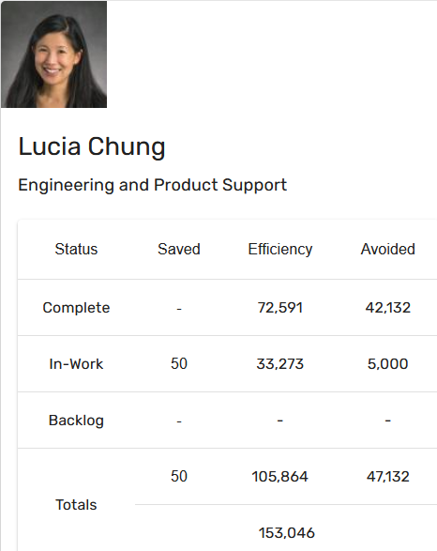
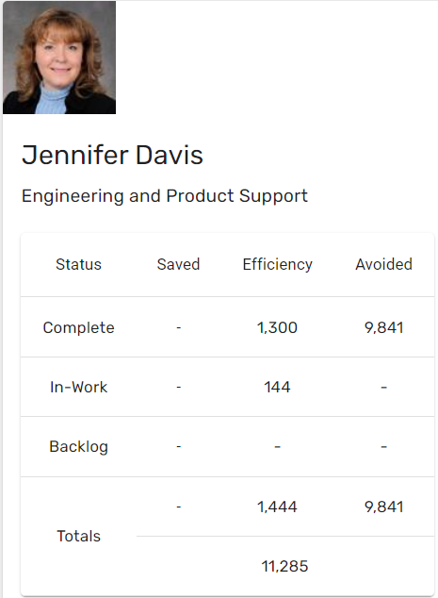
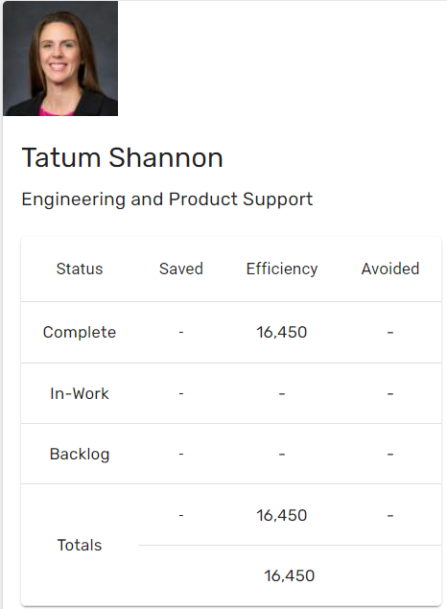
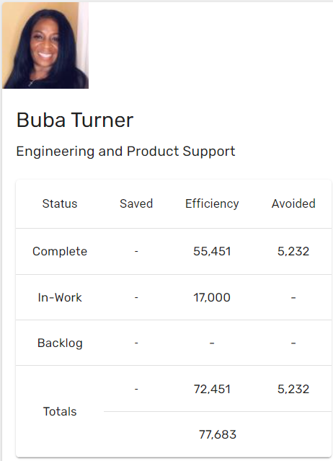
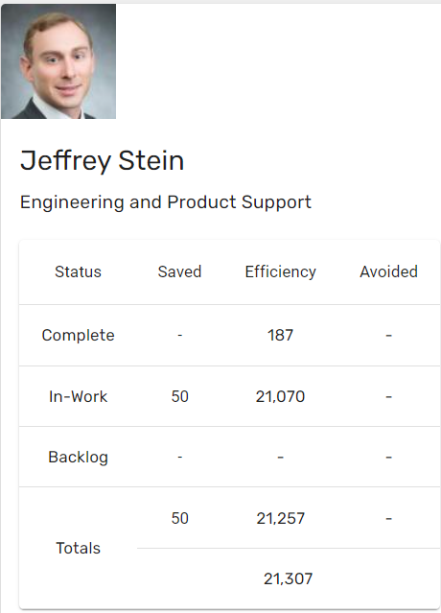
Automation Status - 2024
Target: 140k hrs
Status: 128.2k hrs
Total : 128,203 hours

Slide 10
Thank You

