Slide 1
AMAZON Q

Slide 2
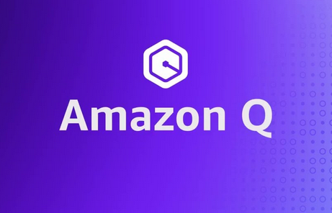
Amazon Q is an artificial intelligence language model developed by Amazon.
It is based on the Amazon Titan and GPT generative artificial intelligence.
Q assists developers with all their tasks—from coding, testing, and upgrading applications, to diagnosing errors
It has multistep planning and reasoning capabilities that can transform and implement new code generated from developer requests.

Slide 3
Q Capabilities

Slide 4
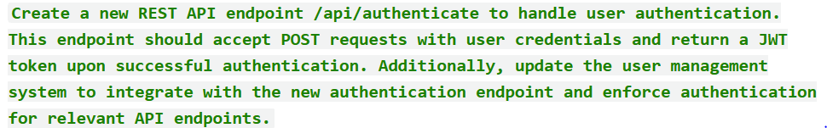
Plan and develop new features ( /Dev )
Dev functionality creates a detailed plan and generate code for the new feature we want to develop.
Give a detailed prompt of the feature
Ex:
Q response:
Amazon Q responds with an implementation plan.
Review the implementation plan that Amazon Q generates.
We can groom the plan by entering modification and more clarification.
Once satisfied with the plan, Q generates new code and proposes updates to your files based on the plan.
Review the generated code, once satisfied Q will help to insert the newly generated code in the codebase.

Slide 5
Key benefits of /DEV functionality
Analysis and Designing Phase
Saves hours of development effort in analysis and designing of new feature and functionality.
Code phase
Code generated by Q saves developer time in write boilerplate code and basic implementation.
Q analyzes the existing project context and generates new APIs and logic in no time.
Helps developer break down complex requirement and create MVP in quick time.
Test phase
/Dev functionality creates a detailed test plan as well as creates unit test case for each layer.
Helps in improving the code coverage for test cases.

Slide 6
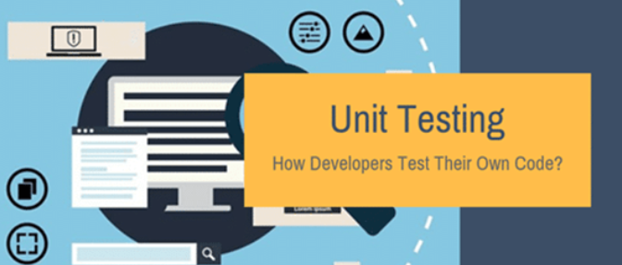
Detailed unit test plan using /dev
Based on the prompt it creates a detailed test plan for all MVC layers of the application.
Once satisfied with the plan, it generates the code for test case for each layer.
The code coverage for the test case is more than 85% including edge cases and exception handling.

Slide 7
Scanning code using Q
Code security scanning
SAST scanning - Identifies various security issues, such as resource leaks, SQL injection, and cross-site scripting.
Secrets scanning – Scans code and text files for secrets such as hardcoded passwords, database connection strings, and usernames.
Code quality scanning - Amazon Q detects quality and maintainability issues in the code to ensure codebase is meeting quality and efficiency best practices.

Slide 8
Explain and optimize functionality
Explain – Get code explained in natural language.
Refactor – Improve code readability or efficiency, among other improvements.
Fix – Debug code for existing and potential exceptions.
Optimize – Enhance code performance.
Steps:
Select the highlighted code and use send to Q as prompt option.
Based on the feature selected, Q will respond with the updated code or document(in case of explain).
Once satisfied with the updated code insert the code to the exact place.

Slide 9
Key Benefits
/Explain
Q first analyze the project context and creates a detailed explanation of the attributes, complex business logics used
and any other function called from the selected code.
Saves hours of development time in preparing the P490 documentation of legacy as well as new functionality developed.
/Optimize
Q first analyze the selected code and replaces the deprecated methods and logic with the latest implementation.
Implements the best design pattern in the code which will make code more efficient and reduces boilerplate.
Improves reusability and reduces redundancy in the code.
Improves readability by replacing attributes and variable with meaningful names.

Slide 10
/Transform functionality
Amazon Q can upgrade Java 8 and Java 11 code to Java 17 code.
Project is a Java 8 or Java 11 project built on Maven.
Current IDE supported are : JetBrains and VS Code.
After the transformation is complete, we can verify the upgraded code before updating project.
We can view the difference in the code and apply patch if satisfied.
Takes around 50 mins to transform the entire project from Java 8 and 11 to Java 17.

Slide 11
THANK YOU

