Slide 1
DevSecOps & Automation – EP&S Monthly Report Out - June 2024

Slide 2
CONTENTS
2024 OKR and Focus Areas
Progress
Technical Session
Automation Progress
Training and references

Slide 3
2024 OKR AND FOCUS AREAS
DevSecOps
1- Improve maturity for business critical applications
to Level 3 (minimum).- focus on 10% of applications (50) that have completed Assessment.
2- Focus on DevSecOps maturity for apps already in cloud or plan to move in 2024
3- Complete assessment for product with highest ROI - 20% Remaining Apps.
4- Build Reusable libraries from learnings and success stories
5- Training and Upskilling sessions for team ( 3 per Quarter)
6- Pilot projects with Software chapter team to improve maturity
High ROI products for focus:
Jennifer
Regulatory and Safety
Tatum
System Engineering
Electrical Engineering
Customer Engineering (CE)
Buba
Digital Market Products
Technical Publications
Jeff
Embedded Program Support
Product Support Analysis
Automation
1- Improve Automation efficiency high ROI Products and bring product efficiencies.
2- Overall savings of 140K Hrs
3- Build Lean practices and automation for Compliance , TechDebt and Compute

Slide 4
Progress
Status
Objectives – E&PS
Automation Savings Achieved : 23721 Hrs.
DevSecOps Assessments :
Completed - 34
In-Progress(Roadmap Pending) - 24
DevSecOps Maturity Improvements (Re-assessments)
Completed - 8
In-Progress(Roadmap Pending) - 7
Upskill Sessions
Completed - 5
Scheduled - 2
Automation Savings 2024: 140 K Hrs.
DevSecOps Assessments: 130 Apps
DevSecOps Maturity Improvement - 50 Apps
Upskill Sessions - 12
Highlights & Look Ahead
Help Needed
Focal working with product team to work on prioritizations
Work in brining efficiencies through product maturity
Working with DSO Pioneer team to bring leanings & Savings for pilot projects completed
Tableau Dashboard LINK
Prioritization on DevSecOps adoption in products
Automation Savings updates on COP

Slide 5
Engineering Progress
 |  |  |  | 2024 Target |  |  |  | 2024 Actuals
Director | Product Name | Application # | Total assessments Completed | Assessments | Reassessments | Automation Savings Target(70000) | DSO Focals Assigned | Assessments |  | Reassessments
 |  |  |  |  |  |  | Primary Focal | Completed | In-Progress | Completed | In-Progress
Jennifer | TOTAL | 177 | 39 | 27 | 6 |  |  | 6 | 3 | 2 | 1
 | Regulatory and Safety | 29 | 12 | 3 | 2 | 11285 | Radhakrishnan, Chinjumol | 2 |  | 1
 | Research and Technology | 11 | 9 |  | 1 |  | Singh, Abhishek K
 | Test and Evaluation | 43 | 14 | 7 | 2 |  | Jha, Ravi N | 4 | 3 | 1 | 1
 | IPDM PLM | 94 | 4 | 17 | 1 |  | Singh, Omji Kunjbihari
Tatum | TOTAL | 333 | 149 | 56 | 22 |  |  | 14 | 8 | 3 | 1
 | Authoring Process Planning | 27 | 16 | 1 | 2 | 16450 | Urimindi, Sreenivasulu | 3
 | Data Distribution and Management | 57 | 19 | 8 | 3 |  | Urimindi, Sreenivasulu Vinod Thomas |  | 2 | 1
 | Automation Programming | 24 | 4 | 4 | 1 |  | Chougule, Priyanka Dhanpal |  | 1
 | Customer Engineering (CE) | 9 | 0 | 2 | 0 |  | Nair, Aathira Manikandan | 1
 | 3DX PLM | 12 | 14 | 1 | 2 |  | Kaur, Harmeet |  | 1
 | Electrical Engineering | 44 | 6 | 11 | 1 |  | K L, Bharath | 4 |  | 1
 | Flight Engineering and Propulsion | 51 | 62 | 14 | 9 |  | Mohiddin Basha, Mahammed Gulam | 1 | 4 | 1
 | Mechanical and Structural Engineering | 50 | 6 | 8 | 1 |  | P, Ashwini | 3
 | Systems Engineering | 46 | 5 | 6 | 1 |  | Prabhat, Kumar | 2 |  |  | 1
 | Production System Simulation | 1 | 1
 | Visualization and xR | 12 | 16 | 1 | 2 |  | Rompicherla, Rakesh
 | TOTAL | 510 | 188 | 83 | 28 | 27735 |  | 20 | 11 | 5 | 2

Slide 6
Product support Progress
 |  |  |  | 2024 Target |  |  |  | 2024 Actuals
Director | Product Name | Application # | Total assessments Completed | Assessments | Reassessments | Automation Savings Target(70000) | DSO Focals Assigned | Assessments |  | Reassessments
 |  |  |  |  |  |  | Primary Focal | Completed | In-Progress | Completed | In-Progress
Buba | TOTAL | 147 | 70 | 20 | 10 | 35000 |  | 4 | 9 |  | 4
 | Digital Market Products | 43 | 22 | 6 | 3 | 77683 | Popeck (US), John |  | 6 |  | 1
 | Customer Operations | 24 | 16 | 2 | 2 |  | Balraj, Bharath K |  | 3 |  | 2
 | Technical Publications | 55 | 23 | 7 | 4 |  | Kandan, Narendran | 2 |  |  | 1
 | Training & Other | 25 | 9 | 5 | 1 |  | Rooge, Padma Prasad | 2
Jeff | TOTAL | 226 | 76 | 30 | 12 | 35000 |  | 10 | 4 | 3 | 1
 | Automation Programming | 26 | 26 |  | 4 | 21307 | H D, Sarika
 | Innovation Hub
 | Material Management | 20 | 9 | 3 | 1 |  | Jenkins (US), Renee M | 2 | 1
 | Maintenance Repair and Overhaul | 27 | 12 | 3 | 2 |  | Fink (US), Brendan A
 | Integrated Logistics Planning and Management | 33 | 11 | 5 | 2 |  | Nadampalli Kumarraju, Lavanya | 2 | 1
 | Product Support Analysis | 31 | 7 | 5 | 1 |  | Varghese, Jessy | 1 |  | 2
 | Embedded Program Support | 89 | 11 | 14 | 2 |  | Amaragatti, Sharanappa | 5 | 2 | 1 | 1
 | TOTAL | 373 | 146 | 50 | 22 | 98990 |  | 14 | 13 | 3 | 5

Slide 7
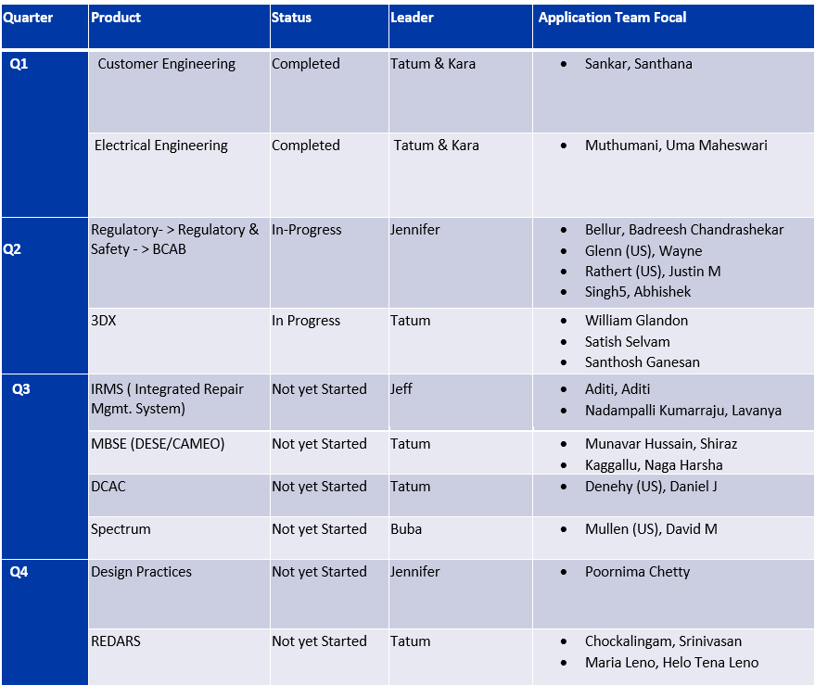
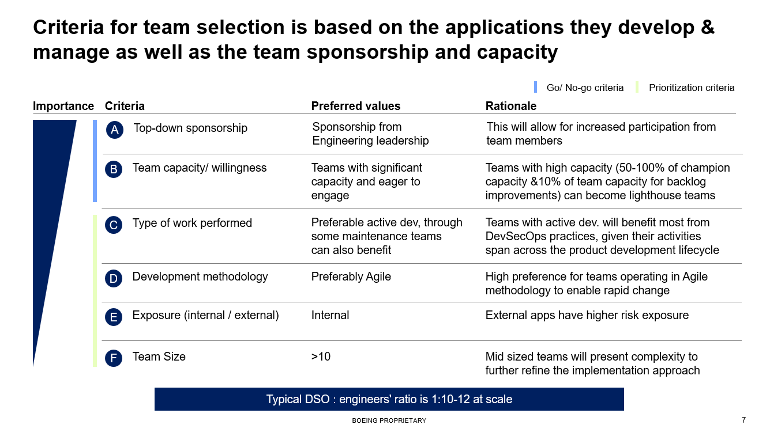
DevSecops Pilots( Embedded Support)
Next Steps
Adopt learnings to larger applications and share strategy in upcoming sessions
Identify High ROI application that need embedded support
Criteria for embedded Support

Slide 8
DevSecOps capability building: Out of all the support models, Embedded support has the most promise for Engineering
Details follow
Embedded Support
Consulting / On-demand Support
Hands-on support to identify software productivity opportunities, prioritize and develop a detailed roadmap
Embedded expert coaching to oversee implementation of first two sprints (i.e., role shadowing, spot-training, pair programming)
Detailed implementation plan to scale out successful initiatives across the product family / division
Best Practice Guidance
Office hours hosted by experts to answer technical questions
Pull-based experts support for implementation
Targeted best-practice training programs contextualized to Boeing’s tools and ways of working (e.g., DevSecOps, coding practices)
Support offered
Metrics, targets and progress tracking
Standards, best practices and support for tooling and processes
Self-serve recipes to identify software excellence opportunities across SDLC
Selection criteria
(detailed criteria in backup)
Table stakes for all teams
Team size >10 people
>20% capacity for SWX improvements
Team size >10 people
Active development
Ability to integrate pioneers into team
>20% capacity for SWX improvements

Slide 9
Amazon Q & Code Whisperer Updates
Capabilities identified and POC worked
In progress for capability identification
Not Achievable by Amazon Q
Background
Boeing is evaluating Amazon Web Services (AWS) CodeWhisperer through a Proof of Concept exercise with the intent of implementing the tool in various business operations.
Teams from IT&DA M&Q, DPACS, Software Engineering, and BR&T Math formed to evaluate
USE CASE | STATUS
Unit test case creation capability
New services planning and creation using /Dev functionality
Optimizing, refactoring and understanding complex existing legacy codebase
Mitigating the Coverity high and medium security vulnerability using /optimize capability
Actual business usecase like NIMT, Redars line darkening
Generate oracle forms methods into java/.net (cross-platform possible)
Creating UI frontend code & unit test cases for Vue.JS application.
Goal
To validate and understand the use cases and terms of service of the tool while also measuring the efficiency of the code generated
Objective
Test several use cases and quantify the impact on accuracy and productivity across different functions within various software engineering teams, looking at its applicability within an operational context. Also, identify the critical safety concerns and potential hazards.

Slide 10
TECHNICAL SESSION

Slide 11
Technical Upskill sessions
No. | Topic | Presenter Name | Date | Trainings Links
1 | Software Composition Analysis | Sushil Mishra | 12th March, 2024 | Click Here
2 | Containerization, Dockers and Deployment on Cloud | Siddharth Muttin | 20th March, 2024 | Click Here
3 | Deploy self-hosted Azure agent on OpenShift | Sumeet Kumar | 17th April, 2024 | Click Here
4 | Deploy Selenium grid on OpenShift for test cases execution | Sumeet Kumar | 8th May, 2024 | Click Here
5 | Learning from DevSecOps embedded support | DevSecOps Team | 20th June, 2024 | Click Here
6 | Google Cloud Platform - Overview | Anup Pattanaik | 11th July, 2024 | Enroll Here
7 | Google Cloud Platform – Deep Dive | Anup Pattanaik | 25th July, 2024 | Enroll Here

Slide 12
AUTOMATION PROGRESS

Slide 13




Automation 2024
Implement automation capabilities through out the applications and achieve 140000 automation hours
OKR
Objective
Accomplishments:
Automate repetitive processes
Automation hours of 126725 Hrs has been accounted in the CoP.
Capture automation to Return On Investment.
Knowledge sharing and bring culture of Automation

Slide 14
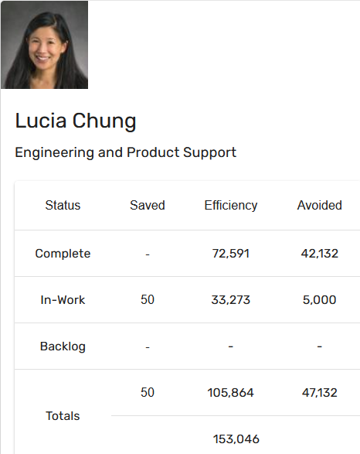
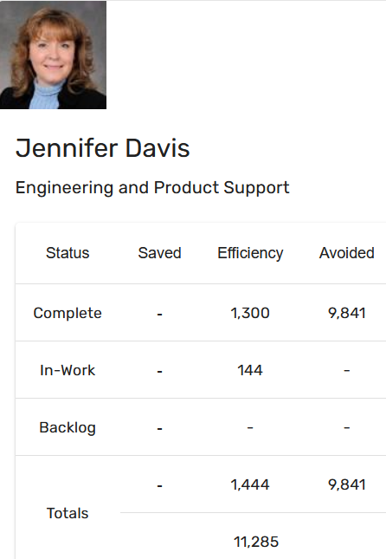
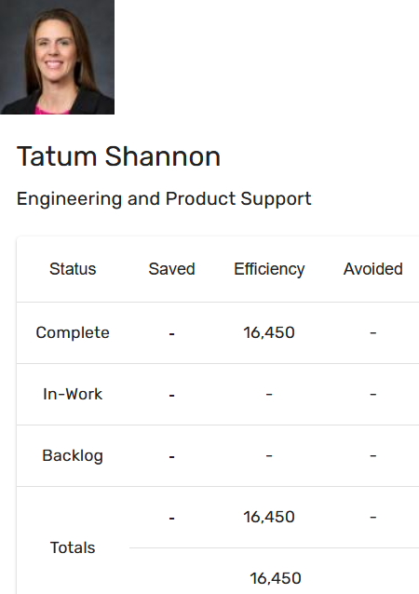
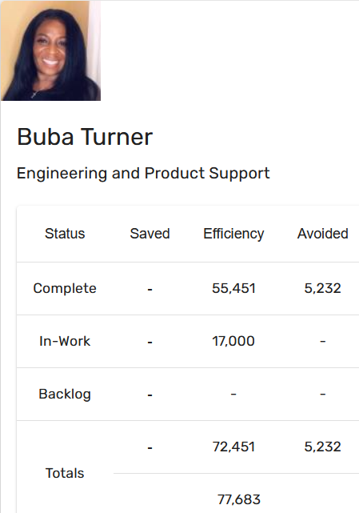
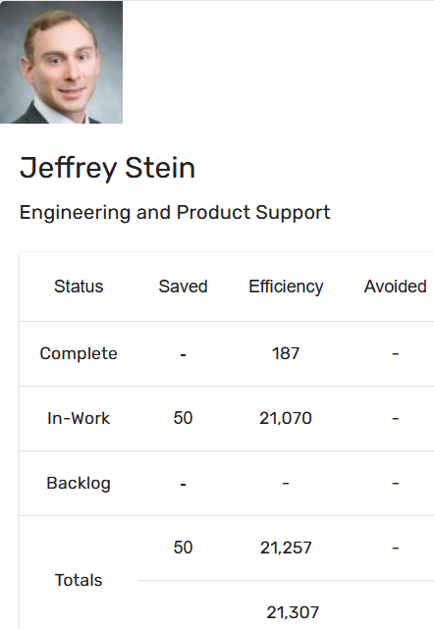
Automation Status - 2024
Target: 140k hrs
Current status: 126.7k hrs
Total : 126725 hours

Slide 15
Training and references

Slide 16
Training and support
Automation COP
https://devsecops.web.boeing.com/index.html [DevSecOps Enterprise Website]
Training:
https://devsecops.web.boeing.com/trainings.html
https://insite.web.boeing.com/culture/viewMedia.do?mediaId=428840
Insite: DevSecOps related video series
Degreed: https://degreed.com/pathway/mpl66o5r9d/pathway
Oreilly: https://learning.oreilly.com/library/view/the-devops-handbook/9781457191381/
Enterprise Support
In case of any queries interested teams can register themselves through EMC (check for the session with the name “DevSecOps Office Hours (India)”).
For Product Teams in US, Click Here to block your slot
For Product Teams in India, Click Here to block your slot
DSO Support Systems | Description | URL
ATOMS | Platform to onboard to some of the commonly used tools like Coverity, Netsparker, SonarQube | https://atoms.web.boeing.com/home
ATOMS-CI | Saves your team time by generating an automated continuous integration pipeline and integrating different tools | https://atoms-ci.web.boeing.com/ci
DevSecOps | Official DevSecOps website | https://devsecops.web.boeing.com/index.html
AppDynamics | Monitoring tool documentation | https://itms.pages.boeing.com/wiki/appdynamics/
Enablement kit | Architecture Checklist to improve maturity | https://devsecops.web.boeing.com/assessment/enablementKit.html
DSO Mattermost channel | Join this channel for any questions/updates | https://mattermost.web.boeing.com/dso/channels/town-square
DSO Consultation | Connect with the experts | DL DSO Consulting
DSO COE InSite Group | Join this group for any questions/updates | https://insite.web.boeing.com/culture/viewGroup.do?groupId=168061
DevSecOps Video Library | Videos on different implementation | https://insite.web.boeing.com/culture/displayGroupMedia.do?groupId=168061

Slide 17
Assessment Process
DevSecOps Assessment Process Flow (Swimlane)
Please refer to the attached PDF.
GSEP Process for Dashboard Access
Please use the link to get access to the assessment dashboard. This is an auto approval process. Please select the first option for Business Stakeholder group.
Try to access this Dashboard Link after few minutes.
Info center Dashboard Link
Refer attached excel for pending reassessments and assessments.

Slide 18
Contact us
 | DRI | Project Management | Core Team Focal | Enterprise collaboration
DevSecOps | Abhishek Singh Kenneth C Shew | Abhishek K, Singh Kumar Anand | Valiyarayil, Siby Nair, Aathira Manikandan P, Ashwini Amaragatti, Sharanappa Balraj, Bharath K Fink (US), Brendan A Ghosh, Subhabrata H D, Sarika Jenkins (US), Renee M Jha, Ravi N K L, Bharath Kandan, Narendran Kaur, Harmeet Kumar, Abhishek Kumar, Rahul Malik (US), Muhammad A Mohiddin Basha, Mahammed Gulam Nadampalli Kumarraju, Lavanya Padmanaban Shunmugam, Nihila Pattanaik, Anup K Popeck (US), John Prabhat, Kumar Prakash, Sumit Radhakrishnan, Chinjumol Rompicherla, Rakesh Rooge, Padma Prasad Singh, Omji Kunjbihari Urimindi, Sreenivasulu Varghese, Jessy DL Product Systems - DevSecOps Core Team | Sharina Haynes Karthik Tirukkoylur Sekhar Dolly Bhaskara Sushil Mishra Donald R Wellington DL DSO DRIs
Automation | Kenneth C Shew Naga Harsha Kaggallu | Priyanka Dhanpal Chougule

Slide 19
Thank You

