Slide 1
DevSecOps & Automation – EP&S Monthly Report Out - March 2024

Slide 2
CONTENTS
2024 OKR and Focus Areas
DSO Status per director
Technical Session
Automation Progress
Training and references

Slide 3
2024 OKR AND FOCUS AREAS
DevSecOps
1- Improve maturity for business critical applications
to Level 3 (minimum).- focus on 10% of applications (50) that have completed Assessment.
2- Focus on DevSecOps maturity for apps already in cloud or plan to move in 2024
3- Complete assessment for product with highest ROI - 20% Remaining Apps.
4- Build Reusable libraries from learnings and success stories
5- Training and Upskilling sessions for team ( 3 per Quarter)
6- Pilot projects with Software chapter team to improve maturity
High ROI products for focus:
Jennifer
Regulatory and Safety
Tatum
System Engineering
Electrical Engineering
Customer Engineering (CE)
Buba
Digital Market Products
Technical Publications
Jeff
Embedded Program Support
Product Support Analysis
Automation
1- Improve Automation efficiency high ROI Products and bring product efficiencies.
2- Overall savings of 140K Hrs (35K/Per Director)
3- Build Lean practices and automation for Compliance , TechDebt and Compute

Slide 4
Progress
Status
Objectives – E&PS
Automation Savings Achieved : 23577 Hrs.
DevSecOps Assessments :
Completed - 4
In-Progress(Roadmap Pending) - 36
DevSecOps Maturity Improvements (Re-assessments)
Completed - 1
In-Progress(Roadmap Pending) - 9
Upskill Sessions
Completed - 2
Scheduled - 2
Automation Savings 2024: 140 K Hrs.
DevSecOps Assessments: 130 Apps
DevSecOps Maturity Improvement - 50 Apps
Upskill Sessions - 12
Highlights & Look Ahead
Help Needed
Focal working with product team to work on prioritizations
Pilot project:
DORA Metrics integration.
McKinsey POC for CE & Electrical
Upcoming sessions planned Q2
Build Reusable libraries from learnings and success stories
Tableau Dashboard LINK
Prioritization on DevSecOps adoption in products
Automation Savings updates on COP

Slide 5
Engineering Progress
 |  |  |  | 2024 Target |  |  | 2024 Actuals |  |  |  | DSO Focal Assigned
DIRECTOR | Product Name | Application # | Total assessments Completed | Assessments | Reassessments | Automation Savings Target (70000) | Assessments |  | Reassessments
 |  | 177 | 39 | 27 | 6 |  | Completed | In-Progress | Completed | In-Progress
Jennifer | Regulatory and Safety | 29 | 12 | 3 | 2 |  |  | 2 |  |  | Radhakrishnan, Chinjumol <chinjumol.radhakrishnan@boeing.com>;
 | Research and Technology | 11 | 9 |  | 1 |  |  |  |  |  | Singh, Abhishek K <abhishek.k.singh@boeing.com>;
 | Test and Evaluation | 43 | 14 | 7 | 2 |  |  | 5 |  | 1 | Jha, Ravi N <ravi.n.jha@boeing.com>;
 |  |  |  |  |  |  |  |  |  |  | Singh, Abhishek K <abhishek.k.singh@boeing.com>;
 | Non DTPLM | 94 | 4 | 17 | 1 |  |  |  |  |  | Singh, Omji Kunjbihari <omjikunjbihari.singh@boeing.com>;
 |  |  |  |  |  |  |  |  |  |  | Balraj, Bharath K <bharath.k.balraj@boeing.com>;
 |  |  |  |  |  |  |  |  |  |  | Ghosh, Subhabrata <subhabrata.ghosh@boeing.com>;
 |  | 333 | 149 | 56 | 22
Tatum | Authoring Process Planning | 27 | 16 | 1 | 2 |  |  | 2 |  |  | Kaur, Harmeet <harmeet.kaur@boeing.com>;
 | Data Distribution and Management | 57 | 19 | 8 | 3 |  | 1 | 2 |  | 1 | Urimindi, Sreenivasulu <sreenivasulu.urimindi@boeing.com>;
 |  |  |  |  |  |  |  |  |  |  | Vinod, Thomas <thomas.vinod@boeing.com>;
 | Automation Programming | 24 | 4 | 4 | 1 |  |  | 1 |  |  | H D, Sarika <sarika.hd@boeing.com>;
 |  |  |  |  |  |  |  |  |  |  | Chougule, Priyanka Dhanpal <priyankadhanpal.chougule@boeing.com>;
 | Customer Engineering (CE) | 9 | 0 | 2 | 0 |  | 1 | 1 |  |  | Nair, Aathira Manikandan <aathiramanikandan.nair@boeing.com>;
 | DT PLM | 12 | 14 | 1 | 2 |  |  |  |  |  | Kaur, Harmeet <harmeet.kaur@boeing.com>;
 | Electrical Engineering | 44 | 6 | 11 | 1 |  | 1 |  | 1 | 1 | K L, Bharath <bharath.kl@boeing.com>;
 |  |  |  |  |  |  |  |  |  |  | Kandan, Narendran <narendran.kandan2@boeing.com>;
 | Flight Engineering and Propulsion | 51 | 62 | 14 | 9 |  |  | 2 |  |  | Mohiddin Basha, Mahammed Gulam <mahammedgulam.mohiddinbasha@boeing.com>;
 |  |  |  |  |  |  |  |  |  |  | Prabhat, Kumar <kumar.prabhat@boeing.com>;
 |  |  |  |  |  |  |  |  |  |  | Prakash, Sumit <sumit.prakash@boeing.com>;
 |  |  |  |  |  |  |  |  |  |  | Anand, Kumar <kumar.anand@boeing.com>;
 | Mechanical and Structural Engineering | 50 | 6 | 8 | 1 |  |  |  |  |  | P, Ashwini <ashwini.p@boeing.com>;
 |  |  |  |  |  |  |  |  |  |  | Rompicherla, Rakesh <rakesh.rompicherla@boeing.com>;
 | Systems Engineering | 46 | 5 | 6 | 1 |  |  | 2 |  | 1 | Pattanaik, Anup K <anup.k.pattanaik@boeing.com>;
 |  |  |  |  |  |  |  |  |  |  | Kolhar, Laxmidevi <laxmidevi.kolhar@boeing.com>;
 | Production System Simulation | 1 | 1 | 0 | 0
 | Visualization and xR | 12 | 16 | 1 | 2 |  |  |  |  |  | Rompicherla, Rakesh <rakesh.rompicherla@boeing.com>;
 | TOTAL | 510 | 188 | 83 | 28 | 8634 | 3 | 17 | 1 | 4

Slide 6
Product support Progress
 |  |  |  | 2024 Target |  |  | 2024 Actuals
Director | Product Name | Application # | Total assessments Completed | 2024 Target Assessments | 2024 Target Reassessments | Automation Savings (70000 Hrs) | Assessments |  | Reassessments |  |  | DSO Focal Assigned
 |  | 147 | 70 | 20 | 10 |  | Completed | In-Progress | Completed |  | In-Progress
Buba | Digital Market Products | 43 | 22 | 6 | 3 |  |  | 6 |  |  | 1 | Fink (US), Brendan A <brendan.a.fink@boeing.com>; Jenkins (US), Renee M <renee.m.jenkins@boeing.com>;
 | Customer Operations | 24 | 16 | 2 | 2 |  |  | 3 |  |  | 2 | Nair, Aathira Manikandan <aathiramanikandan.nair@boeing.com>;
 | Technical Publications | 55 | 23 | 7 | 4 |  |  | 1 |  |  | 1 | Prabhat, Kumar <kumar.prabhat@boeing.com>; Kolhar, Laxmidevi <laxmidevi.kolhar@boeing.com>;
 | Training & Other | 25 | 9 | 5 | 1 |  |  |  |  |  |  | Rooge, Padma Prasad <padmaprasad.rooge@boeing.com>;
 |  | 226 | 76 | 27 | 12
Jeff | Automation Programming | 26 | 26 |  | 4 |  |  |  |  |  |  | H D, Sarika <sarika.hd@boeing.com>; Chougule, Priyanka Dhanpal <priyankadhanpal.chougule@boeing.com>;
 | Innovation Hub
 | Material Management | 20 | 9 | 3 | 1 |  |  | 3 |  |  |  | Fink (US), Brendan A <brendan.a.fink@boeing.com>; Jenkins (US), Renee M <renee.m.jenkins@boeing.com>;
 | Maintenance Repair and Overhaul | 27 | 12 | 3 | 2 |  |  | 2 |  |  |  | Wellington (US), Donald R <Donald.R.Wellington@boeing.com>;
 | Integrated Logistics Planning and Management | 33 | 11 | 5 | 2 |  | 1 | 1 |  |  |  | Nadampalli Kumarraju, Lavanya <lavanya.nadampallikumarraju@boeing.com>;
 | Product Support Analysis | 31 | 7 | 5 | 1 |  |  |  |  |  |  | Varghese, Jessy <jessy.varghese@boeing.com>;
 | Embedded Program Support | 89 | 11 | 14 | 2 |  |  | 3 |  |  | 1 | Amaragatti, Sharanappa. <sharanappa.amaragatti@boeing.com>; Popeck (US), John <john.popeck@boeing.com>;
TOTAL |  | 373 | 146 | 50 | 22 | 15087 | 1 | 19 |  |  | 5

Slide 7
Bringing efficiency at product
Look ahead
Product Efficiency
Compliance
Tech Debt
Compute
DevSecOps & Automation
Application Roadmap
/retirement
Cloud
Focal to work with product team to work on prioritizations and help bring higher product efficiency.
Upcoming sessions for all mangers and Products manager on detailed overview and 2024 plan
Sessions on DevSecOps training and upskilling
Pilot project for DORA Metrics in E&PS.

Slide 8
POC Status

Slide 9
Code Whisperer Updates
Background
Boeing is evaluating Amazon Web Services (AWS) CodeWhisperer through a Proof of Concept exercise with the intent of implementing the tool in various business operations.
Teams from IT&DA M&Q, DPACS, Software Engineering, and BR&T Math formed to evaluate
Use Cases in Work
Code coverage for unit test case
Actual business usecase like NIMT, Redars line darkening
Legacy application automated test case
Creating UI frontend code & unit test cases for Vue.JS application
Explore the Coverity high and medium security scanning
Oracle form migration . Customer engineering
Gen AI web app Evaluation
BGS DAS Platform
Product Standards
Goal
To validate and understand the use cases and terms of service of the tool while also measuring the efficiency of the code generated
Objective
Test several use cases and quantify the impact on accuracy and productivity across different functions within various software engineering teams, looking at its applicability within an operational context. Also, identify the critical safety concerns and potential hazards.

Slide 10
dora metrics integration updates

Slide 11
POC STATUS
POC Title | Focal | Status
Code Whisperer use case and capabilities | Singh, Abhishek K abhishek.k.singh@boeing.com Iyengar, Hari Srinivas harisrinivas.iyengar@boeing.com Mondal, Jayanta jayanta.mondal@boeing.com Nalam, Dharma T dharma.t.nalam@boeing.com | Team is working on the findings and potential use case of CodeWhisperer such as : Code coverage for unit test case. Actual business usecase like NIMT, Redars line darkening. Legacy application automated test case. Creating UI frontend code & unit test cases for Vue.JS application. Explore the Coverity high and medium security scanning.
DORA Metrics integration | Kolhar, Laxmidevi laxmidevi.kolhar@boeing.com | The product identified for the DORA Metrics integration is : eCFD. Integration of the GSEP service account to pull the pipeline execution data is in progress.

Slide 12
DSO STATUS PER DIRECTOR( till dec 2024)

Slide 13
Engineering Products(Jennifer)
On Track
Watch Item
Off Track
** 2024 target
Assessment - 27
Reassessment - 6

Slide 14
Engineering Products (Tatum)
On Track
Watch Item
Off Track
** 2024 target
Assessment - 56
Reassessment - 22

Slide 15
Engineering Products (Buba)
On Track
Watch Item
Off Track
** 2024 target
Assessment - 20
Reassessment - 10

Slide 16
Engineering Products (Jeff)
On Track
Watch Item
Off Track
** 2024 target
Assessment - 27
Reassessment - 12

Slide 17
TECHNICAL SESSION

Slide 18
Technical session details
No. | Topic | Presenter Name | Date | Trainings Links
1 | Software Composition Analysis | Sushil Mishra | 12th March,2024 | Completed Session Recording
2 | Containerization, Dockers and Deployment on Cloud | Siddharth Muttin | 20th March, 2024 | Completed Session Recording
3 | Deploy self-hosted Azure agent on OpenShift | Sumeet Kumar | 17th April | Enrollment open Click here
4 | Deploy Selenium grid on OpenShift for test cases execution | Sumeet Kumar | 8th May | Enrollment open Click here
5 | GCP | Anup Pattanaik | TBD

Slide 19
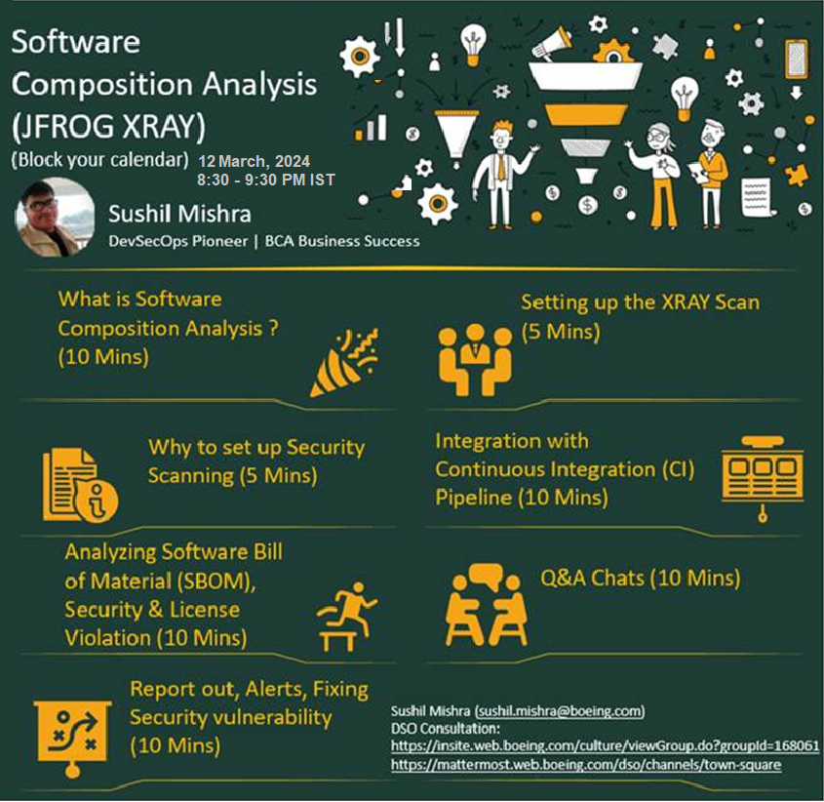

Slide 20
AUTOMATION PROGRESS

Slide 21




Automation 2024
Implement automation capabilities through out the applications and achieve 140000 automation hours
OKR
Objective
Accomplishments:
Automate repetitive processes
Automation hours of 17423 Hrs has been accounted in the CoP.
Capture automation to Return On Investment.
Knowledge sharing and bring culture of Automation

Slide 22
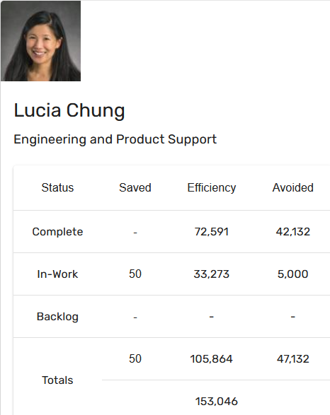
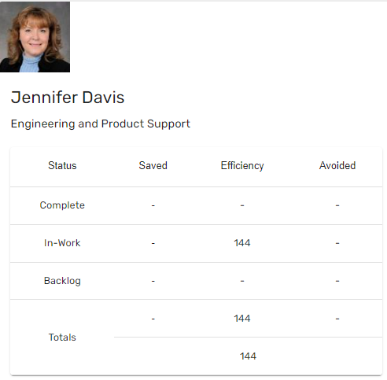
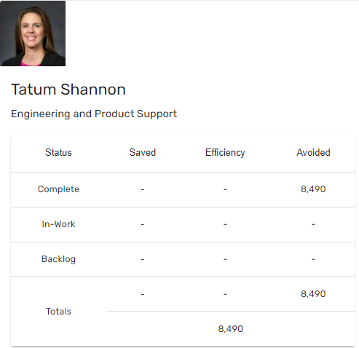
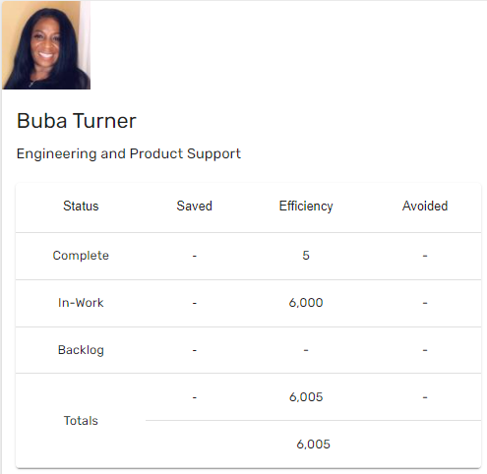
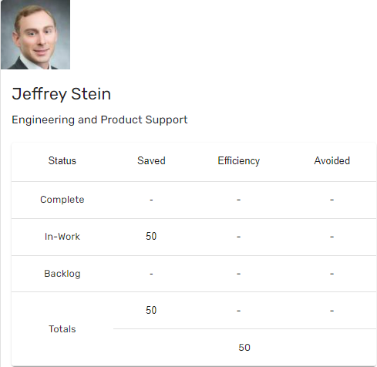
Automation Status - 2024
Target: 140k hrs
Current status: 17.4k hrs
Total : 17423 hours
11224
11224
11224

Slide 23
Training and references

Slide 24
Training and support
Automation COP
https://devsecops.web.boeing.com/index.html [DevSecOps Enterprise Website]
Training:
https://devsecops.web.boeing.com/trainings.html
https://insite.web.boeing.com/culture/viewMedia.do?mediaId=428840
Insite: DevSecOps related video series
Degreed: https://degreed.com/pathway/mpl66o5r9d/pathway
Oreilly: https://learning.oreilly.com/library/view/the-devops-handbook/9781457191381/
Enterprise Support
In case of any queries interested teams can register themselves through EMC (check for the session with the name “DevSecOps Office Hours (India)”).
For Product Teams in US, Click Here to block your slot
For Product Teams in India, Click Here to block your slot
DSO Support Systems | Description | URL
ATOMS | Platform to onboard to some of the commonly used tools like Coverity, Netsparker, SonarQube | https://atoms.web.boeing.com/home
ATOMS-CI | Saves your team time by generating an automated continuous integration pipeline and integrating different tools | https://atoms-ci.web.boeing.com/ci
DevSecOps | Official DevSecOps website | https://devsecops.web.boeing.com/index.html
AppDynamics | Monitoring tool documentation | https://itms.pages.boeing.com/wiki/appdynamics/
Enablement kit | Architecture Checklist to improve maturity | https://devsecops.web.boeing.com/assessment/enablementKit.html
DSO Mattermost channel | Join this channel for any questions/updates | https://mattermost.web.boeing.com/dso/channels/town-square
DSO Consultation | Connect with the experts | DL DSO Consulting
DSO COE InSite Group | Join this group for any questions/updates | https://insite.web.boeing.com/culture/viewGroup.do?groupId=168061
DevSecOps Video Library | Videos on different implementation | https://insite.web.boeing.com/culture/displayGroupMedia.do?groupId=168061

Slide 25
Assessment Process
DevSecOps Assessment Process Flow (Swimlane)
Please refer to the attached PDF.
GSEP Process for Dashboard Access
Please use the link to get access to the assessment dashboard. This is an auto approval process. Please select the first option for Business Stakeholder group.
Try to access this Dashboard Link after few minutes.
Info center Dashboard Link
Refer attached excel for pending reassessments and assessments.

Slide 26
Contact us
 | DRI | Project Management | Core Team Focal | Enterprise collaboration
DevSecOps | Abhishek Singh Kenneth C Shew | Kolhar Laxmidevi Kumar Anand | Singh, Abhishek K Valiyarayil, Siby Nair, Aathira Manikandan P, Ashwini Amaragatti, Sharanappa Balraj, Bharath K Fink (US), Brendan A Ghosh, Subhabrata H D, Sarika Jenkins (US), Renee M Jha, Ravi N K L, Bharath Kandan, Narendran Kaur, Harmeet Kumar, Abhishek Kumar, Rahul Malik (US), Muhammad A Mohiddin Basha, Mahammed Gulam Nadampalli Kumarraju, Lavanya Padmanaban Shunmugam, Nihila Pattanaik, Anup K Popeck (US), John Prabhat, Kumar Prakash, Sumit Radhakrishnan, Chinjumol Rompicherla, Rakesh Rooge, Padma Prasad Singh, Omji Kunjbihari Urimindi, Sreenivasulu Varghese, Jessy DL Product Systems - DevSecOps Core Team | Sharina Haynes Karthik Tirukkoylur Sekhar Dolly Bhaskara Sushil Mishra Donald R Wellington DL DSO DRIs
Automation | Kenneth C Shew Naga Harsha Kaggallu | Priyanka Dhanpal Chougule

Slide 27
Thank You

