Slide 1
DevSecOps & Automation – EP&S Monthly Report Out - October 2023

Slide 2
CONTENTS
Vision
2023 DevSecOps Progress
DSO Status per director
Case Study for Success Story
Automation Progress
Training and references

Slide 3




Vision
Implement Lean practices through DSO maturity coverage and IT Automation.
Increased operating speed and flexibility, release-on-demand, and first-time quality of secure-by-design applications.
Reduced hours and improved efficiency through automation

Slide 4
2023 DevSecOps progress

Slide 5
DevSecOps 2023
OKR
Implement Lean practices through DSO maturity coverage for 70% of High ROI products
Target
Complete DSO Assessments for new applications 120 Apps
[Overall – 280 apps (~30%) ]
Re-Assessments - 40 apps
Implementation roadmap for 40% Applications - 120 apps
[Overall – 200 (~20%) ]
Improved overall maturity to 3.0 from 2.8. Focus on High ROI and business critical Applications.
ROI Calculation - 50 Apps

Slide 6
Progress
On Track
Watch Item
Off Track
2023 OKR Targets
Q1
Q2
Q3
Q4
Target
Completed
Target
Completed
Target
Completed
Target
Completed
Complete DSO Assessments for new applications 120 Apps
21
30
34
30
25 + 60 AMaaS
30
8
30
Implementation roadmap for Applications that have completed assessments- 90 Apps
13
30
28
30
21 + 57 AMaaS
30
4
30
Roadmap implementation , Re-Assessment & ROI calculation for 15% Apps with roadmap created: - 40 apps
15
10
0
10
4
10
13
20
*DSO Improvements pending
**Q4- QBR Focus**
Maturity improvement and maintain Score 3.0+
Maturity Score 3
Maturity Score 3
Maturity Score 3.0 (Non-AMaaS)
Overall Score with AMaaS 2.82
Maturity Score 3.0 (Non-AMaaS)
Overall Score with AMaaS 2.82

Slide 7
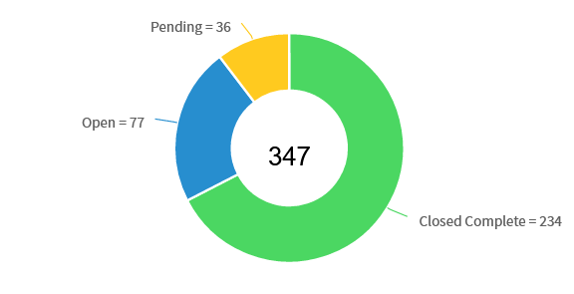
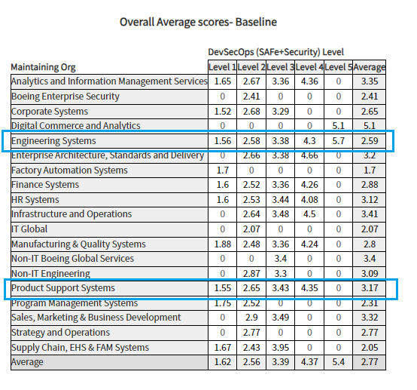
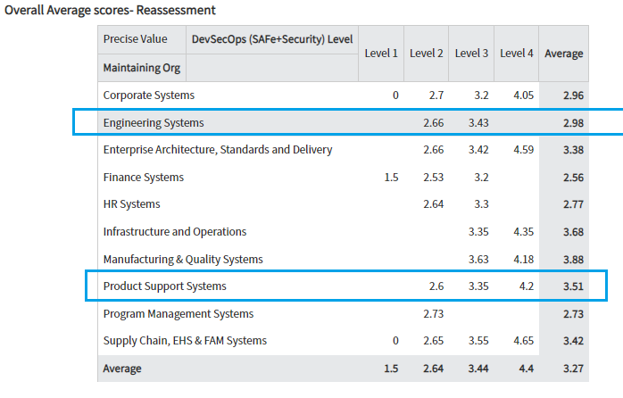
Assessment progress

Slide 8
Look Ahead
Prioritize the application list for 2024 and initiate assessment for all the applications.
Working on strategy and best practices of DevSecOps for supporting Tech Debt
and Compliance.
Focus on re-assessment for improved DevSecOps maturity and automations savings.
Bringing success stories, case study and training for application teams.
Tableau dashboard rollout with integrated view from Infocenter and GSEP.
Continued lunch and learn sessions

Slide 9
Look Ahead Strategy
Key Objectives
Product Efficiency
Compliance
Tech Debt
Compute
DevSecOps & Automation
Application Roadmap
/retirement
Cloud
Look product at holistically and bring maturity and efficiency
Identify problem statement in product capabilities
Leverage DevSecOps and Automation best practices for solving problem

Slide 10
DSO STATUS PER DIRECTOR( till Oct 2023)

Slide 11
Engineering Products(Jennifer)
On Track
Watch Item
Off Track
65
** Reassessment target for 2023 – 10

Slide 12
Engineering Products (Tatum)
On Track
Watch Item
Off Track
87
**Reassessment target for 2023 – 10

Slide 13
Engineering Products (Buba)
On Track
Watch Item
Off Track
30
**Reassessment target for 2023 – 10

Slide 14
Engineering Products (Jeff)
On Track
Watch Item
Off Track
29
**Reassessment target for 2023 – 10

Slide 15
HELP REQUIRED
** Completion of the reassessments as per QBR 2023 targets.
Completing the pending assessment and roadmap. Many applications are not started
assessments completed over 3 months duration.
Refer attached excel for pending reassessments and assessments.

Slide 16
AUTOMATION PROGRESS

Slide 17




Automation 2023
Implement automation capabilities through out the applications and achieve 80000 automation hours
OKR
Objective
Accomplishments:
Automate repetitive processes
Automation hours of 167350 has been accounted in the CoP.
Capture automation to Return On Investment.
Knowledge sharing and bring culture of Automation

Slide 18
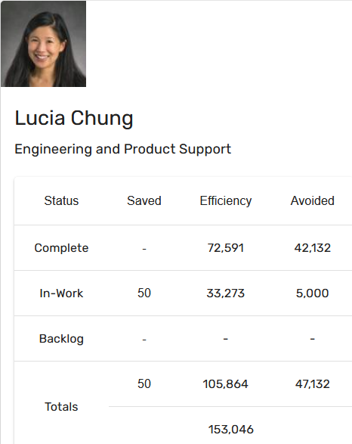
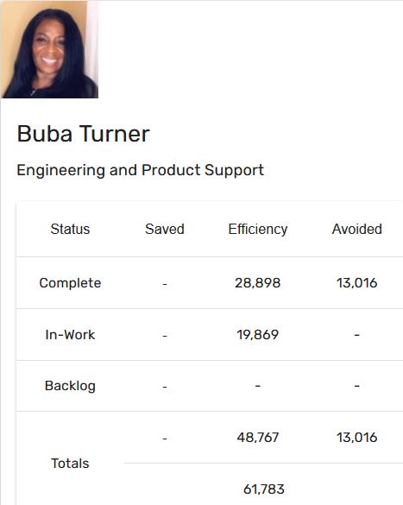
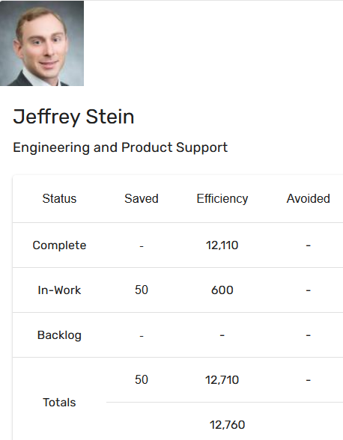
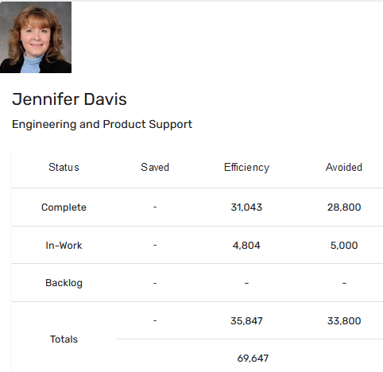
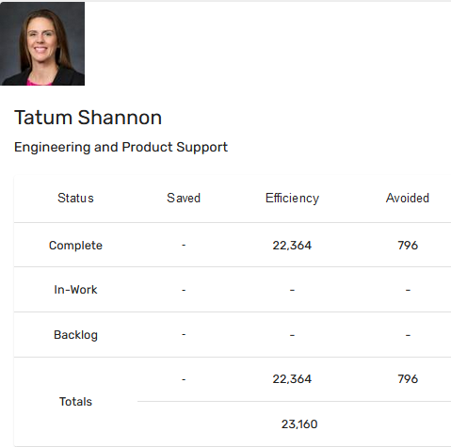
Automation Status - 2023
Target: 80k hrs
Current status: 167k hrs
Total : 167,350 hours

Slide 19
Training and references

Slide 20
Training and support
Automation COP
https://devsecops.web.boeing.com/index.html [DevSecOps Enterprise Website]
Training:
https://devsecops.web.boeing.com/trainings.html
https://insite.web.boeing.com/culture/viewMedia.do?mediaId=428840
Insite: DevSecOps related video series
Degreed: https://degreed.com/pathway/mpl66o5r9d/pathway
Oreilly: https://learning.oreilly.com/library/view/the-devops-handbook/9781457191381/
Enterprise Support
In case of any queries interested teams can register themselves through EMC (check for the session with the name “DevSecOps Office Hours (India)”).
For Product Teams in US, Click Here to block your slot
For Product Teams in India, Click Here to block your slot
DSO Support Systems | Description | URL
ATOMS | Platform to onboard to some of the commonly used tools like Coverity, Netsparker, SonarQube | https://atoms.web.boeing.com/home
ATOMS-CI | Saves your team time by generating an automated continuous integration pipeline and integrating different tools | https://atoms-ci.web.boeing.com/ci
DevSecOps | Official DevSecOps website | https://devsecops.web.boeing.com/index.html
AppDynamics | Monitoring tool documentation | https://itms.pages.boeing.com/wiki/appdynamics/
Enablement kit | Architecture Checklist to improve maturity | https://devsecops.web.boeing.com/assessment/enablementKit.html
DSO Mattermost channel | Join this channel for any questions/updates | https://mattermost.web.boeing.com/dso/channels/town-square
DSO Consultation | Connect with the experts | DL DSO Consulting
DSO COE InSite Group | Join this group for any questions/updates | https://insite.web.boeing.com/culture/viewGroup.do?groupId=168061
DevSecOps Video Library | Videos on different implementation | https://insite.web.boeing.com/culture/displayGroupMedia.do?groupId=168061

Slide 21
Assessment Process
DevSecOps Assessment Process Flow (Swimlane)
Please refer to the attached PDF.
GSEP Process for Dashboard Access
Please use the link to get access to the assessment dashboard. This is an auto approval process. Please select the first option for Business Stakeholder group.
Try to access this Dashboard Link after few minutes.
Info center Dashboard Link

Slide 22
Contact us
 | DRI | Project Management | Core Team Focal | Enterprise collaboration
DevSecOps | Abhishek Singh Kenneth C Shew | Pramithi R Karimpanakkal | Singh, Abhishek K Valiyarayil, Siby Pattanaik, Anup K Ammata, Sudhakar Bakhedi, Bharati Bahubali Balraj, Bharath K Ghosh, Saikat Ghosh, Subhabrata Gundupalli, Rajesh Reddy H D, Sarika K L, Bharath Karri, Ram Sai K-R, Rahul Kuriakose, Tintu M Kurian, Abhijith Kuruba Chandra Kumar Mistry, Ashok Nagaraju, Ganesh Nagziriya, Anshika Nair, Aathira Manikandan Padmanaban Shunmugam, Nihila Abhishek Kumar Prabhat, Kumar Radhakrishnan, Chinjumol Reddy, V Sanjeev Rompicherla, Rakesh Sawant, Swapnil Ravindra Varghese, Jessy Vinukonda, Basha Jayanta Mondal DL Product Systems - DevSecOps Core Team | Karthik Tirukkoylur Sekhar Dolly Bhaskara Arun Prakash Jeyaprakash Anandapadmanabhan Gopalakrishnan Sushil Mishra Donald R Wellington DL DSO DRIs
Automation | Kenneth C Shew Naga Harsha Kaggallu | Priyanka Dhanpal Chougule

Slide 23
Thank You

