Slide 1
DevSecOps & Automation – EP&S Monthly Report Out - November 2023

Slide 2
CONTENTS
Vision
2023 DevSecOps Progress
DSO Status per director
Case Study for Success Story
Automation Progress
Training and references

Slide 3




Vision
Implement Lean practices through DSO maturity coverage and IT Automation.
Increased operating speed and flexibility, release-on-demand, and first-time quality of secure-by-design applications.
Reduced hours and improved efficiency through automation

Slide 4
2023 DevSecOps progress

Slide 5
DevSecOps 2023
OKR
Implement Lean practices through DSO maturity coverage for 70% of High ROI products
Target
Complete DSO Assessments for new applications 120 Apps
[Overall – 280 apps (~30%) ]
Re-Assessments - 40 apps
Implementation roadmap for 40% Applications - 120 apps
[Overall – 200 (~20%) ]
Improved overall maturity to 3.0 from 2.8. Focus on High ROI and business critical Applications.
ROI Calculation - 50 Apps

Slide 6
Progress
On Track
Watch Item
Off Track
2023 OKR Targets
Q1
Q2
Q3
Q4
Target
Completed
Target
Completed
Target
Completed
Target
Completed
Complete DSO Assessments for new applications 120 Apps
21
30
34
30
25 + 60 AMaaS
30
8
30
Implementation roadmap for Applications that have completed assessments- 90 Apps
13
30
28
30
21 + 57 AMaaS
30
4
30
Roadmap implementation , Re-Assessment & ROI calculation for 15% Apps with roadmap created: - 40 apps
15
10
0
10
4
10
13
20
*DSO Improvements pending
**Q4- QBR Focus**
Maturity improvement and maintain Score 3.0+
Maturity Score 3
Maturity Score 3
Maturity Score 3.0 (Non-AMaaS)
Overall Score with AMaaS 2.82
Maturity Score 3.0 (Non-AMaaS)
Overall Score with AMaaS 2.82

Slide 7
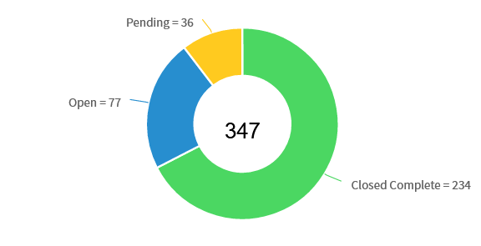
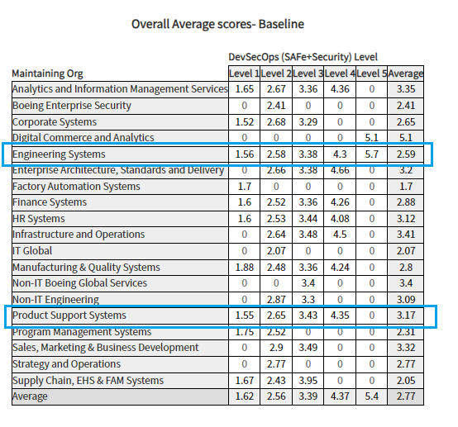
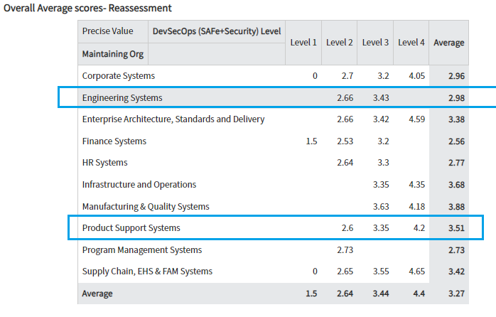
Assessment progress

Slide 8
Look Ahead
Prioritize the application list for 2024 and initiate assessment for all the applications.
Working on strategy and best practices of DevSecOps for supporting Tech Debt
and Compliance.
Focus on re-assessment for improved DevSecOps maturity and automations savings.
Bringing success stories, case study and training for application teams.
Tableau dashboard rollout with integrated view from Infocenter and GSEP.
Continued lunch and learn sessions

Slide 9
Engineering Products(Jennifer)
On Track
Watch Item
Off Track
65
** Reassessment target for 2023 – 10

Slide 10
Engineering Products (Tatum)
On Track
Watch Item
Off Track
87
**Reassessment target for 2023 – 10

Slide 11
Engineering Products (Buba)
On Track
Watch Item
Off Track
30
**Reassessment target for 2023 – 10

Slide 12
Engineering Products (Jeff)
On Track
Watch Item
Off Track
29
**Reassessment target for 2023 – 10

Slide 13
HELP REQUIRED
** Completion of the reassessments as per QBR 2023 targets.
Completing the pending assessment and roadmap. Many applications are not started
assessments completed over 3 months duration.
Refer attached excel for pending reassessments and assessments.

Slide 14
CASE STUDY For SUCCESS STORY

Slide 15


Savings identified after reassessment 2023
9512 Hrs. (As of Oct 2023)
27 Applications in pipeline for reassessment in 2023

Slide 16
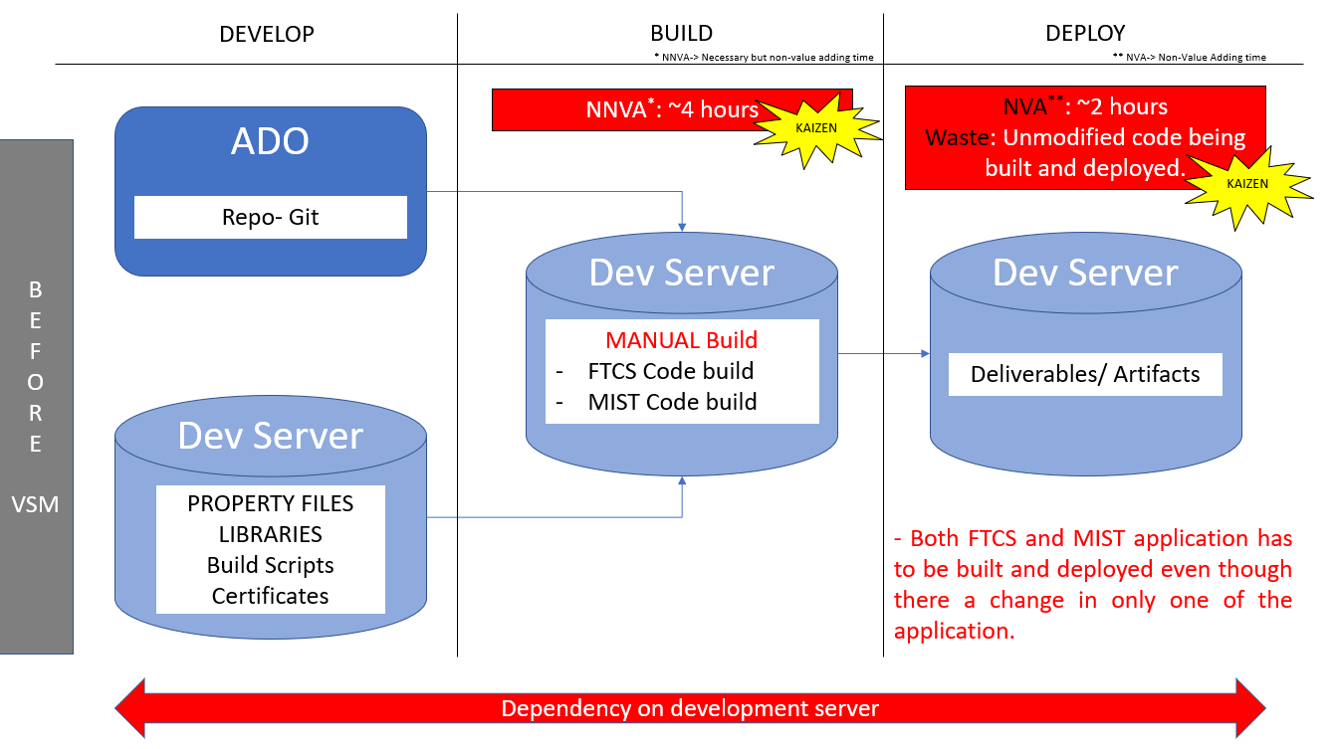
DSO improvement case study using vsm(Value stream mapping)
Challenges in Legacy apps (FTCS/MIST)
App code was in ADO and other dependencies
were maintained in dev server. Challenge in
tracking version for these dependencies.
As the apps are legacy the builds were manual
& tightly coupled.
Small change in any files required complete
shutdown of entire app for 4 hours.
Redundancy – Some Configuration files were
available in different/duplicate locations. Overhead
in maintaining.
Too much idle time and Waste - Unmodified
code being built and deployed.

Slide 17
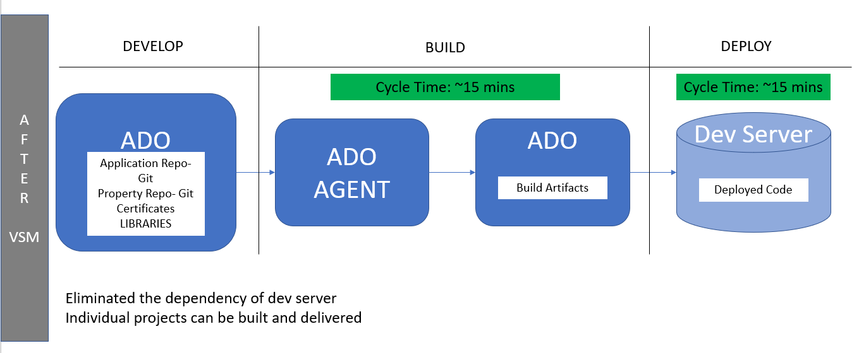
DSO improvement case study using vsm (Value stream mapping)
Mitigating challenges in legacy apps
Migrating app code and other dependencies at to
one place in ADO. Eliminated the dependency of
DEV server during build.
Maintaining and versioning of config files are now
easy with GIT support. Redundancy and overhead is
reduced.
Build process was automated using ADO build
agents, reducing the waste and downtime of the
applications. Need to rebuild unmodified apps is
eliminated by reuse of artifacts from previous build.
Configuration changes (like DB credentials,
WSSO config changes etc) are implemented by
server restarts than build and deploy.
“Build Once; Deploy Anywhere” strategy adopted
with the help of CI-CD implementation.

Slide 18
AUTOMATION PROGRESS

Slide 19




Automation 2023
Implement automation capabilities through out the applications and achieve 80000 automation hours
OKR
Objective
Accomplishments:
Automate repetitive processes
Automation hours of 184270 has been accounted in the CoP.
Capture automation to Return On Investment.
Knowledge sharing and bring culture of Automation

Slide 20
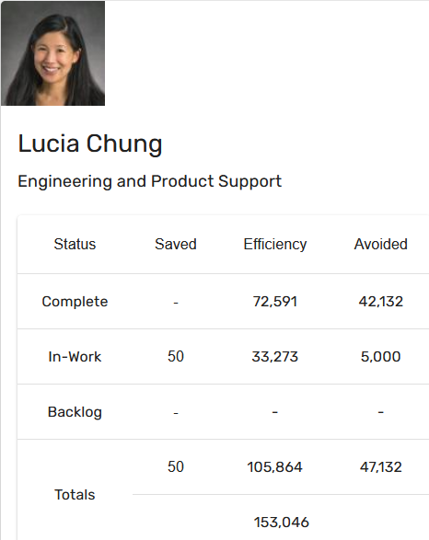
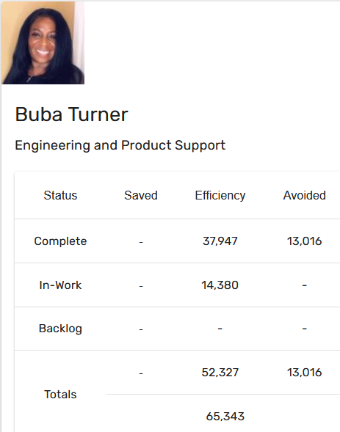
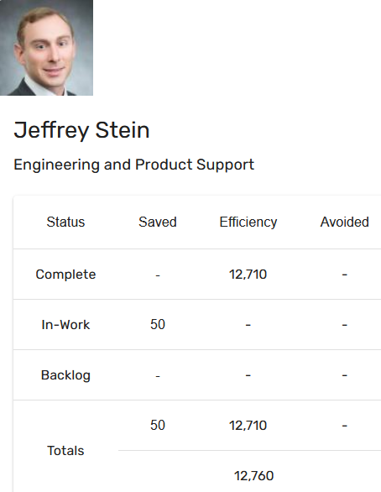
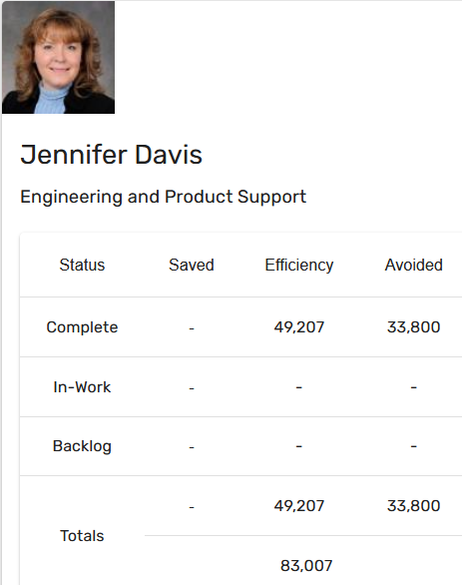
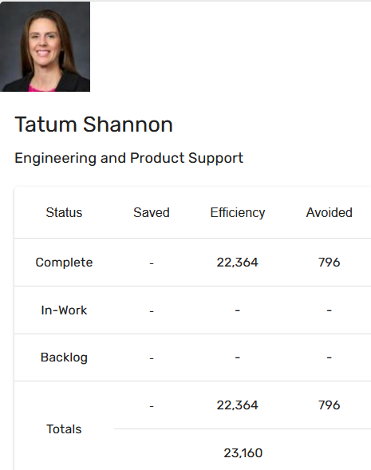
Automation Status - 2023
Target: 80k hrs
Current status: 184k hrs
Total : 184270 hours

Slide 21
Success STORIES
BAM Project: Use of Azure Virtual Machines to deliver agile computing solutions - utilizing Enterprise Cloud Solutions virtual machines to facilitate high priority additive manufacturing work on BDS and Intelligence Center assignments. These requirements would previously be fulfilled by ordering high-cost hardware or upgrades which usually took weeks to arrive after a lengthy approval process. Our team has the autonomy and capability to deploy right-sized virtual machines same-day with the correct amount of processing power targeted to each specific use case. Once the assignments are completed, we can downsize or suspend the virtual machine to save on hosting costs.
BAM IT leveraged an existing system (CAS-MFT) to fully automate large BAM data file transfer from external suppliers/partners/customers into the Data Library and Digital Thread. Data can now be transferred in HOURS instead of WEEKS. External entities drag and drop their data into Boeing’s CAS-MFT secure drop box , and the BAM data is ingested automatically into the Data Library for inclusion in the BAM Digital Thread. BAM is more likely to collect external data given the streamlined process, and the data is available sooner for analysis and analytics.
Modernize BAM data collection: This data connectivity is used by which eliminated downtime, enabled labor efficiency, and enables faster access to data for follow on analysis (e.g. for machine qualification and certification). Benefits include: elimination of manual data retrieval (~$1.4M over 3 years); internal wait time reduction for data (~3-7 days to ~2 hrs, 95% reduction); external wait time reduction for data (~87%); machine down time avoidance from data overload (86% improvement)

Slide 22
Training and references

Slide 23
Training and support
Automation COP
https://devsecops.web.boeing.com/index.html [DevSecOps Enterprise Website]
Training:
https://devsecops.web.boeing.com/trainings.html
https://insite.web.boeing.com/culture/viewMedia.do?mediaId=428840
Insite: DevSecOps related video series
Degreed: https://degreed.com/pathway/mpl66o5r9d/pathway
Oreilly: https://learning.oreilly.com/library/view/the-devops-handbook/9781457191381/
Enterprise Support
In case of any queries interested teams can register themselves through EMC (check for the session with the name “DevSecOps Office Hours (India)”).
For Product Teams in US, Click Here to block your slot
For Product Teams in India, Click Here to block your slot
DSO Support Systems | Description | URL
ATOMS | Platform to onboard to some of the commonly used tools like Coverity, Netsparker, SonarQube | https://atoms.web.boeing.com/home
ATOMS-CI | Saves your team time by generating an automated continuous integration pipeline and integrating different tools | https://atoms-ci.web.boeing.com/ci
DevSecOps | Official DevSecOps website | https://devsecops.web.boeing.com/index.html
AppDynamics | Monitoring tool documentation | https://itms.pages.boeing.com/wiki/appdynamics/
Enablement kit | Architecture Checklist to improve maturity | https://devsecops.web.boeing.com/assessment/enablementKit.html
DSO Mattermost channel | Join this channel for any questions/updates | https://mattermost.web.boeing.com/dso/channels/town-square
DSO Consultation | Connect with the experts | DL DSO Consulting
DSO COE InSite Group | Join this group for any questions/updates | https://insite.web.boeing.com/culture/viewGroup.do?groupId=168061
DevSecOps Video Library | Videos on different implementation | https://insite.web.boeing.com/culture/displayGroupMedia.do?groupId=168061

Slide 24
Assessment Process
DevSecOps Assessment Process Flow (Swimlane)
Please refer to the attached PDF.
GSEP Process for Dashboard Access
Please use the link to get access to the assessment dashboard. This is an auto approval process. Please select the first option for Business Stakeholder group.
Try to access this Dashboard Link after few minutes.
Info center Dashboard Link

Slide 25
Contact us
 | DRI | Project Management | Core Team Focal | Enterprise collaboration
DevSecOps | Abhishek Singh Kenneth C Shew | Kolhar Laxmidevi Kumar Anand | Singh, Abhishek K Valiyarayil, Siby Pattanaik, Anup K Ammata, Sudhakar Bakhedi, Bharati Bahubali Balraj, Bharath K Ghosh, Saikat Ghosh, Subhabrata Gundupalli, Rajesh Reddy H D, Sarika K L, Bharath Karri, Ram Sai K-R, Rahul Kuriakose, Tintu M Kurian, Abhijith Kuruba Chandra Kumar Mistry, Ashok Nagaraju, Ganesh Nagziriya, Anshika Nair, Aathira Manikandan Padmanaban Shunmugam, Nihila Abhishek Kumar Prabhat, Kumar Radhakrishnan, Chinjumol Reddy, V Sanjeev Rompicherla, Rakesh Sawant, Swapnil Ravindra Varghese, Jessy Vinukonda, Basha Jayanta Mondal DL Product Systems - DevSecOps Core Team | Karthik Tirukkoylur Sekhar Dolly Bhaskara Arun Prakash Jeyaprakash Anandapadmanabhan Gopalakrishnan Sushil Mishra Donald R Wellington DL DSO DRIs
Automation | Kenneth C Shew Naga Harsha Kaggallu | Priyanka Dhanpal Chougule

Slide 26
Look Ahead Strategy
Key Objectives
Product Efficiency
Compliance
Tech Debt
Compute
DevSecOps & Automation
Application Roadmap
/retirement
Cloud
Look product at holistically and bring maturity and efficiency
Identify problem statement in product capabilities
Leverage DevSecOps and Automation best practices for solving problem

Slide 27
DSO STATUS PER DIRECTOR( till NOV 2023)

Slide 28
Thank You

Slide 29
RE-AssessMENT STATUS
On Track
Watch Item
Off Track

Slide 30
RE-AssessMENT STATUS
On Track
Watch Item
Off Track

