Slide 1
FTCS Automated Pipeline
Sathwik
Niranjan
Prabhjyot
Sumit
Abhishek k
Chandran

Slide 2
FTCS Value Stream Mapping (VSM)
Backlog Grooming
Development
Test
Deliver
Requirements
Analysis
Build
Promote
Cycle Time
Touch Time
Lead Time
Cycle Time
Touch Time
Lead Time
Cycle Time
Touch Time
Lead Time
Cycle Time
Touch Time
Lead Time
Prioritization
Development
Coverity Scans
Source Code Prep
Cycle Time
Touch Time
Lead Time
Hand off
Hand off
Hand off
Cycle Time
Touch Time
Lead Time
Cycle Time
Touch Time
Lead Time
Cycle Time
Touch Time
Lead Time
DEV Testing
QA Testing
Checklist Prep
Cycle Time
Touch Time
Lead Time
Cycle Time
Touch Time
Lead Time
Cycle Time
Touch Time
Lead Time

Slide 3
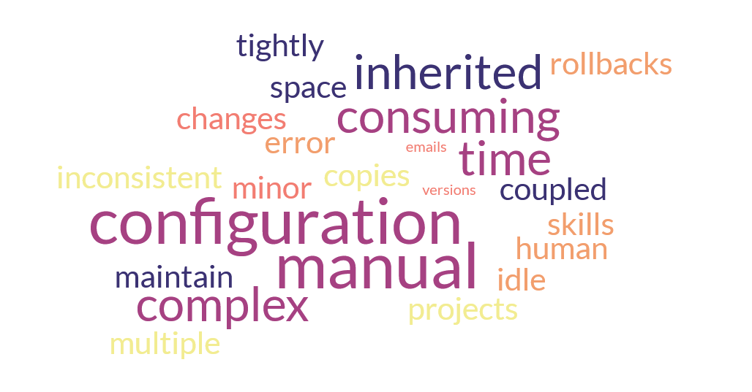
Key Issues

Slide 4

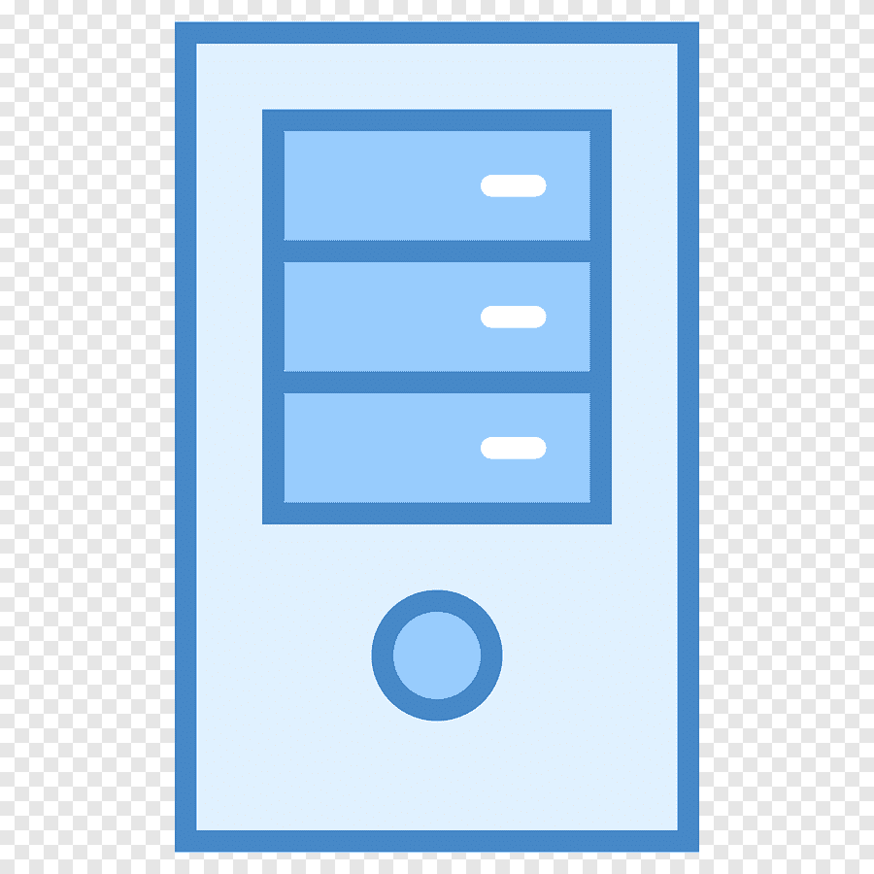
Existing Build & Deployment Process in FTCS
ADO REPO
APP Code
App Server
App Server
App Server
Manual Builds
Artifacts creation
Deployment
Config files
Properties
Libraries
Certificates etc

Slide 5
Disadvantages:
Multiple Build Cycles for Dev environments.
Manual builds and tightly coupled with application server.
A small change requires the redeployment of the entire monolith application.
Slower development speed.
Room for Human error.
Rollbacks aren’t easier.

Slide 6


Solution Approach
App Server
ADO Repo
ADO Agent
Build Artifactory
App Code
Builds the Repo
Artifacts are generated
Artifacts are stored here
Deployment

Slide 7
Key Benefits
Adopting the strategy of ‘Build once, deploy Anywhere’.
Reducing the complexity of Source code delivery
Closing in towards Cloud adoption
Reduced runtime of builds resulting in lesser application down time.
Language independent process.

Slide 8
WHY Configuration management
Configuration is the process of specifying and loading external values to the software application statically or dynamically. One such example is the database config which we typically provide in the property file and use different values for different environments like Dev, QA, and Production.
Current Configuration System Issues in FTCS:
Multiple versions of same configuration file (Repository/Server Location).
Difficult to manage the consistency and version history of configuration changes.
A small change requires the redeployment of the entire monolith application.
Slower development speed.
Environment specific folders

Slide 9
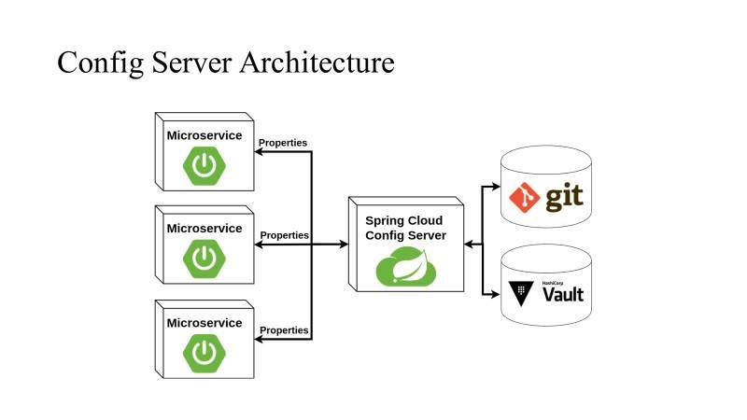
Solution Approach - Modern Applications

Slide 10
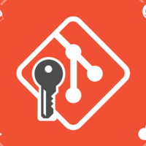
Pipeline for Configuration files
ADO Repo
ADO Agent
Build Artifactory
App Server
Config files
Properties
Certificates
Libraries etc
Builds the Repo
Artifacts are generated
Artifacts are stored here
Server restart

Slide 11
Key Benefits:
Configuration management is the automated process to manage all the configurations of different environments like Dev, QA, and Production.
Advantages:
Externalized
Configurations are Version controlled
Automated and standardized
Increased efficiency
Reduced application down time
Consistent
Efficient Management of sensitive information.

Slide 12
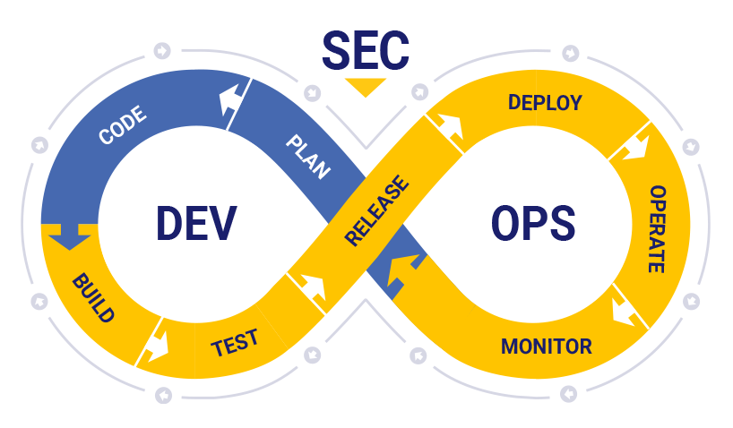
DevSecOps Success Story
After automating the CI/CD process the DSO maturity have improved from 34% to 46% and in turn made a significant savings of ~900 hours/year.
The success story is selected and published in DSO and automation monthly newsletter and shared among Engineering & Product Support division in May,2023.
Also published the DSO improvement Case study in the newsletter in October,2023.

Slide 13
Contact us
Application | Project Management | Core Team Focal | Architect Support
FTCS/MIST | Singh, Abhishek abhishek.singh5@boeing.com Vikram, Neha Aditya nehaaditya.vikram@boeing.com Neminathan, Chandran Jeyaram ChandranJeyaram.Neminathan@boeing.com Ganiger, Govindaraju S govindaraju.s.ganiger@boeing.com | Pati, Niranjana niranjana.pati2@boeing.com Singh, Abhishek K abhishek.k.singh@boeing.com Pancheti, Sathwik sathwik.pancheti@boeing.com Siddhu, Prabhjyot prabhjyot.siddhu@boeing.com P-R, Mercy P Mercy.P.P-R@boeing.com Chavan, Preeti preeti.chavan@boeing.com DL FTS FTCS India DL-FTSFTCSIndia@exchange.boeing.com | Dutta, Sumit sumit.dutta@boeing.com

Slide 14
Thank You

