Slide 1
PS Innovation Corner – An Overview

Slide 2


Explore PS Innovation Corner
Currently, QID submission is the way to submit an idea. This application helps you refine your idea before you go for QID submission.
Stakeholder
Scope for Idea Improvement
Innovation Corner ‘Get Idea Reviewed’ Feature:
Idea secured & visible to reviewers only
You (inventor)
Got an idea!
Want to improve idea before QID submission?
Yes
Submit your idea using
‘Get Idea Reviewed’
Improved idea!
No
PS Innovation Core Team + SME
Core Team assigns SME for guidance/mentorship to improve the idea
….
Idea review by SME + Support from Core Team & IPM Team
IPM Team
QID Submission on India QID submission SharePoint

Slide 3


Architecture Pattern
Client-Server software pattern in which user interface, application processing and data management
functions are physically separated and logically connected over network protocols
UI
Angular v9, Angular Material,Flex,BootStrap
Presentation Layer
Logic Layer
JDK v8, Spring Boot v2.3,
REST API, JWT
MySQL
Data Layer
Pivotal Cloud Foundry
Infrastructure Layer

Slide 4
Business Logic Layer
Actors – Reviewer and Idea inventor
Roles and responsibilities
Reviewer – Reviews Idea, Closes Idea…
Inventor - Submit idea, Fetch Idea, Edit idea..
Security
JWT (Analogous to OTP)
API Security
Method level security
Best Practices
Separate Profile for separate environments(Profiling)
Global exception handler and log retention

Slide 5
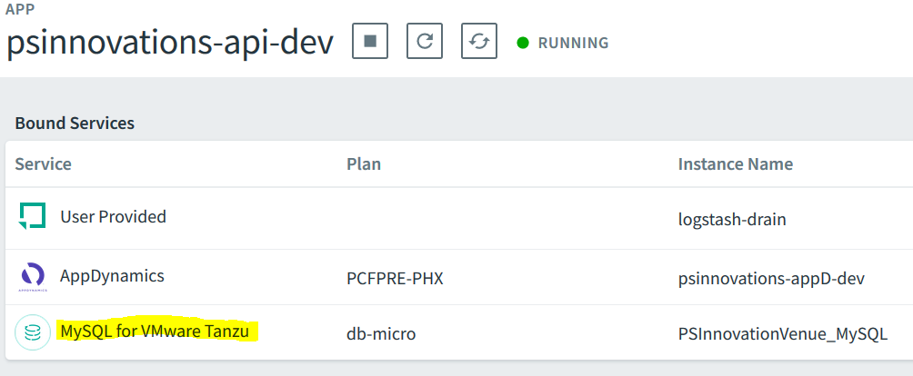
Data Layer
Data Layer of application comprises database/data storage system that stores all of the important
information that the application needs to deliver services to users

Slide 6
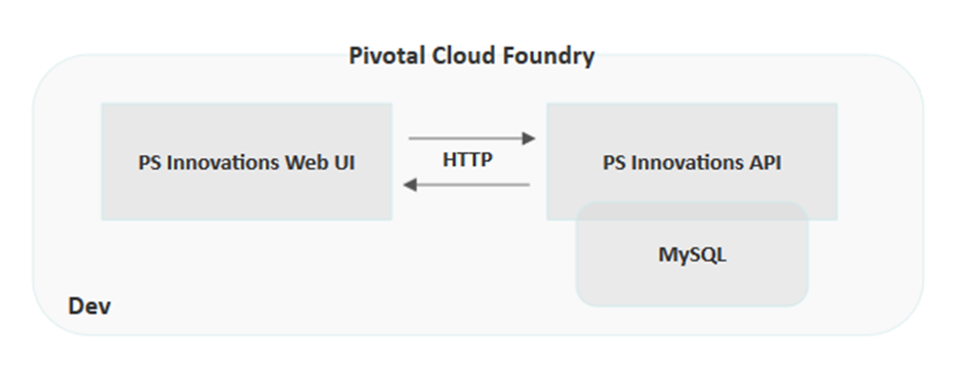
Application Infrastructure Layer
Application infrastructure includes all of the computational and operational infrastructure and components that are necessary to manage the development, deployment and management of enterprise applications.

Slide 7
Questions ?

Slide 8
Thank you
Thank you Abhishek Banerjee for the opportunity.
Shoutouts
Senior experts - Remya and Prashant
Dynamic Duo - Krupa and Niranjan
Young bloods and the future of tomorrow - Amitabh, Abhishek and Sathwik
Our Photography Champion - Ravi

