Slide 1
E-Play
Online Event creation and booking app.

Slide 2
Use Cases
Organiser can create events such as Movie , RSVP , Plays , Comedy shows etc.
User can book tickets for any ticketed event as well as accept or reject invitations of RSVP events.
User can get recommendations about the event based on his user profile( city, previous bookings, likes and his friends bookings).
It can solve seat blocking duration issue of different ticketing platforms.

Slide 3
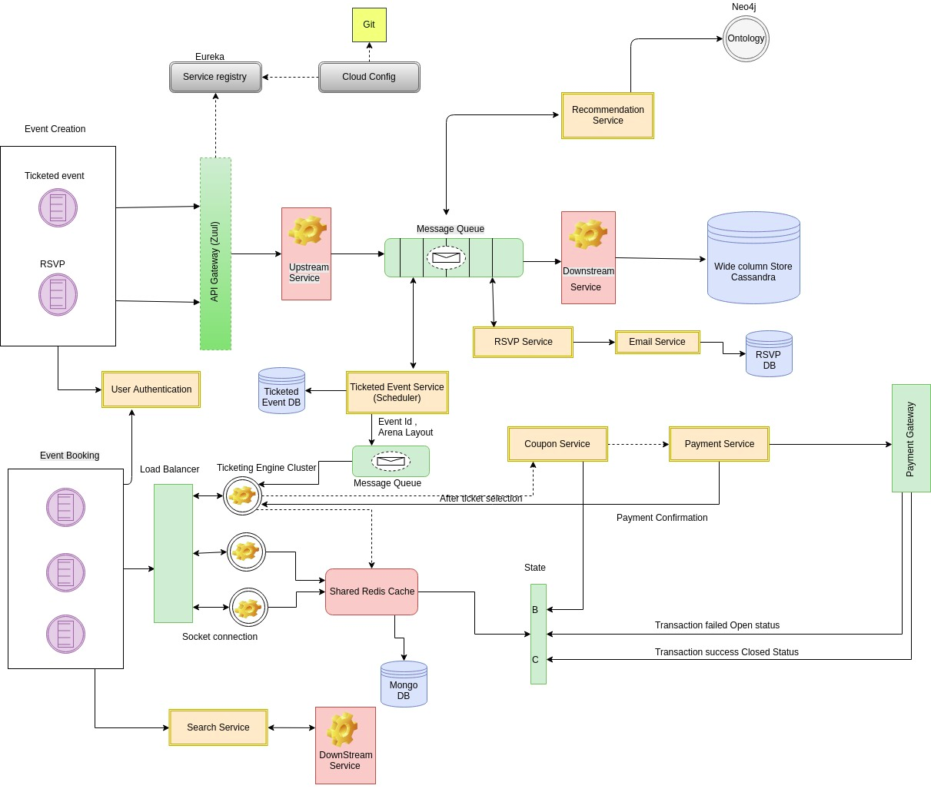
Architecture

Slide 4








Tech Stack

Slide 5
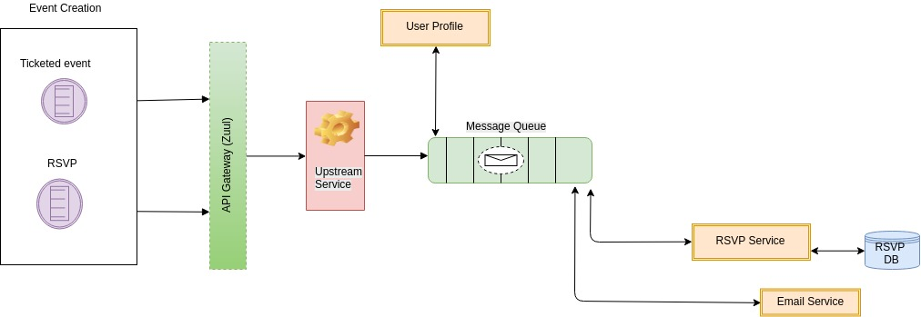
RSVP Architecture

