Slide 1
Spring to Spring boot Migration
--FTCS Applications

Slide 2
Contents
Introduction
Why migrate?
Advantages of spring boot
Applications chosen for migration and status
Migration steps
Concerns
Before and after migration
Demo contents

Slide 3
Spring and Spring boot
The Spring framework provides comprehensive infrastructure support for developing Java applications.
Spring Boot is basically an extension of the Spring framework, which eliminates the boilerplate configurations required for setting up a Spring application.
Spring Boot is not intended to replace Spring, but to make working with it faster and easier and more efficient development ecosystem

Slide 4
Why Migrate?
Cloud application : In order to make the application for cloud readiness it is important to satisfy the 12 factor principle.
Ant to Maven
Dev-ops build pipeline
Ant to Maven migration is taken care when the code is migrated from sping to spring boot. Additionally spring boots offers many other benefits.

Slide 5
Benefits of spring boot applications
Makes the application faster and easier for developers to create and test Java-based applications by providing a default setup for unit and integration tests.
Reduces development time and increases the overall productivity of the development team.
Helps you auto configure all components for a production-grade Spring application.
Avoids writing lots of boilerplate code, annotations, and XML configuration.
Comes with embedded HTTP servers like Tomcat or Jetty to test web applications.
Adds many plugins that developers can use to work with embedded.
Spring boot allows you to easily connect with database and queue services like Oracle, PostgreSQL, MySQL, MongoDB, Redis, Solr, ElasticSearch, Rabbit MQ, ActiveMQ,

Slide 6
Applications chosen Migration and Current status
S.No | Project | Status | Remark
1. | EnterpriseOauthClient | Completed | Integration testing is pending.
2 | EnterpriseOauthResource | Completed | Integration testing is pending.
3 | MDLParser | Completed | Integration testing is pending.
4 | MISTWebApp | Completed | Integration testing is pending.
5 | CommonWebServices | Completed | Needs to be tested with DB
6 | MISTFTCS services | In Progress
7 | Orbeon | In Progress
8 | Standalone | Not started
9 | Part II services | Not started

Slide 7
Steps followed for the Migration
Step 1: Migrated To SpringBoot - Analyzed Dependency
Step 2: Updated Maven Dependency.
Step 3: Converted all XML configurations to Java annotations.
Step 4: Deploy in local Tomcat and test it.
Step 5: Created Build Pipeline, auto trigger on every commit to Dev branch
Step 6: Created Release pipeline on PCF for successful builds

Slide 8
Concerns
Non availability of dependencies in SRES
Space constraints issue on of PCF

Slide 9
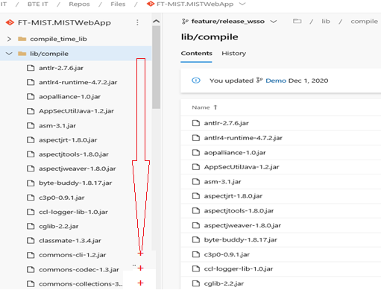
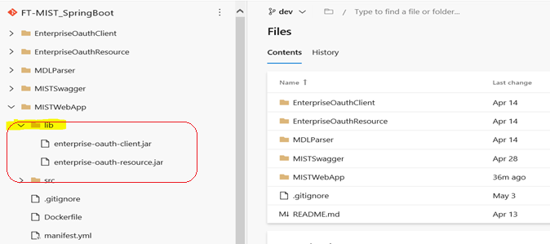
MISTWebApp library folder before Migration
MISTWebApp library folder after Migration

Slide 10
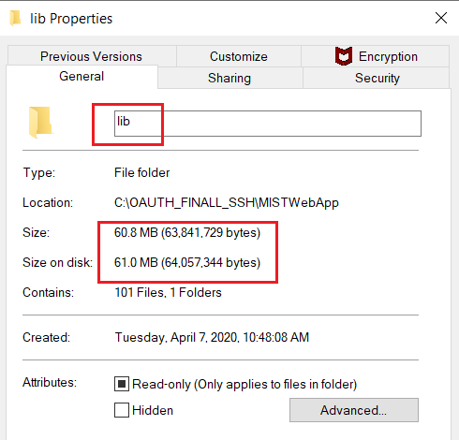
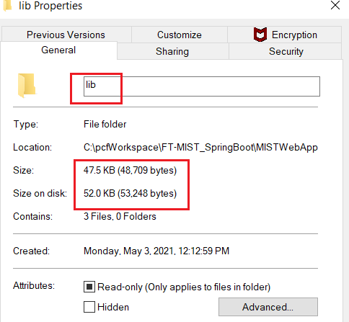
MISTWebApp library size folder before Migration
MISTWebApp library size folder after Migration

Slide 11
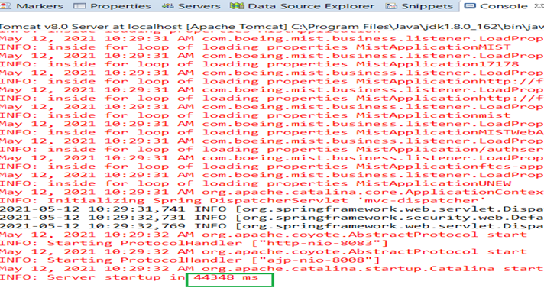
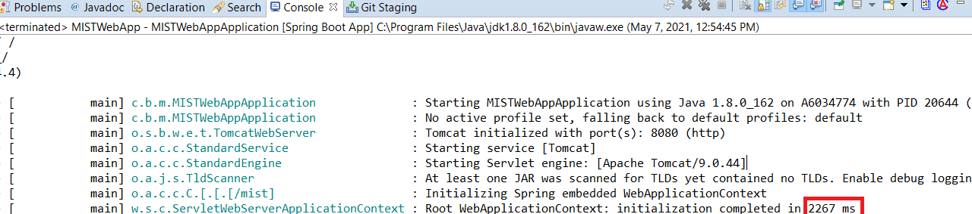
Application start up time before Migration
Application start up time after
Migration
~20x faster

Slide 12
1. Launching MIST application in PCF https://mistwebapp-dev.apps.pcfpre-phx.cloud.boeing.com/mist/home 2. Opening MIST swagger https://mistwebapp-dev.apps.pcfpre-phx.cloud.boeing.com/mist/swagger-ui/index.html?configUrl=/mist/api-docs/swagger-config 3. Make the changes in the application and demo build and release pipeline
Demo contents

Slide 13
Thank you

