Slide 1





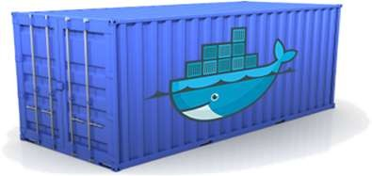





Containers
Containers are an executable unit of software in which application code is packaged, along with its libraries, dependencies and related configuration files, in common ways so that it can be run anywhere, whether it be on desktop, traditional IT infrastructure, or the cloud.
Static website
User DB
Web frontend
Queue
Analytics DB
Build once, run anywhere
Configure once, run anything
Development VM
QA Server
Data Centers
Public Cloud
Production Cluster
Build, Ship and Run

Slide 2
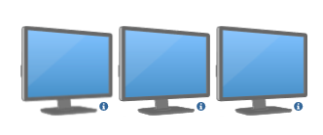

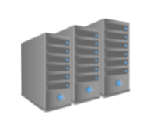
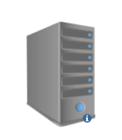
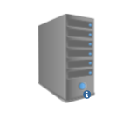


Evolution of Containerization
Say, you have three different Java based application that you plan to host it. Each of these application make use of different versions of Java as well as associated libraries and dependencies, differ from one application to application.
Traditional Model
Virtualization
Containerization
Dev Team
Dev Team
Dev Team
Ops Team
Ops Team
Ops Team

Slide 3
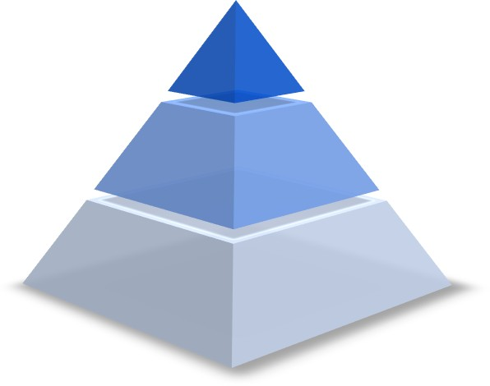
Who sees the benefit?
Management
Cost effective
Faster time to market
Happy engineers
Ops Team
Configure once, run anything
Eliminate inconsistencies between the IT environment
Improves speed and reliability of CI/CD
Developers
Build once, run anywhere
Environment standardization for the entire application lifecycle
No headaches in installing bunch of compatible versions of s/w

Slide 4
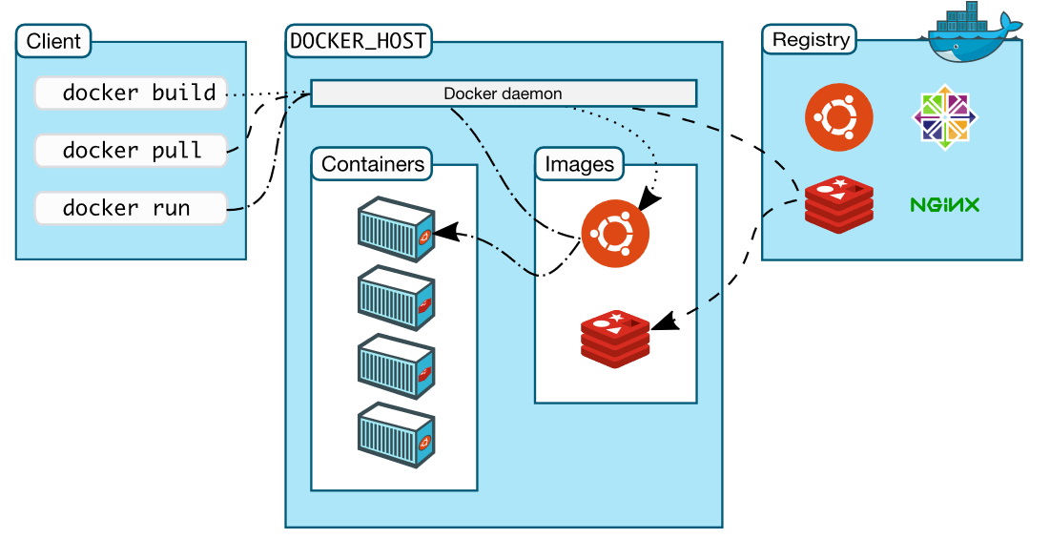
Docker Architecture
Docker user client-server architecture with these major components,
  Docker Client
  Docker daemon
  Docker Registry

Slide 5
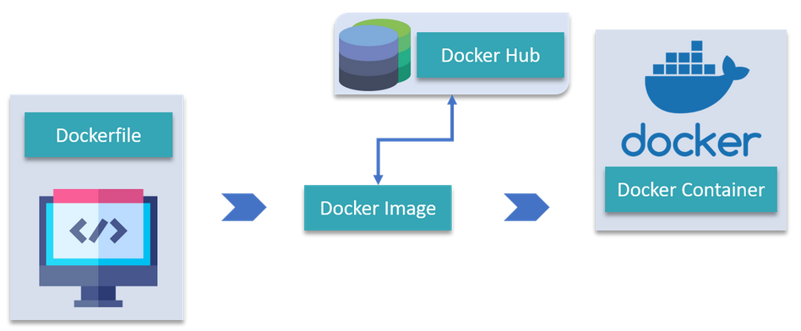
Docker Objects
DockerFile :
A Dockerfile is a text document which contains all the commands that a user can call on the command line to assemble an image. So, Docker can build images automatically by reading the instructions from a Dockerfile.
Images :
Images are nothing but a template which is used to create Docker containers. It also contain metadata that describe the container's capabilities and needs.
Containers :
Docker Container is a running instance of a Docker Image and they hold the entire package needed to run the application.
Pull/Push
Build
Run

Slide 6
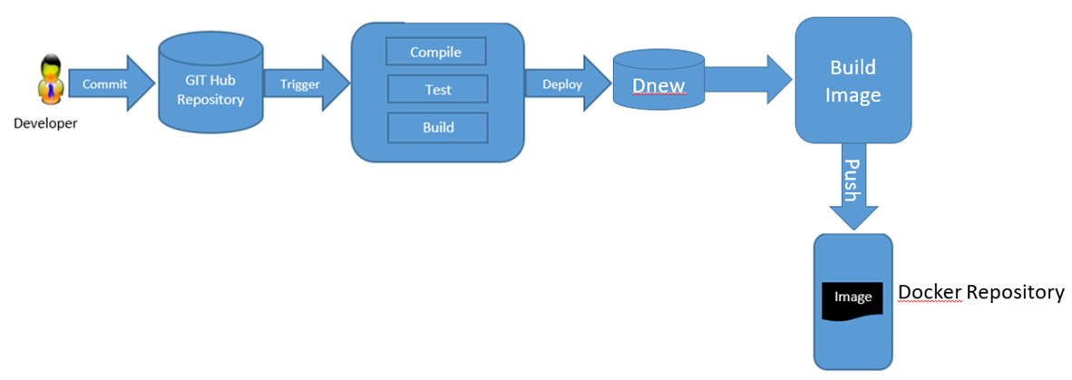
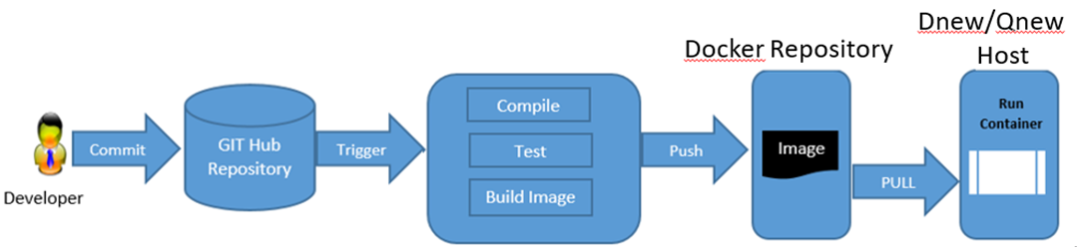
Continuous Integration – Push Docker image
Continuos Integration – Push Docker image & deploy in container

