Slide 1
CSEAM531P Machine Learning
LCA Course

Slide 2
Unit-1 Introduction to ML
Machine Learning, Types of Machine Learning, ML Workflow, Key Concepts: - Bias-Variance trade-off, Overfitting and Under fitting, Dataset Types :-Structured vs. Unstructured Data, Imbalanced Data Handling- Oversampling, Under sampling, SMOTE , Data Pre-processing:- Handling Missing Data, Data Scaling - Normalization & Standardization, Categorical Encoding- One-Hot, Label Encoding & Target Encoding. Applications of Machine Learning.
LAB
Experiment 1: Program to balance an imbalanced dataset using the SMOTE technique. Load a sample dataset, check class distribution, apply SMOTE, and verify the new distribution.
Experiment 2: Program to handle missing data using mean imputation and encode categorical columns using one-hot encoding.

Slide 3
Machine Learning, Types of Machine Learning, ML Workflow, Key Concepts: - Bias-Variance trade-off, Overfitting and Under fitting,

Slide 4
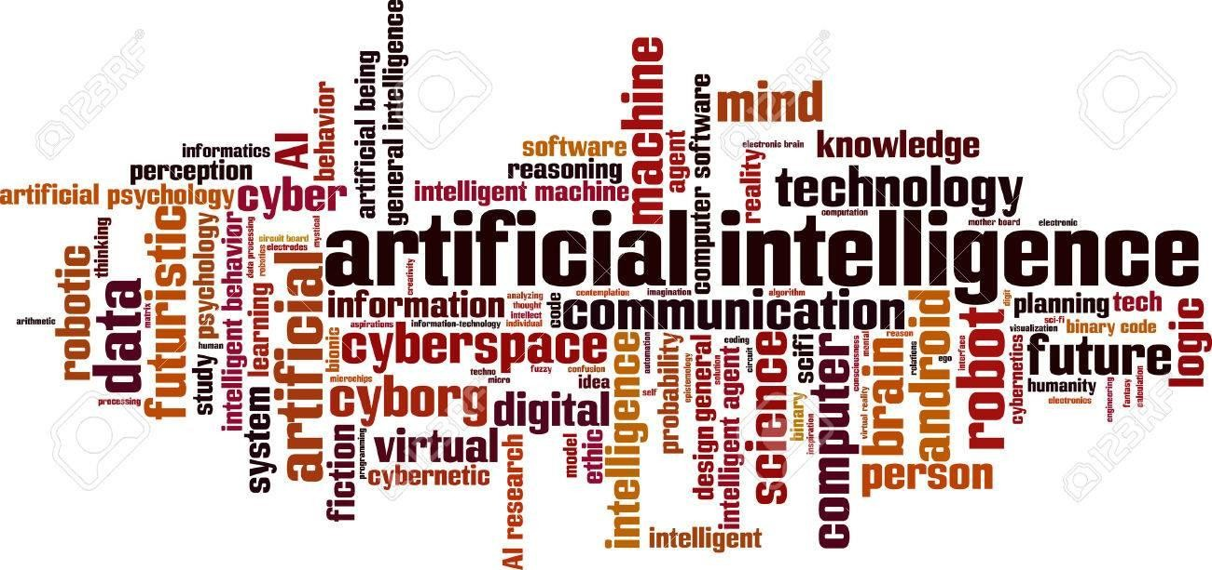
What is Artificial Intelligence(AI)?
Artificial intelligence (AI) is a wide-ranging branch of computer science concerned with building smart machines capable of performing tasks that typically require human intelligence.
Artificial intelligence is the simulation of human intelligence processes by machines, especially computer systems.
Artificial intelligence leverages computers and machines to mimic the problem-solving and decision-making capabilities of the human mind.

Slide 5
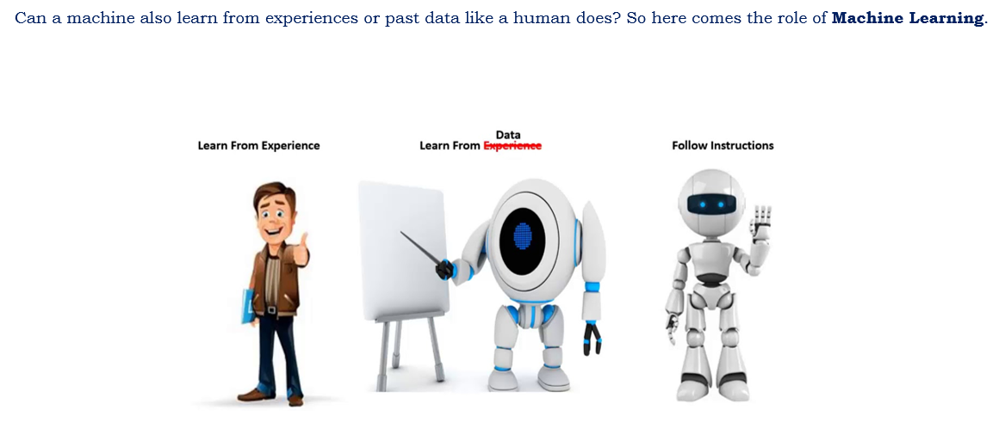
Machine Learning

Slide 6
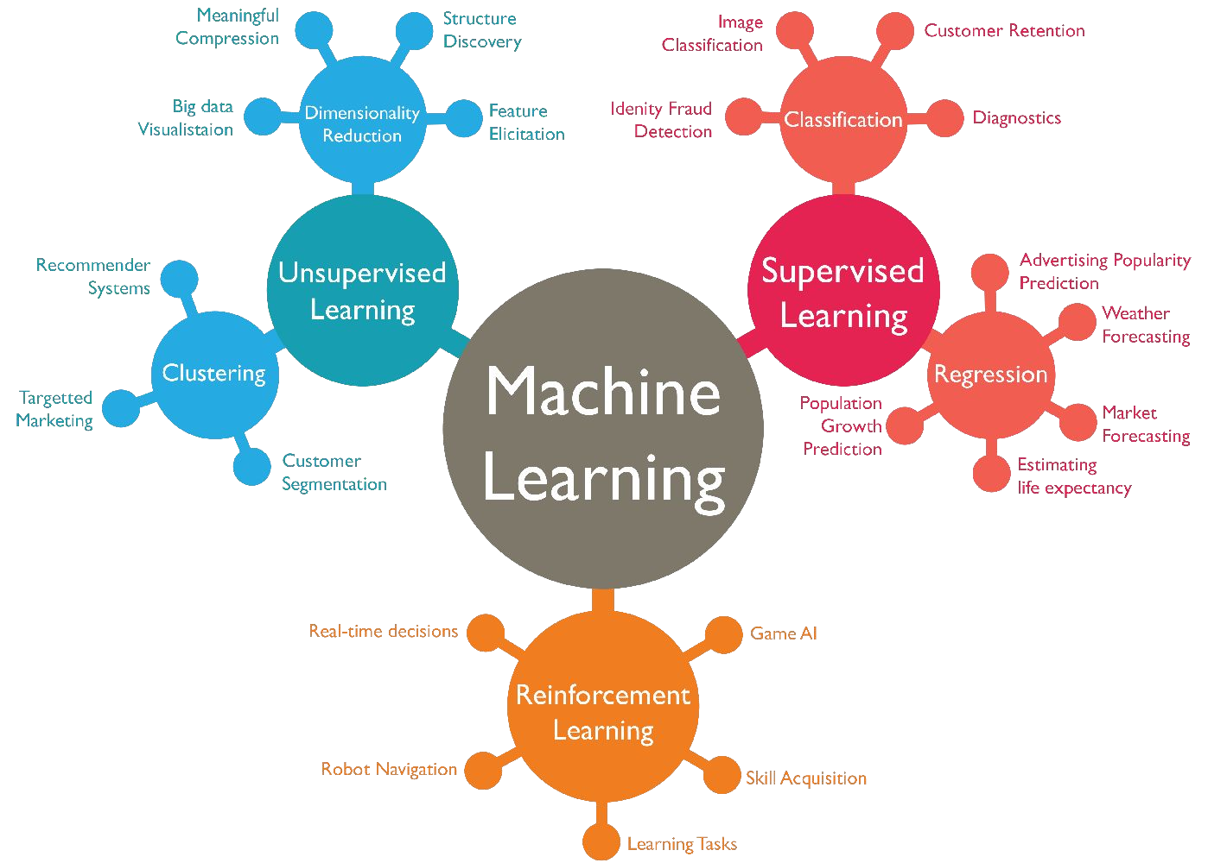
Machine Learning
Machine Learning is a branch of Artificial Intelligence (AI) that enables computers to learn from data and make predictions or decisions without being explicitly programmed.
Machine learning algorithms use historical data as input to predict new output values.
Recommendation engines are a common use case for machine learning. Other popular uses include fraud detection, spam filtering, malware threat detection, business process automation (BPA) and Predictive maintenance.

Slide 7
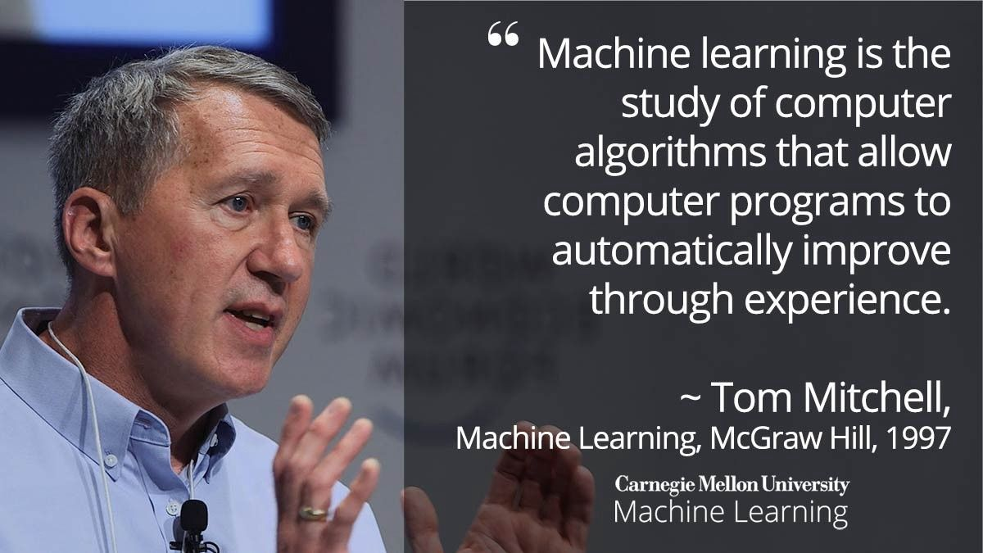
Definition of Machine Learning

Slide 8
Machine Learning Model Definition
“Learning is any process by which a system improves performance from experience.”
- Herbert Simon
Definition by Tom Mitchell :
Machine Learning is the study of algorithms that
improve their performance P
at some task T
with experience E (equate this to training data).
A well-defined learning task is given by <P, T, E>

Slide 9
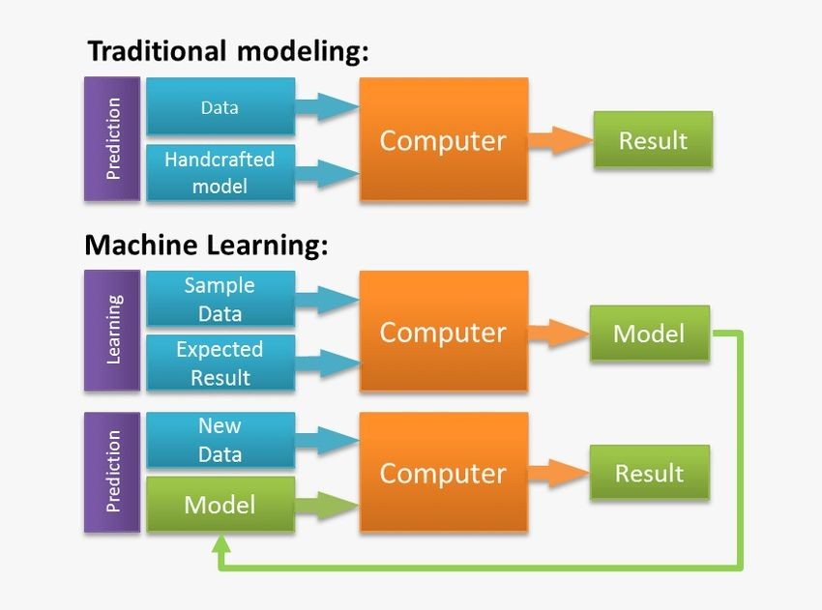
Traditional Modelling vs Machine Learning

Slide 10
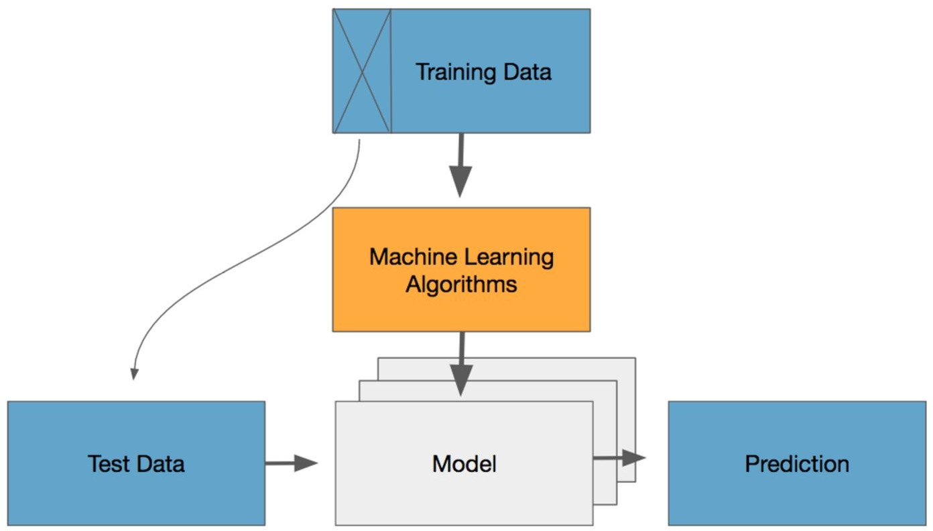
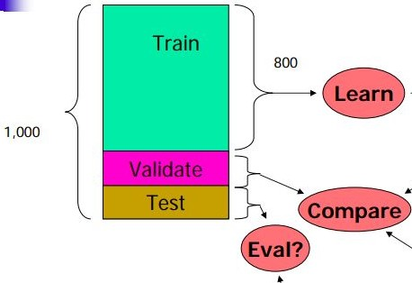
Machine Learning – As a flow
80%
20%
Source - Google

Slide 11
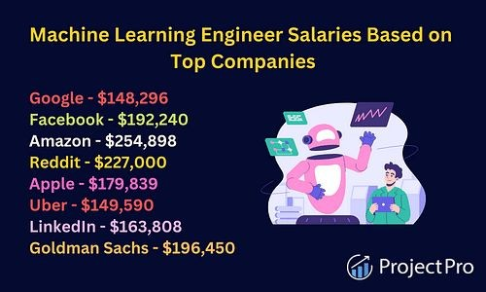
Why is ML important?
Machine learning is important because it gives enterprises a view of trends in customer behaviour and business operational patterns, as well as supports the development of new products.
Many of today's leading companies, such as Facebook, Google and Uber, make machine learning a central part of their operations.
Machine learning has become a significant competitive differentiator for many companies.

Slide 12
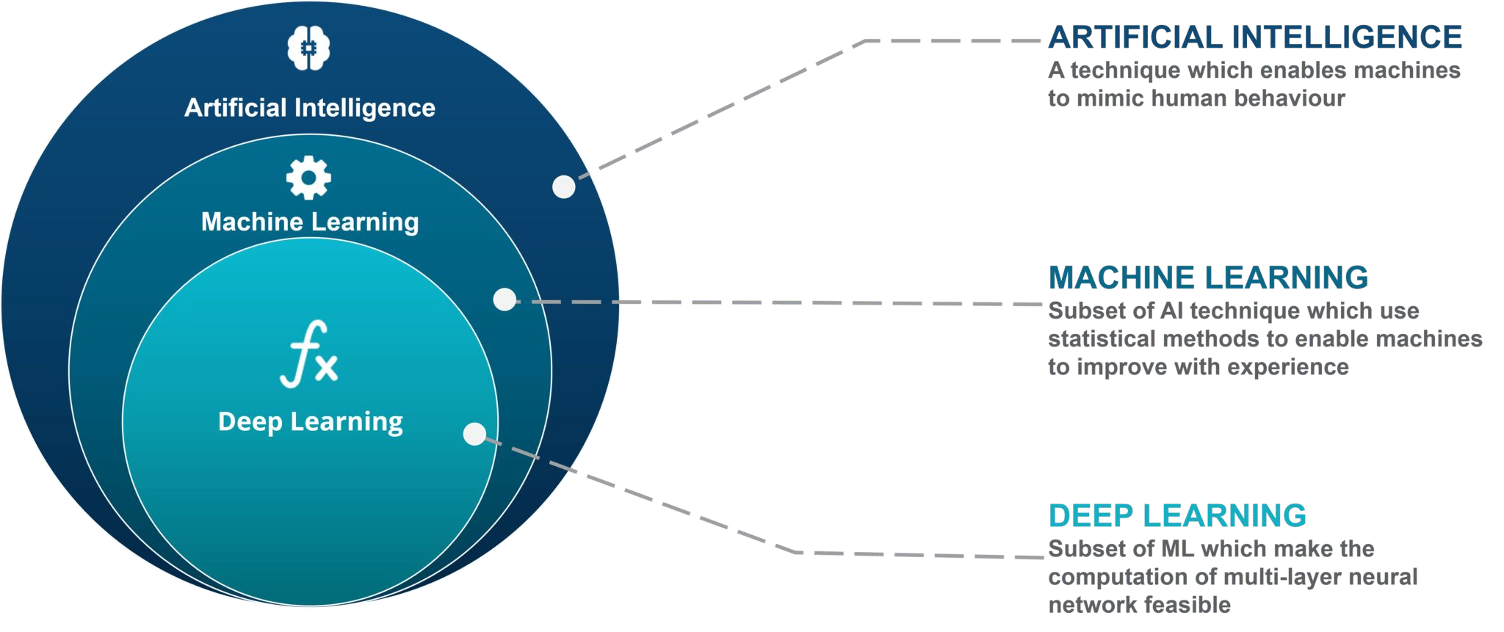
Relation between AI and ML
Machine learning is a subset of AI which allows a machine to automatically learn from past data without programming explicitly.
The goal of AI is to make a smart computer system like humans to solve complex problems.
The goal of ML is to allow machines to learn from data so that they can give accurate output.

Slide 13
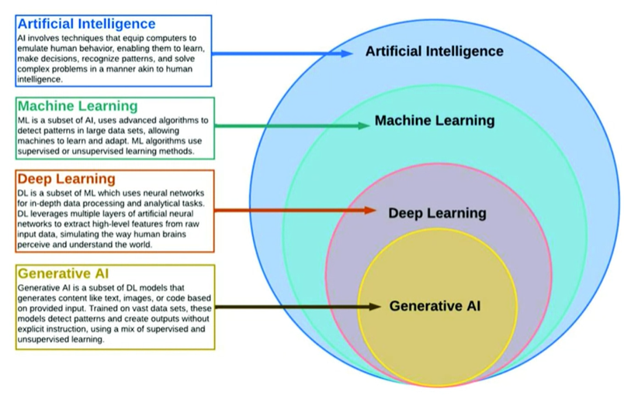

Slide 14
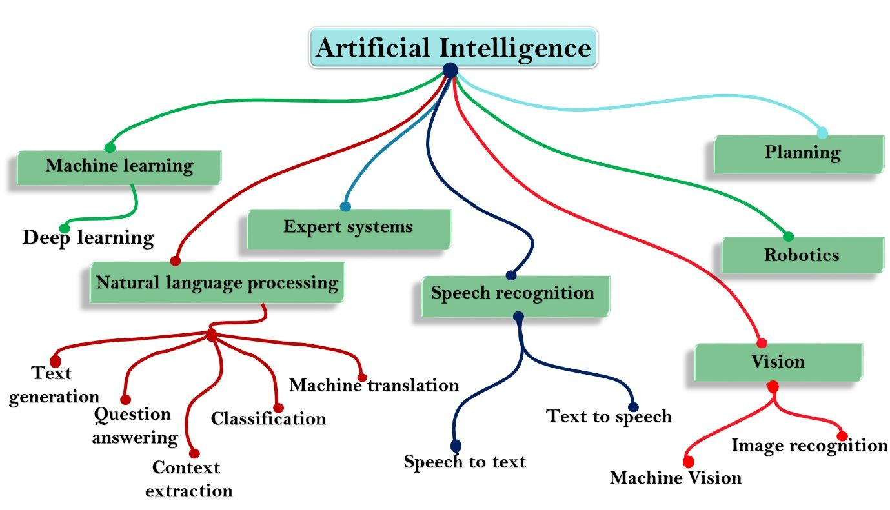
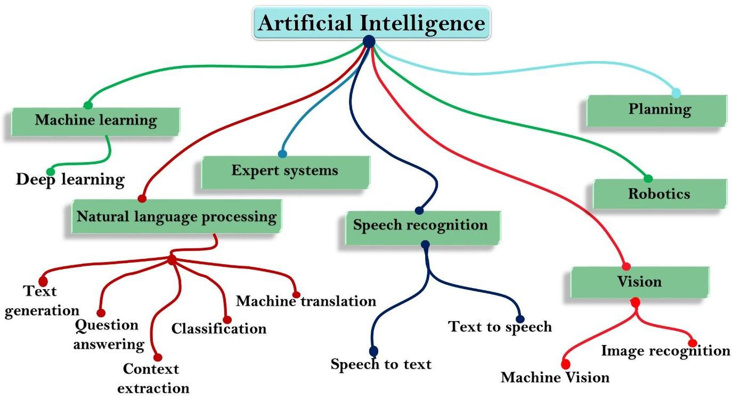
AI vs. ML

Slide 15
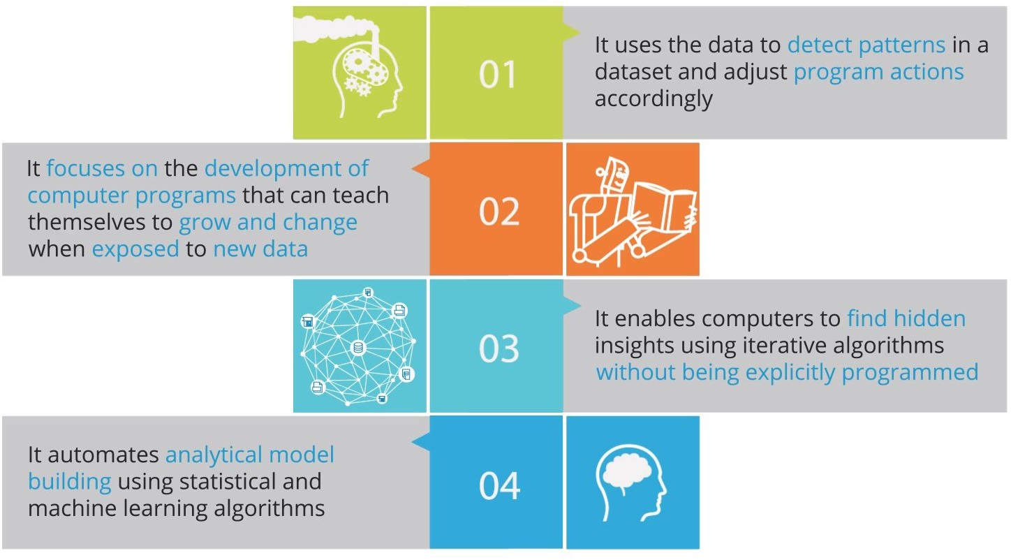
Features of Machine Learning

Slide 16
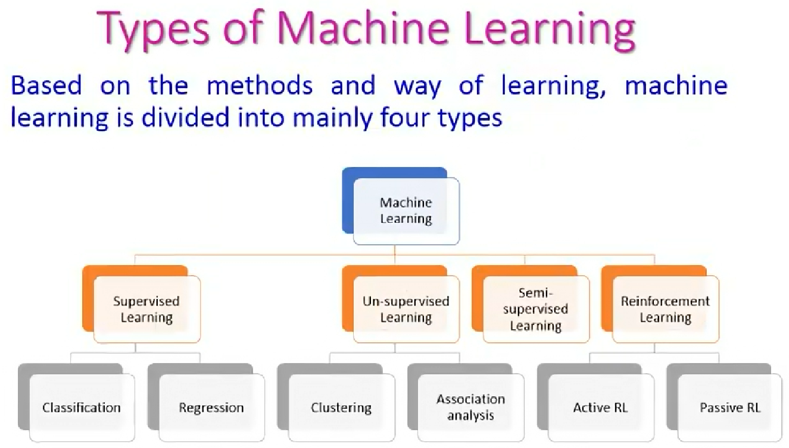
K-NN
K-means

Slide 17
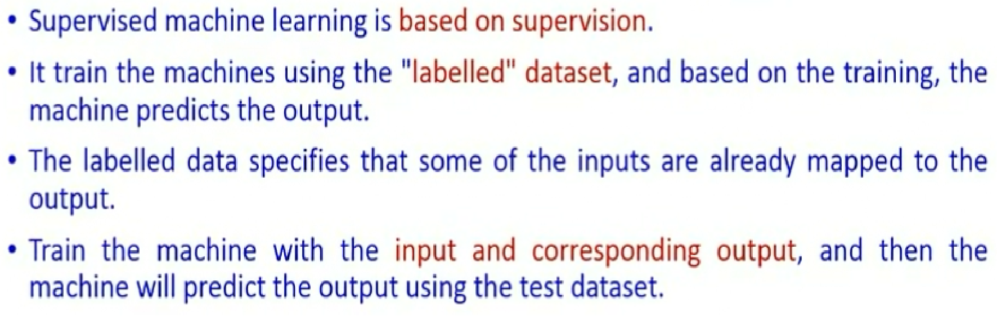
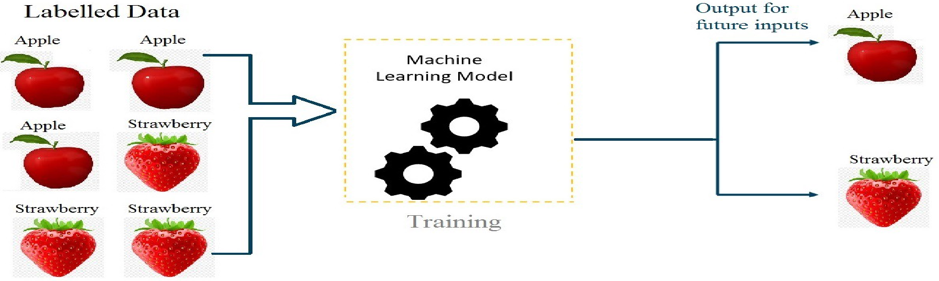
1)Supervised Machine Learning

Slide 18
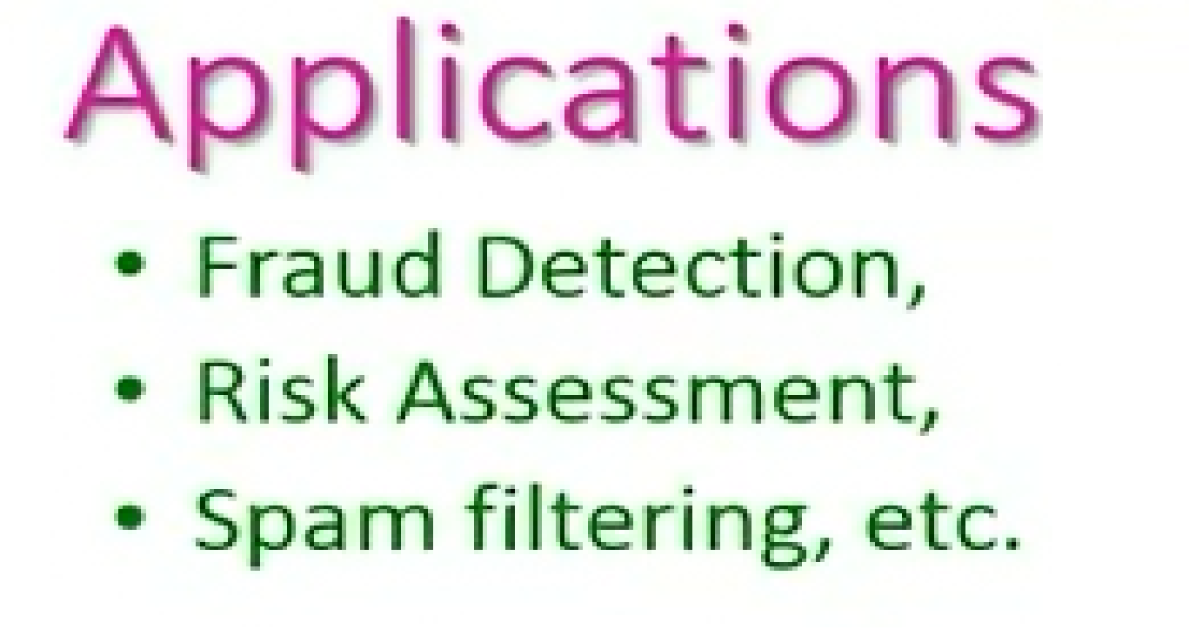
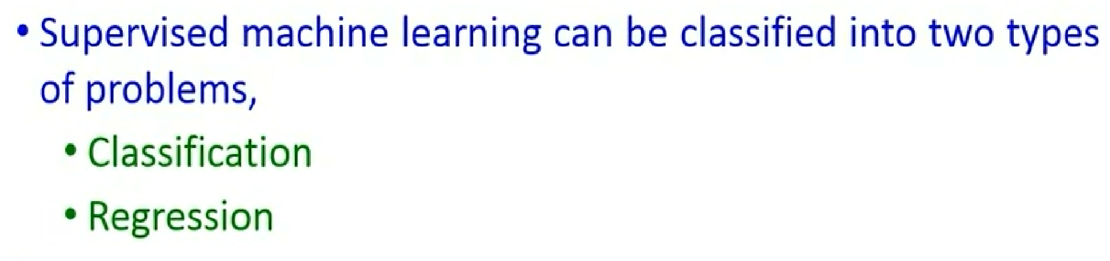

Slide 19
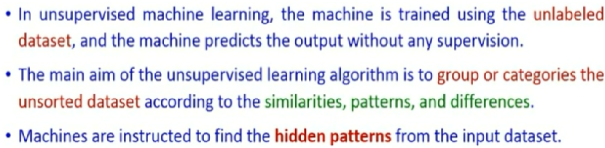
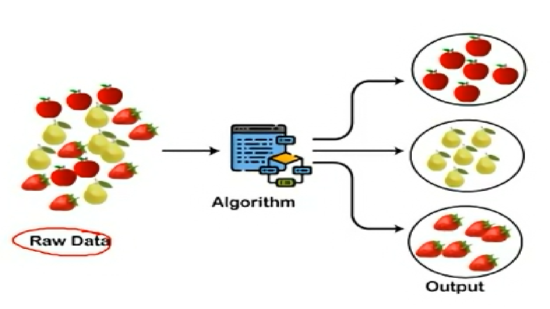
2)Unsupervised Machine Learning
Cluster 1
Fruits-A
Cluster 2
Fruits-B
Cluster 3
Fruits-C

Slide 20
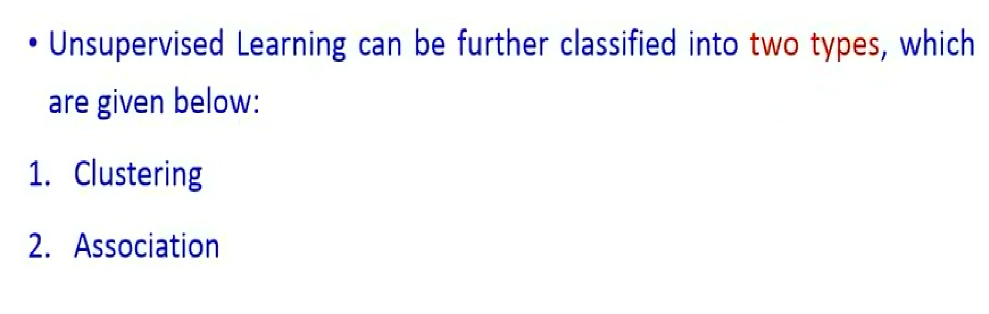

Slide 21
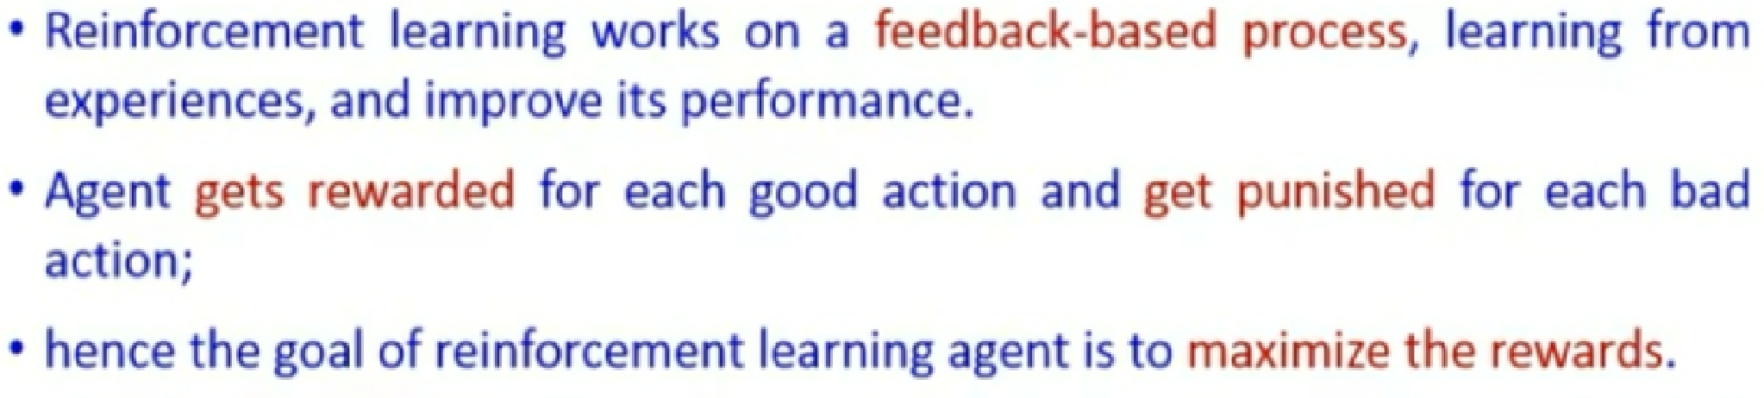
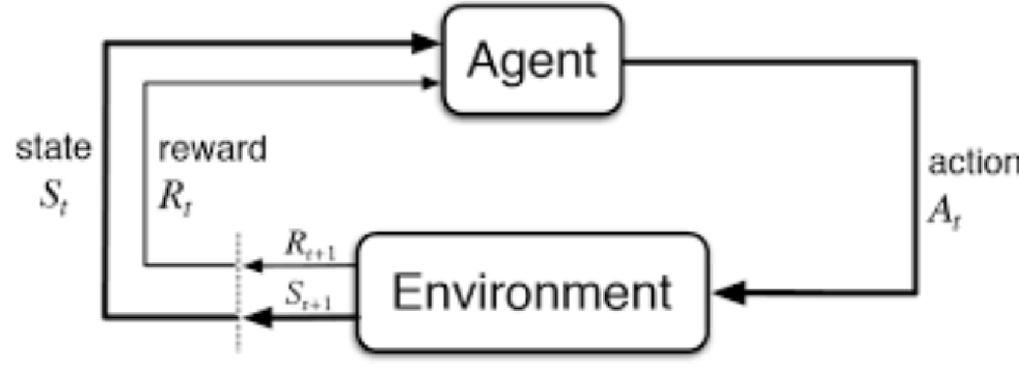
3) Reinforcement Learning

Slide 22
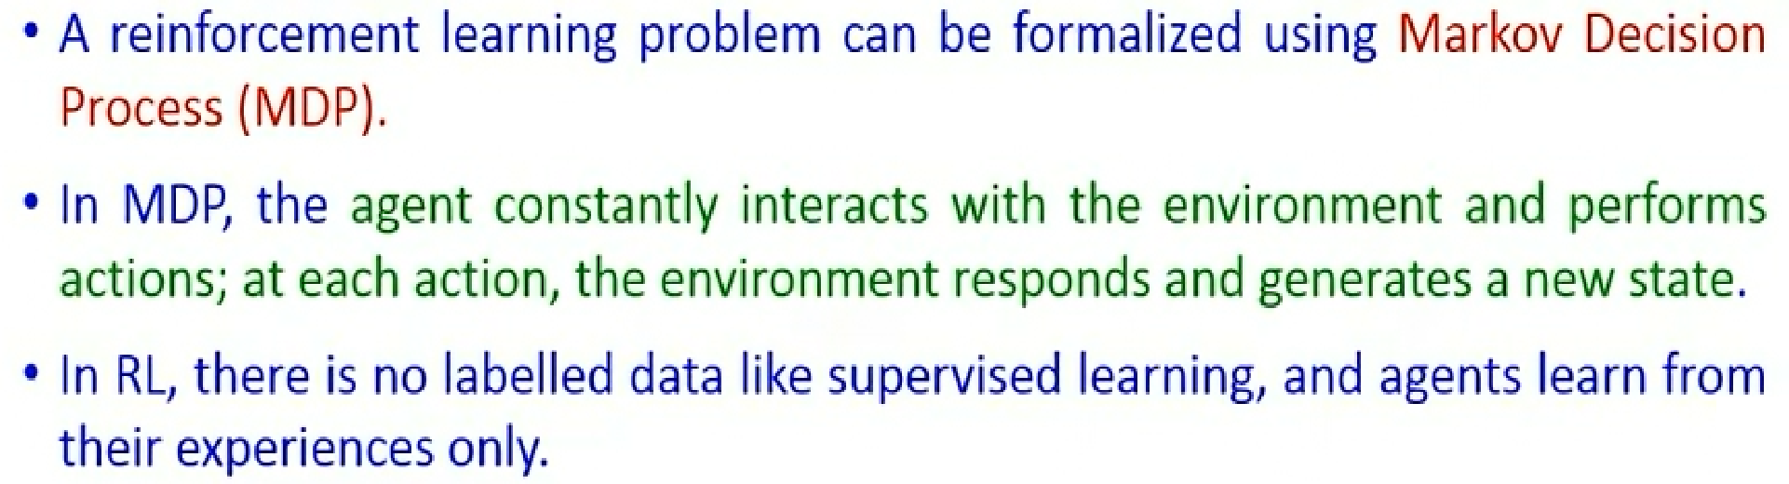
Reinforcement Learning
4) Semi-Supervised Learning:
This type combines elements of both supervised and unsupervised learning. It uses a small labeled dataset along with a larger unlabeled dataset to improve learning accuracy.

Slide 23
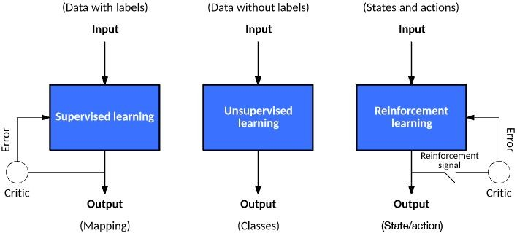
Machine Learning Models

Slide 24
RECAP

Slide 25
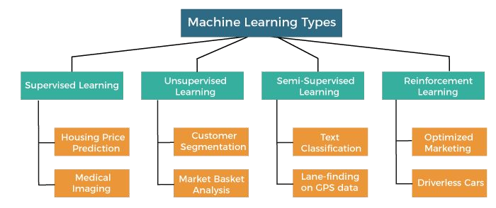
Types of ML
There are mainly 4 types of ML. These are :
Supervised Learning: In this type of ML, the algorithm is trained on a labeled dataset, where it learns to map input data to corresponding output labels. It can be used for tasks like classification and regression.
Unsupervised Learning: Here, the algorithm is given an unlabeled dataset, and it tries to find patterns, relationships, or structures within the data. Clustering and anomaly detection are common use cases.
Semi-Supervised Learning: This type combines elements of both supervised and unsupervised learning. It uses a small labeled dataset along with a larger unlabeled dataset to improve learning accuracy.
Reinforcement Learning: In this approach, an agent learns to interact with an environment to achieve a goal. It receives feedback in the form of rewards or penalties and adjusts its actions to maximize rewards over time.

Slide 26
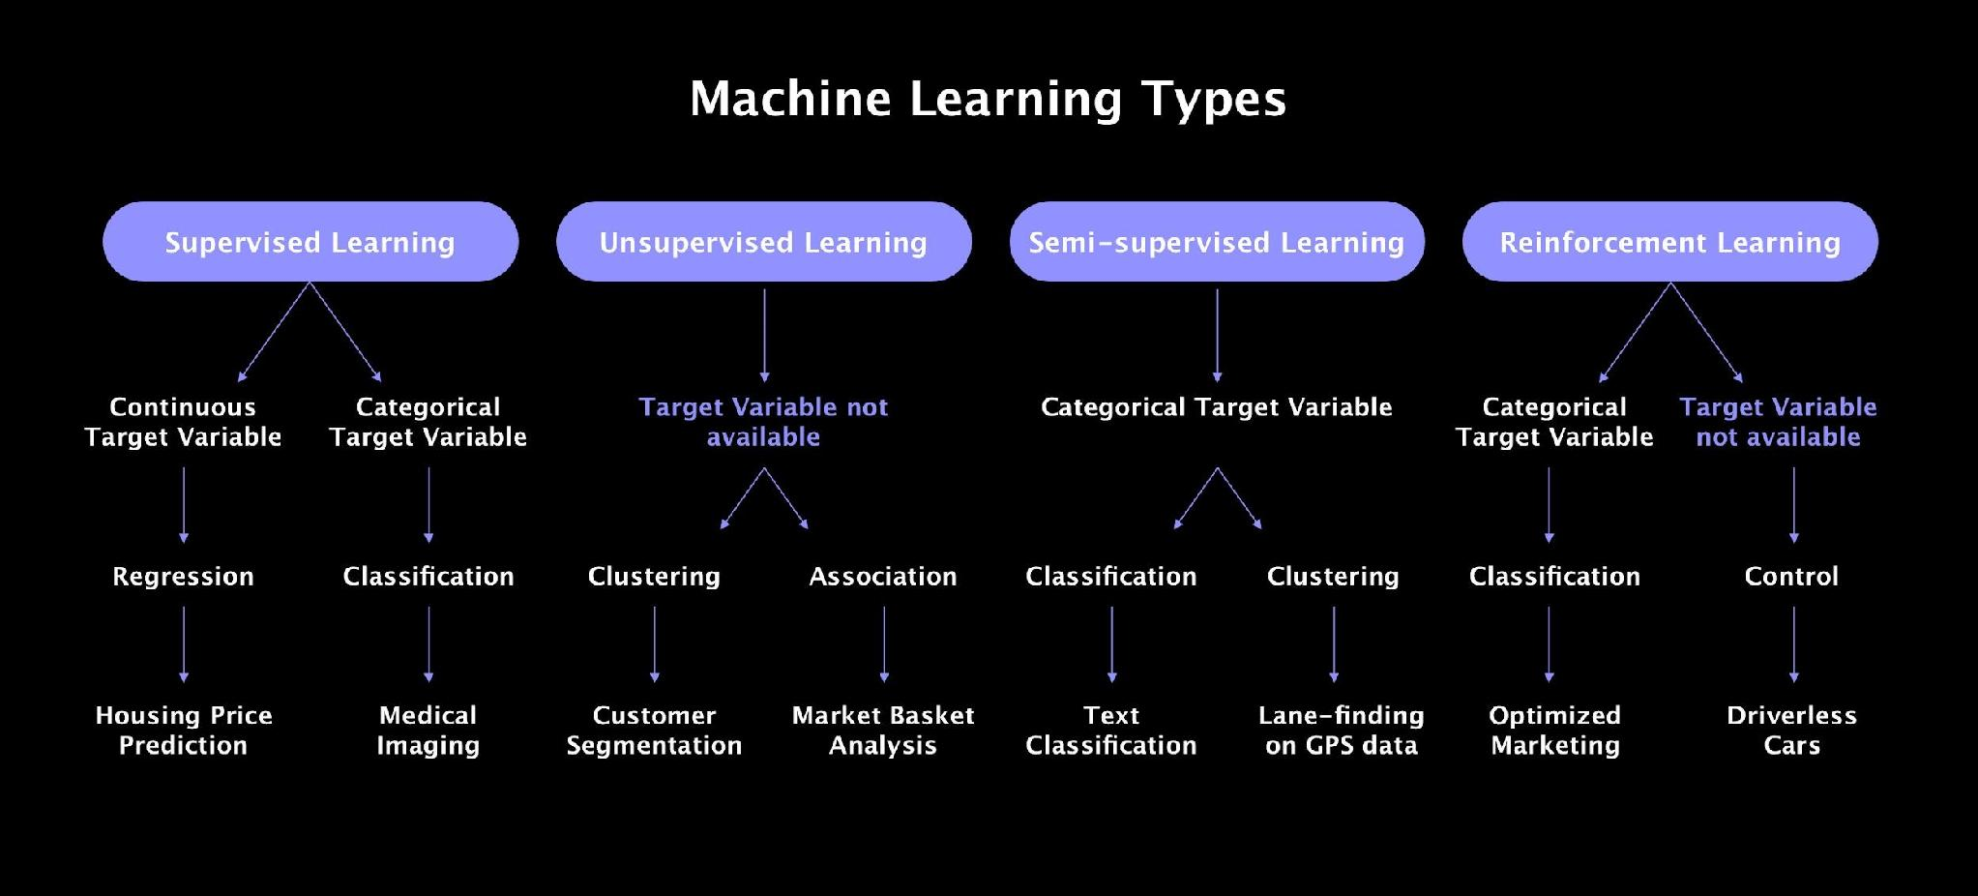
TYPES OF ML

Slide 27
Types of Machine Learning : Machine Learning is mainly categorized into three types
Supervised Learning
    Labeled data is used (input + correct output).
    Goal: Learn a mapping from input to output.
    Examples:
    Classification: Spam detection, disease diagnosis
    Regression: House price prediction
2. Unsupervised Learning
        Uses unlabeled data.
    Goal: Discover hidden patterns or structure.
Examples:
    Clustering: Customer segmentation
    Dimensionality Reduction: PCA for visualization
3
3. Reinforcement Learning
  Learning by interacting with an environment.
  Receives rewards or penalties based on actions.
Examples:
    Game playing
    Robotics,
    self-driving cars

Slide 28
MACHINE LEARNING WORKFLOW

Slide 29
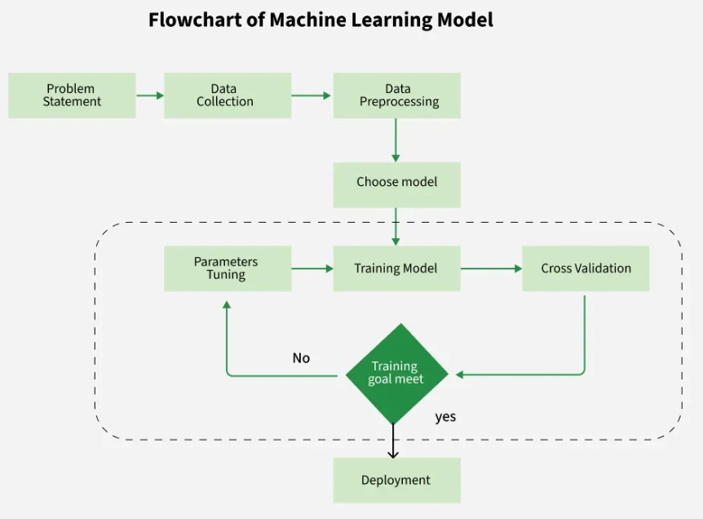
Machine Learning Workflow

Slide 30
1. Collect Data
Before anything else you need data. Data can come from many sources like surveys, sensors or databases. This data could be about anything like customer details, images or sales numbers. The more data you have the better the model will perform.
The quality of your data is important because the model learns from it. More accurate and relevant data leads to better predictions. If the data is wrong or incomplete the model won’t perform well.
The type of data you collect depends on the problem you're trying to solve. Eg. If you're building a recommendation system then user interactions and preferences become important. For a speech recognition system audio data is important.

Slide 31
2. Preprocess Data
Once you have data it needs to be cleaned. Raw data can have missing values, errors or irrelevant information.
Preprocessing involves:
Handling missing values either by removing them or filling them with sensible values.
Converting text into numbers. For example, turning words into numbers using techniques like one-hot encoding.
Normalizing or scaling data ensure that no feature is too large or too small compared to others.

Slide 32
3. Choose a Model
There are many types of machine learning models to choose from and it depend on the problem you're solving. Widely used are:
Supervised Learning: Trains models on labeled data to predict or classify new, unseen data.
Unsupervised Learning: Finds patterns or groups in unlabeled data, like clustering or dimensionality reduction.
Semi-Supervised Learning: uses a mix of labeled and unlabeled data, making it helpful when labeling data is costly or time-consuming.
Reinforcement Learning: Learns through trial and error to maximize rewards and is ideal for decision-making tasks.
4. Train the Model
In this step the model learns from the data. The training process involves feeding the data into the model and adjusting it so it can predict the output correctly.
During training the model makes predictions and then compares them to the actual answers. It then adjusts itself to reduce errors. This process is repeated many times and gradually improves model's accuracy.

Slide 33
5. Evaluate the Model
After training the model, it needs to be evaluated to check how well it performs. You do this by testing the model on new, unseen data. Some common evaluation metrics include:
Accuracy: it define how many predictions were correct. It’s commonly used for classification tasks like deciding if an email is spam or not.
Precision and Recall: These metrics are used when you need to know how well the model is performing in specific situations like detecting positive cases in medical tests.
Mean Squared Error (MSE): For regression tasks like predicting house prices, MSE measures how close the model's predictions are to the actual values.

Slide 34

5. Evaluate the Model
Accuracy: it define how many predictions were correct. It’s commonly used for classification tasks like deciding if an email is spam or not.

Slide 35
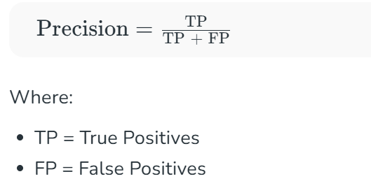
5. Evaluate the Model
Precision: It measures how many of the positive predictions made by the model are actually correct. It's useful when the cost of false positives is high such as in medical diagnoses where predicting a disease when it’s not present can have serious consequences.

Slide 36
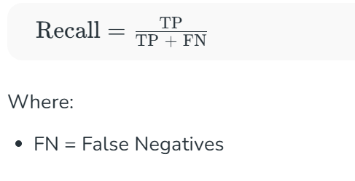
5. Evaluate the Model
Recall: Recall measures how many of the actual positive cases were correctly identified by the model. It is important when missing a positive case (false negative) is more costly than false positives.

Slide 37
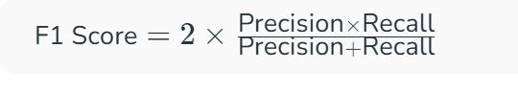
5. Evaluate the Model
F1 Score: The F1 Score is the harmonic mean of precision and recall. It is useful when we need a balance between precision and recall as it combines both into a single number. A high F1 score means the model performs well on both metrics.

Slide 38
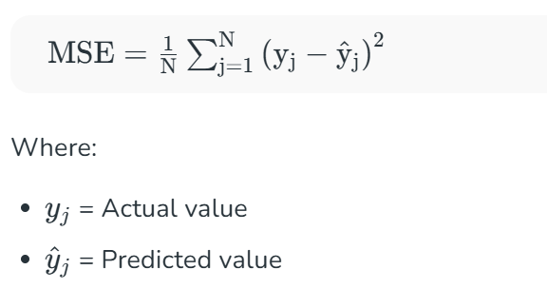
5. Evaluate the Model
Mean Squared Error (MSE): MSE calculates the average of the squared differences between the predicted and actual values. Squaring the differences ensures that larger errors are penalized more heavily helps in making it sensitive to outliers.

Slide 39
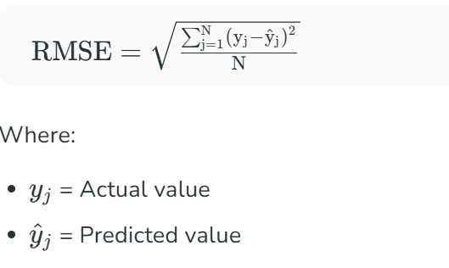
5. Evaluate the Model
Root Mean Squared Error (MSE): RMSE is the square root of MSE, bringing the metric back to the original scale of the data.

Slide 40
6. Hyperparameters Tuning
To make the model work better we can adjust its settings called hyperparameters. These are not learned by the model but are set before training. Tuning them helps improve accuracy and performance. This include:
Learning rate: This controls how quickly the model updates itself during training.
Number of layers or trees: In deep learning or decision tree models you can adjust the number of layers or decision nodes.
Batch size: In deep learning this controls how many data points the model sees before updating its weights.
7. Deploy the Model
Once the model is trained and performs well, save it and create an API using tools like Flask or FastAPI and host it on a server or cloud platform like AWS, Google Cloud or Azure to make it accessible for real-world use.
Test the API to ensure it works correctly and use containers like Docker for consistent deployment.
Continuously monitor the model to check its performance and accuracy over time.
Notes:
Flask is a micro framework, while FastAPI is a full-stack framework. FastAPI is much better when it comes to performance and speed.
Docker is a software platform that allows you to build, test, and deploy applications quickly. Docker packages software into standardized units called containers that have everything the software needs to run including libraries, system tools, code, and runtime. Using Docker, you can quickly deploy and scale applications into any environment and know your code will run. Docker works by providing a standard way to run your code. Docker is an operating system for containers. Similar to how a virtual machine virtualizes (removes the need to directly manage) server hardware, containers virtualize the operating system of a server. Docker is installed on each server and provides simple commands you can use to build, start, or stop containers.

Slide 41
Bias-Variance Trade-off

Slide 42
Example-1: Driving to Work
You want to estimate how long your commute will take.
Underfitting:
"It always takes 30 minutes."
Result:
You’re late on rainy days.
You’re too early on weekends.
→ You ignore important factors like weather and traffic.

Slide 43
Example: Driving to Work (Continued….)
Overfitting:
"If I leave at 8:02 am on a Tuesday with 75% fuel, and the first traffic light is green, and I hear a particular song on the radio, then it will take 28.5 minutes."
Result:
This works only in that exact situation.
When anything changes, your estimate is wrong.
→ You paid attention to too many irrelevant details.
Underfitting | Overfitting
Too simple | Too complicated
Ignores important factors | Focuses too much on tiny details
Poor results everywhere | Works well on past, fails on new

Slide 44
Example-2: Baking a Cake
You want to predict how long a cake should be baked based on its size.
Underfitting (Too simple):
You say: "All cakes should bake for 30 minutes, no matter their size."
Result:
Small cakes get burned.
Large cakes are undercooked.
→ The rule is too simple. It does not consider important differences.
Overfitting (Too complicated):
You say: "If the cake has 3 eggs, was made on a Tuesday, by Grandma, in her old oven, in winter, and the batter was stirred 67 times, then bake for exactly 33 minutes and 15 seconds."
Result:
Works perfectly for that one cake.
Fails completely when you try it on a new cake.
→ The rule is too detailed and memorizes one special case, not the general pattern.

Slide 45
Bias-Variance Trade-off
Concept Definition
Bias Error due to oversimplifying the model (underfitting)
Variance Error due to too much complexity (overfitting)
High Bias: Model is too simple, poor performance on training and test data.
High Variance: Model fits training data well but fails on unseen data(testing).
Goal: Find the optimal balance between bias and variance for best generalization.
Use techniques like cross-validation, regularization, or ensemble methods to manage this trade-off.
Notes:
Regularization in machine learning is a set of techniques used to prevent overfitting and improve a model's ability to generalize to new, unseen data. It essentially adds a penalty to the model's loss function, discouraging it from learning overly complex patterns that might not be representative of the underlying data. in machine learning is a set of techniques used to prevent overfitting and improve a model's ability to generalize to new, unseen data. It essentially adds a penalty to the model's loss function, discouraging it from learning overly complex patterns that might not be representative of the underlying data.
Cross-validation is a technique used in machine learning to evaluate how well a model generalizes to new, unseen data. It involves splitting the dataset into multiple subsets (folds), training the model on some folds, and testing it on the remaining fold(s). By repeating this process with different fold combinations, cross-validation provides a more robust estimate of the model's performance than a single train-test split.

Slide 46
Regularization: A set of techniques used in ML to prevent overfitting and improve a model's ability to generalize to new, unseen data. It essentially adds a penalty to the model's loss function, discouraging it from learning overly complex patterns that might not be representative of the underlying data. In machine learning, it is a set of techniques used to prevent overfitting and improve a model's ability to generalize to new, unseen data. It essentially adds a penalty to the model's loss function, discouraging it from learning overly complex patterns that might not be representative of the underlying data.
Cross-validation: A technique used in machine learning to evaluate how well a model generalizes to new, unseen data. It involves splitting the dataset into multiple subsets (folds), training the model on some folds, and testing it on the remaining fold(s). By repeating this process with different fold combinations, cross-validation provides a more robust estimate of the model's performance than a single train-test split.

Slide 47
Overfitting
The model learns noise and random fluctuations in the training data.
Too complex, performs well on training data but poorly on test data.
Symptoms: High training accuracy, low test accuracy.
Solutions:
  Use simpler models
  Regularization (L1, L2)
  Prune decision trees
  Use more data
  Cross-validation

Slide 48
Underfitting
The model is too simple to capture patterns in the data.
Performs poorly on both training and test sets.
Symptoms: Low accuracy on both training and test data.
Solutions:
  Use more complex models
  Add more features
  Reduce regularization

Slide 49
Problem | Cause | Solution
Underfitting | High bias, simple model | Increase complexity
Overfitting | High variance, complex model | Simplify model, regularize, add data
Bias-Variance Trade-off | Balancing simplicity and flexibility

Slide 50
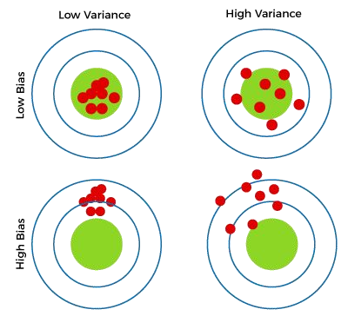
Bull’s Eye for Bias and Variance Trade-off
1) High Bias, Low Variance:
A model with high bias and low variance is said to be underfitting.
2) High Variance, Low Bias:
A model with high variance and low bias is said to be overfitting.

Slide 51
Bias – Variance Combinations
3) High-Bias, High-Variance:
Model is not able to capture the underlying patterns in the data (high bias) and is also too sensitive to changes in the training data (high variance).
As a result, the model will produce inconsistent and inaccurate predictions on average.

Slide 52
Bias – Variance Combinations
4) Low Bias, Low Variance:
Model is able to capture the underlying patterns in the data (low bias) and is not too sensitive to changes in the training data (low variance).
This is the ideal scenario for a machine learning model, as it is able to generalize well to new, unseen data and produce consistent and accurate predictions.

Slide 53
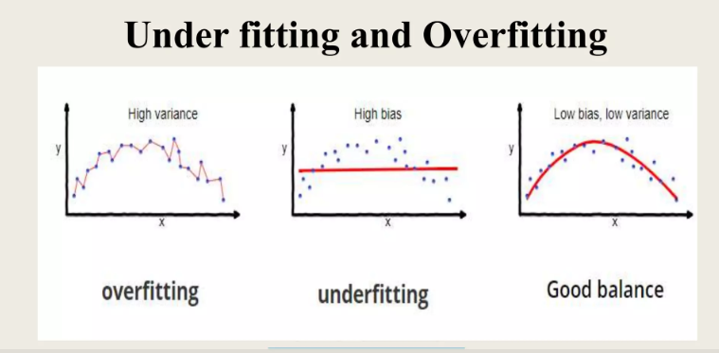

Slide 54
References
Text Book:
1. Kevin Murphy, Machine Learning: A Probabilistic Perspective, MIT Press, 2012
2. Tom M. Mitchell, ―Machine Learning, McGraw-Hill Education (India) Private Limited, 2013
References (Text / Online Ref):
1. EthemAlpaydin, ―Introduction to Machine Learning (Adaptive Computation and Machine Learning), The MIT Press 2004.
2. Stephen Marsland, ―Machine Learning: An Algorithmic Perspective, CRC Press, 2009.
3. T. Hastie, R. Tibshirani, J. H. Friedman, “The Elements of Statistical Learning”, Springer; 1st edition, 2001.
4. Christopher Bishop, Pattern Recognition and Machine Learning, Springer, 2007..
Self-Study: https://www.coursera.org/specializations/machine-learning-introduction
https://www.edureka.co/blog/ai-vs-machine-learning-vs-deep-learning/
https://www.mygreatlearning.com/blog/what-is-artificial-intelligence/
https://www.topbots.com/netflix-movie-recommender-system-rework/
https://www.prnewswire.co.uk/news-releases/artificial-intelligence-ai-in-retail- market-to-reach-usd-23-426-3-million-by-2026-rising-awareness-about-the-advantages-of-ai-in-retail-operations-to-propel-growth-says-fortune-business-insig hts-tm--885263461.html
https://towardsdatascience.com/advantages-and-disadvantages-of-artificial-int elligence-182a5ef6588c
https://machinelearningmastery.com/smote-oversampling-for-imbalanced-classification/

Slide 55
THANK YOU
Moumita Ghosh (Asst. Prof.)
Department of ADSE
CHRIST (DEEMED TO BE UNIVERSITY)

